Slide 1
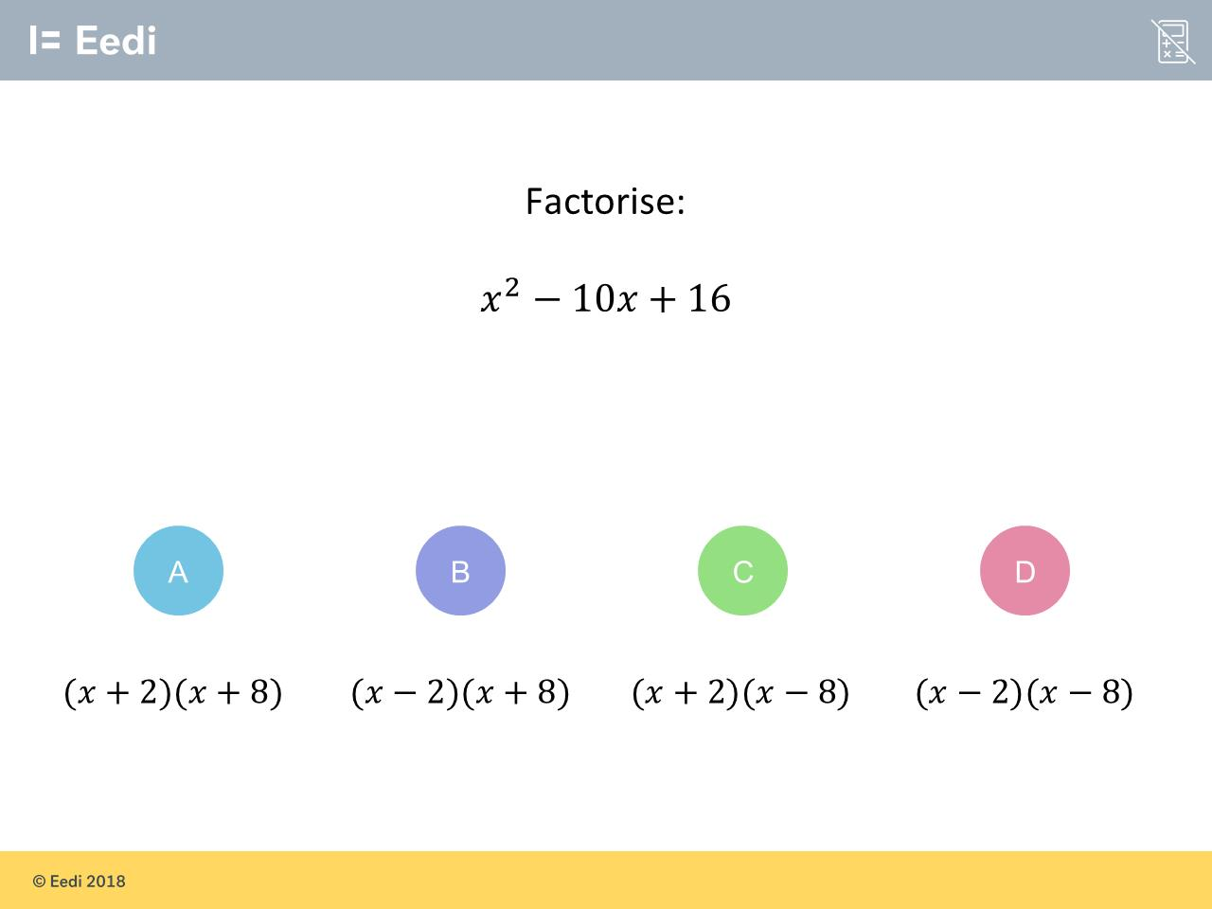
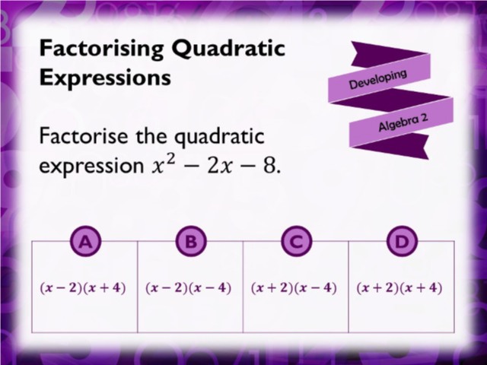
Worst answered question?
Most common wrong answer?

Slide 2
ANSWERS

Slide 3
Worst answered question?

Slide 4
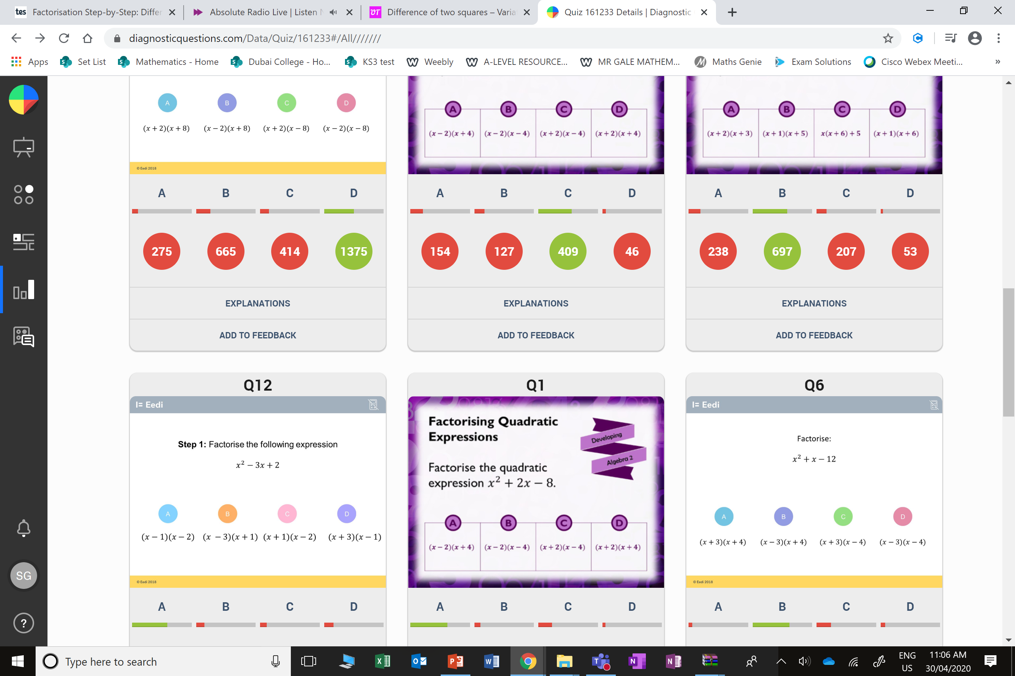
B
The student may believe we need one sign to be minus to get the -10.

Slide 5
A
They have the negative and positive the wrong way round.

