Slide 1
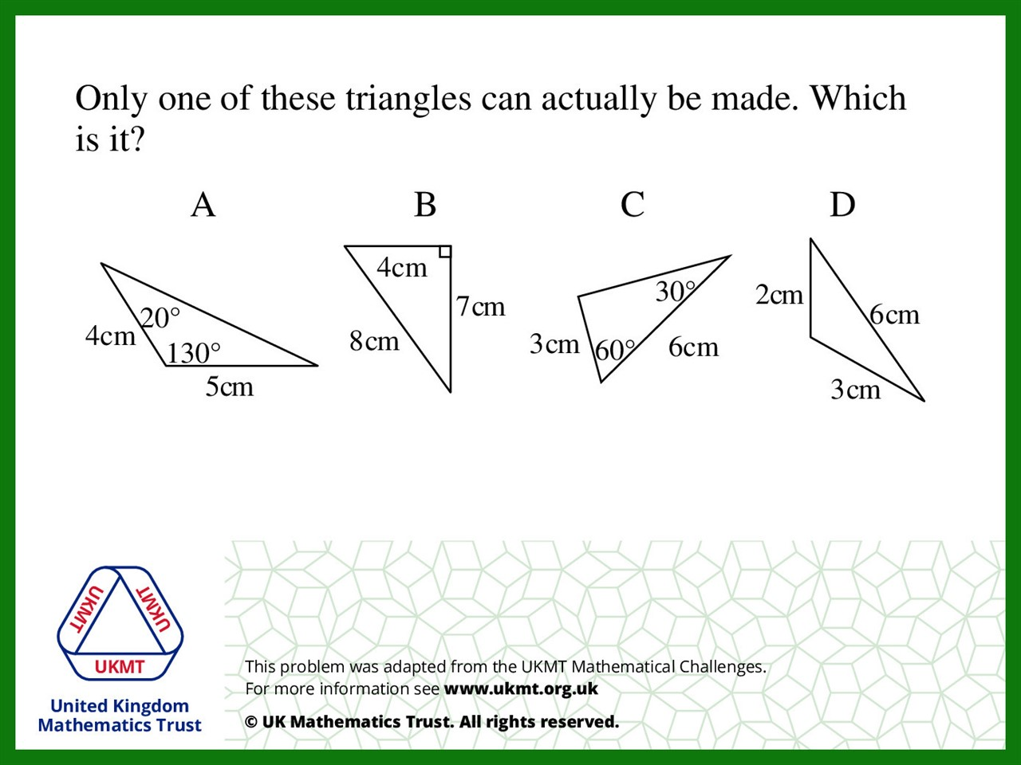
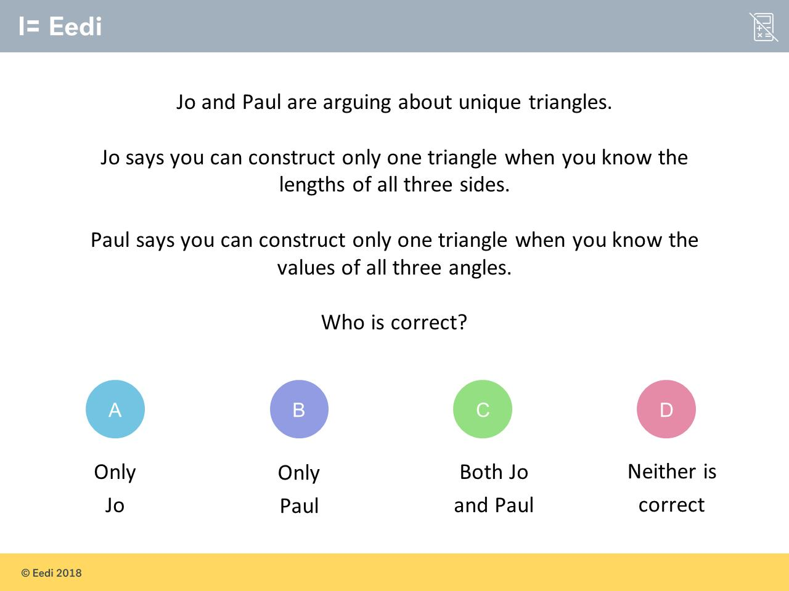
Worst answered question?
Most common wrong answer?

Slide 2
ANSWERS

Slide 3
Worst answered question?

Slide 4

C
The lengths can be different and are not effected by the angle.

Slide 5

B
There is enough information
but one of the sides is incorrect.

