Slide 1
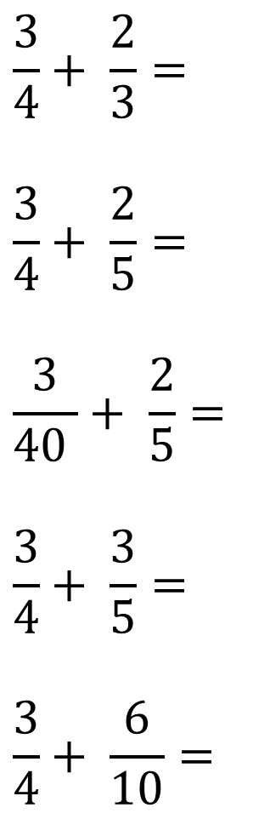
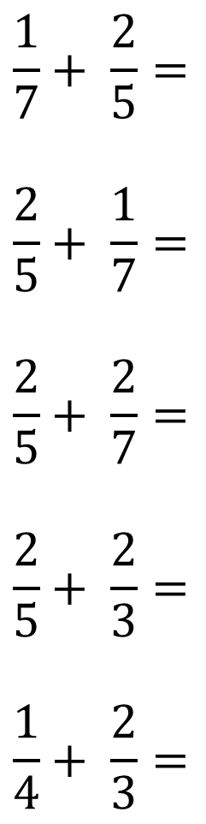
Add the following fractions and simplify if possible.
1)
$$\frac{1}{7}+ \frac{2}{5}=$$
$$\frac{2}{5}+ \frac{1}{7}=$$
$$\frac{2}{5}+ \frac{2}{7}=$$
$$\frac{2}{5}+ \frac{2}{3}=$$
$$\frac{1}{4}+ \frac{2}{3}=$$
$$\frac{3}{4}+ \frac{2}{3}=$$
$$\frac{3}{4}+ \frac{2}{5}=$$
$$\frac{3}{40 }+ \frac{2}{5}=$$
$$\frac{3}{4}+ \frac{3}{5}=$$
$$\frac{3}{4}+ \frac{6}{10}=$$
6)
2)
7)
3)
8)
4)
9)
5)
10)

Slide 2
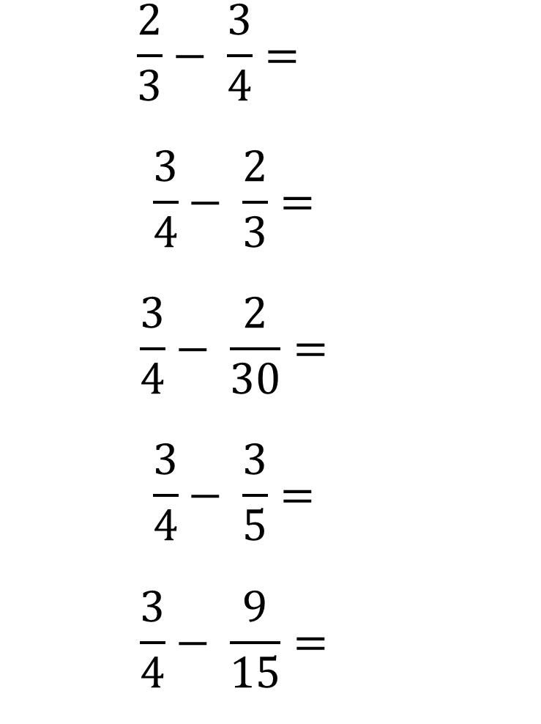
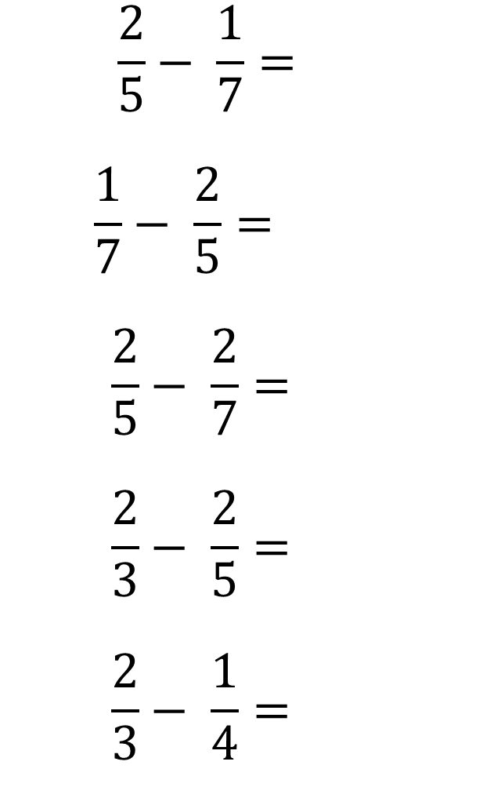
Subtract the following fractions and simplify if possible.
$$\frac{2}{5}− \frac{1}{7}=\frac{9}{35}$$
$$\frac{1}{7}− \frac{2}{5}=−\frac{9}{35}$$
$$\frac{2}{5}− \frac{2}{7}= \frac{4}{35}$$
$$\frac{2}{3}− \frac{2}{5}= \frac{4}{15}$$
$$\frac{2}{3}− \frac{1}{4}= \frac{5}{12}$$
$$\frac{2}{3}− \frac{3}{4}=−\frac{1}{12}$$
$$\frac{3}{4}− \frac{2}{3}= \frac{1}{12}$$
$$\frac{3}{4}− \frac{2}{30}= \frac{41}{60}$$
$$\frac{3}{4}− \frac{3}{5}= \frac{3}{20}$$
$$\frac{3}{4}− \frac{9}{15}= \frac{3}{20}$$
1)
6)
2)
7)
3)
8)
4)
9)
5)
10)

Slide 3
ANSWERS

Slide 4
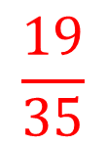
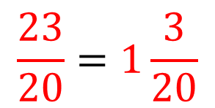
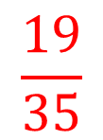
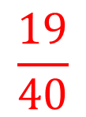
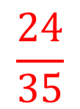
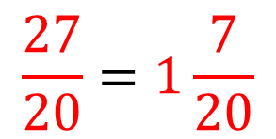
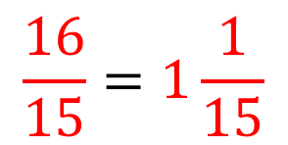
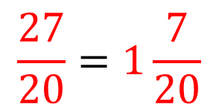
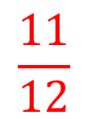
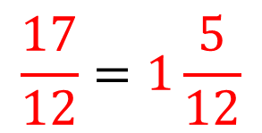
Add the following fractions and simplify if possible.
$$\frac{1}{7}+ \frac{2}{5}=$$
$$\frac{2}{5}+ \frac{1}{7}=$$
$$\frac{2}{5}+ \frac{2}{7}=$$
$$\frac{2}{5}+ \frac{2}{3}=$$
$$\frac{1}{4}+ \frac{2}{3}=$$
$$\frac{19}{35}$$
$$\frac{3}{4}+ \frac{2}{3}=$$
$$\frac{3}{4}+ \frac{2}{5}=$$
$$\frac{3}{40 }+ \frac{2}{5}=$$
$$\frac{3}{4}+ \frac{3}{5}=$$
$$\frac{3}{4}+ \frac{6}{10}=$$
$$\frac{17}{12}=1\frac{5}{12}$$
1)
6)
$$\frac{19}{35}$$
$$\frac{23}{20}=1\frac{3}{20}$$
2)
7)
$$\frac{24}{35}$$
$$\frac{19}{40}$$
3)
8)
$$\frac{16}{15}=1\frac{1}{15}$$
$$\frac{27}{20}=1\frac{7}{20}$$
4)
9)
$$\frac{11}{12}$$
$$\frac{27}{20}=1\frac{7}{20}$$
5)
10)

Slide 5
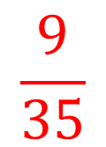
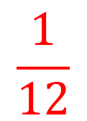

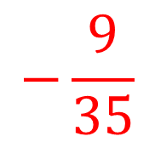
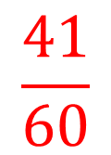
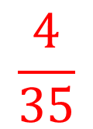
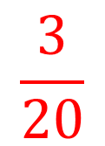
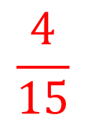
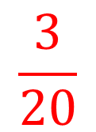
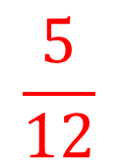
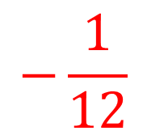
Subtract the following fractions and simplify if possible.
$$\frac{9}{35}$$
$$−\frac{1}{12}$$
$$\frac{2}{5}− \frac{1}{7}=\frac{9}{35}$$
$$\frac{1}{7}− \frac{2}{5}=−\frac{9}{35}$$
$$\frac{2}{5}− \frac{2}{7}= \frac{4}{35}$$
$$\frac{2}{3}− \frac{2}{5}= \frac{4}{15}$$
$$\frac{2}{3}− \frac{1}{4}= \frac{5}{12}$$
$$\frac{2}{3}− \frac{3}{4}=−\frac{1}{12}$$
$$\frac{3}{4}− \frac{2}{3}= \frac{1}{12}$$
$$\frac{3}{4}− \frac{2}{30}= \frac{41}{60}$$
$$\frac{3}{4}− \frac{3}{5}= \frac{3}{20}$$
$$\frac{3}{4}− \frac{9}{15}= \frac{3}{20}$$
1)
6)
$$−\frac{9}{35}$$
$$\frac{1}{12}$$
2)
7)
$$\frac{4}{35}$$
$$\frac{41}{60}$$
3)
8)
$$\frac{4}{15}$$
$$\frac{3}{20}$$
4)
9)
$$\frac{5}{12}$$
$$\frac{3}{20}$$
5)
10)

