Slide 1
Radians
Trigonometric Equations
Chapter 5
(Part 4 of 5)

Slide 2
Solving Trigonometric Equations
You basically solve trigonometric equations involving radians
the same way you solve them involving degrees.

Slide 3
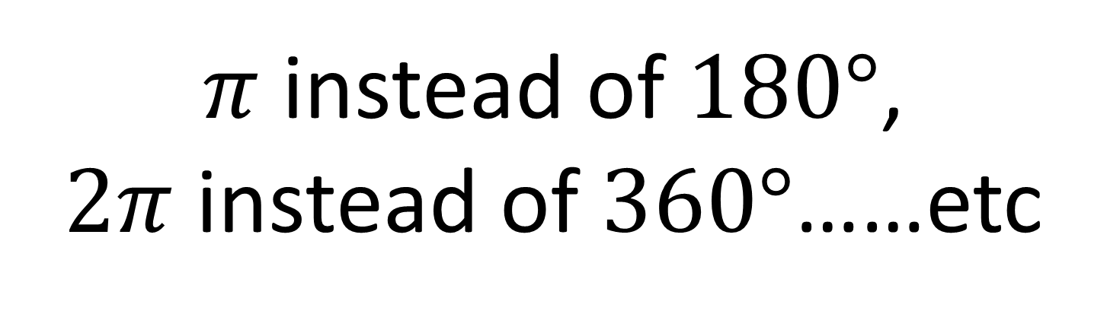
There are two differences…
Your calculator needs to be in radians mode.
$π$ instead of $180°$,
$2π$instead of $360°$……etc

Slide 4
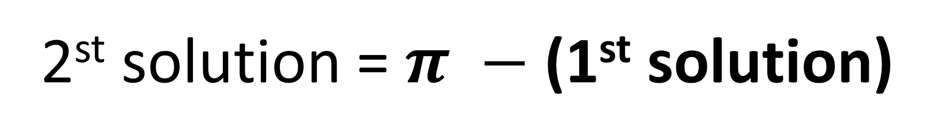
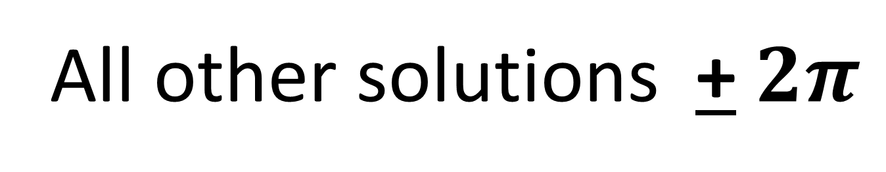
Solving sin x
1st solution = sin⁻¹
2st solution = $π −$(1st solution)
All other solutions + $2π$

Slide 5

Solving cos x
1st solution = cos⁻¹
2st solution = $2π −$(1st solution)
All other solutions + $2π$

Slide 6

Solving tan x
1st solution = tan⁻¹
All other solutions + $π$

Slide 7
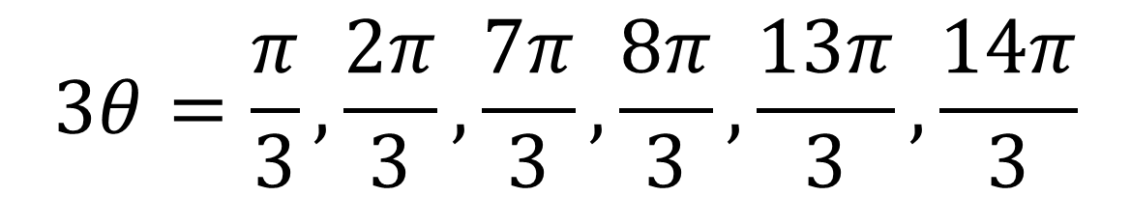
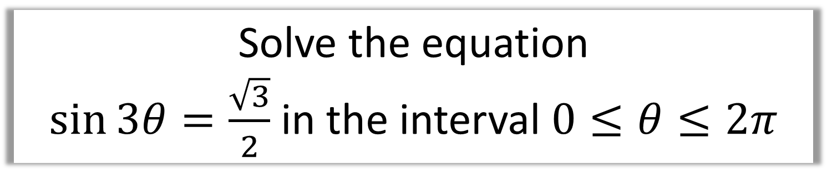
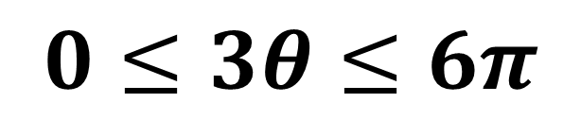
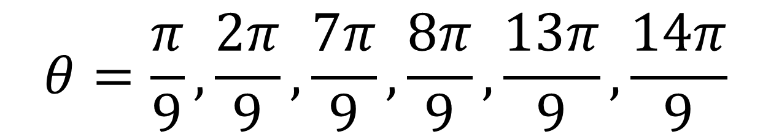
Solve the equation
$\sin{3θ}=\frac{\sqrt{3}}{2}$ in the interval $0≤θ≤2π$
$$0≤3θ≤6π$$
$$3θ=\frac{π}{3},\frac{2π}{3},\frac{7π}{3},\frac{8π}{3},\frac{13π}{3},\frac{14π}{3}$$
$$θ=\frac{π}{9},\frac{2π}{9},\frac{7π}{9},\frac{8π}{9},\frac{13π}{9},\frac{14π}{9}$$

Slide 8
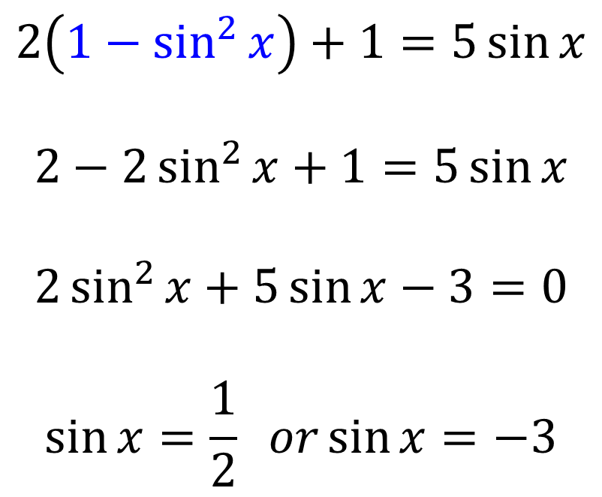
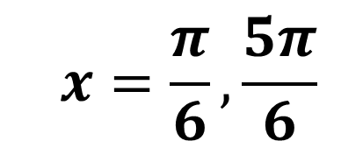
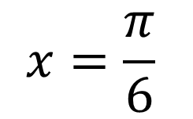
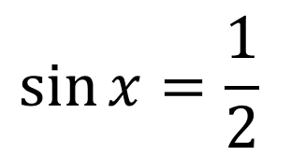

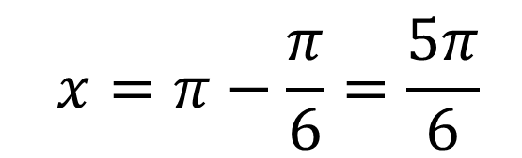
Find all the solutions, in the interval 0 ≤ x < 2π, of the equation
2 cos² x + 1 = 5 sin x,
giving each solution in terms of π. (6)
$$\sin{x}=\frac{1}{2}$$
$$2\left(1−\sin^{2}{x}\right)+1=5\sin{x}$$
$$2−2\sin^{2}{x}+1=5\sin{x}$$
$$2\sin^{2}{x}+5\sin{x}−3=0$$
$$\sin{x}=\frac{1}{2} or\sin{x}=−3$$
$$\sin{x}=−3$$
No Solutions
$$x=\frac{π}{6}$$
$$x=π−\frac{π}{6}=\frac{5π}{6}$$
$$x=\frac{π}{6}, \frac{5π}{6}$$

