Slide 1
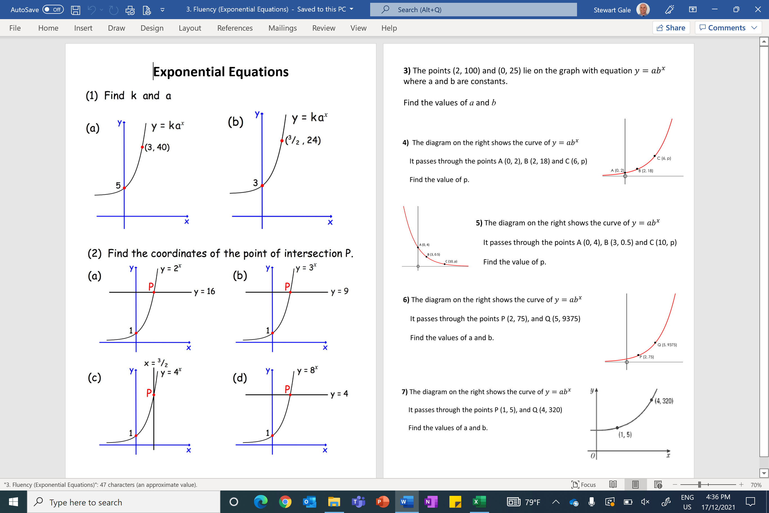

Slide 2
ANSWERS

Slide 3
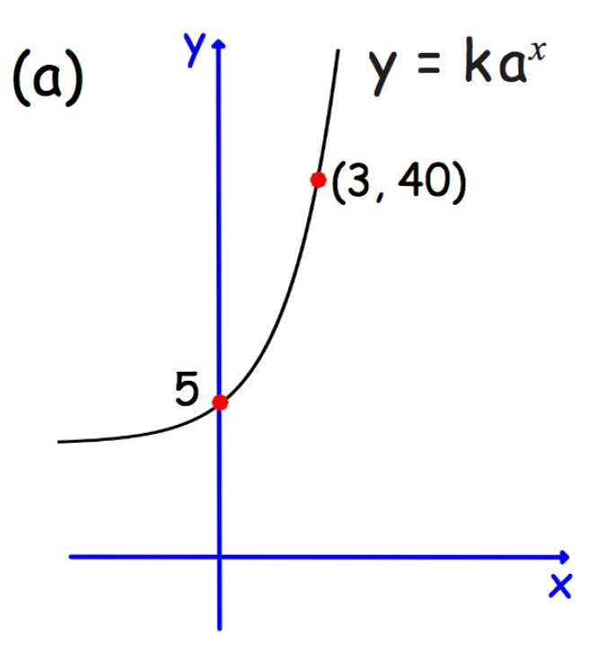
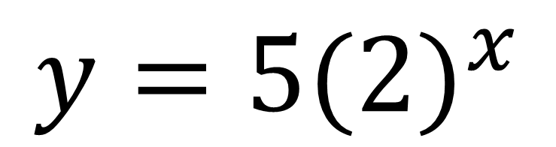
$$y=5({2)}^{x}$$

Slide 4
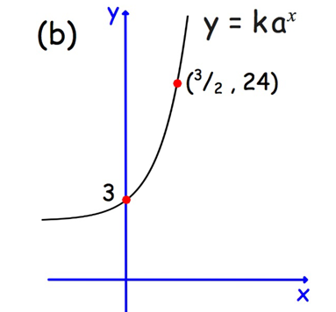
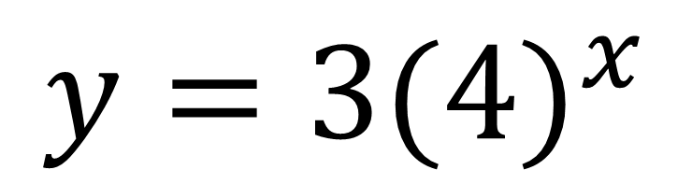
$$y=3({4)}^{x}$$

Slide 5
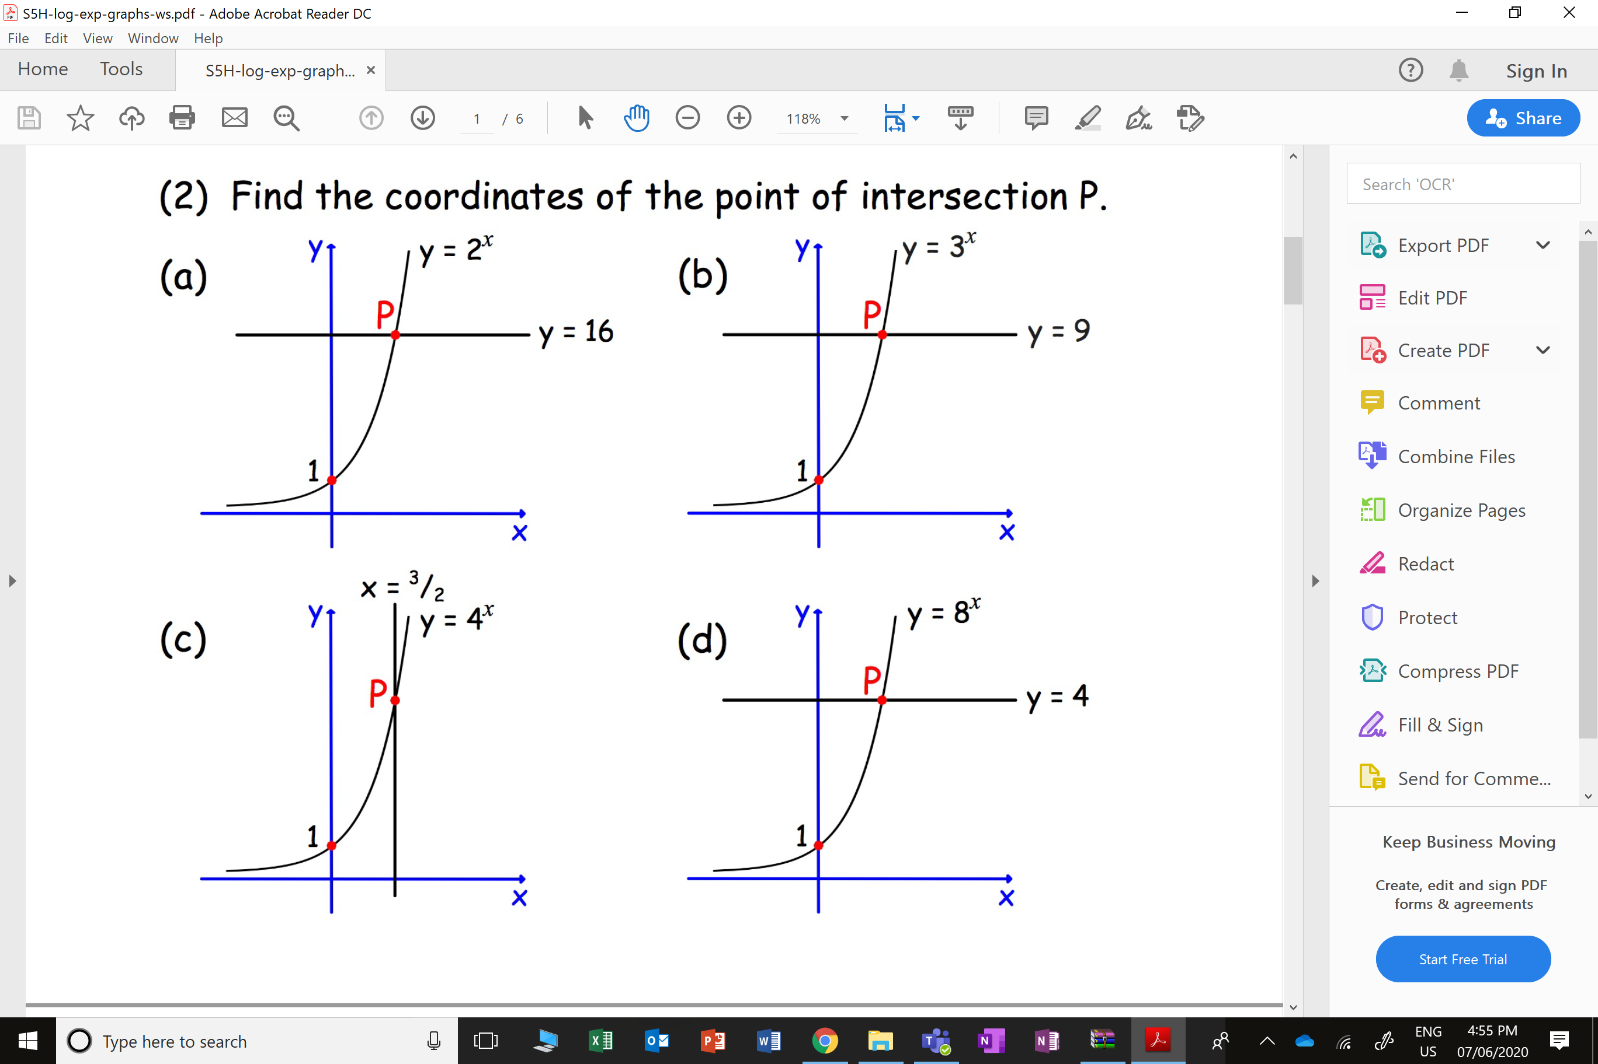
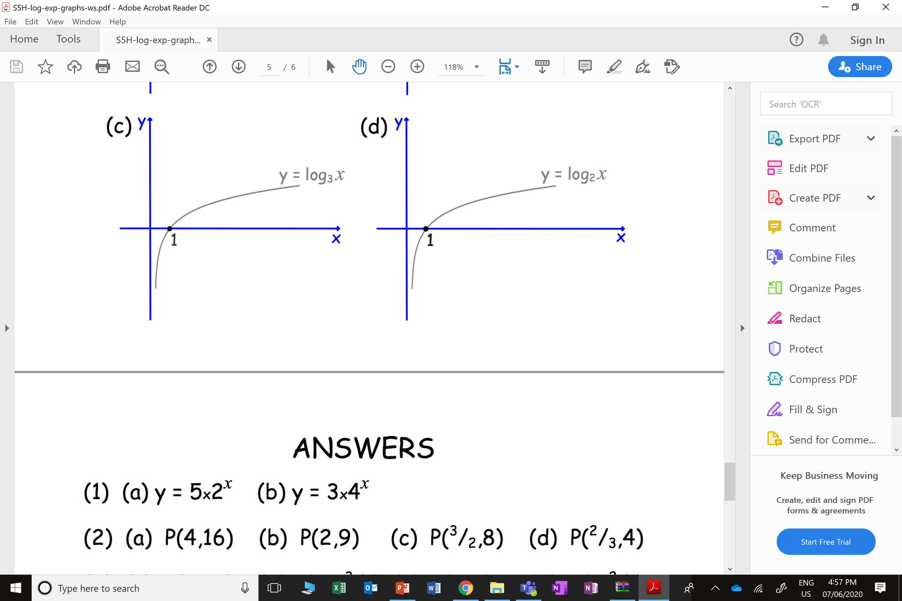

Slide 9
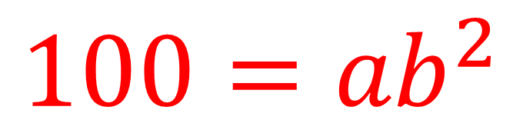

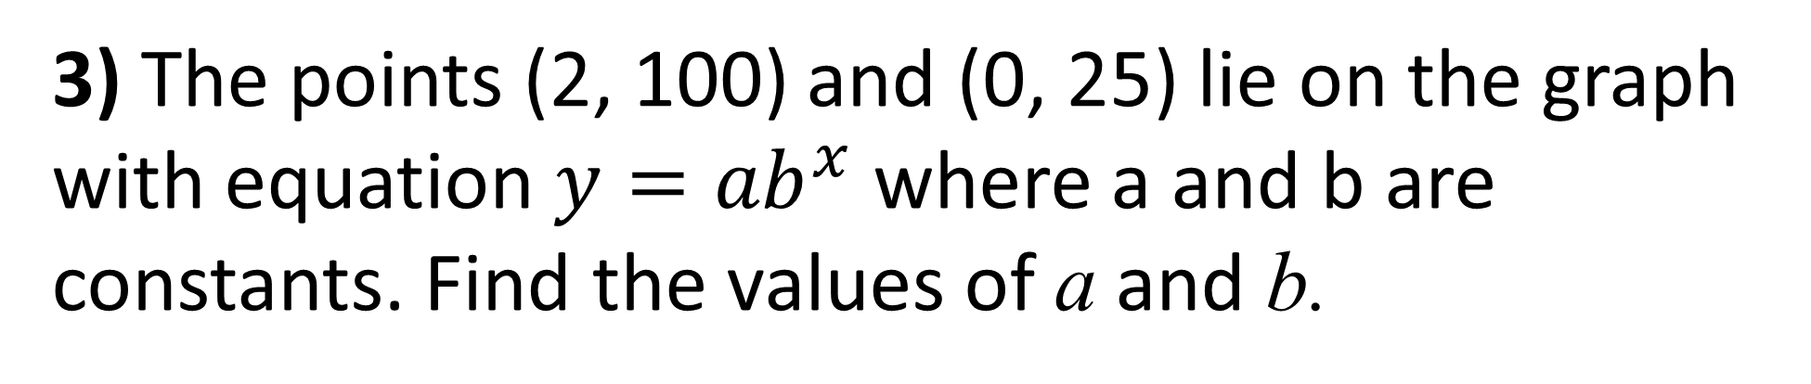
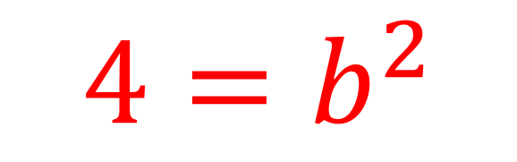
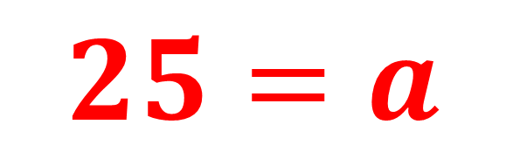
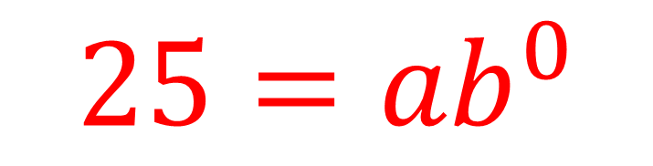
3) The points (2, 100) and (0, 25) lie on the graph with equation ${y=ab}^{x}$ where a and b are constants. Find the values of a and b.
$${25=ab}^{0}$$
$${100=ab}^{2}$$
$$25=a$$
$${4=b}^{2}$$
$$b=2$$

Slide 10
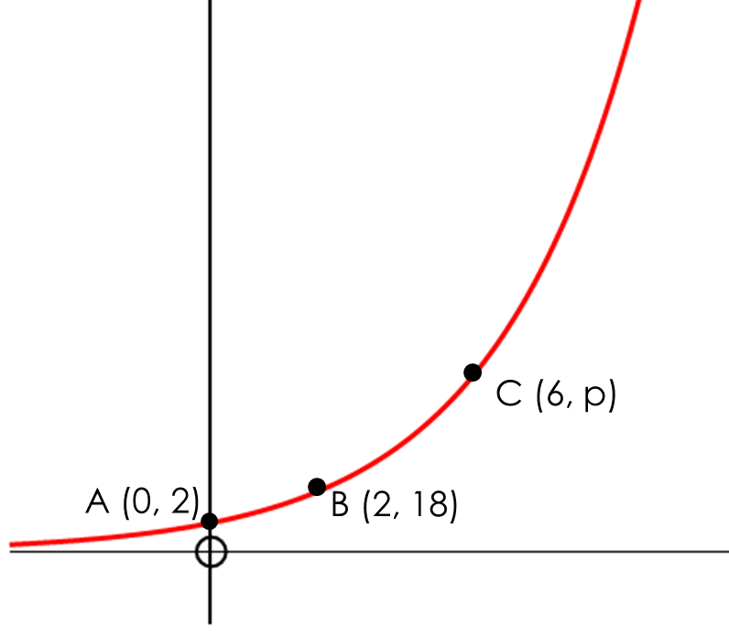
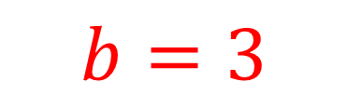
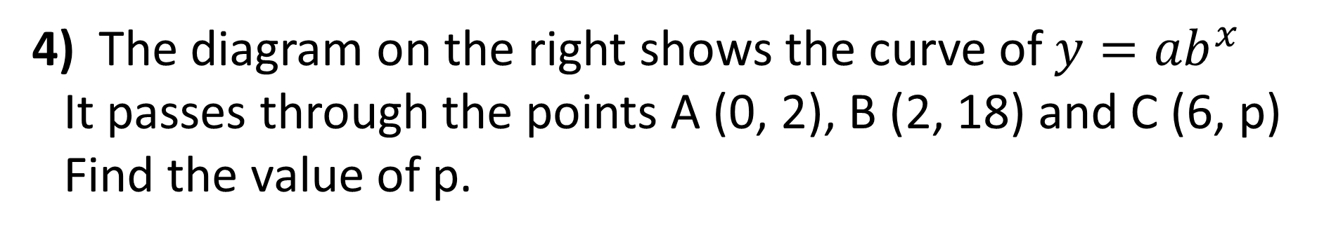
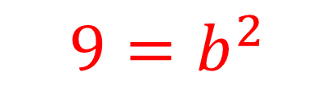
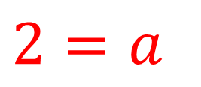
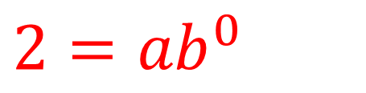
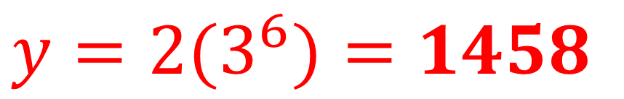
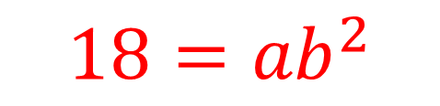
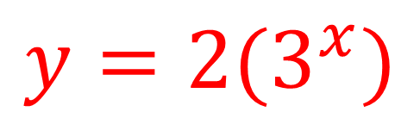
4) The diagram on the right shows the curve of ${y=ab}^{x}$
It passes through the points A (0, 2), B (2, 18) and C (6, p)
Find the value of p.
$${2=ab}^{0}$$
$${18=ab}^{2}$$
$$2=a$$
$${9=b}^{2}$$
$$b=3$$
$${y=2(3}^{x})$$
$${y=2(3}^{6})=1458$$

Slide 11
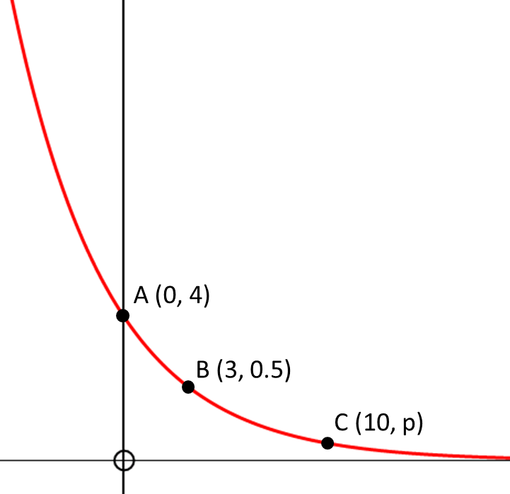
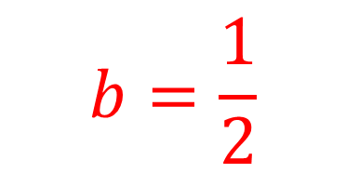
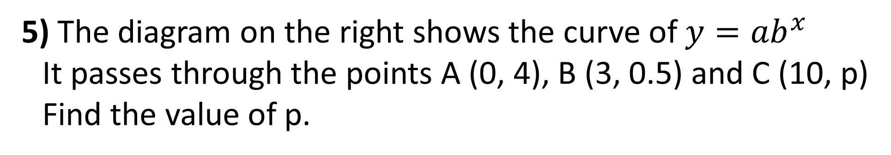
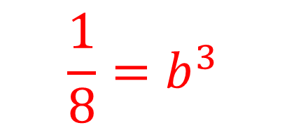
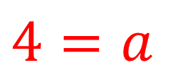
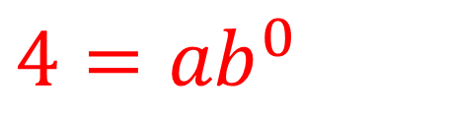
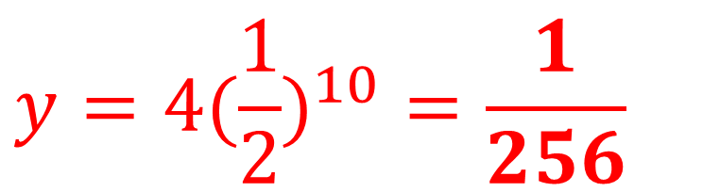
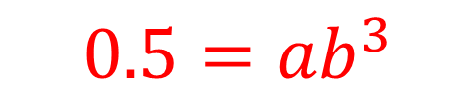
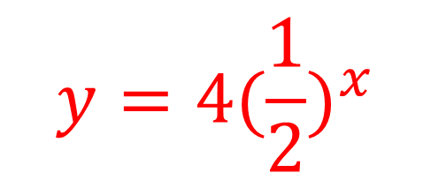
5) The diagram on the right shows the curve of ${y=ab}^{x}$
It passes through the points A (0, 4), B (3, 0.5) and C (10, p)
Find the value of p.
$${4=ab}^{0}$$
$${0.5=ab}^{3}$$
$$4=a$$
$$\frac{1}{8}{=b}^{3}$$
$${y=4(\frac{1}{2})}^{x}$$
$$b=\frac{1}{2}$$
$${y=4(\frac{1}{2})}^{10}=\frac{1}{256}$$

Slide 12
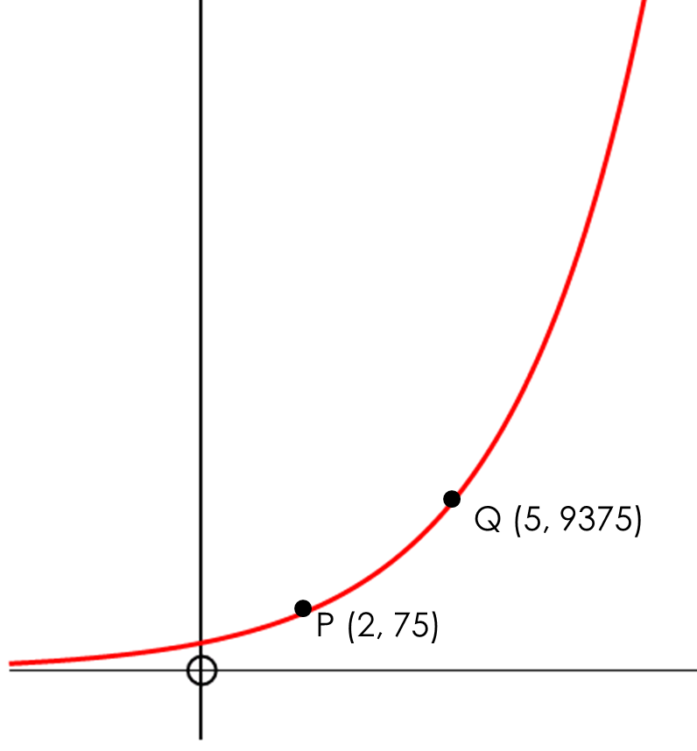
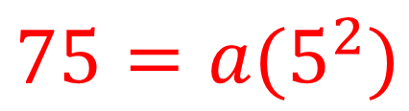
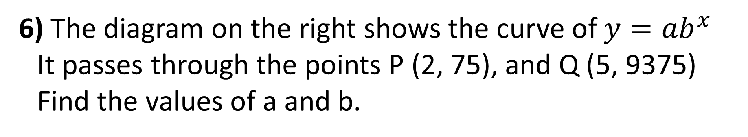
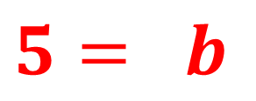
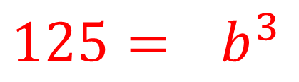
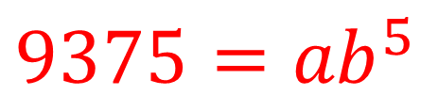
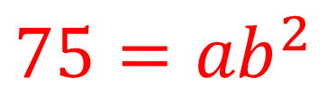
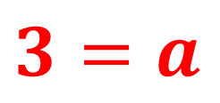
6) The diagram on the right shows the curve of ${y=ab}^{x}$
It passes through the points P (2, 75), and Q (5, 9375)
Find the values of a and b.
$${9375=ab}^{5}$$
$${75=ab}^{2}$$
$${125=ab}^{3}$$
$$5= b$$
$${75=a(5}^{2})$$
$$3=a$$

Slide 13
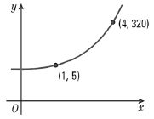
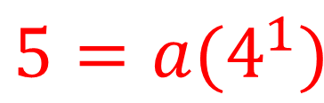
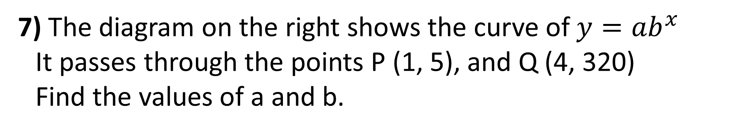
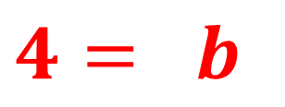
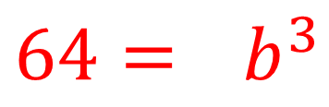
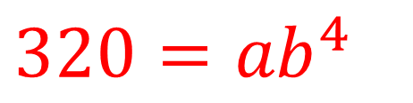
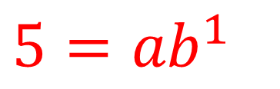
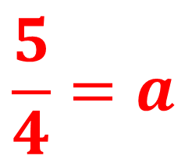
7) The diagram on the right shows the curve of ${y=ab}^{x}$
It passes through the points P (1, 5), and Q (4, 320)
Find the values of a and b.
$${320=ab}^{4}$$
$${5=ab}^{1}$$
$${64=ab}^{3}$$
$$4= b$$
$${5=a(4}^{1})$$
$$\frac{5}{4}=a$$

