Slide 1

Senior Challenge 4
GOLD

Slide 2
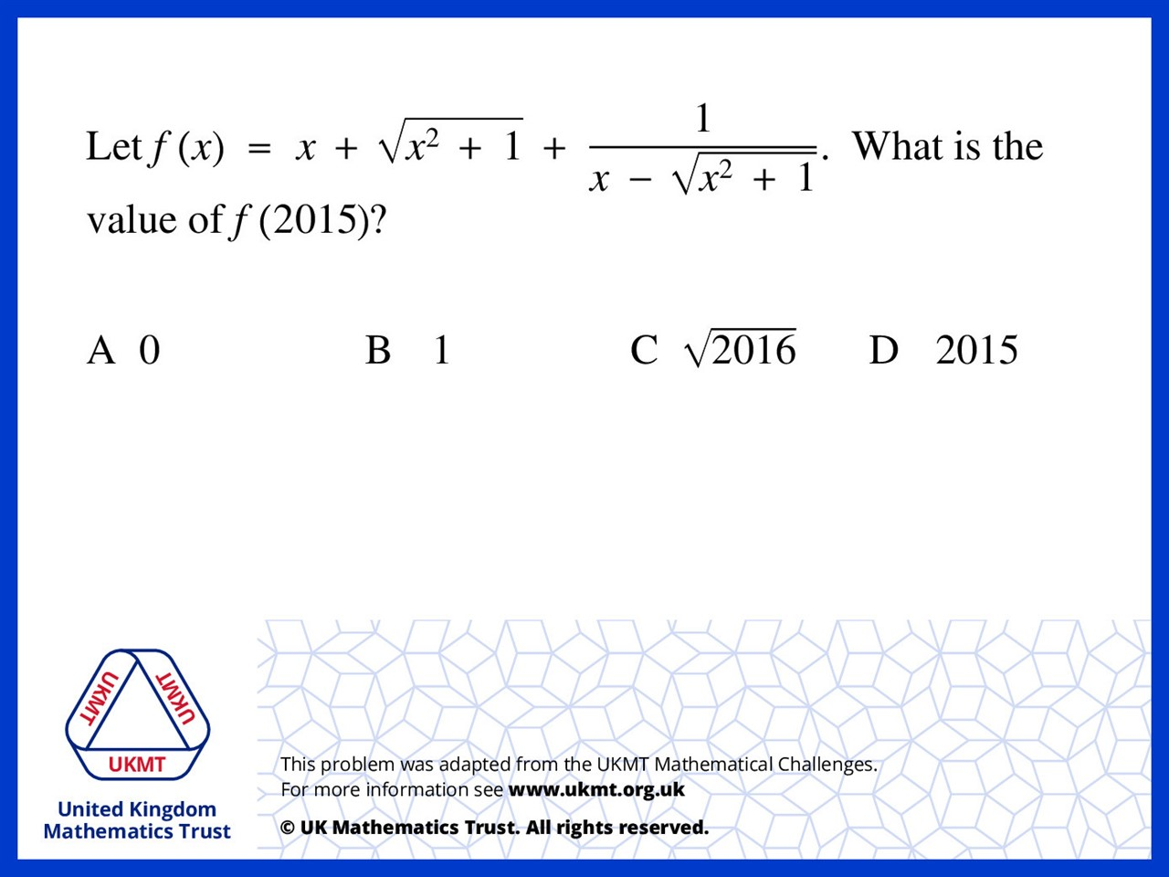
Q1.
Write as a single fraction, numerators
(difference of squares) cancel to make 0,
so in fact f(anything) = 0

Slide 3
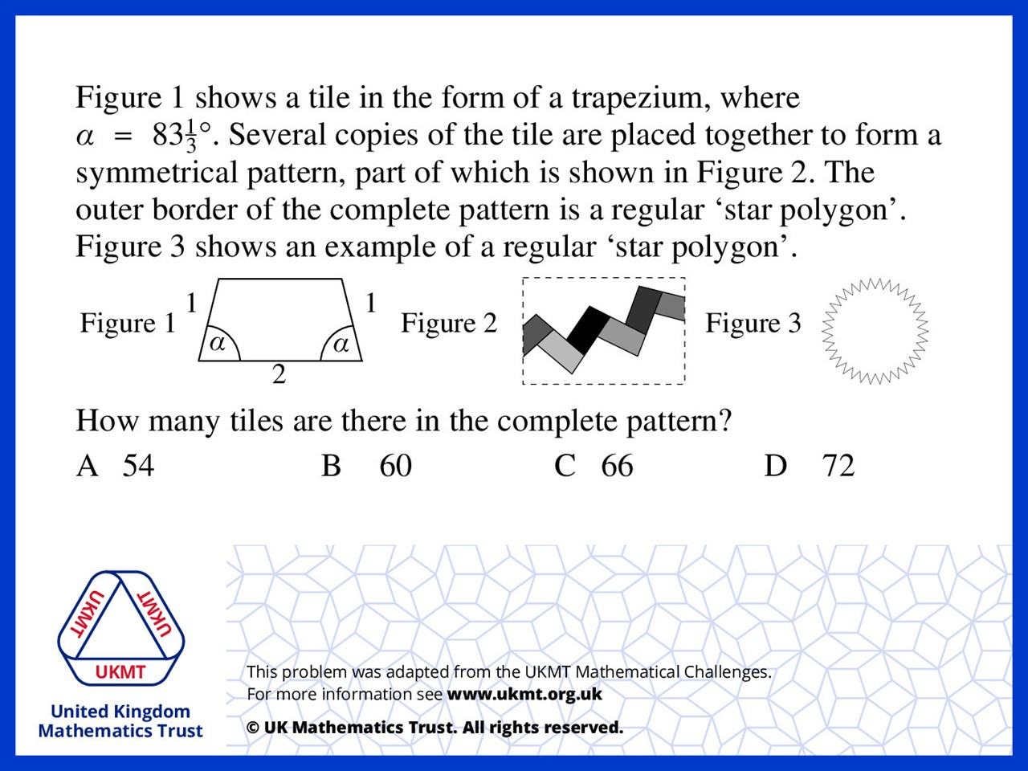
Q2.
External angle is 96 + 2/3
So it rotates by 20/3 degrees each turn 360 ÷ (20/3) = 54

Slide 4
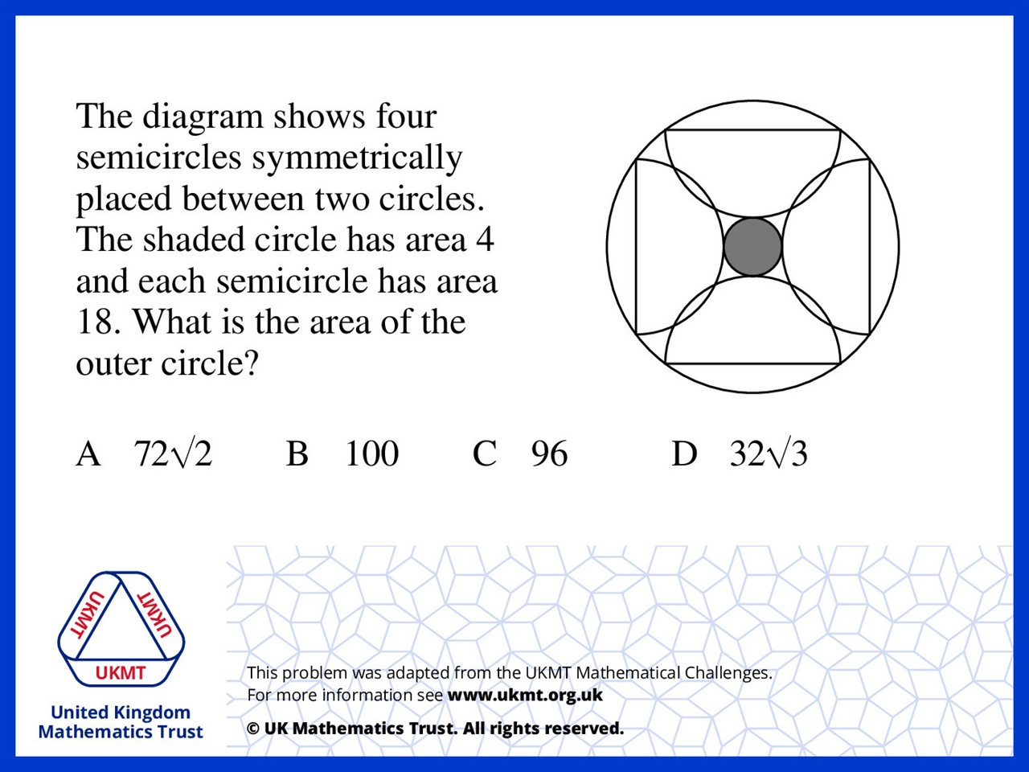
Q3.
Radius (shaded circle) = 1.128 Radius (semicircle) = 3.386
To calculate the radius of the outer circle we can create a right angled triangle between the uppermost point of the left semicircle, the centre of the semicircle (if it was a full circle) and the centre of the shaded circle. You already had the measurements for a (the uppermost point to the middle of the left semicircle) and b (the line between the middle point of the semicircle and the middle of the shaded circle), and could use Pythagoras to calculate c, which was the outer circles radius. I then used the area formula on my result, 5.64 to make 99.93 (approx) and rounded that to 100

Slide 5
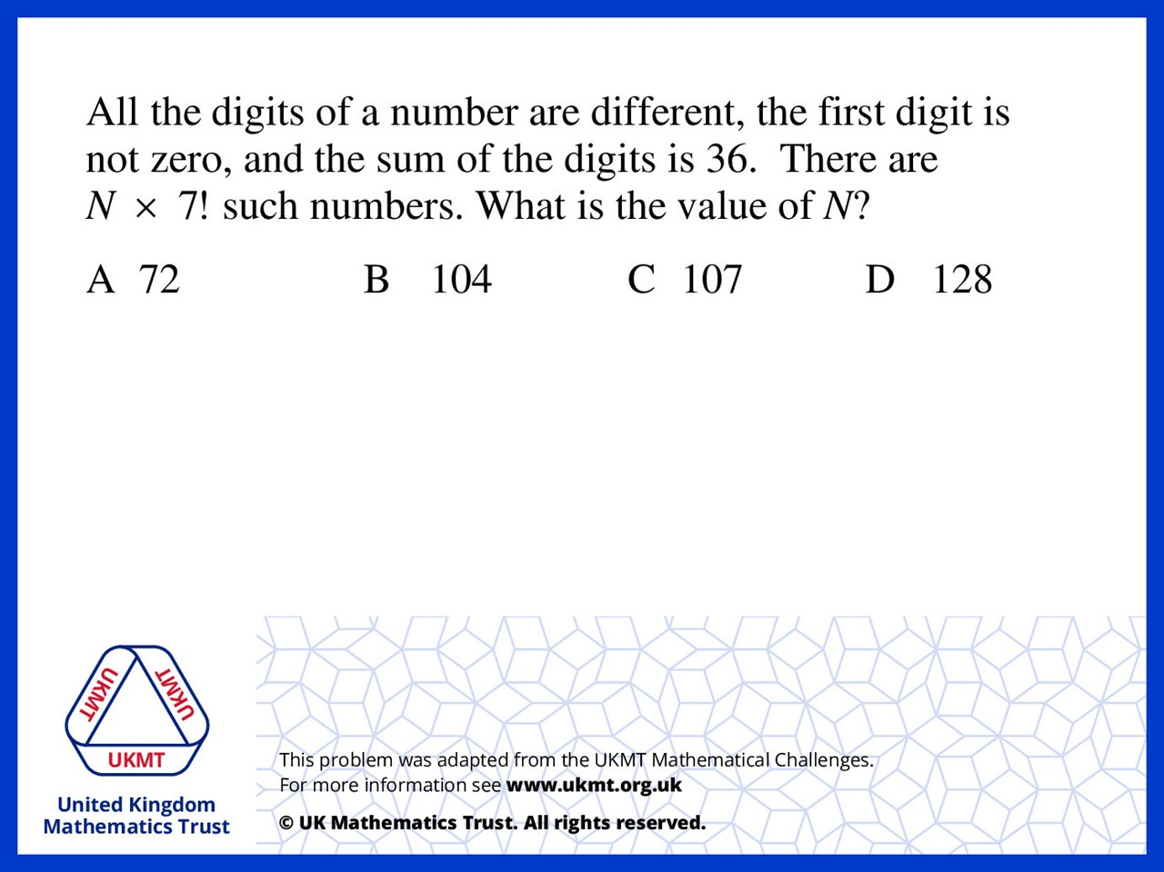
Q4.
If we add up 0 to 9 we get 45,
so we take away 9 from the sum each time
we construct a number (9 or 1,8 or 1,2,6 etc.)
we end up with 9! + 4 x 8! + 3 x 7! = 107 x 7!

Slide 6
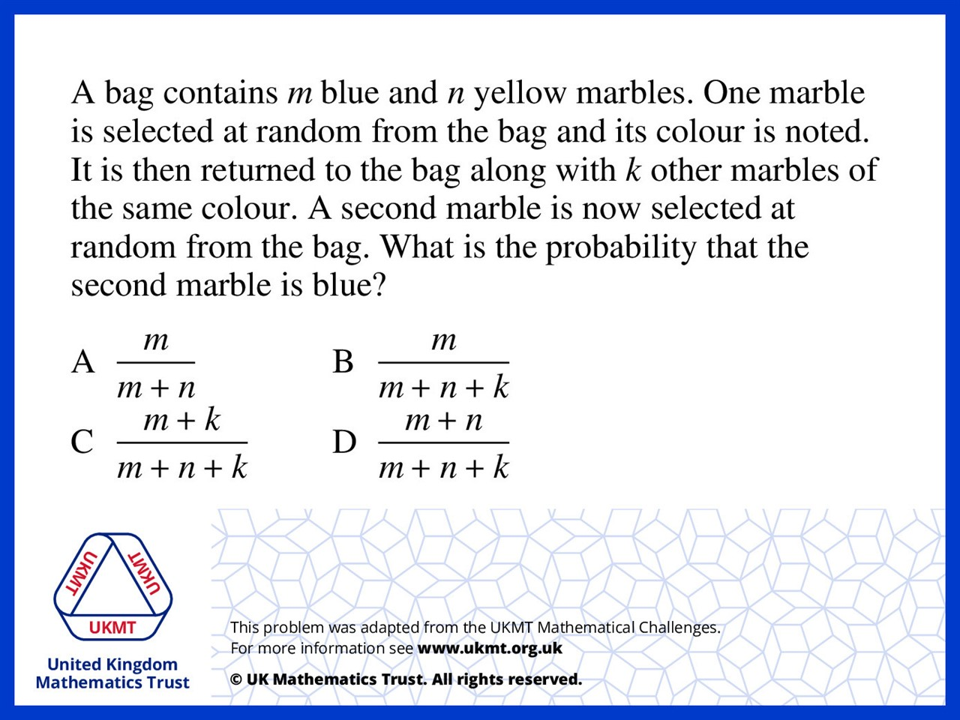
Q5.
It doesn't matter that you have taken out a marble and placed it back so it is the number of blue marbles divided by the total number of marbles

