Slide 1
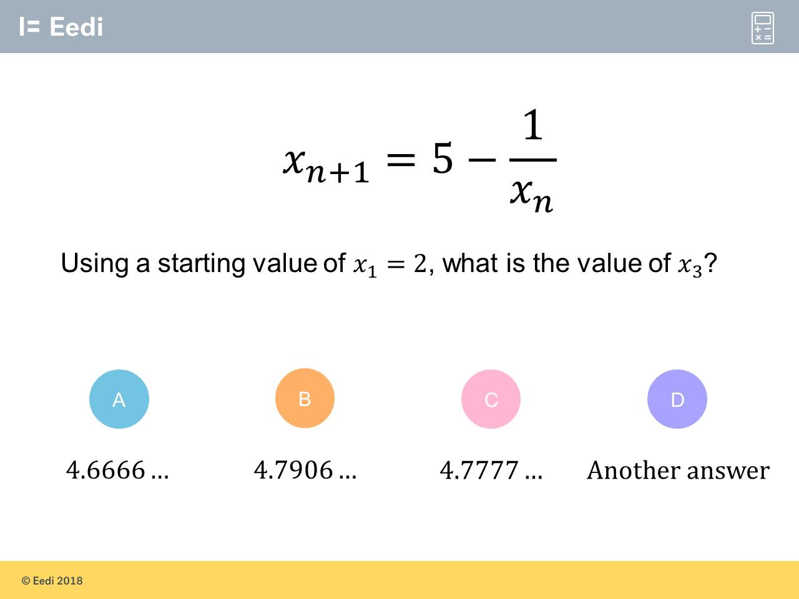
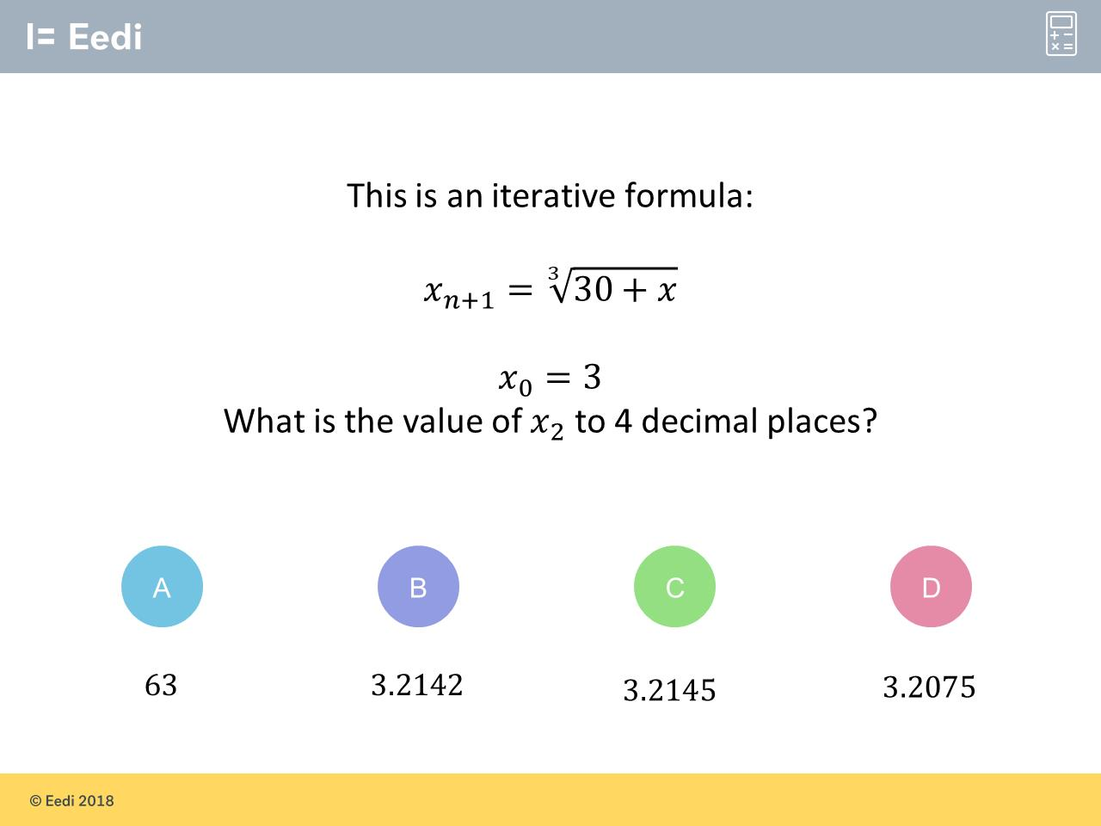
Worst answered question?
Most common wrong answer?

Slide 2
ANSWERS

Slide 3
Worst answered question?

Slide 4
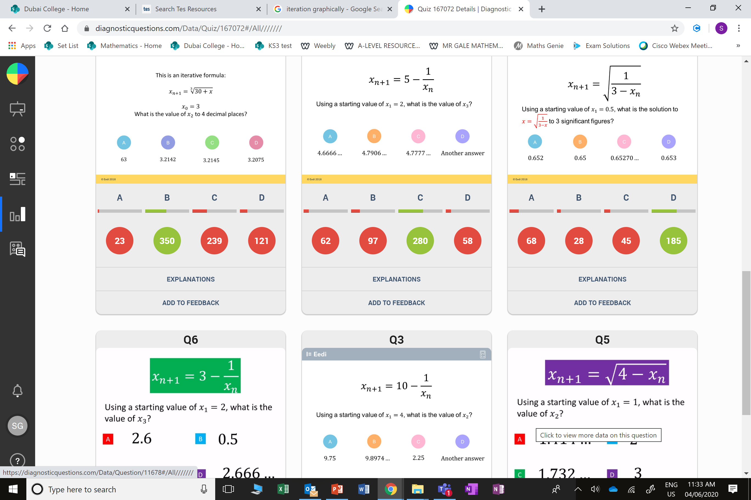
C
The student may have rounded x₁ before putting it into the formula.

Slide 5
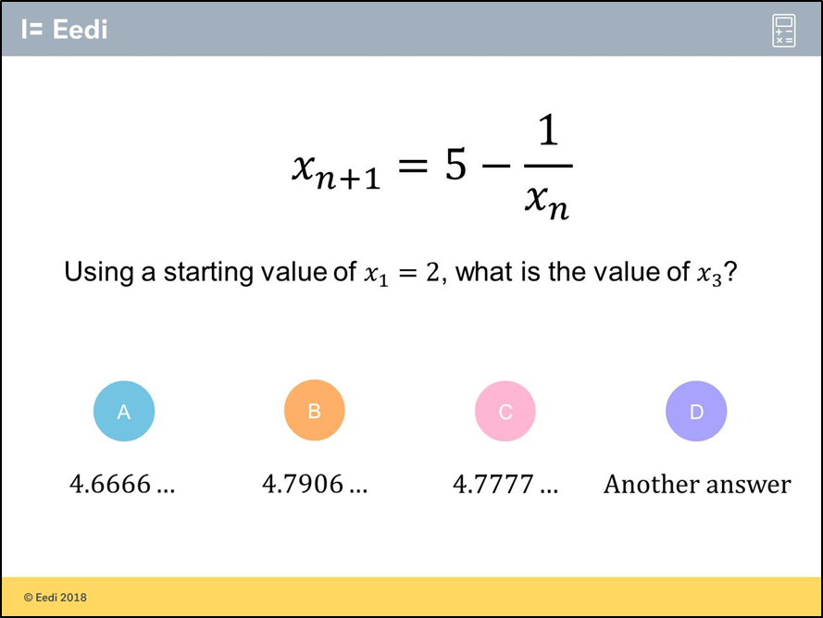
B
The student has completed one too many iterations.

