Slide 1
LO: Indices and Equations
(Changing Base Values)

Slide 2
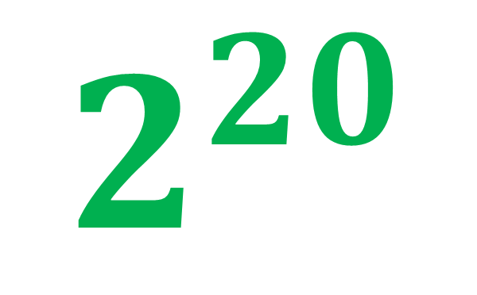
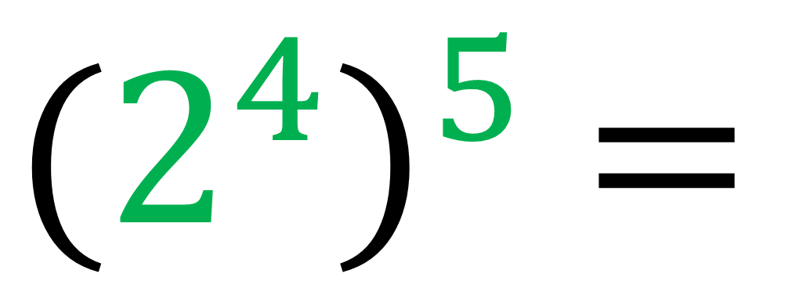
Simplify
$${(2^{4})}^{5} =$$
$$2^{20}$$

Slide 3
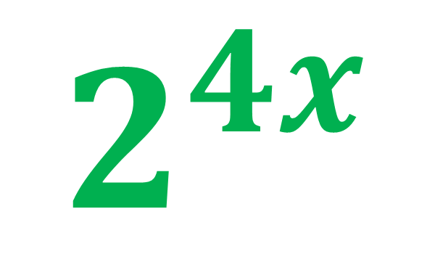
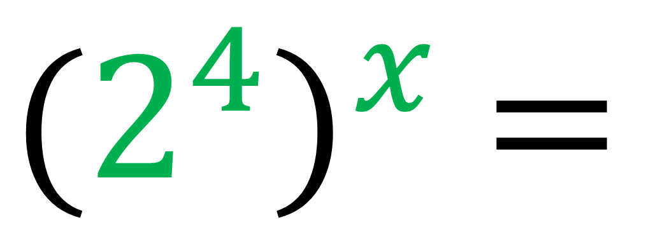
Simplify
$${(2^{4})}^{x} =$$
$$2^{4x}$$

Slide 4
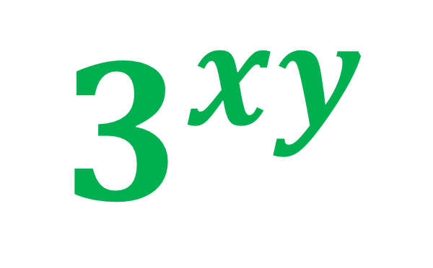
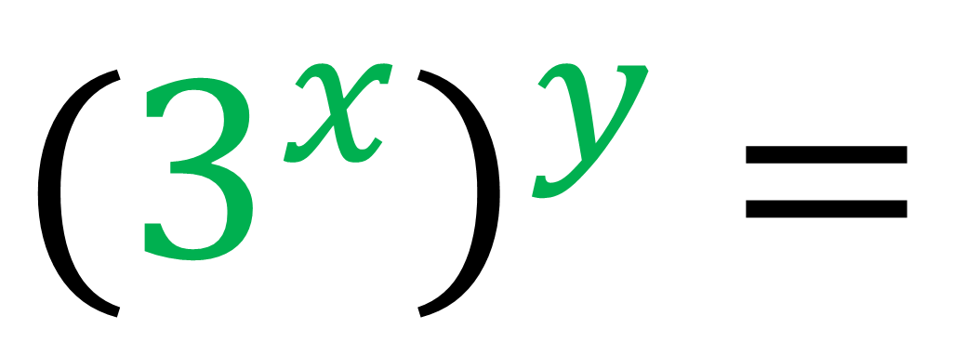
Simplify
$${(3^{x})}^{y} =$$
$$3^{xy}$$

Slide 5
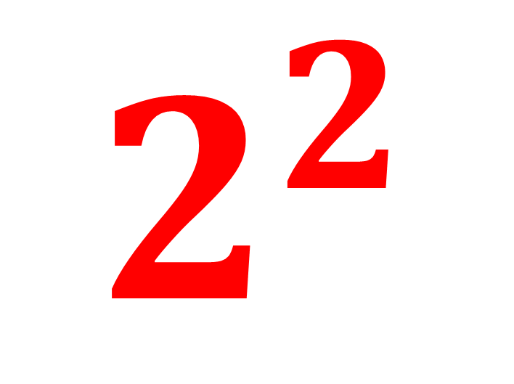
Write 4 as a power
with a base value of 2.
$$2^{2}$$

Slide 6
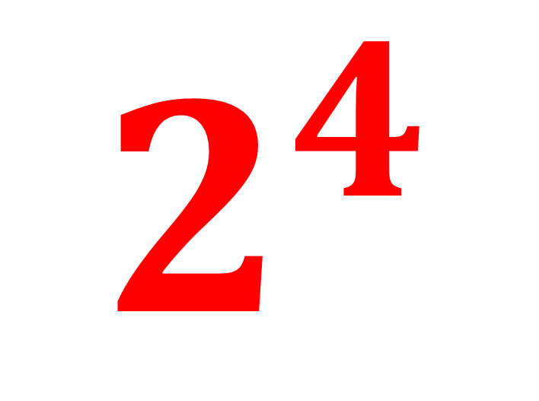
Write 16 as a power
with a base value of 2.
$$2^{4}$$

Slide 7
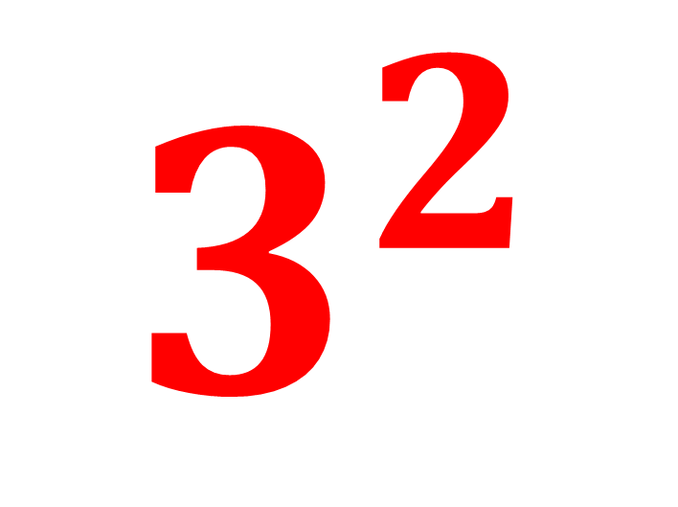
Write 9 as a power
with a base value of 3.
$$3^{2}$$

Slide 8
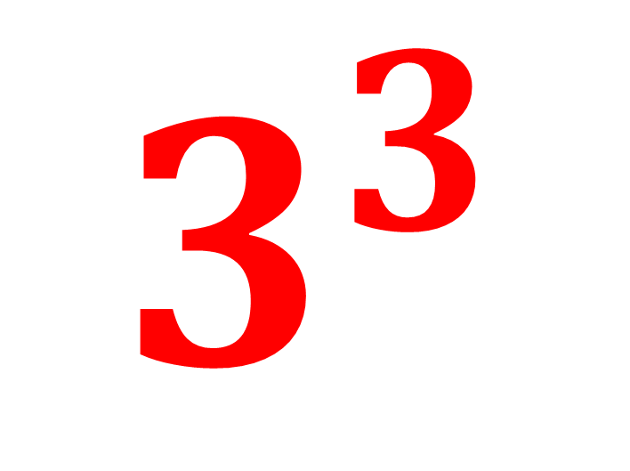
Write 27 as a power
with a base value of 3.
$$3^{3}$$

Slide 9
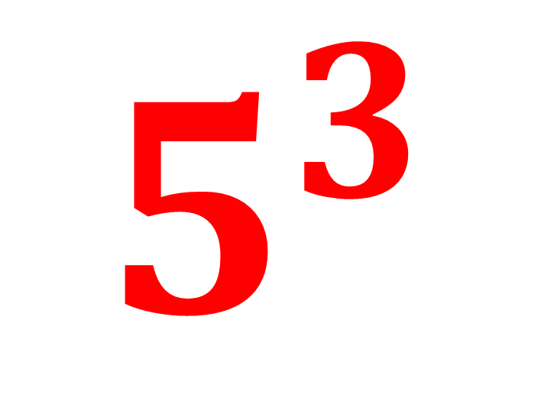
Write 25 as a power
with a base value of 5.
$$5^{3}$$

Slide 10
Write 125 as a power
with a base value of 5.
$$5^{3}$$

Slide 11
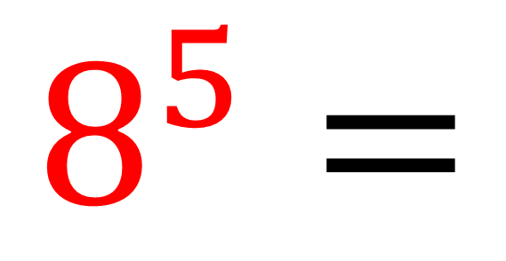
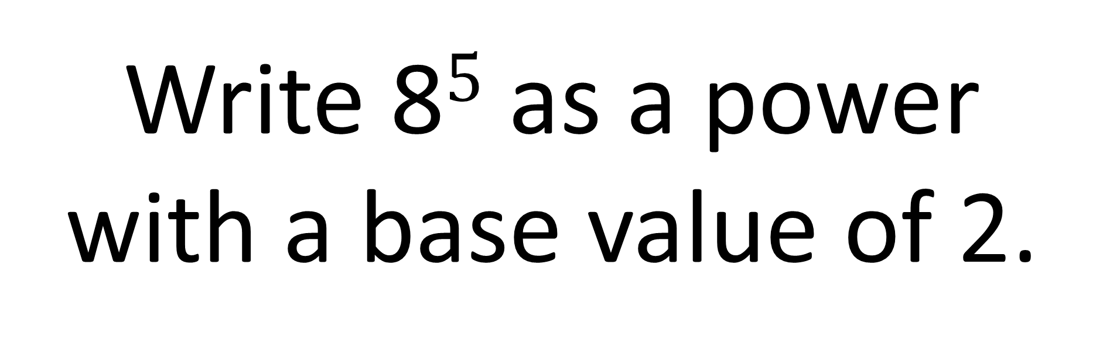
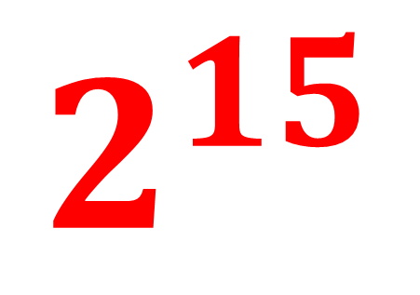
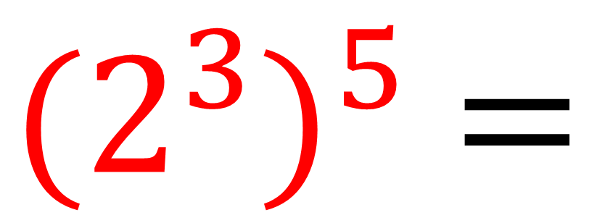
Write 8$5$ as a power
with a base value of 2.
$${(2^{3})}^{5} =$$
$$2^{15}$$
$$8^{5}=$$

Slide 12
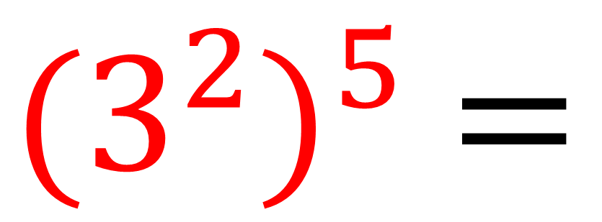
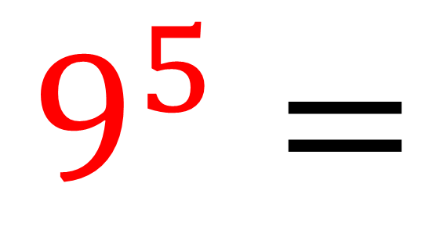
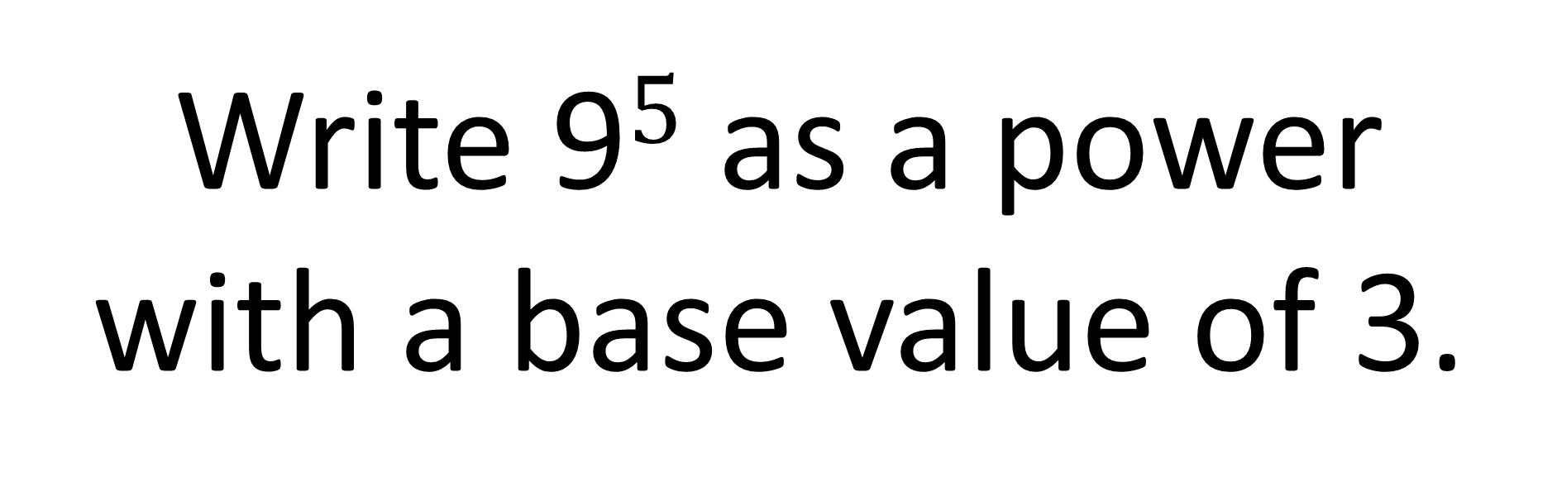
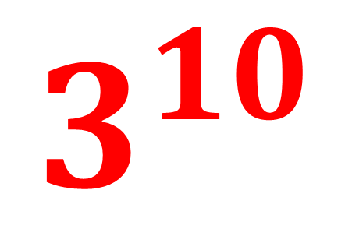
Write 9$5$ as a power
with a base value of 3.
$${(3^{2})}^{5} =$$
$$3^{10}$$
$$9^{5}=$$

Slide 13
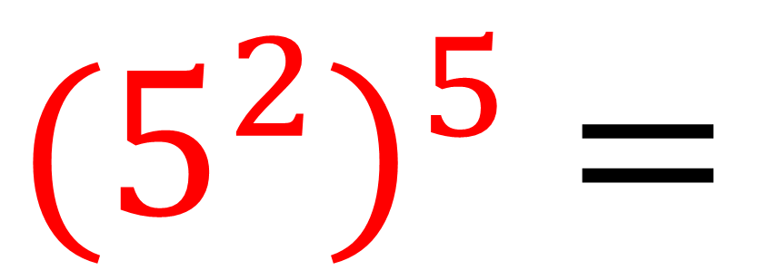
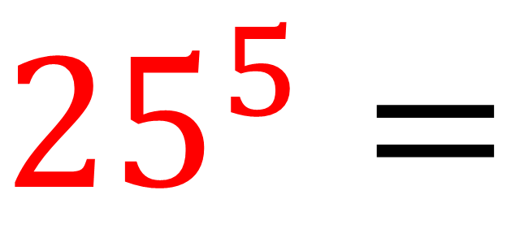

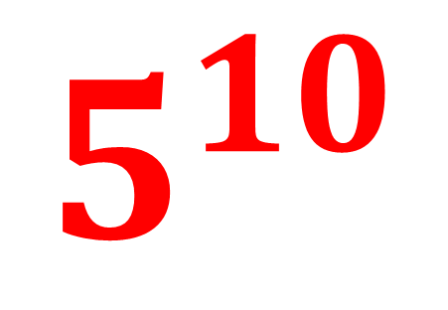
Write 25$5$ as a power
with a base value of 5.
$${25}^{5}=$$
$${(5^{2})}^{5} =$$
$$5^{10}$$

Slide 14
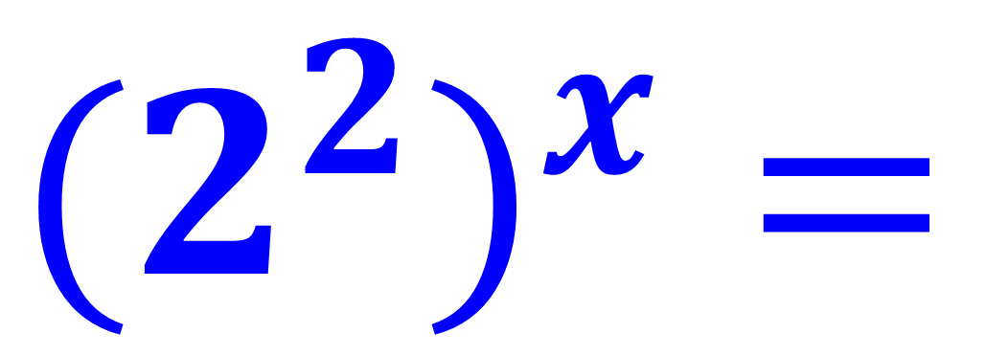
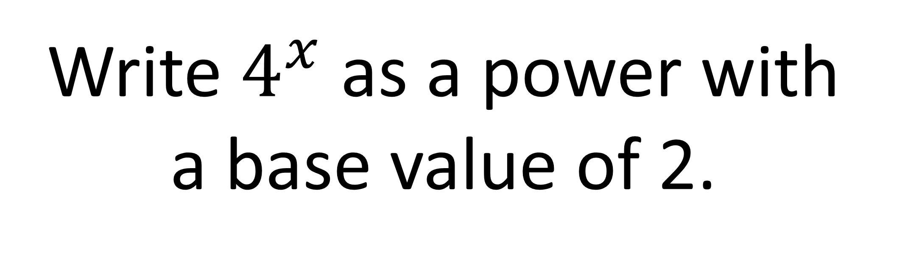
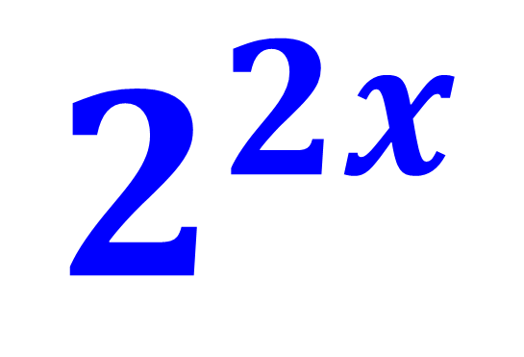
Write $4^{x}$ as a power with a base value of 2.
$${{(2}^{2})}^{x}=$$
$$2^{2x}$$

Slide 15
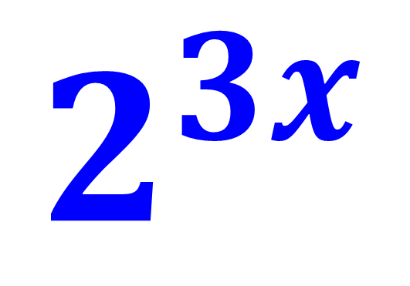
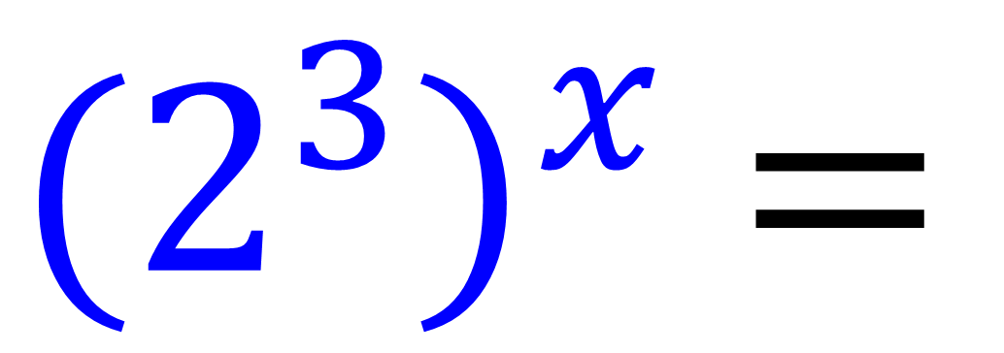
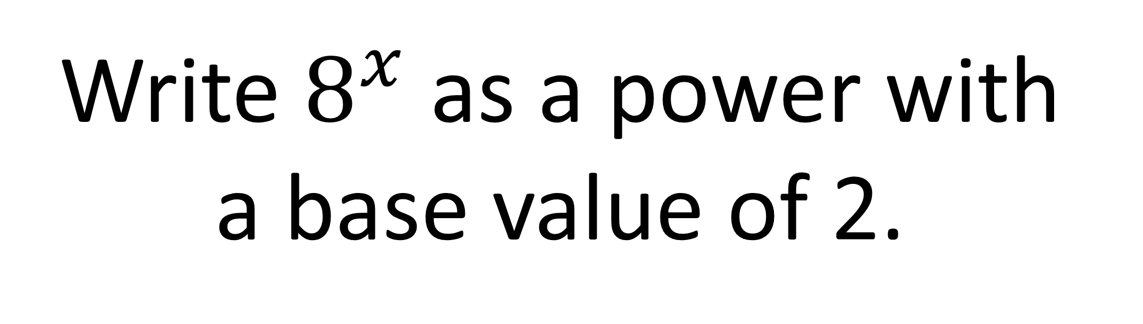
Write $8^{x}$ as a power with a base value of 2.
$${(2^{3})}^{x} =$$
$$2^{3x}$$

Slide 16
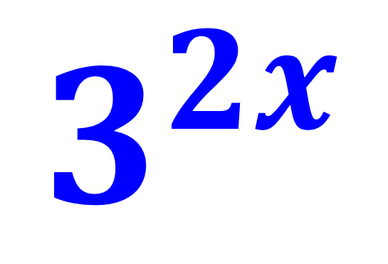
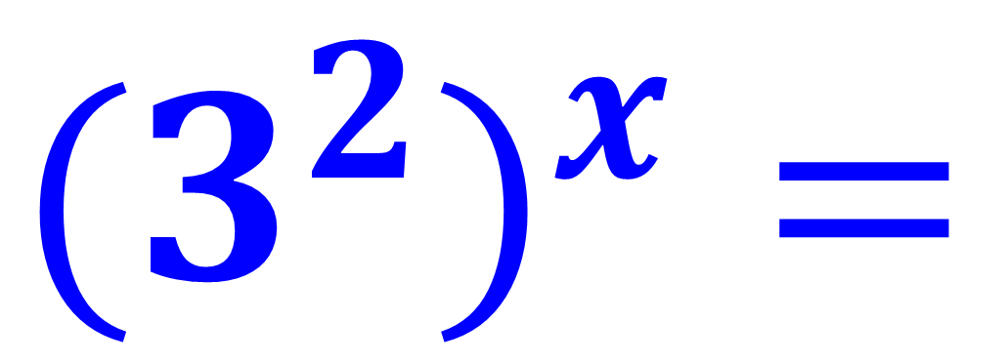
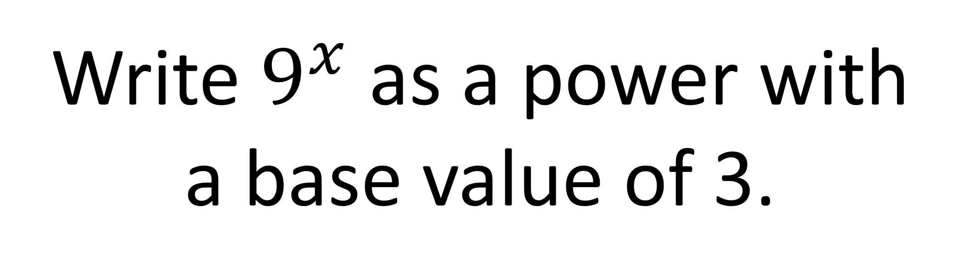
Write $9^{x}$ as a power with a base value of 3.
$${{(3}^{2})}^{x}=$$
$$3^{2x}$$

Slide 17
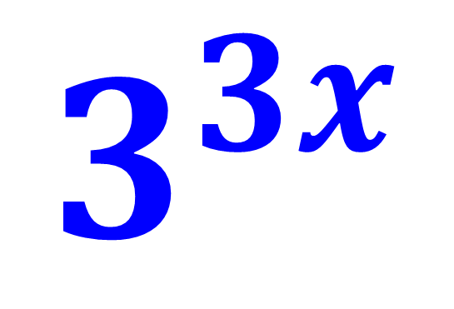
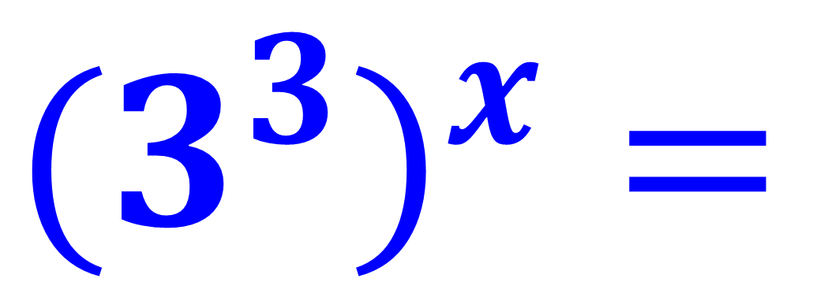
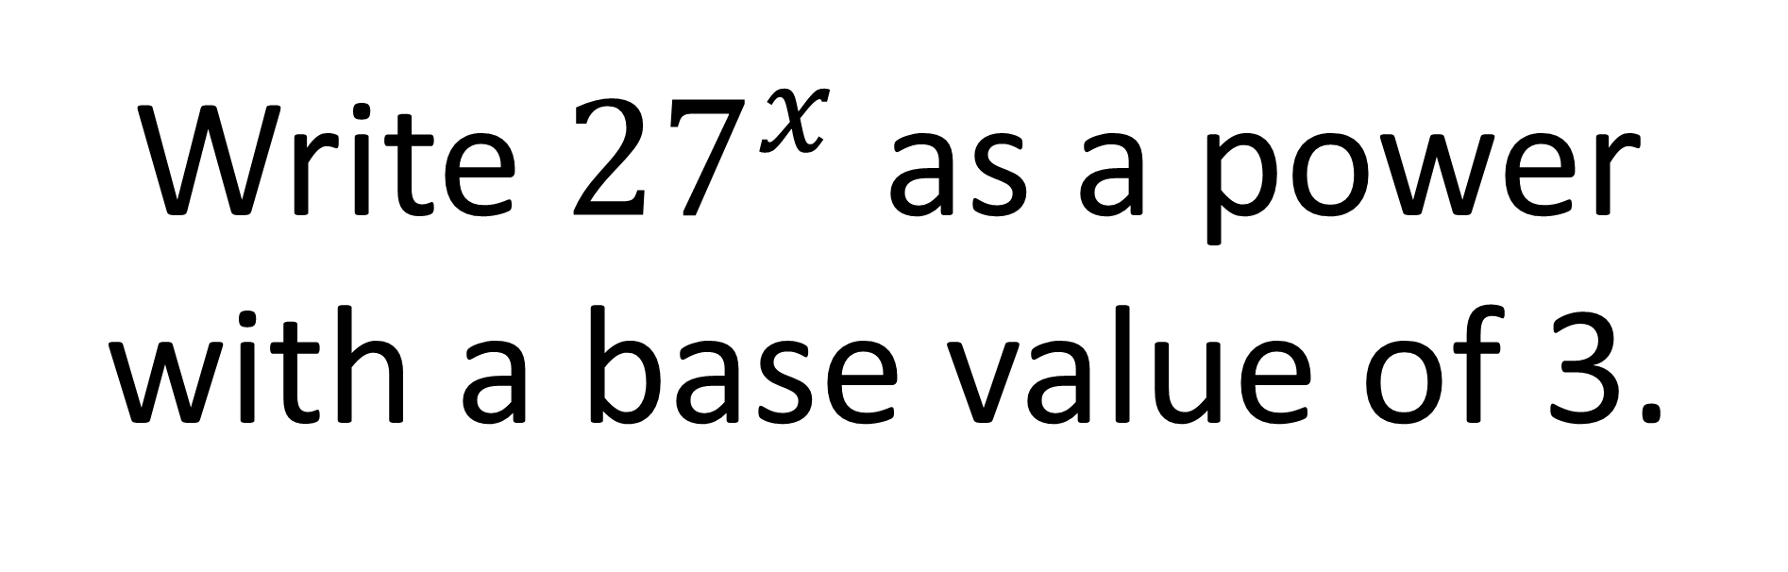
Write ${27}^{x}$ as a power with a base value of 3.
$${{(3}^{3})}^{x}=$$
$$3^{3x}$$

Slide 18
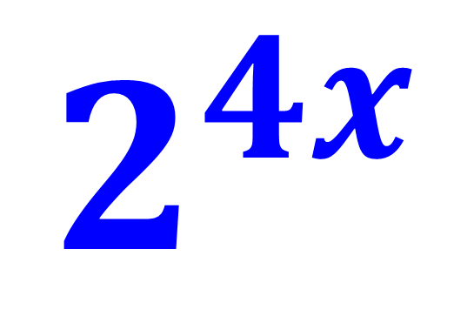
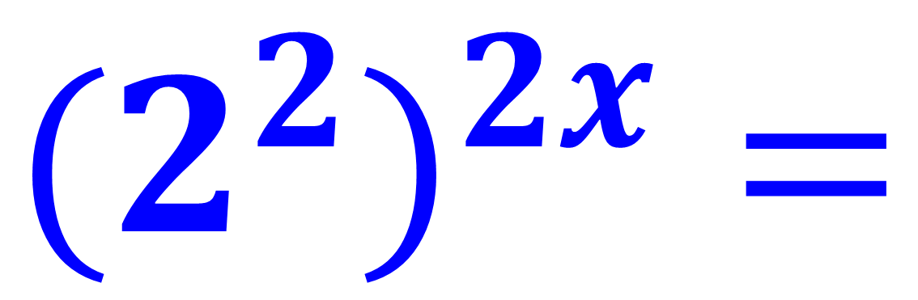
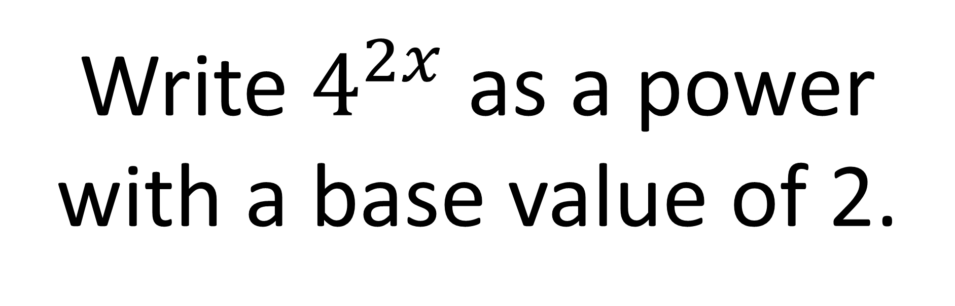
Write $4^{2x}$ as a power with a base value of 2.
$${{(2}^{2})}^{2x}=$$
$$2^{4x}$$

Slide 19
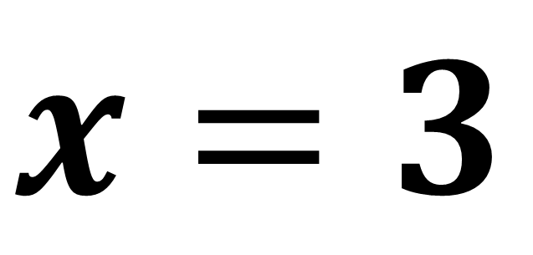
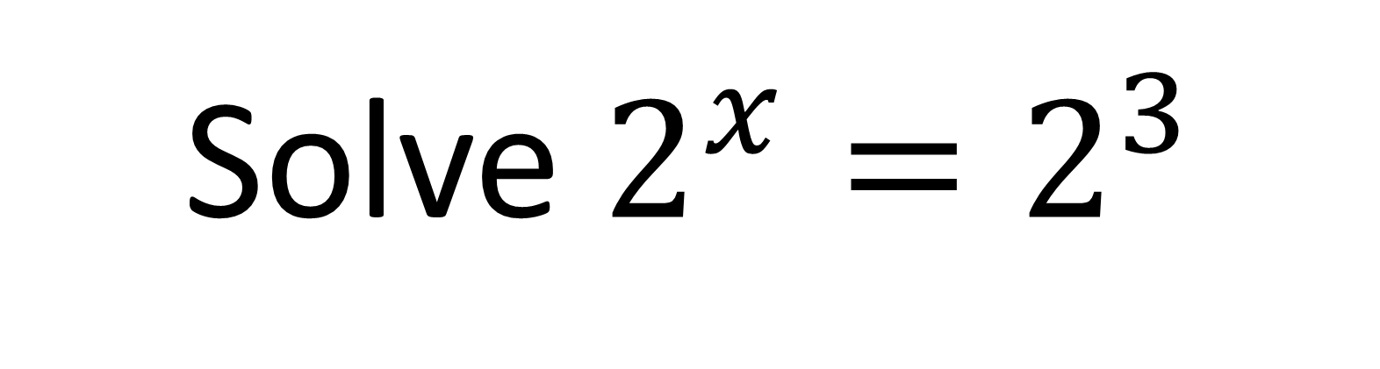
Solve $2^{x}=2^{3}$
$$x=3$$

Slide 20
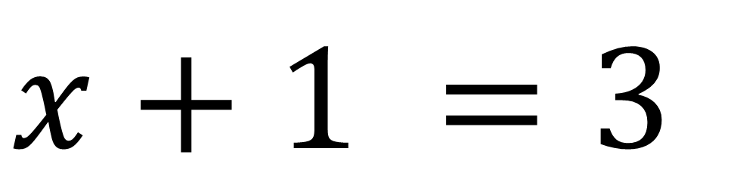
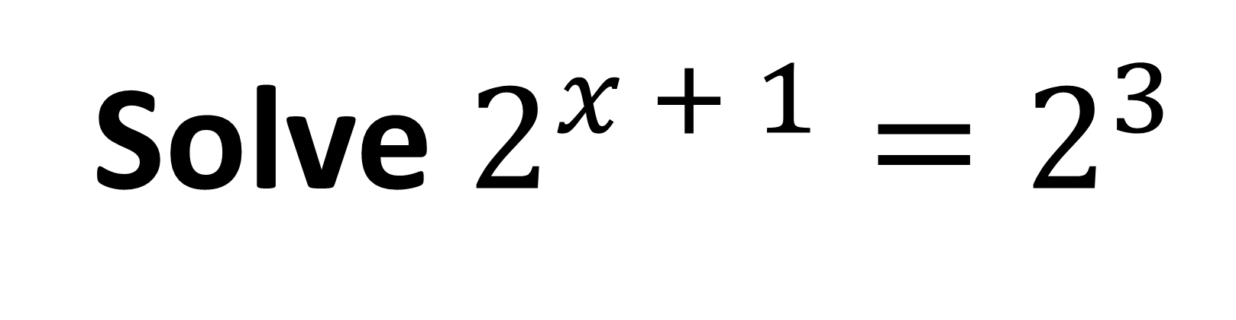
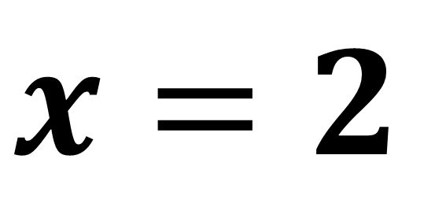
Solve $2^{x + 1}=2^{3}$
$$x+1 =3$$
$$x=2$$

Slide 21
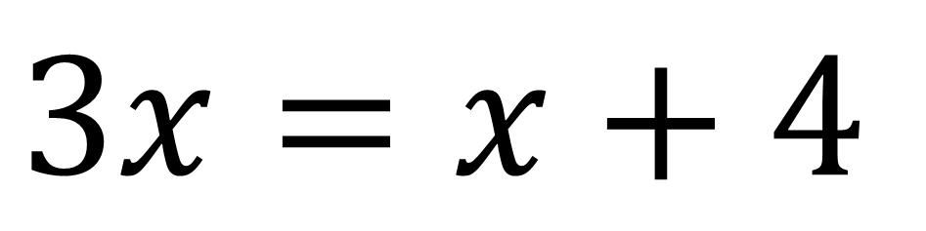
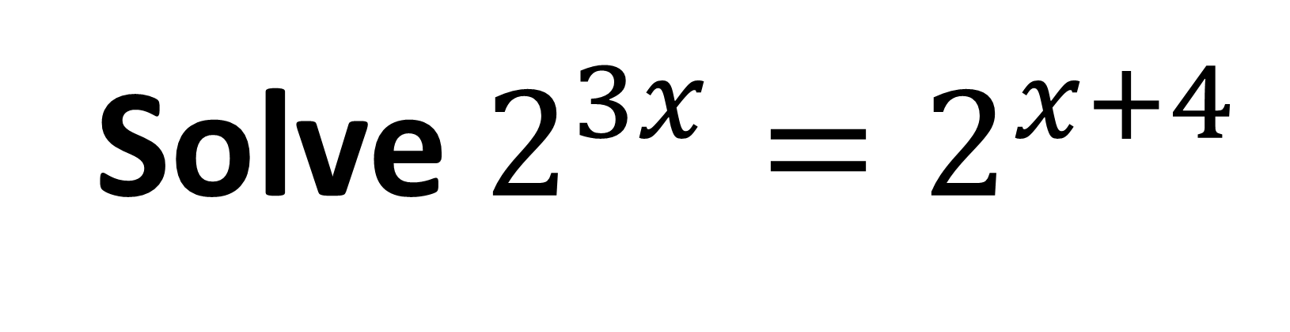
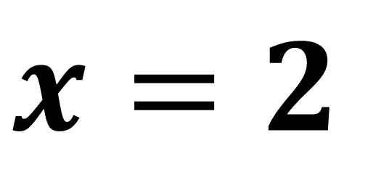
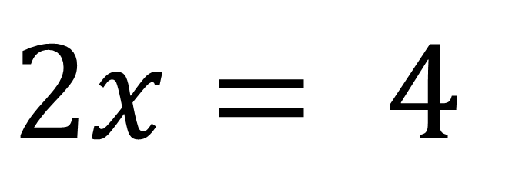
Solve $2^{3x}=2^{x+4}$
$$3x=x+4$$
$$2x= 4$$
$$x=2$$

Slide 22
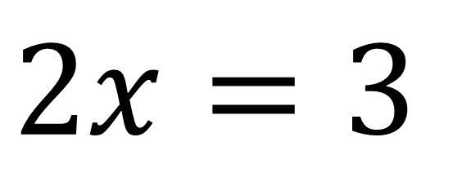
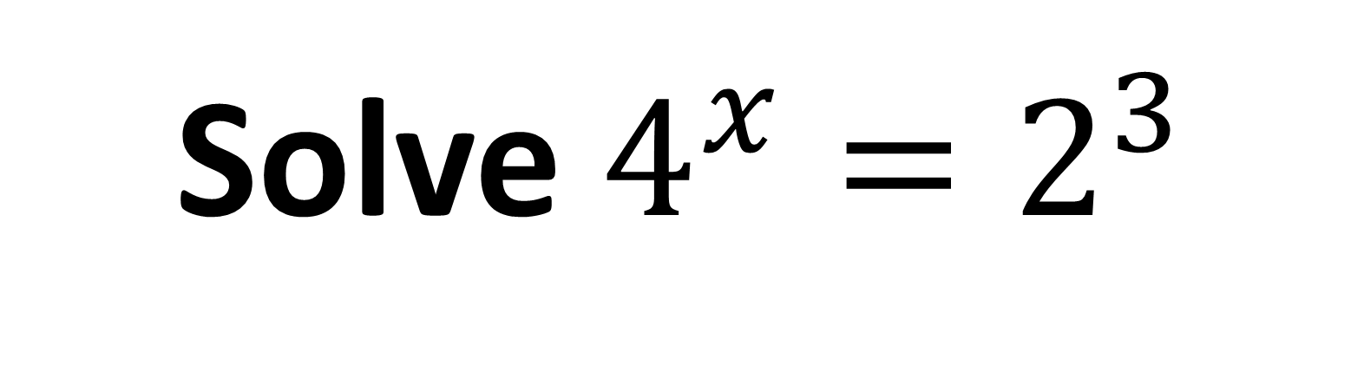
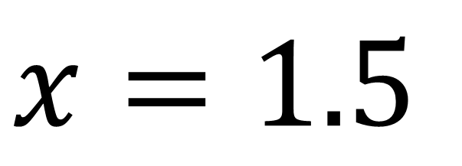
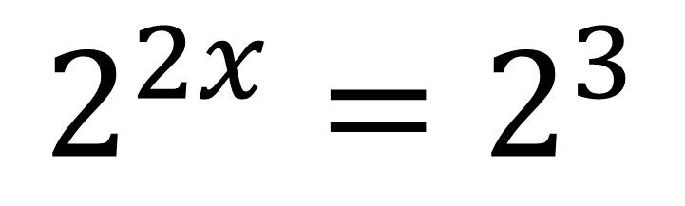

Solve $4^{x}=2^{3}$
$${{(2}^{2})}^{x}=2^{3}$$
$$2^{2x}=2^{3}$$
$$2x=3$$
$$x=1.5$$

Slide 23





Solve $4^{x}=8^{3}$
$${\left(2^{2}\right)}^{x}={\left(2^{3}\right)}^{3}$$
$$2^{2x}=2^{9}$$
$$2x=9$$
$$x=4.5$$

Slide 24





Solve $4^{x + 1}=2^{3}$
$${{(2}^{2})}^{x + 1}=2^{3}$$
$$2^{2x + 2}=2^{3}$$
$$2x+2 =3$$
$$x=0.5$$

Slide 25





Solve $4^{x+1}=8^{x}$
$${{(2}^{2})}^{x + 1}={{(2}^{3})}^{x}$$
$$2^{2x + 2}=2^{3x}$$
$$2x+2=3x$$
$$x=2$$

Slide 26





Solve $9^{4x+1}={27}^{x}$
$${{(3}^{2})}^{4x + 1}={{(3}^{3})}^{x}$$
$$2^{8x + 2}=3^{3x}$$
$$8x+2=3x$$
$$x=−\frac{2}{5}$$

Slide 27
Extension Work

Slide 28





Solve $2^{x}=\frac{8^{3}}{\sqrt{2}}$
$$2^{x}=\frac{{\left(2^{3}\right)}^{3}}{2^{0.5}}$$
$${2^{x}= 2}^{8.5}$$
$$2^{x}=\frac{2^{9}}{2^{0.5}}$$
$$x=8.5$$

Slide 29




Solve $2\sqrt{2}=2^{k}$
$$2^{1}2^{\frac{1}{2}}=2^{k}$$
$$2^{1.5}=2^{k}$$
𝑘 $=$ 1.5

Slide 30




$$\sqrt{2}=$$
$$2^{x}$$
What is the value of x?
$$x=$$
$$\frac{1}{2}$$

