Slide 1
Elastic Collisions in 1D
Collisions with a Planes
Chapter 4
(Part 3 of 5)

Slide 2
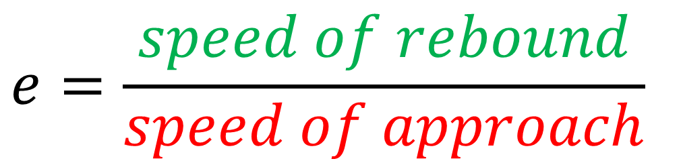


Hitting the Wall
$$speed of approach$$
$$speed of rebound$$
$$e=\frac{speed of rebound}{speed of approach}$$

Slide 3

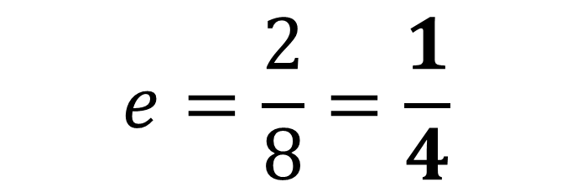
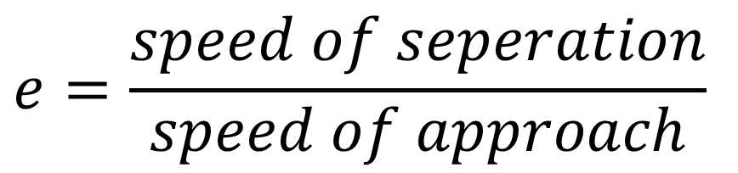

A Particle collides normally with a fixed vertical plane.
The diagram shows the speeds of the particles before and after collision.
Find the value of the coefficient of restitution, e.
$$8ms^{−1}$$
$$2ms^{−1}$$
$$e=\frac{2}{8}=\frac{1}{4}$$
$$e=\frac{speed of seperation}{speed of approach}$$

Slide 4
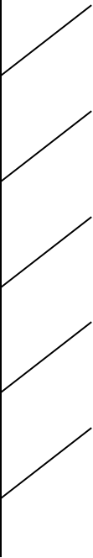




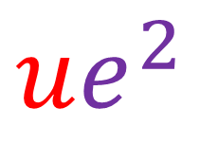

$$u$$
Multiple Collisions
$$e$$
$$eu$$
$$ue^{2}$$
$$e$$
$$eu$$

Slide 5
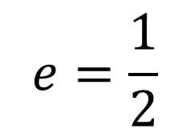

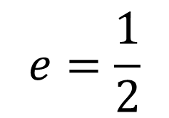
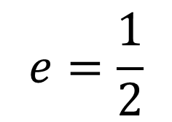
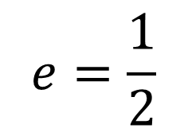
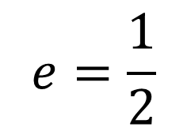
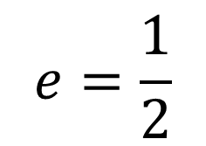


What are the velocities after each collision?
$$e=\frac{1}{2}$$
$$e=\frac{1}{2}$$
$$12{ms}^{−1}$$
$$e=\frac{1}{2}$$
$$−6{ms}^{−1}$$
$$e=\frac{1}{2}$$
$$e=\frac{1}{2}$$
$$e=\frac{1}{2}$$
$$3{ms}^{−1}$$

Slide 6
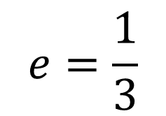
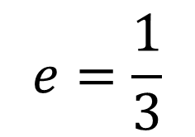
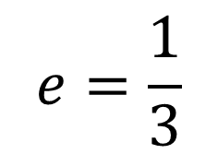


What are the Speeds after each collision?
$$e=\frac{1}{2}$$
$$e=\frac{1}{3}$$
$$12{ms}^{−1}$$
$$e=\frac{1}{3}$$
$$6{ms}^{−1}$$
$$e=\frac{1}{2}$$
$$2{ms}^{−1}$$
$$e=\frac{1}{2}$$
$$e=\frac{1}{3}$$

Slide 7
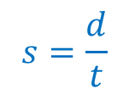
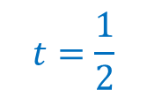

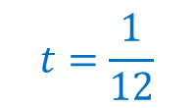
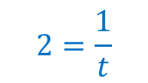

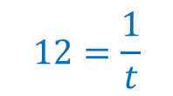
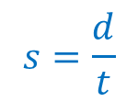

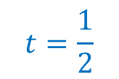

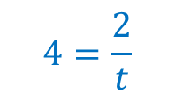
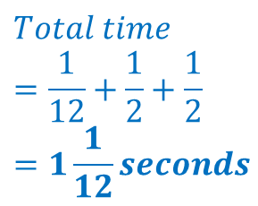
How long does it take to get from point A to point B?
A
$$s=\frac{d}{t}$$
$$12=\frac{1}{t}$$
$$12{ms}^{−1}$$
$$t=\frac{1}{12}$$
1m
$$s=\frac{d}{t}$$
$$4=\frac{2}{t}$$
$$4{ms}^{−1}$$
$$t=\frac{1}{2}$$
2m
B
$$Total time$$
$$=\frac{1}{12}+\frac{1}{2}+\frac{1}{2}$$
$$=1\frac{1}{12}seconds$$
$$s=\frac{d}{t}$$
$$2=\frac{1}{t}$$
$$2{ms}^{−1}$$
$$t=\frac{1}{2}$$
1m

Slide 8




Vertical Movement
$$u$$
$$v$$
$$ev$$
$$e$$

Slide 9
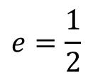




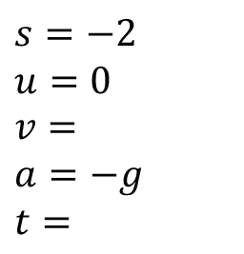


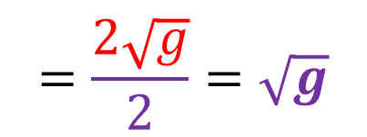


What is the initial speed after it hits the floor (in terms of $g$)?
$$0{ms}^{−1}$$
$$2m$$
$$ev$$
$$=\frac{2\sqrt{g}}{2}=\sqrt{g}$$
$$v$$
$$e=\frac{1}{2}$$
$$s=−2$$
$$u=0$$
$$v=$$
$$a=−g$$
$$t=$$
$$u=\sqrt{g}$$
$$v^{2}=u^{2}+2as$$
$$v^{2}=0+2(−g)(−2)$$
$$v=2\sqrt{g}$$

Slide 10
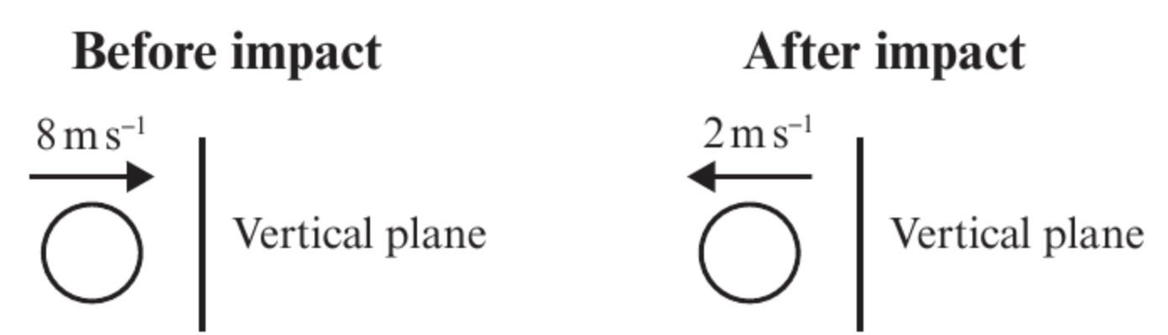
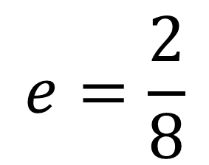
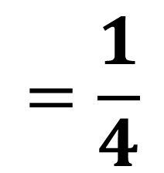
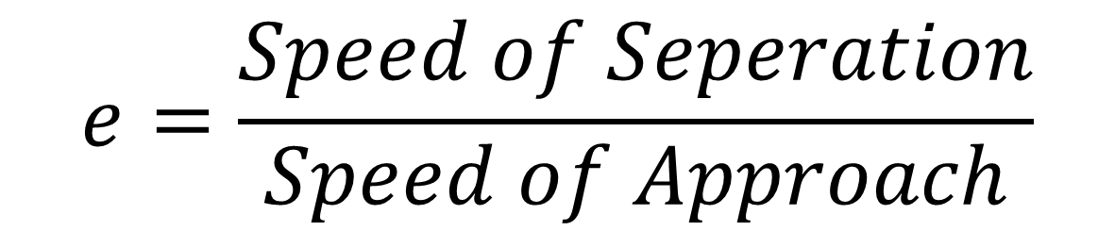
Question A
A particle collides normally with a fixed vertical plane.
The diagram shows the speeds of the particle before and after the collision.
Find the value 𝑒
$$e=\frac{Speed of Seperation}{Speed of Approach}$$
$$e=\frac{2}{8}$$
$$=\frac{1}{4}$$

Slide 11
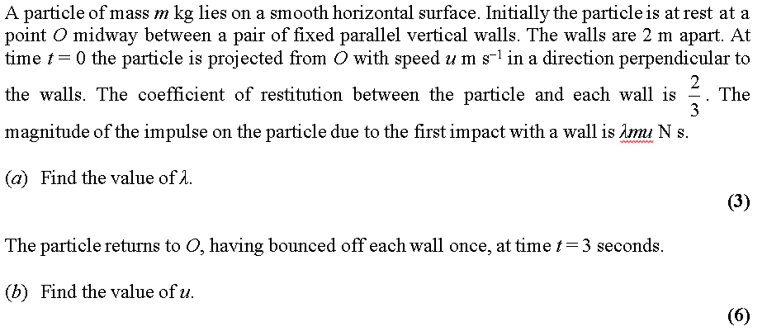
Question B

Slide 12
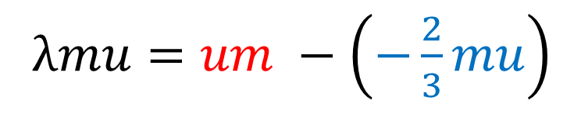
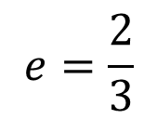
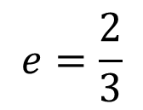

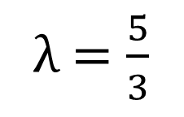

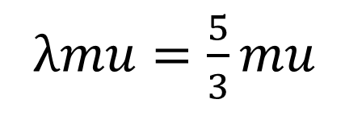
a.
$$e=\frac{2}{3}$$
$$u$$
m
$$−\frac{2}{3}u$$
$$e=\frac{2}{3}$$
m
Impulse $=$ Momentum After – Momentum Before
λ$mu=um −\left(−\frac{2}{3}mu\right)$
λ$mu=\frac{5}{3}mu$
λ$=\frac{5}{3}$

Slide 13
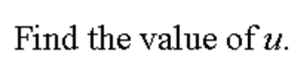
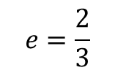
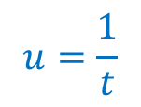
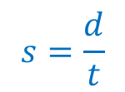

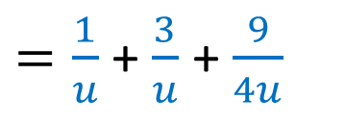

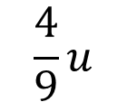
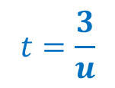
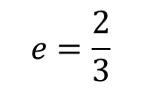
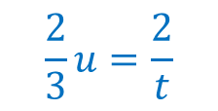
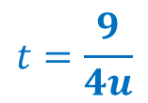
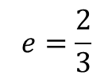
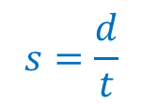
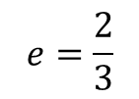


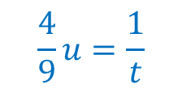




b.
$$s=\frac{d}{t}$$
$$u=\frac{1}{t}$$
$$t=\frac{1}{u}$$
$$e=\frac{2}{3}$$
$$u$$
$$1m$$
$$e=\frac{2}{3}$$
$$s=\frac{d}{t}$$
$$\frac{2}{3}u=\frac{2}{t}$$
$$t=\frac{3}{u}$$
$$\frac{2}{3}u$$
$$e=\frac{2}{3}$$
$$2m$$
$$\frac{4}{9}u$$
Total Time
$$e=\frac{2}{3}$$
$=\frac{1}{u}$+ $\frac{3}{u}$ + $\frac{9}{4u}$+
$$1m$$
$$t=\frac{9}{4u}$$
$$s=\frac{d}{t}$$
$$\frac{4}{9}u=\frac{1}{t}$$
$$=\frac{25}{4u}$$

Slide 14



b.
$$t=\frac{25}{4u}$$
$$3=\frac{25}{4u}$$
$$u=\frac{25}{12}$$

Slide 15
Question C
A particle falls 0.225m from rest onto a smooth horizontal plane.
It then rebounds to a height of 0.1m.
Find the coefficient of restitution between the particle and the plane.
Give your answer to 2 significant figures.

Slide 16















A particle falls 0.225m from rest onto a smooth horizontal plane. It then rebounds to a height of 0.1m.
Find the coefficient of restitution between the particle and the plane. Give your answer to 2 significant figures.
$$0$$
$$0$$
$$0.225m$$
$$v$$
$$0.1m$$
$$ev$$
$$s=−0.225$$
$$u=0$$
$$v=$$
$$a=−g$$
$$t=$$
$$s=0.1$$
$$u=ev=2.1e$$
$$v=0$$
$$a=−g$$
$$t=$$
$$v^{2}=u^{2}+2as$$
$$v^{2}=u^{2}+2as$$
$$v^{2}=0+2(−g)(−0.225)$$
$$0={(2.1e)}^{2}+2(−g)(0.1)$$
$$v=2.1$$
$$0={4.41e}^{2}−1.96$$
$$e=\frac{2}{3}$$

Slide 17


A ball is dropped from a height of $hm$.
The coefficient of restitution between
the ball and the ground is $e$.
What is the total distance travelled
by the ball before
it comes to rest permanently?

Slide 18






A ball is dropped from a height of $hm$.
The coefficient of restitution between the ball and the ground is $e$.
What is the total distance travelled by the ball before it comes to rest permanently?
Speed just before first impact
with the ground:
$$s=h$$
$$u=0$$
$$v=$$
$$a=g$$
$$t=$$
$$v^{2}=u^{2}+2as$$
$$v^{2}=2gh$$
$$h$$
$$v=\sqrt{2gh}$$

Slide 19







A ball is dropped from a height of $hm$.
The coefficient of restitution between the ball and the ground is $e$.
What is the total distance travelled by the ball before it comes to rest permanently?
Distance travelled to highest point
after first bounce
$$s=$$
$$u=e\sqrt{2gh}$$
$v=$ $0$
$$a=−g$$
$$t=$$
$$e=\frac{speed ofrebound}{speed of approach}$$
$$e=\frac{speed ofrebound}{\sqrt{2gh}}$$
$$v^{2}=u^{2}+2as$$
$$speed ofrebound= e\sqrt{2gh}$$
$$0=e^{2}2gh −2gs$$
s $=e^{2}h$

Slide 20






















$$h$$
s $=e^{2}h$
s $=e^{2}h$
s $=e^{4}h$
s $=e^{4}h$
$$s=h$$
$$u=0$$
$$v=$$
$$a=g$$
$$t=$$
$$e=\frac{speed ofrebound}{speed of approach}$$
$$e=\frac{speed ofrebound}{speed of approach}$$
$$speed ofrebound= e\sqrt{2gh}$$
$$speed ofrebound= e\sqrt{2ge^{2}h}$$
$$s=$$
$$u=e\sqrt{2gh}$$
$v=$ $0$
$$a=−g$$
$$t=$$
$s=$ $e^{2}h$
$$u=0$$
$$v=$$
$$a=g$$
$$t=$$
$$s=$$
$$u=e\sqrt{2ge^{2}h}$$
$v=$ $0$
$$a=−g$$
$$t=$$
$$v^{2}=u^{2}+2as$$
$$v^{2}=u^{2}+2as$$
$$v^{2}={(e\sqrt{2ge^{2}h})}^{2}− 2gs$$
$$v=\sqrt{2gh}$$
$$v^{2}=u^{2}+2as$$
$$v^{2}=u^{2}+2as$$
s $=e^{4}h$
s $=e^{2}h$
$$v=\sqrt{2ge^{2}h}$$

Slide 21



A ball is dropped from a height of $hm$.
The coefficient of restitution between the ball and the ground is $e$.
What is the total distance travelled by the ball before it comes to rest permanently?
Total distance = $h+{2e}^{2}h+2e^{4}h+2e^{6}h+ …$
This is $h$ + the sum of an infinite geometric series with $a=2e^{2}h$ and $r=e^{2}$
So Total distance $=$ $h+\frac{a}{1 − r}$
$$=h+\frac{2e^{2}h}{1−e^{2}}$$
$$=\frac{h(1+e^{2})}{1−e^{2}}$$

