Slide 1
LO: Simultaneous Equations
(By Substitution)

Slide 2
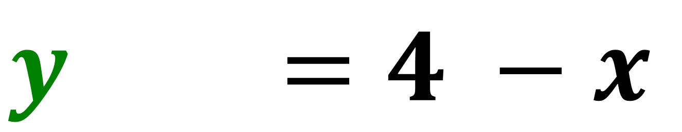
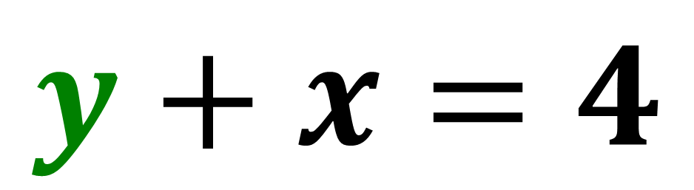
Rearrange to make y subject of the formula.
$$y+x=4$$
$$y+x=4 −x$$

Slide 3
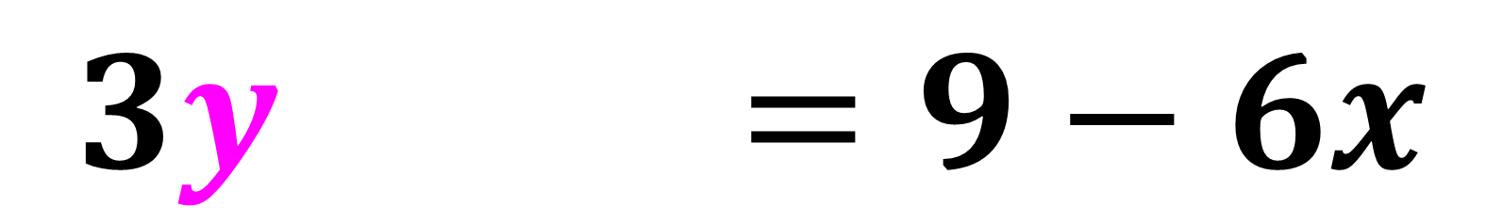
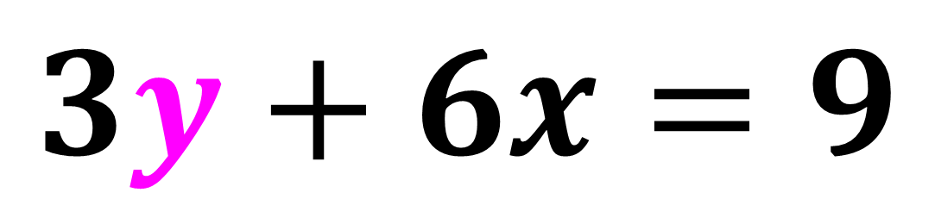
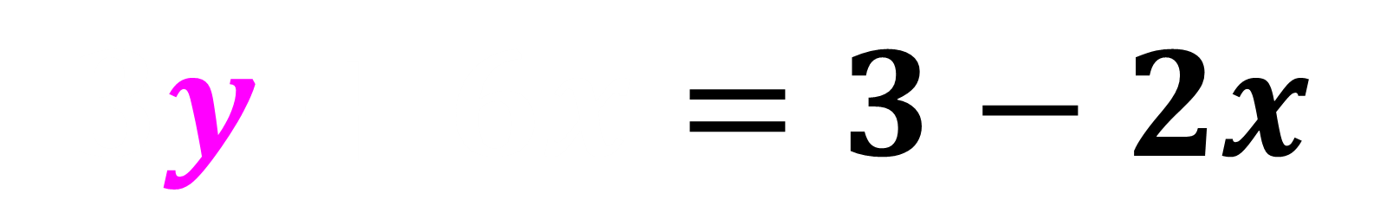
Rearrange to make y subject of the formula.
$$3y+6x=9$$
$$3y+6x=9−6x$$
$$3y+6x=3−2x$$

Slide 4
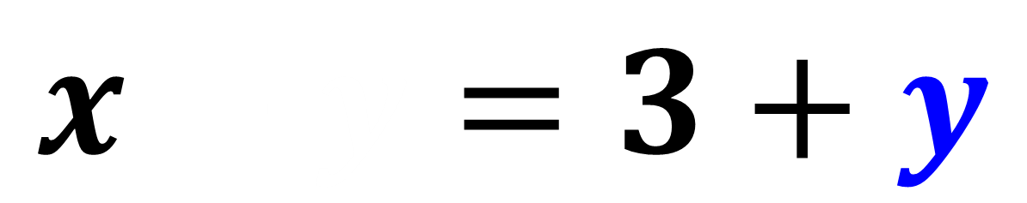
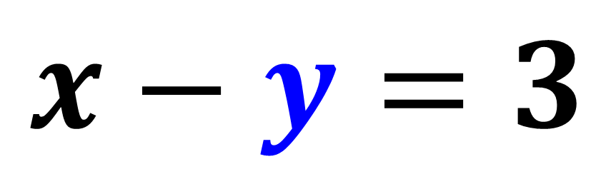
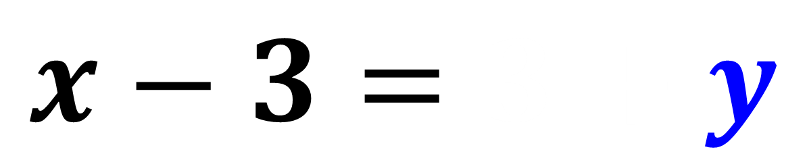
Rearrange to make y subject of the formula.
$$x−y=3$$
$$x−y=3+y$$
$$x−3=3+y$$

Slide 5
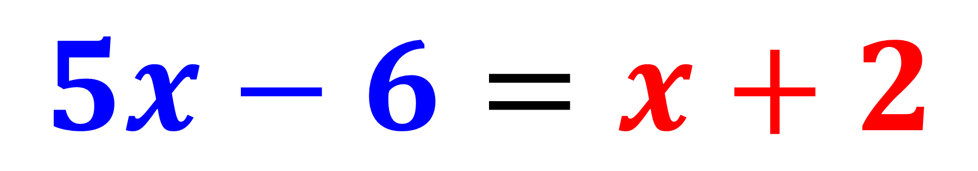
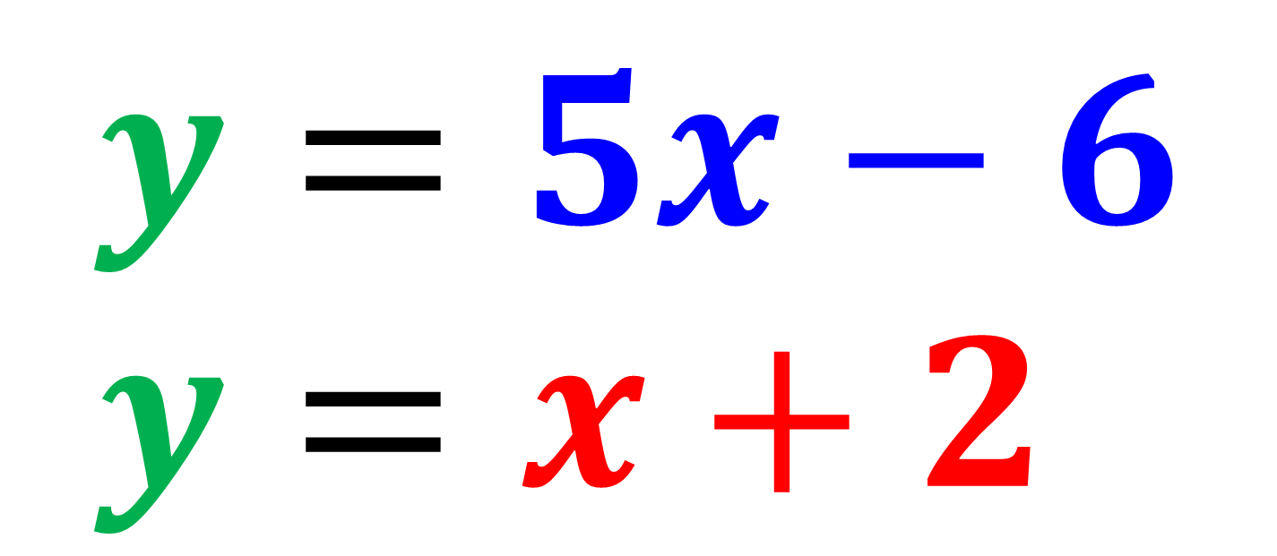
$$y=5x−6 \\ y=x+2$$
$$5x−6=x+2$$

Slide 6
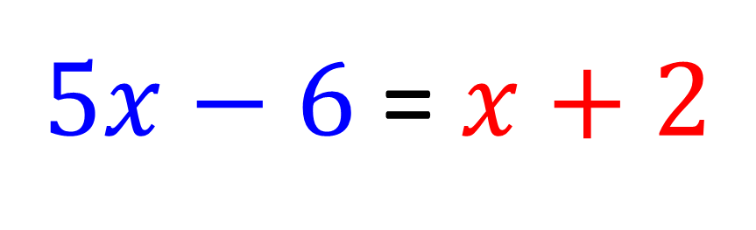
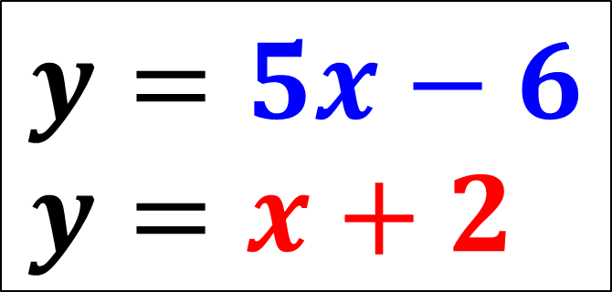


$$y=5x−6 \\ y=x+2$$
$5x−6$ = $x+2$
$4x$ = 8
$4x$ = 2
y = 4

Slide 7
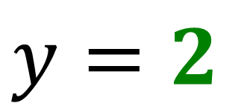
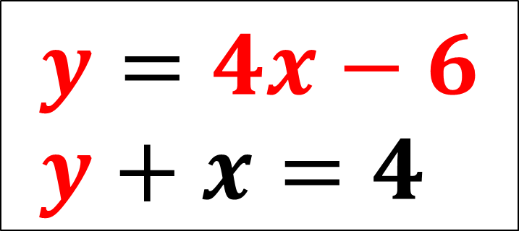
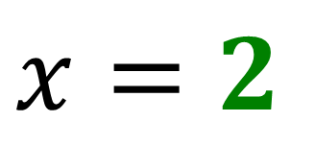
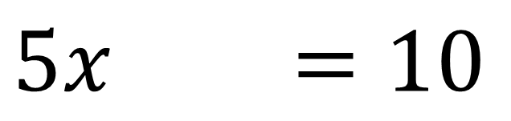
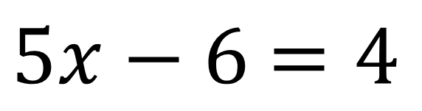
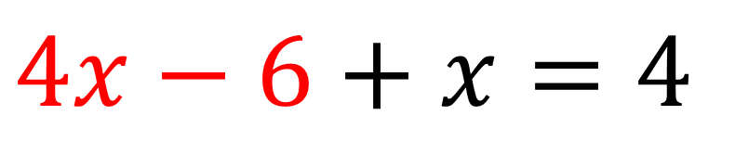
$$y=4x−6 \\ y+x=4$$
$4x−6$ $+ x=4$
$5x−6$ $=4$
$5x−6$ $=10$
$$x=2$$
$$y=2$$

Slide 8
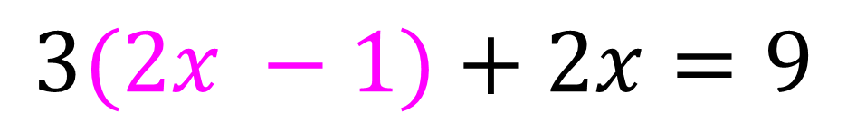
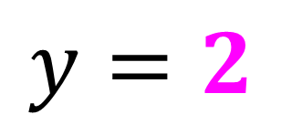
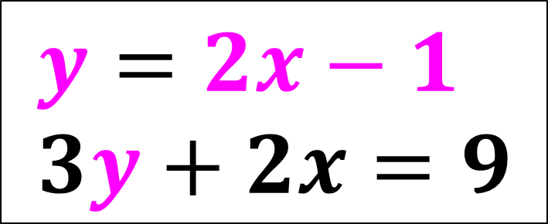
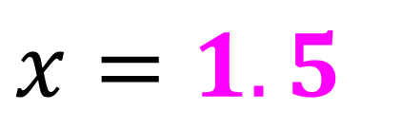
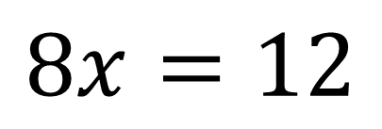
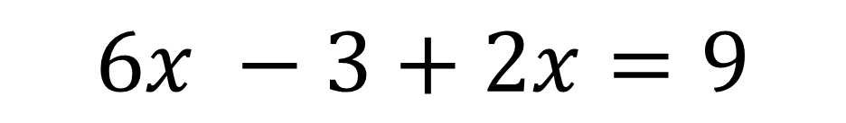
$$y=2x−1 \\ 3y+2x=9$$
$$3(2x −1)+2x=9$$
$$6x −3+2x=9$$
$$8x=12$$
$$x=1.5$$
$$y=2$$

Slide 9
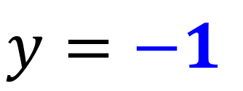
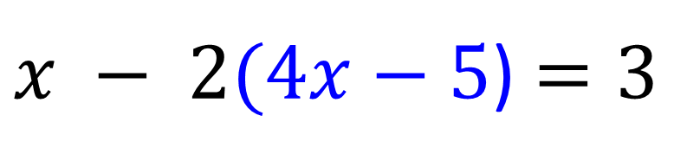
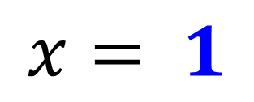
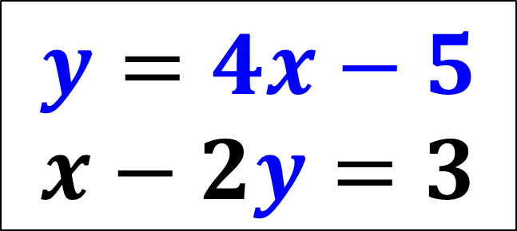
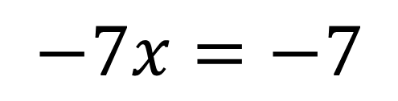
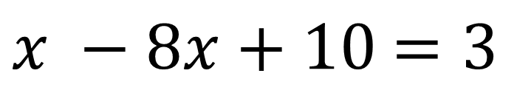
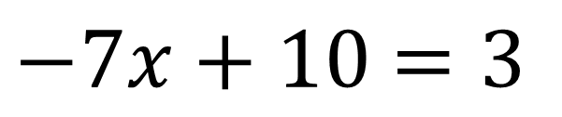
$$y=4x−5 \\ x−2y=3$$
$x − 2(4x−5$) $=3$
$x −8x+10$ $=3$
$−7x+10$ $=3$
$$−7x=−7$$
$$x= 1$$
$$y=−1$$

Slide 10

Andrew paid £12 for 4 cups of coffee and 4 cups of tea.
3 cups of coffee cost as much as 2 cups of tea.
What is the cost of a single coffee?
What is the cost of single tea?

Slide 11
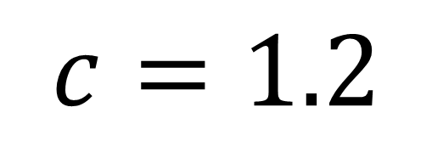
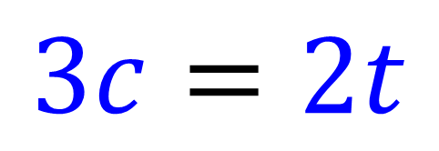
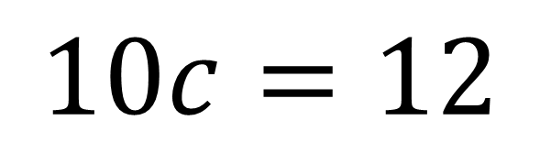
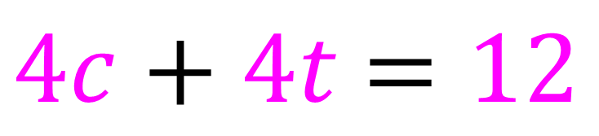
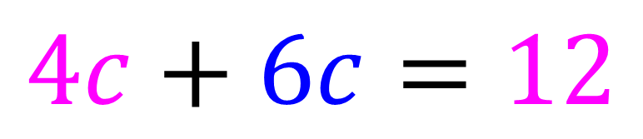
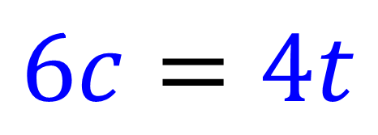
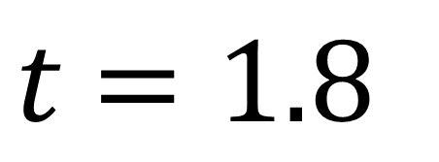
$4c+4t$ $=12$
$$4c+6c=12$$
$$3c=2t$$
$$10c=12$$
$$c=1.2$$
$$6c=4t$$
$t$ $=1.8$

