Slide 1
1) A box contains 10 red and 15 yellow balls. One is taken out and not replaced. Another is taken out.
(a) If the first ball taken out is red, what is the probability that the second ball is:
(i) red (ii) yellow?
(b) If the first ball taken out is yellow, what is the probability that the second ball is:
red (ii) yellow?
2) A fruit bowl contains six Granny Smith apples and eight Golden Delicious apples. Kevin takes two apples at random.
(a) If the first apple is a Granny Smith, what is the probability that the second is:
(i) a Granny Smith
(ii) a Golden Delicious?
(b) What is the probability that:
(i) both are Granny Smiths
(ii) both are Golden Delicious?
3) Ann has a bargain box of tins. They are unlabeled but she knows that six tins contain soup and four contain peaches.
(a) She opens two tins. What is the probability that:
(i) they are both soup
(ii) they are both peaches?
(b) What is the probability that she has to open two tins before she gets a tin of peaches?
(c) What is the probability that she has to open three tins before she gets a tin of peaches?
(d) What is the probability that she will get a tin of soup if she opens five tins?
Notes:
1

Slide 2
ANSWERS

Slide 3





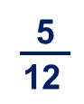

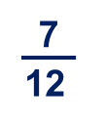
1) A box contains 10 red and 15 yellow balls. One is taken out and not replaced. Another is taken out.
(a) If the first ball taken out is red, what is the probability that the second ball is:
red (ii) yellow?
(b) If the first ball taken out is yellow, what is the probability that the second ball is:
(i) red (ii) yellow?
=
=
=
=
Notes:
3

Slide 4
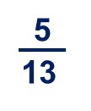
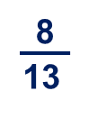
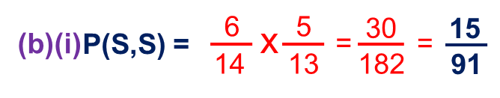
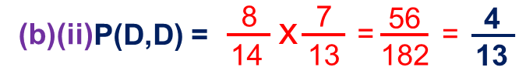
2) A fruit bowl contains six Granny Smith apples and eight Golden Delicious apples.
Kevin takes two apples at random.
If the first apple is a Granny Smith, what is the probability that the second is:
(i) a Granny Smith
(ii) a Golden Delicious?
(b) What is the probability that:
both are Granny Smiths
(ii) both are Golden Delicious?
Notes:
4

Slide 5
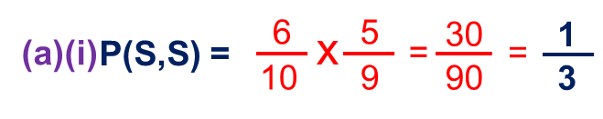
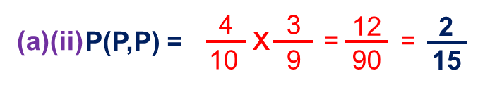
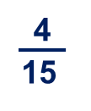
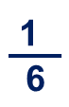
3) Ann has a bargain box of tins. They are unlabelled but she knows that six tins contain soup and four contain peaches.
(a) She opens two tins. What is the probability that:
they are both soup
(ii) they are both peaches?
(b) What is the probability that she has to open two tins before she gets a tin of peaches?
(c) What is the probability that she has to open three tins before she gets a tin of peaches?
(d) What is the probability that she will get a tin of soup if she opens five tins?
1
Notes:
5

