Slide 1

Intermediate Challenge 3
SILVER

Slide 2
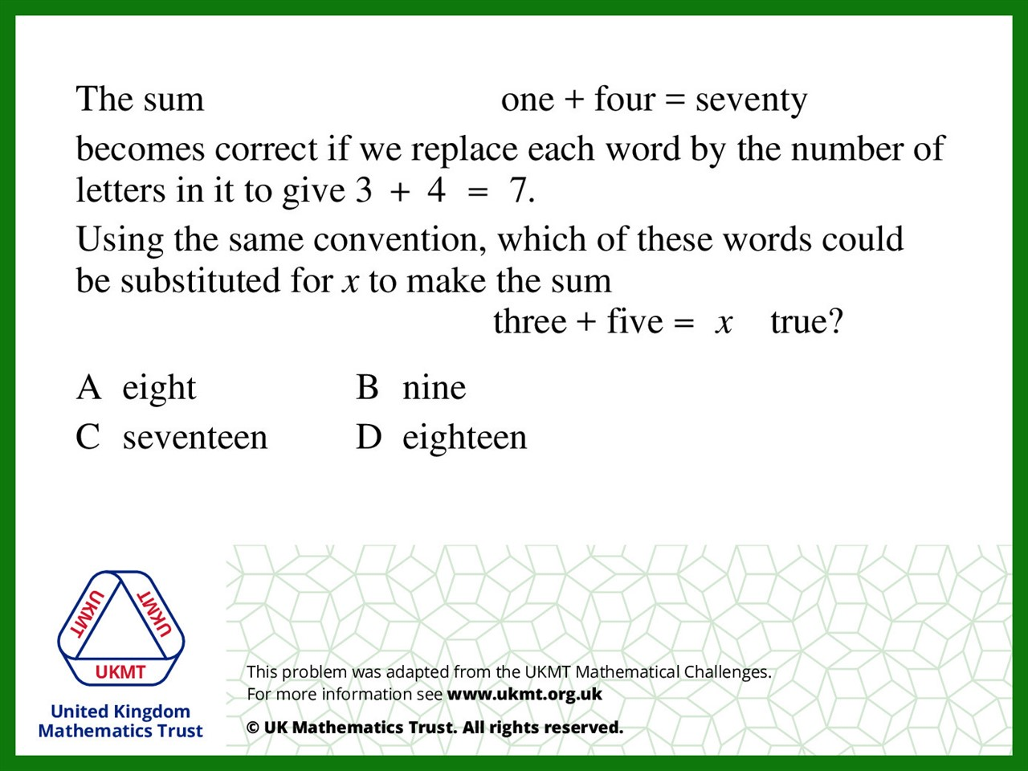
Q1.
Three = 5
Five = 4
5 + 4 = 9
Seventeen = 9 letters

Slide 3
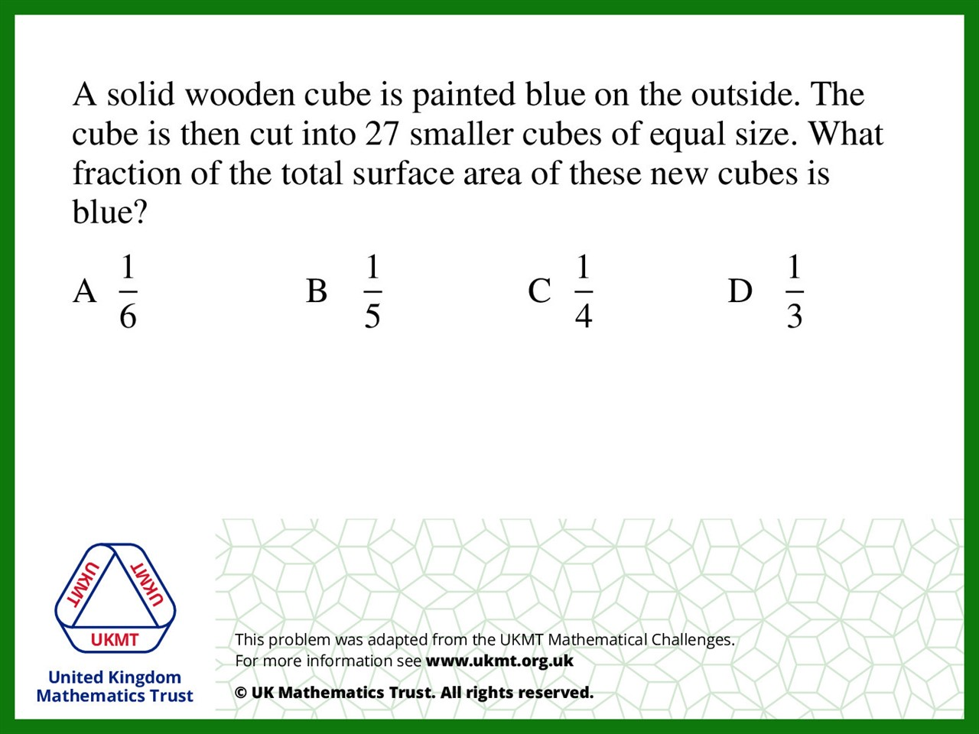
Q2.
There will be 162 cube faces in total with 27 cubes (27 x 6)
54 of these will be painted blue (9x6)
54/162 = 1/3

Slide 4
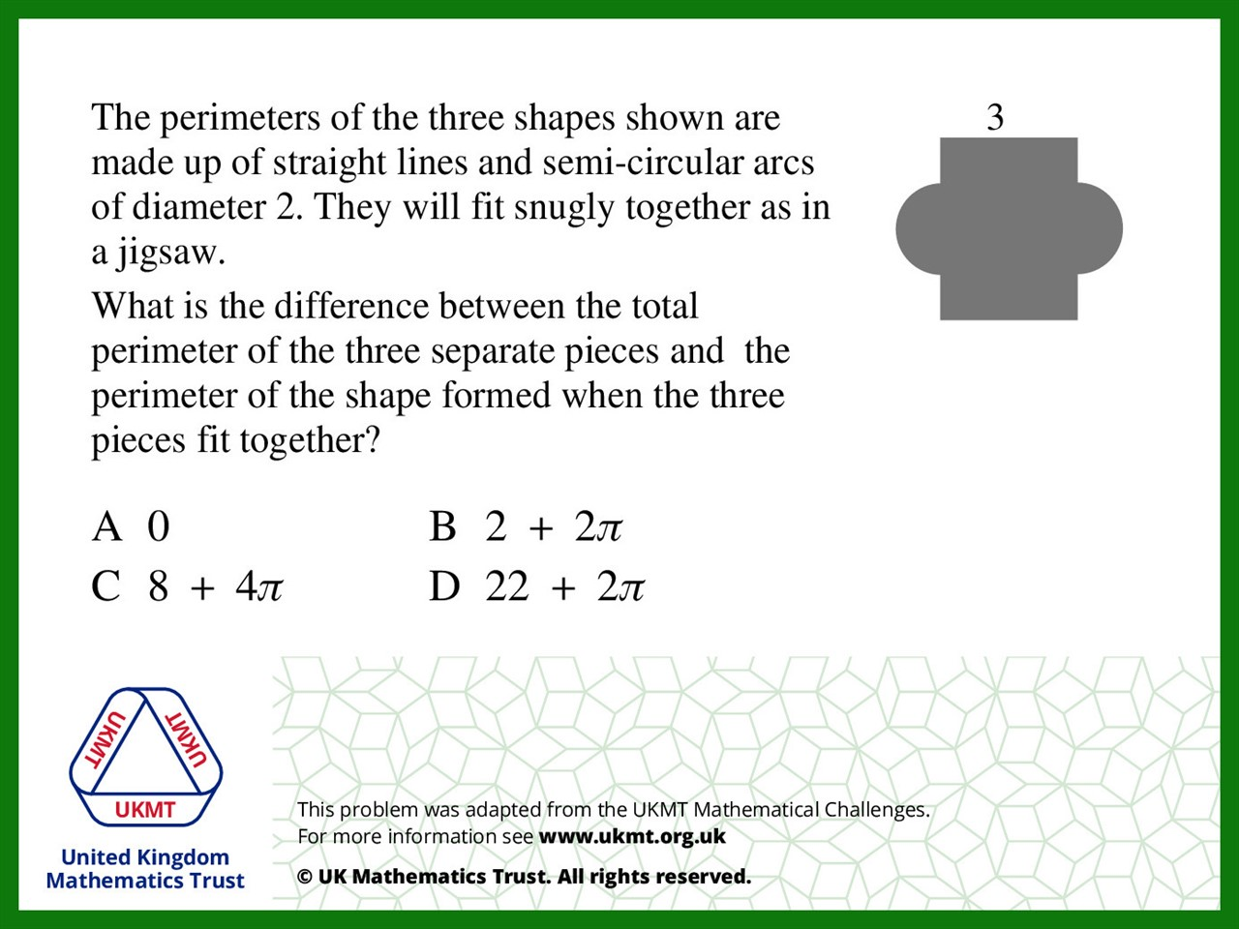
Q3.
Perimeter of Arcs 2(2πr)
r = 1 so Perimeter of Arcs is 4π
C is the only answer with 4π

Slide 5
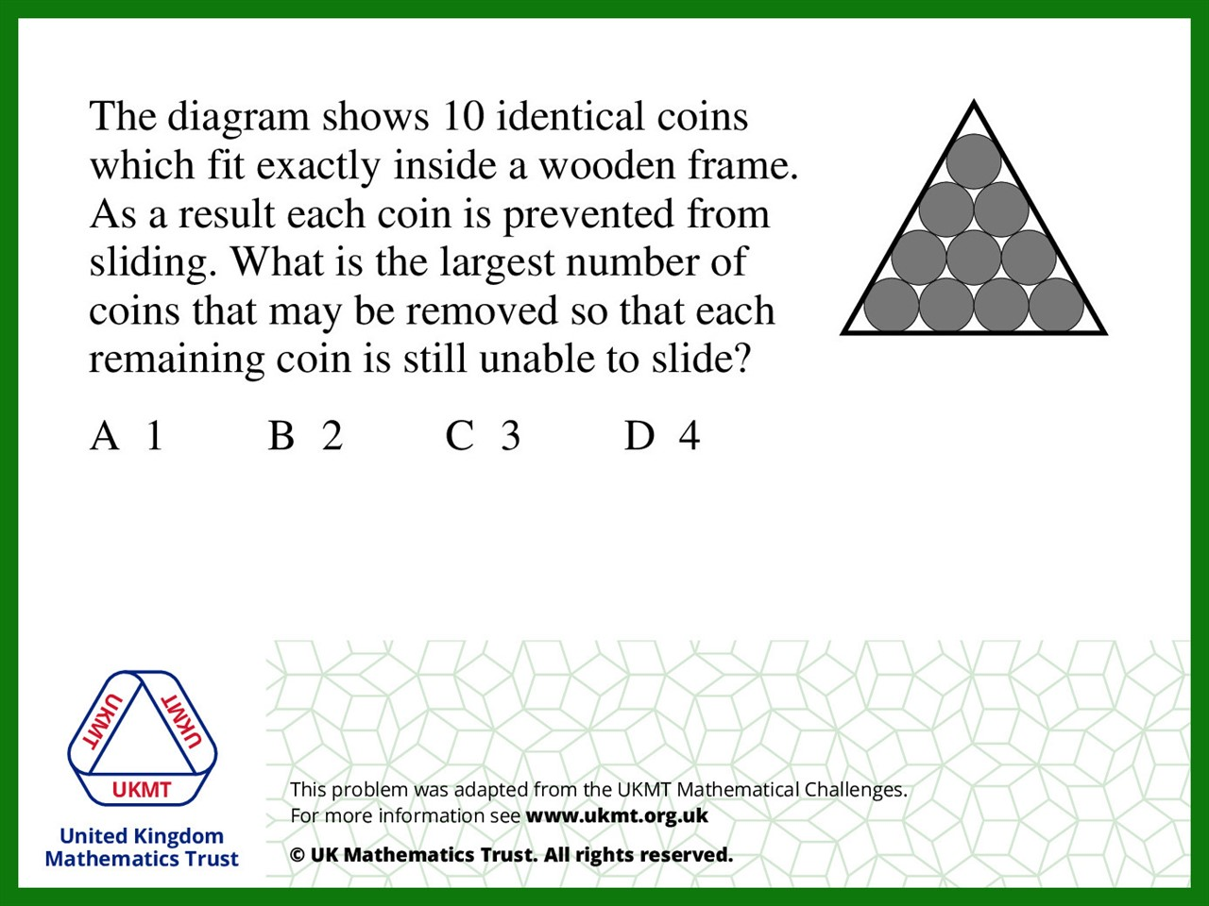
Q4.
If the coins at three corners and the coin in the middle gets removed, remaining coins will still be unable to slide.

Slide 6
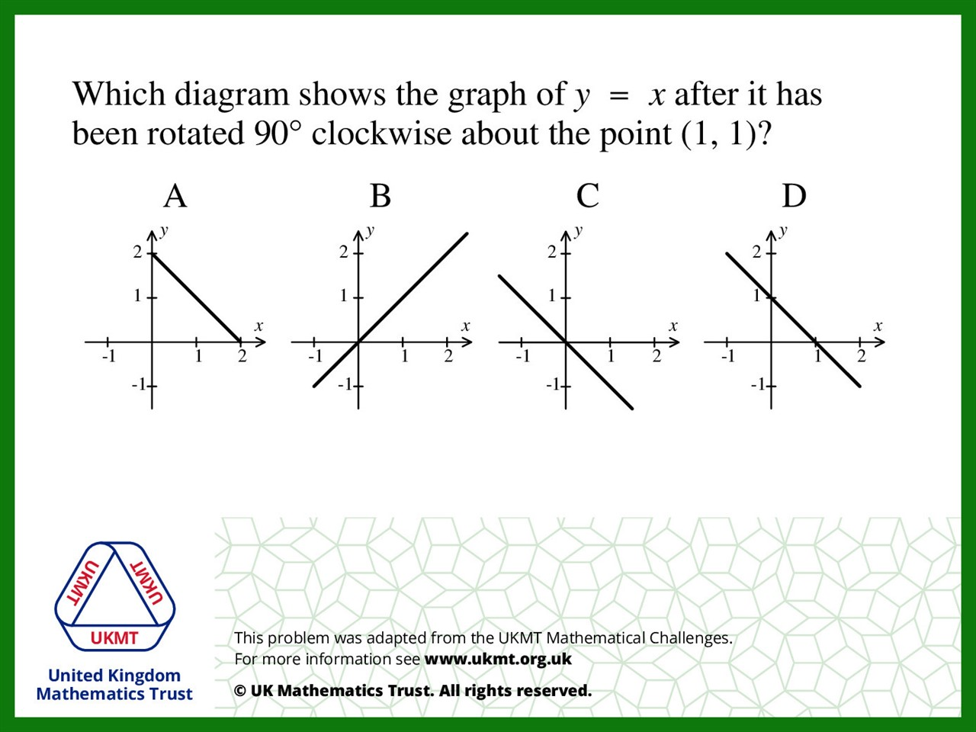
Q5.
If you rotate 90 clockwise about point (1,1), it will turn into the line passing first quadrant and passing (2,2).

