Slide 1

Diagnostic Assessment .Delta 2
Unit 4
Conversion Graphs
Distance Time Graphs
Rates of Change Graphs
Misleading Graphs

Slide 2
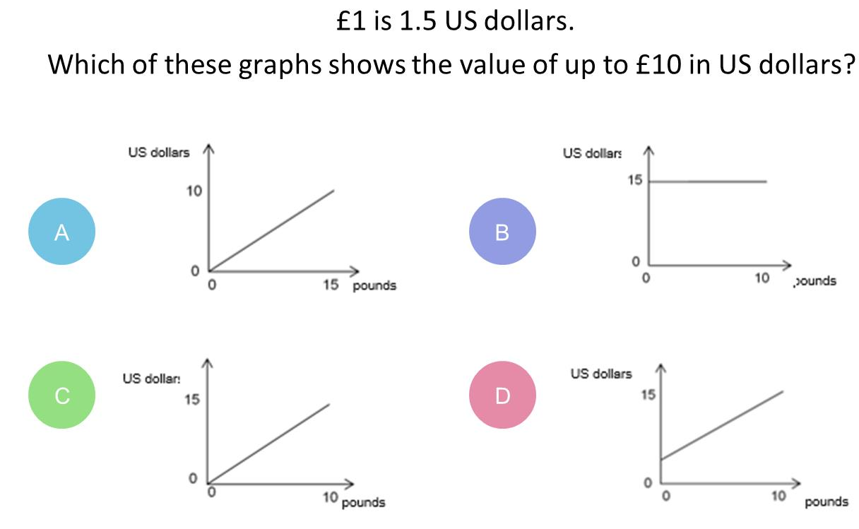
Question 1 – Conversion Graphs

Slide 3
Answer 1 – Conversion Graphs
CORRECT ANSWER | CORRECT EXPLANATION
C | The gradient is 15/10 = 1.5, and the intercept is 0, which would be the correct graph.
COMMON MISTAKES | WHAT MIGHT BE YOUR MISTAKE
A | The student has answered as if £1.5 = $1.
B | The student has not recognised that the graph should have a gradient.
D | The student has not recognised that the graph should start at (0,0).

Slide 4
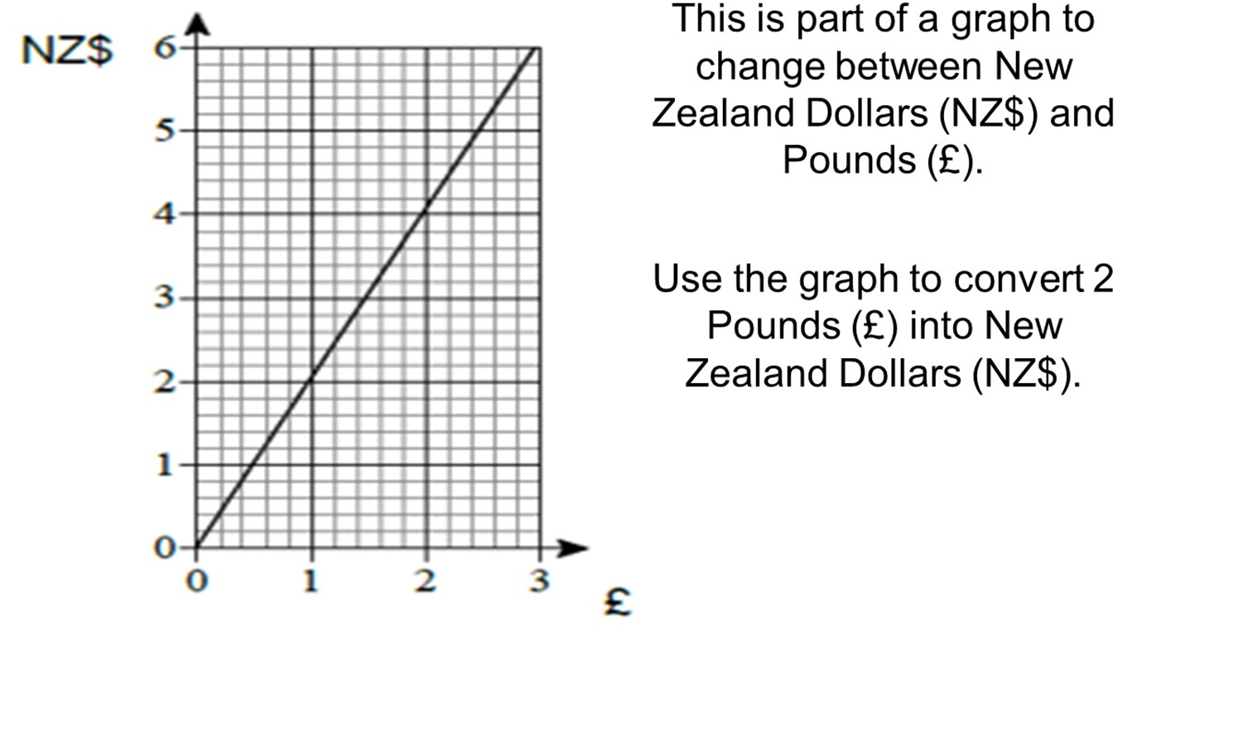
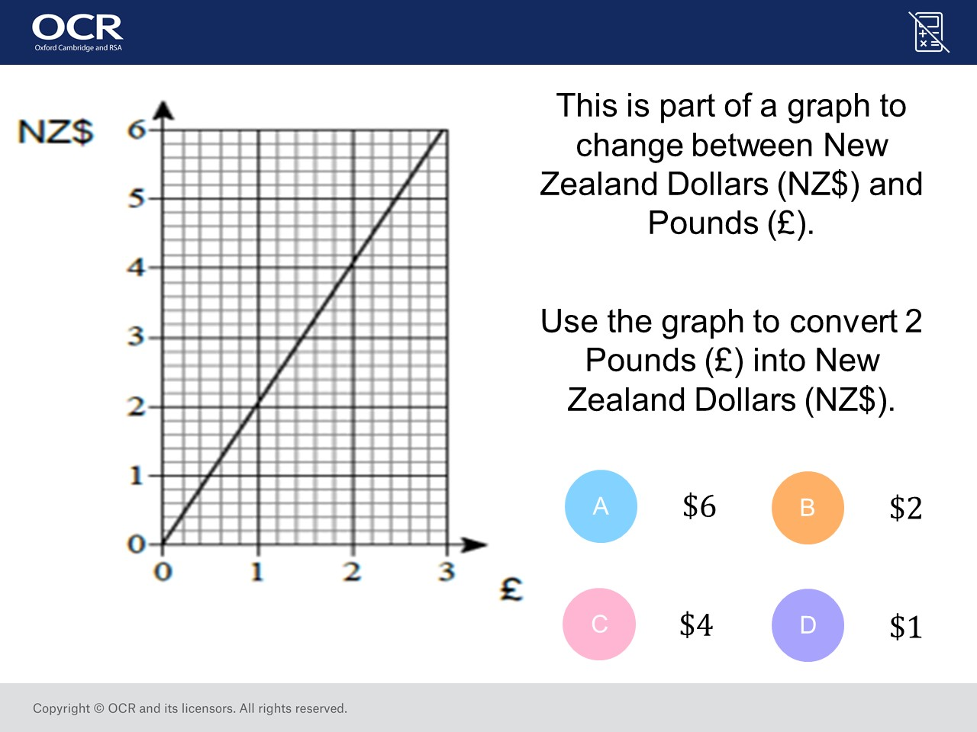
Question 2 – Conversion Graphs

Slide 5
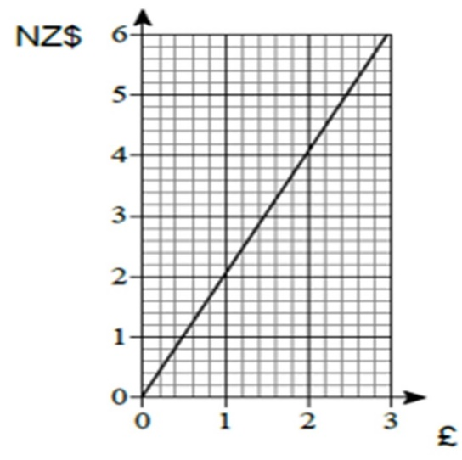
Answer 2 – Conversion Graphs
CORRECT ANSWER | CORRECT EXPLANATION
$4 | Read off 2 from the bottom axis up to the line, and then read across to 4 on the vertical axis.
COMMON MISTAKES | WHAT MIGHT BE YOUR MISTAKE
$6 | The student has chosen the extreme part of the graph.
$2 | The student has assumed a 1:1 conversion.
$1 | The student has found the reverse conversion, NZ$ to £.

Slide 6
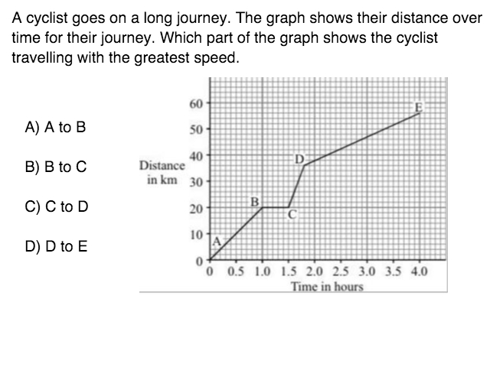
Question 3 – Distance Time Graph

Slide 7
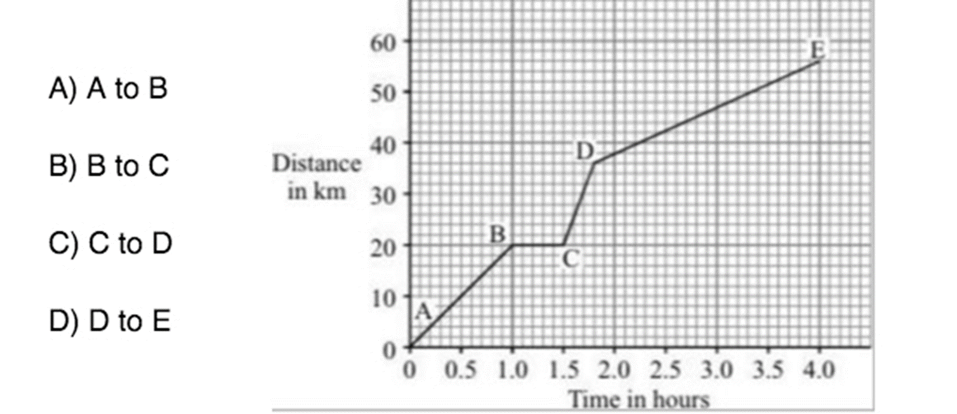
Answer 3 – Distance Time Graph
CORRECT ANSWER | CORRECT EXPLANATION
C | Because the gradient of the line is the speed and the line from C to D has the steepest gradient so it's speed is the fastest
COMMON MISTAKES | WHAT MIGHT BE YOUR MISTAKE
A | The student did not recongise that C to D is steeper.
B | The student thinks the it is the quickest across the x axis.
D | The student has chosen the highest part on the y axis.

Slide 8
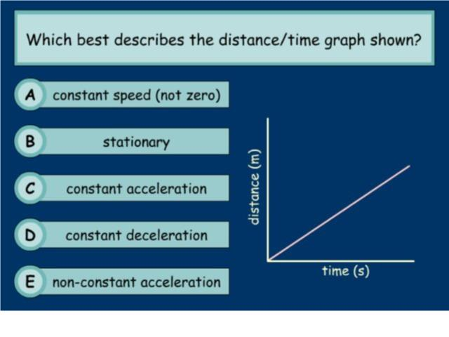
Question 4 – Distance Time Graphs

Slide 9
Answer 4 – Distance Time Graphs
CORRECT ANSWER | CORRECT EXPLANATION
A | The graph is linear (straight) therefore it has constant speed.
COMMON MISTAKES | WHAT MIGHT BE YOUR MISTAKE
C | Acceleration is the change of speed over time. This graph is distance over time
D | Deceleration is the change of speed over time (plus the graph would be downhill). This graph is distance over time.
E | The graph would be curved.

Slide 10
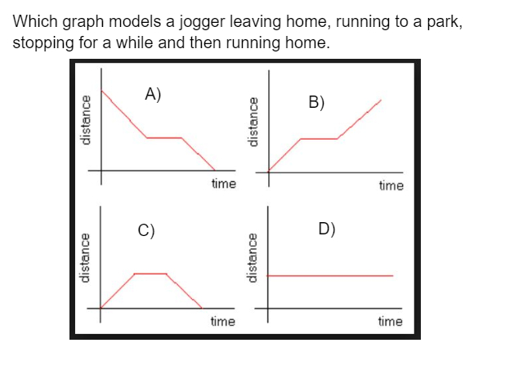
Question 5 – Distance Time Graphs

Slide 11
Answer 5 – Distance Time Graphs
CORRECT ANSWER | CORRECT EXPLANATION
C | Uphill = running away from home. Flat = stopped. Downhill = running home
COMMON MISTAKES | WHAT MIGHT BE YOUR MISTAKE
A | This graph starts with a distance shown on the y axis already, the jogger would start at zero at home and gain distance from home
B | this graph starts at home at zero, stops but then continues will more distance from home (zero) instead of returning back to zero distance (back home)
D | This graph shows a constant distance from home and therefore shows no distance from home extra with time so not moving

Slide 12
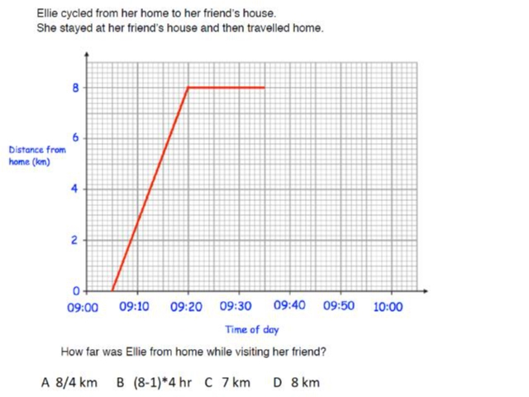
Question 6 – Distance Time Graphs

Slide 13
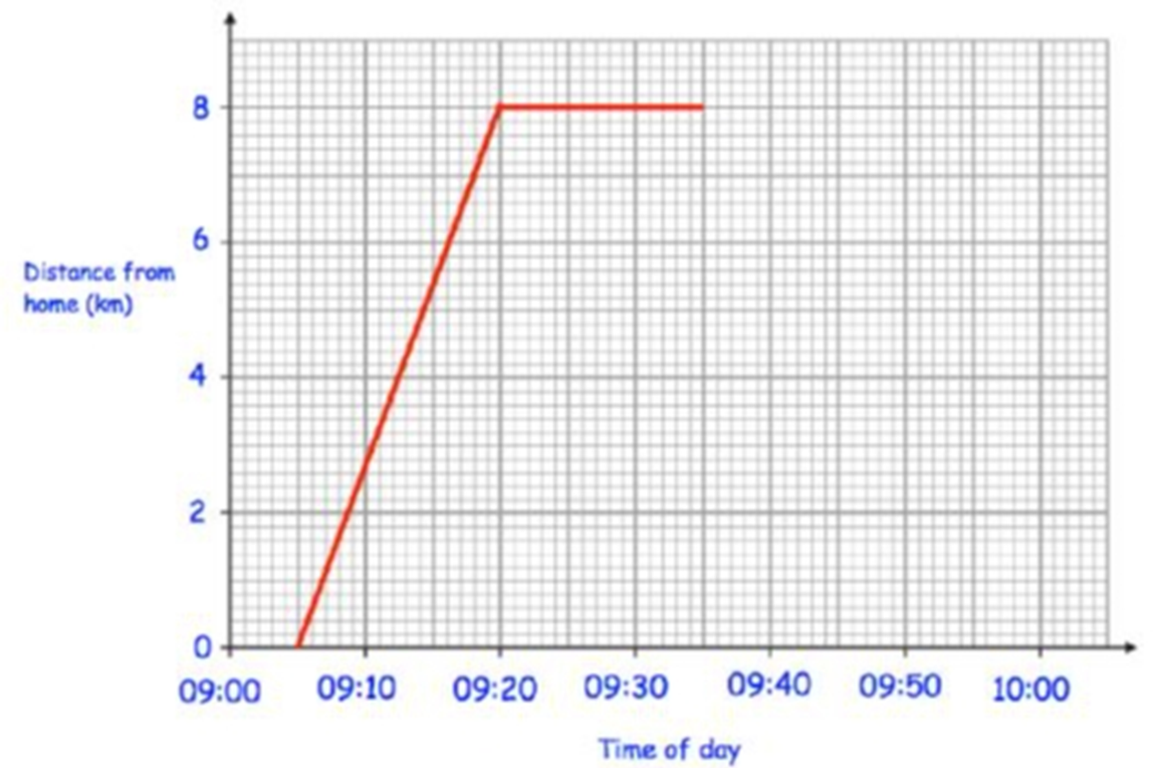
Answer 6 – Distance Time Graphs
CORRECT ANSWER | CORRECT EXPLANATION
8 | starting at 0km she travelled 8km in 15 mins from 9.05 to 9.20 while travelling to her friends house
COMMON MISTAKES | WHAT MIGHT BE YOUR MISTAKE
9.40 | just look at the distance from 0 to 8km along the y axis that was travelled from 9.05 to 9.20 while she travelled to her friends house, that is all required
30 | just look at the distance from 0 to 8km along the y axis that was travelled from 9.05 to 9.20 while she travelled to her friends house, that is all required.

Slide 14
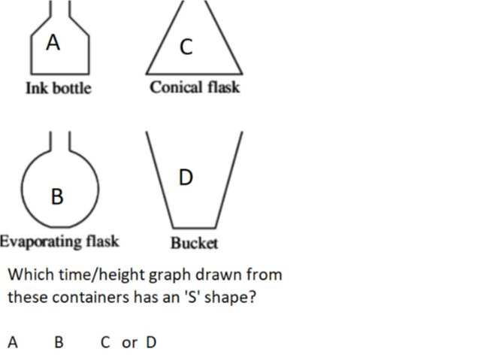
Question 7 – Rates of Change Graphs

Slide 15
Answer 7 – Rates of Change Graphs
CORRECT ANSWER | CORRECT EXPLANATION
B | The round bottle shape is gradually changing with time, firstly getting wider then changing back to narrower again
COMMON MISTAKES | WHAT MIGHT BE YOUR MISTAKE
A | his container has straight sides so will have straight lines on the graph changing suddenly as the container sides change
C | This container has straight sides so will have straight lines on the graph changing suddenly as the container sides change
D | This container has straight sides so will have straight lines on the graph changing suddenly as the container sides change

Slide 16
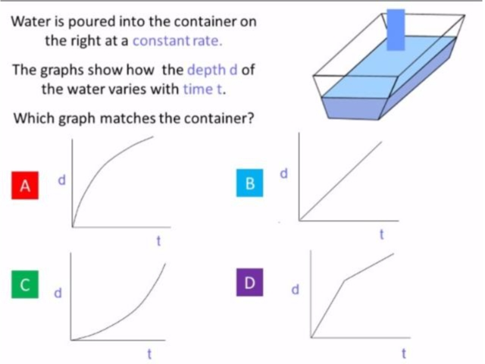
Question 8 – Rates of Change Graphs

Slide 17
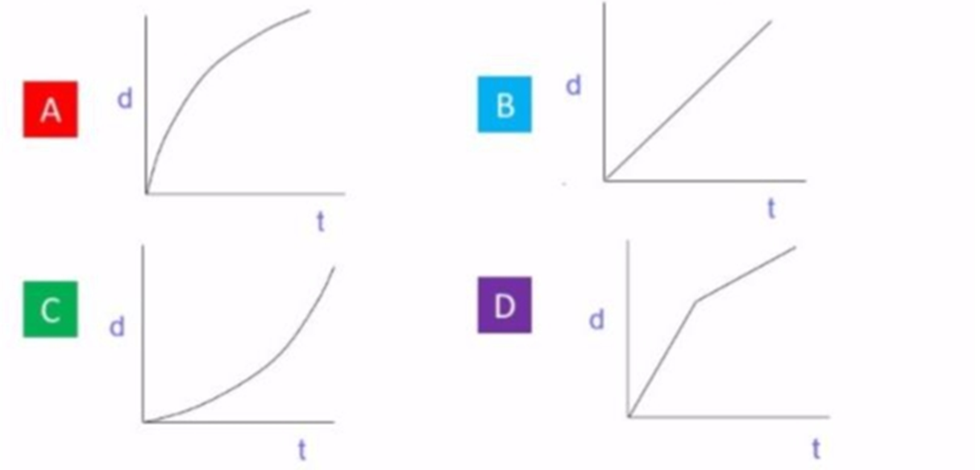
Answer 8 – Rate of Change Graphs
CORRECT ANSWER | CORRECT EXPLANATION
A | The rate at which the water raised slows down with time as more water is required to get the level to rise with time
COMMON MISTAKES | WHAT MIGHT BE YOUR MISTAKE
B | this is a straight line but the rate at which the water depth changes decreases with time and does not stay constant
C | this shows an increasing rate with time but the water height will slow with time instead as more water is needed to raise the water level
D | the graph there is a sudden change but this does not happen in the water tank as it is a gradual slowing of height with time

