Slide 1
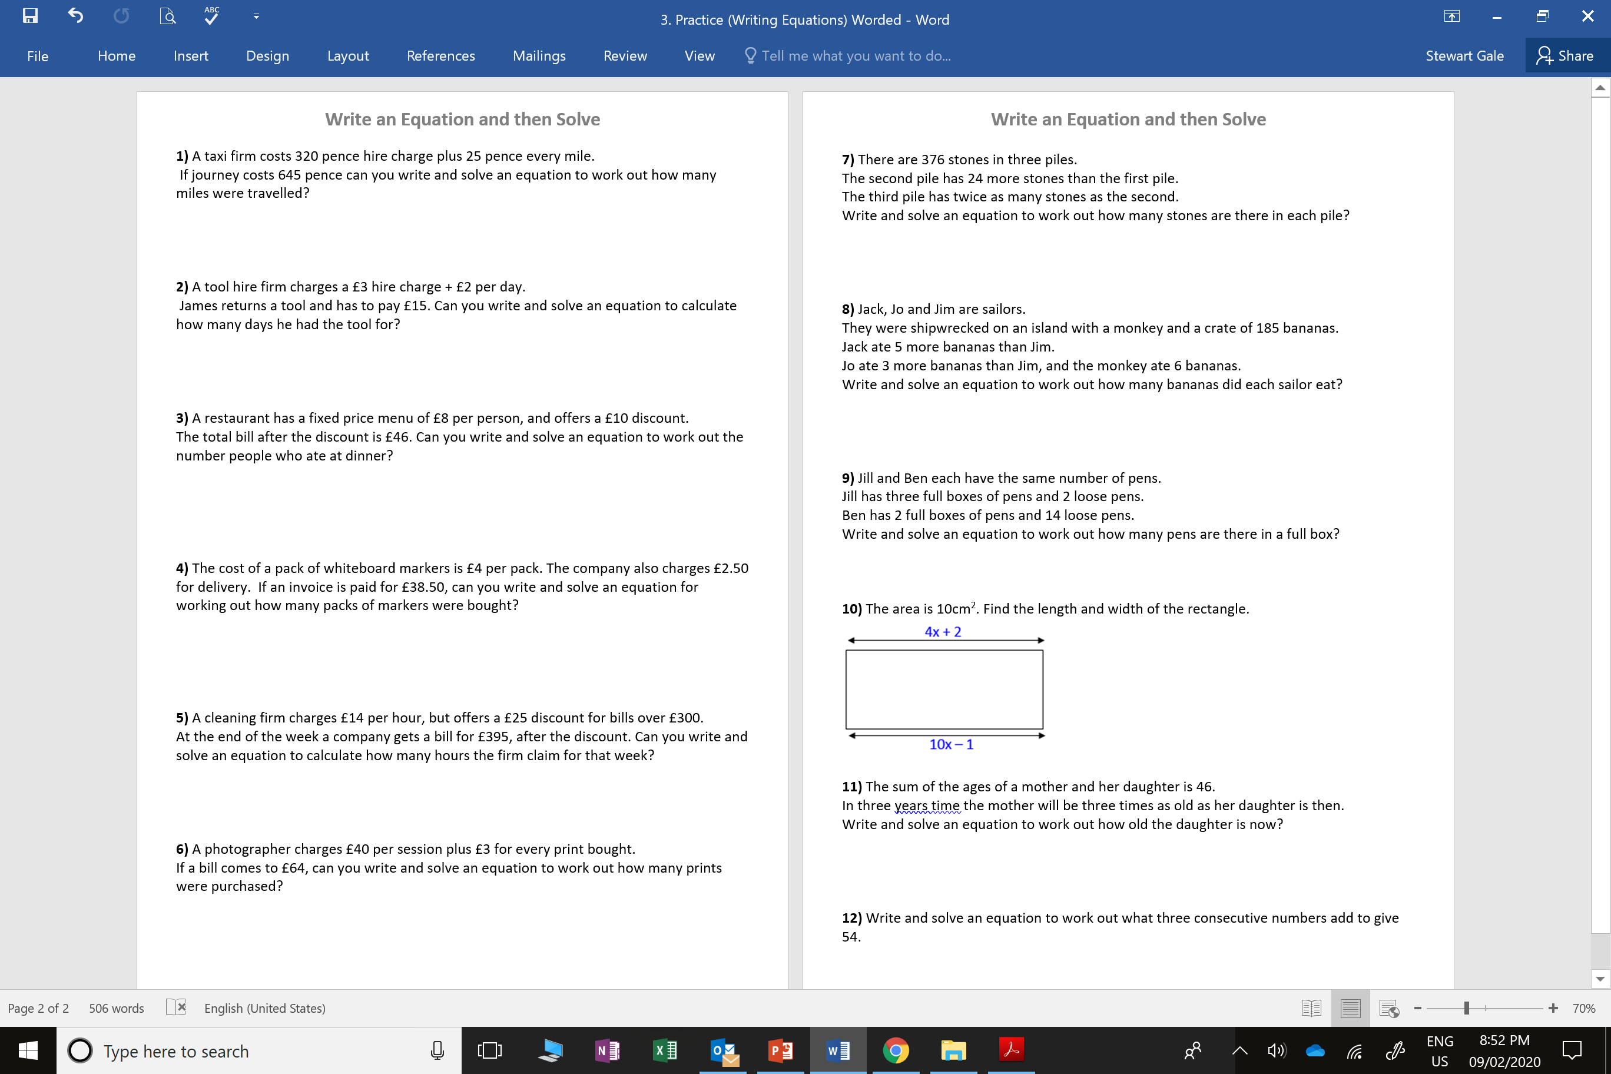

Slide 2
ANSWERS

Slide 3
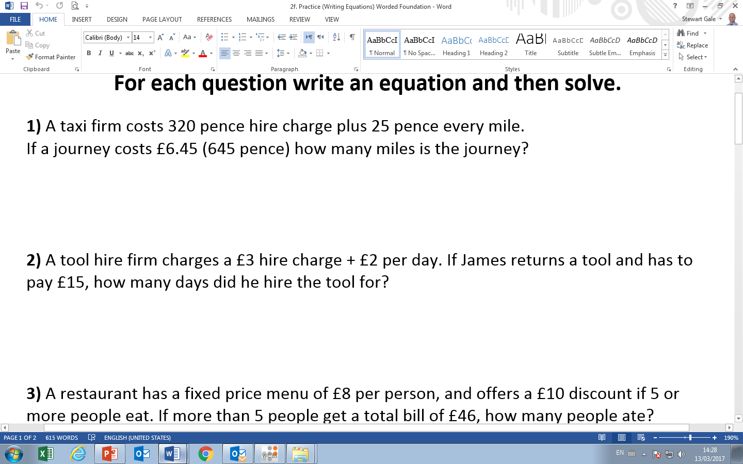
25m + 320 = 645
m = 13

Slide 4
2d + 3 = 15
d = 6

Slide 5
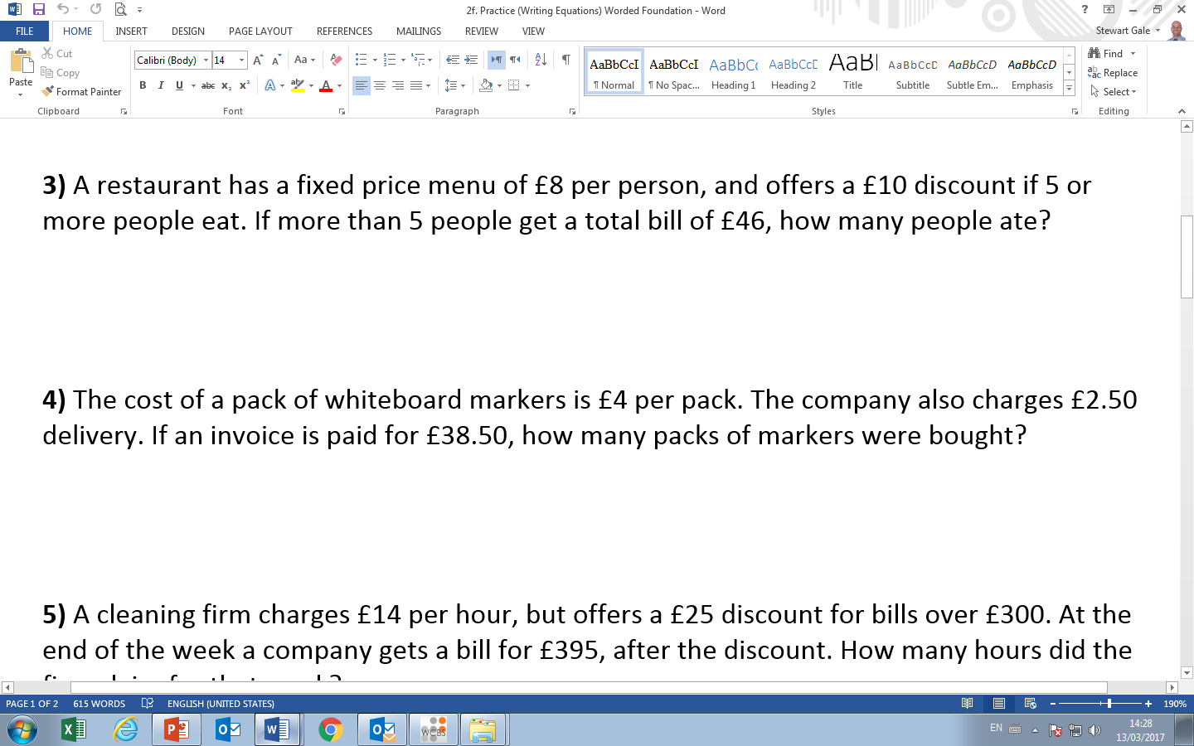
8p - 10 = 46
p = 7

Slide 6
4p + 2.5 = 38.5
p = 9

Slide 7
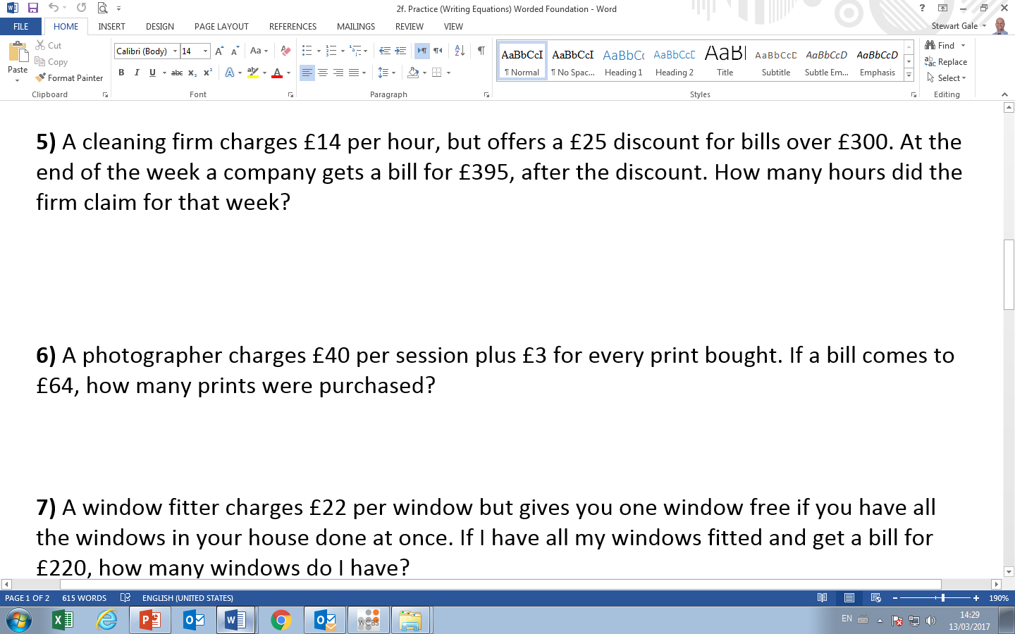
14h – 25 = 395
h = 30

Slide 8
3p + 40 = 64
p = 8

Slide 9
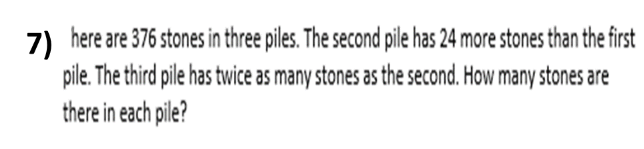
x + x + 24 + 2(x + 24) = 376
76, 100, 200
4x + 72 = 376
4x + 72 = 304
4x + 72 = 376

Slide 10
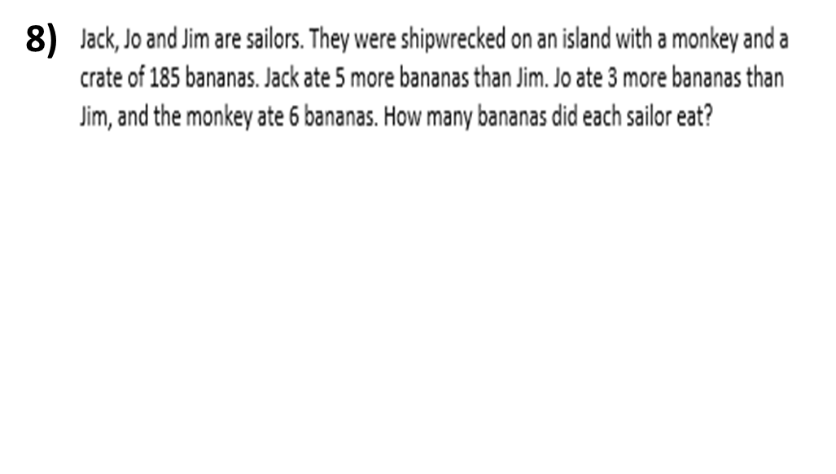
x + x + 5 + x + 3 + 6 = 185
3x + 14 = 185
3x + 72 = 171
4x + 72 = 357
57, 62, 60

Slide 11
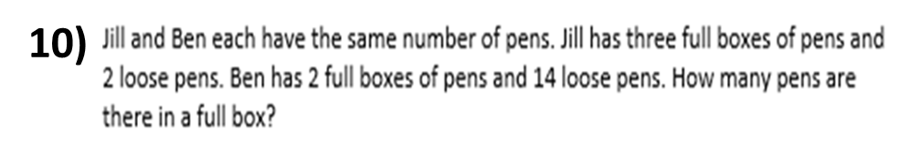
9)
3x = 2x + 14
2x = 12

Slide 12
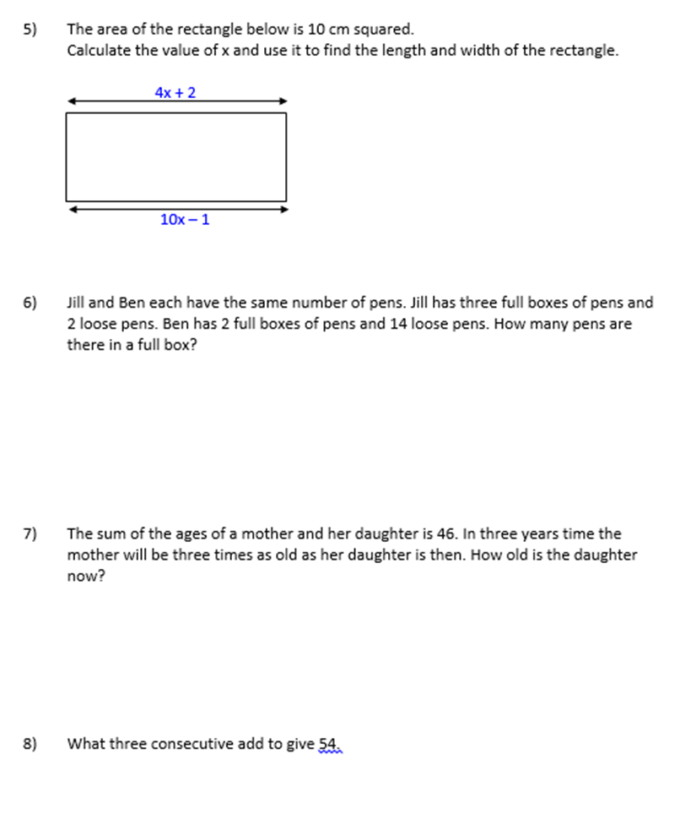
10)
9)
4x + 2 = 10x - 1
4x + 3 = 16x - 1
2x = 0.5
Length = 4
Width = 2.5

Slide 13
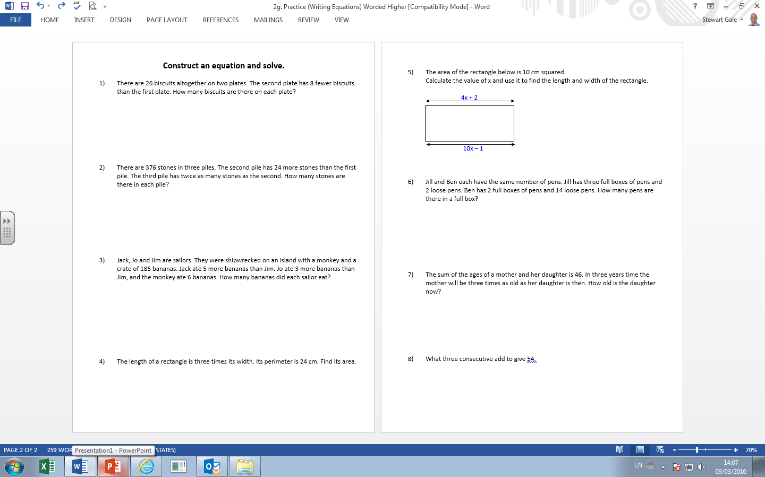
11)
x + 3 + 3(x + 3) = 46
4x + 12 = 52
4x + 12 = 10
4x + 12 = 40
10 and 36

Slide 14
12)
x + x + 1 + x + 2 = 54
3x + 3 = 54
3x + 3 = 51
3x + 3 = 17
17, 18 and 19

