Slide 1
LO: Number
Sequences

Slide 2
What are the next letters in the sequence?
O | T | T | F | F | S | S | E
N | W | H | O | I | I | E | I
E | O | R | U | V | X | V | G
 |  | E | R | E |  | E | H
 |  | E |  |  |  | N | T

Slide 3
A list of numbers that follows
a pattern is called a sequence.
2, 4, 6, 8, 10, 12, 14,.....

Slide 4
Each number in a sequence is called a term.
2, 4, 6, 8, 10, 12,....
What is the 5th term?
10

Slide 5
Generating Sequences
To generate a sequence, what two things do you need to know?
Rule
Starting Number

Slide 6
Generating Sequences
Rule | Term 1 | Term 2 | Term 3 | Term 4 | Term 5
Add 5 | -2
Add 5 | 3
3 | 8 | 13 | 18
8 | 13 | 18 | 23

Slide 7
Term to Term Rules
Find the next two numbers in each sequence
5, 11, 17, 23, 29,
35, 41

Slide 8
Term to Term Rules
Find the next two numbers in each sequence
4, 1, -2, -5, -8,
-11, -14

Slide 9
Term to Term Rules
Find the next two numbers in each sequence
3, 6, 12, 24, 48,
96, 192

Slide 10
Term to Term Rules
Find the next two numbers in each sequence
1, 4, 9, 16, 25,
36, 49

Slide 11
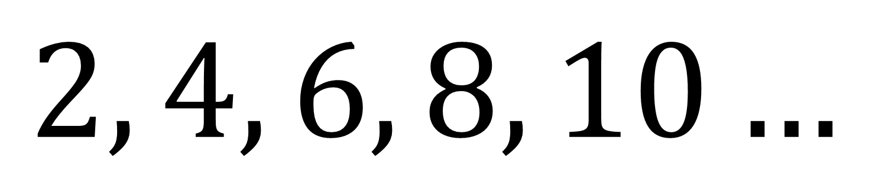
What is the 10th term
in the sequence?
$$2, 4, 6, 8, 10…$$
20

Slide 12
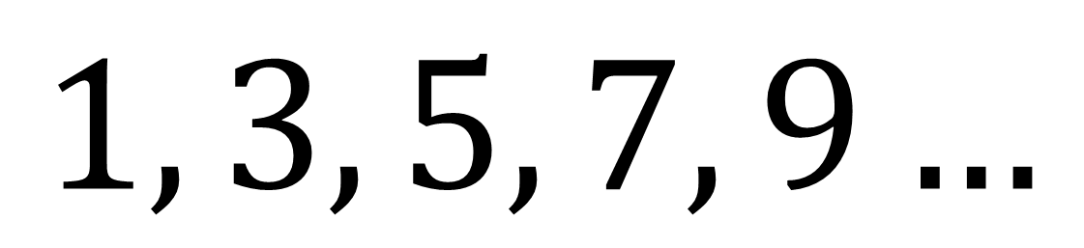
What is the 10th term
in the sequence?
$$1, 3, 5, 7, 9…$$
19

Slide 13
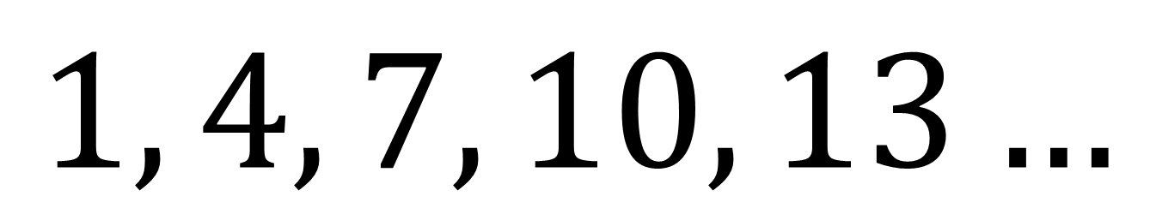
What is the 10th term
in the sequence?
$$1, 4, 7, 10, 13…$$
28

Slide 14
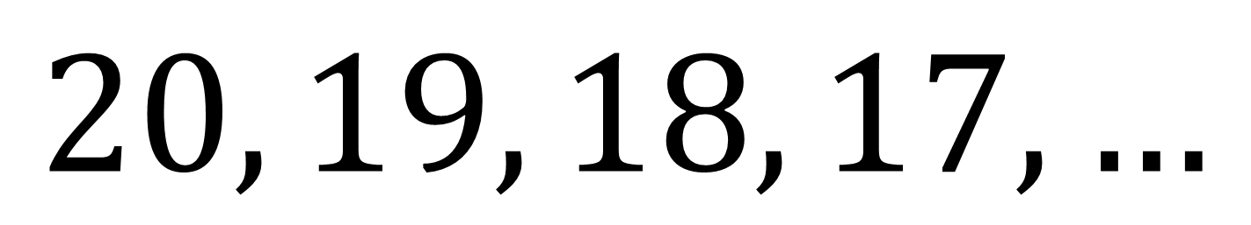
What is the 10th term
in the sequence?
$$20, 19, 18, 17, …$$
11

Slide 15
What sequences can you name?
Even
Squared
Odd
Cubed
Fibonacci
Triangular

Slide 16
Some sequences are special and are worth
learning about.

Slide 17

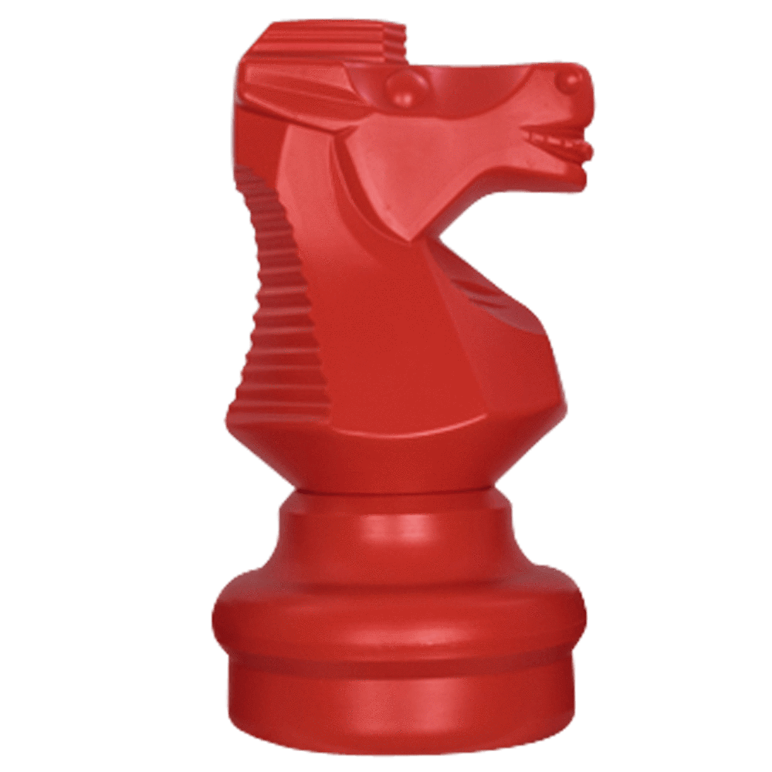
Squared Numbers
36
1 | 4 | 9 | 16 | 25
10
11
12
13
14
15
16
16
25
36
1
4
9
17

Slide 18
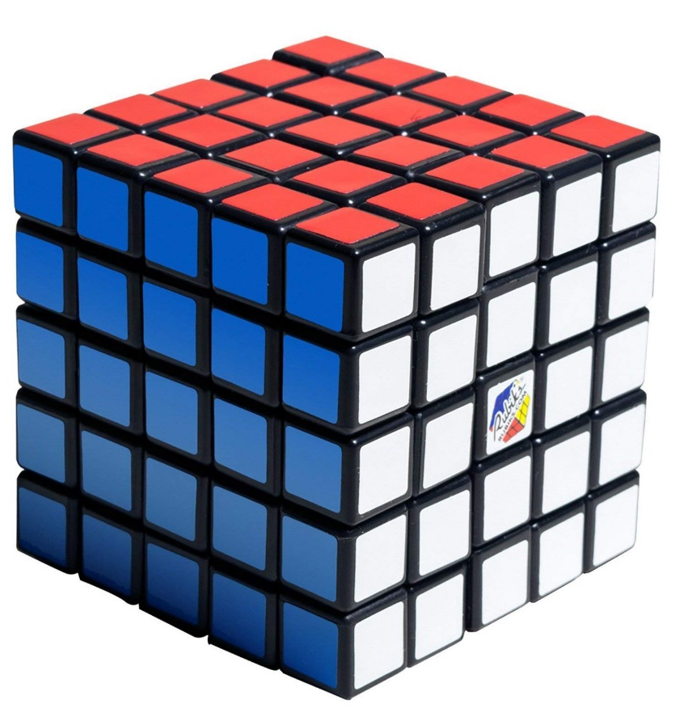
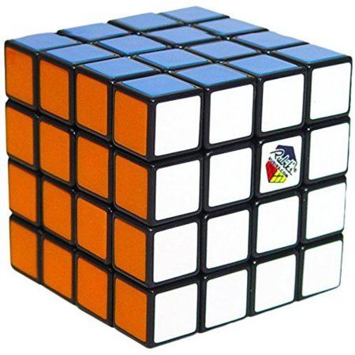
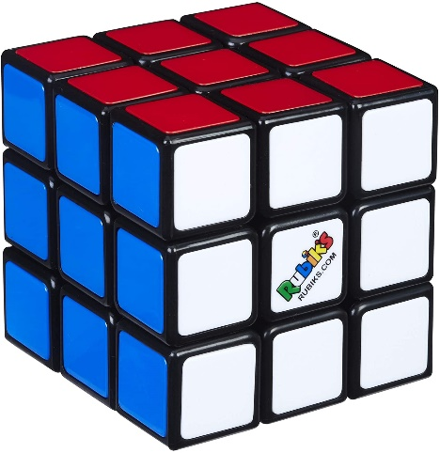
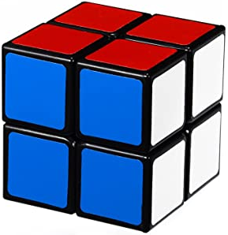
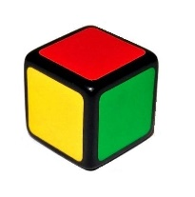
Cubed Numbers
216
1 | 8 | 27 | 64 | 125

Slide 19

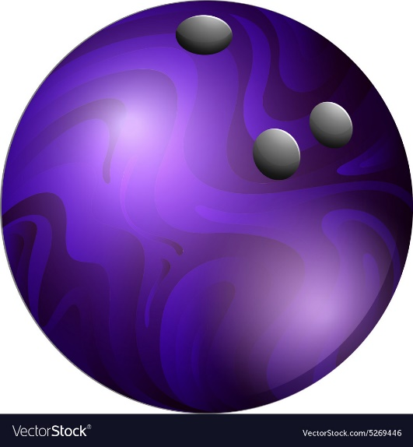
Triangular Numbers
21
1 | 3 | 6 | 10 | 15
10
9
8
7
6
5
4
3
2
1

Slide 20
Adding Triangular Numbers
What do you notice when you add two consecutive triangular numbers?
1
3
6
10
15

Slide 21
Adding Triangular Numbers
1 + 3 = 4
10 + 15 = 25
3 + 6 = 9
You get
square numbers.
6 + 10 = 16

Slide 22
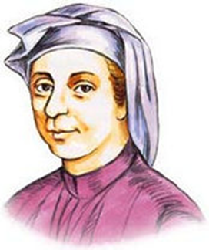
Fibonacci Sequence
1 | 1 | 2 | 3
5
8
13
21
34
55
You add the previous two numbers.

Slide 23
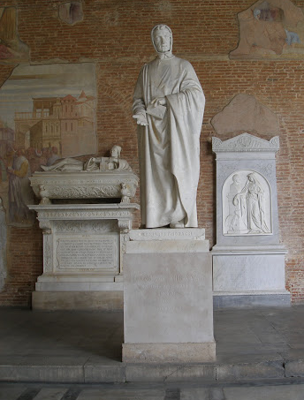
Full Name:
Nickname:
Born:
Died Age:
Famous For:
Interesting Fact:
Leonardo Pisano
Fibonacci
1170 in Pisa, Italy
80 years old
His Sequence.
In his honour
a statue of him was built in Pisa.

Slide 25
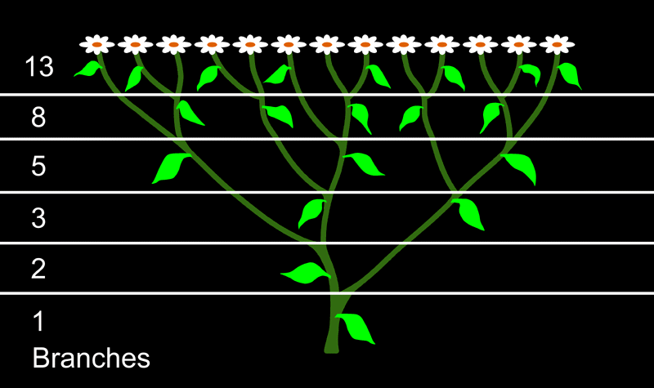
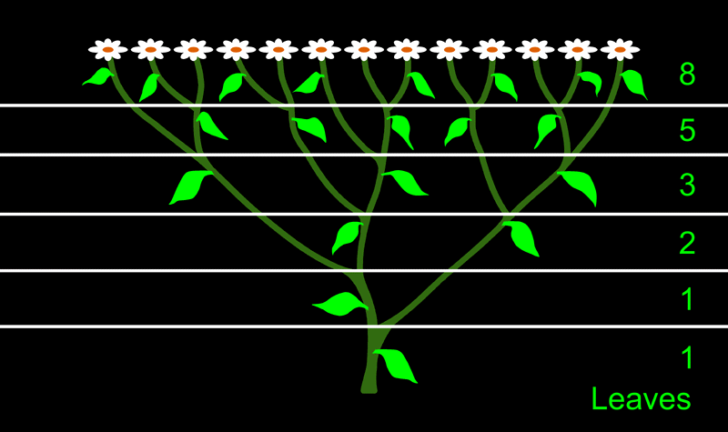
 | Fibonacci numbers can be found in leaves and stems.

Slide 26
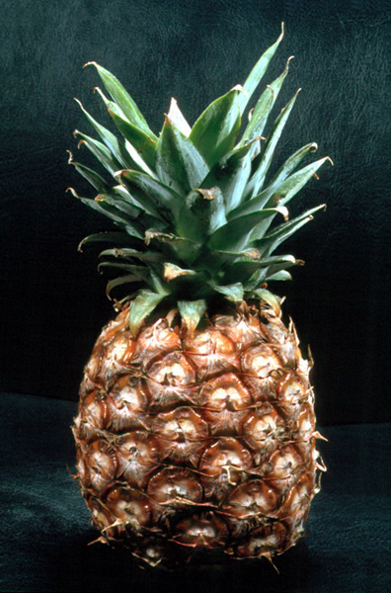
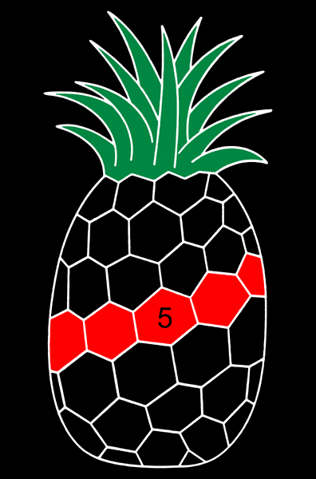
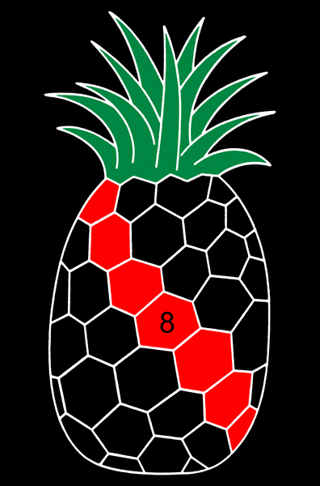
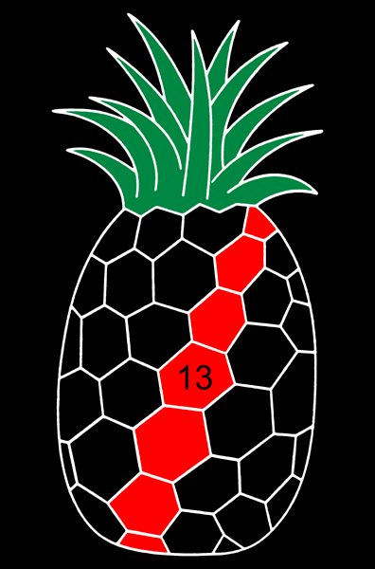
Fibonacci numbers can be found in pineapples.
Pineapple scales are patterned into spirals.

Slide 27
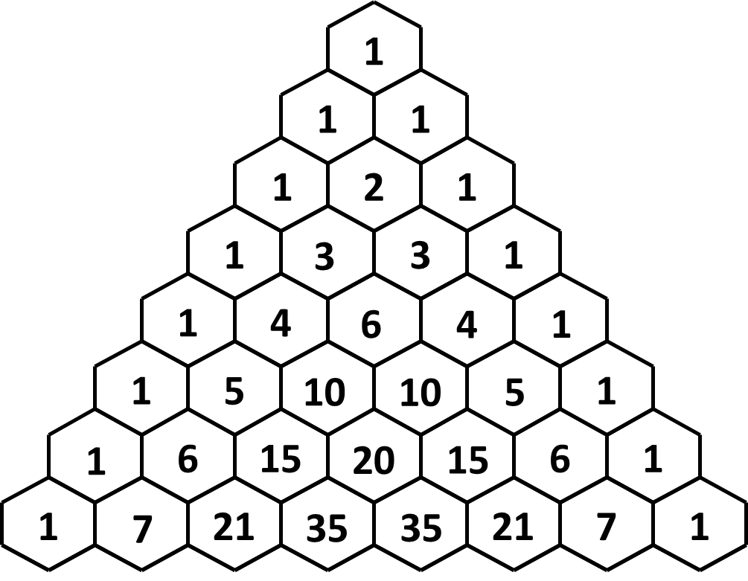
Pascals Triangle is a great source of sequences.

Slide 28
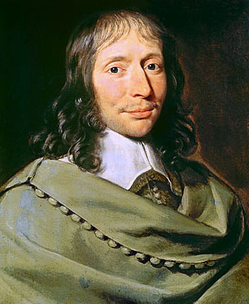
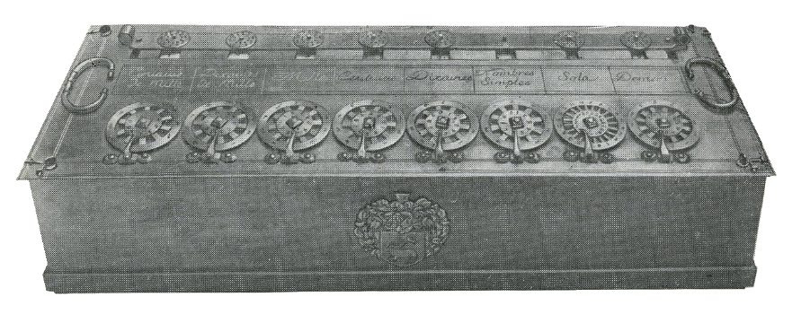
Full Name:
Nickname:
Born:
Died Age:
Famous For:
Interesting Fact:
Blaise Pascal
Pascal
1623 in Clermont, France
39 years old
His triangle
Pascal invented
the worlds first fully functional
calculator at the age of 19

Slide 29
Can you work out how Pascal's triangle is made?
What are the missing numbers?
1
1
1
1
2
1
1
3
3
1
1
4
6
4
1
1
5
10
10
5
1
1
6
15
20
15
6
1
1
7
21
35
35
21
7
1
1
8
28
56
70
56
28
8
1

Slide 30
Spot triangular numbers in the triangle.
1
1
1
1
2
1
1
3
3
1
1
4
6
4
1
1
5
10
10
5
1
1
6
15
20
15
6
1
1
7
21
35
35
21
7
1

Slide 31
Spot squared numbers in the triangle.
1
1
1
1
2
1
1
3
3
1
1
4
6
4
1
1
5
10
10
5
1
1
6
15
20
15
6
1
1
7
21
35
35
21
7
1

Slide 32
Spot Fibonacci numbers in the triangle.
1
1
1
2
1
1
3
5
1
2
1
8
1
3
3
1
1
4
6
4
1
1
5
10
10
5
1
1
6
15
20
15
6
1
1
7
21
35
35
21
7
1

Slide 33
What do you notice about the hockey sticks?
1
1
1
1
2
1
1
3
3
1
1
4
6
4
1
1
5
10
10
5
1
1
6
15
20
15
6
1
1
7
21
35
35
21
7
1

