Slide 1
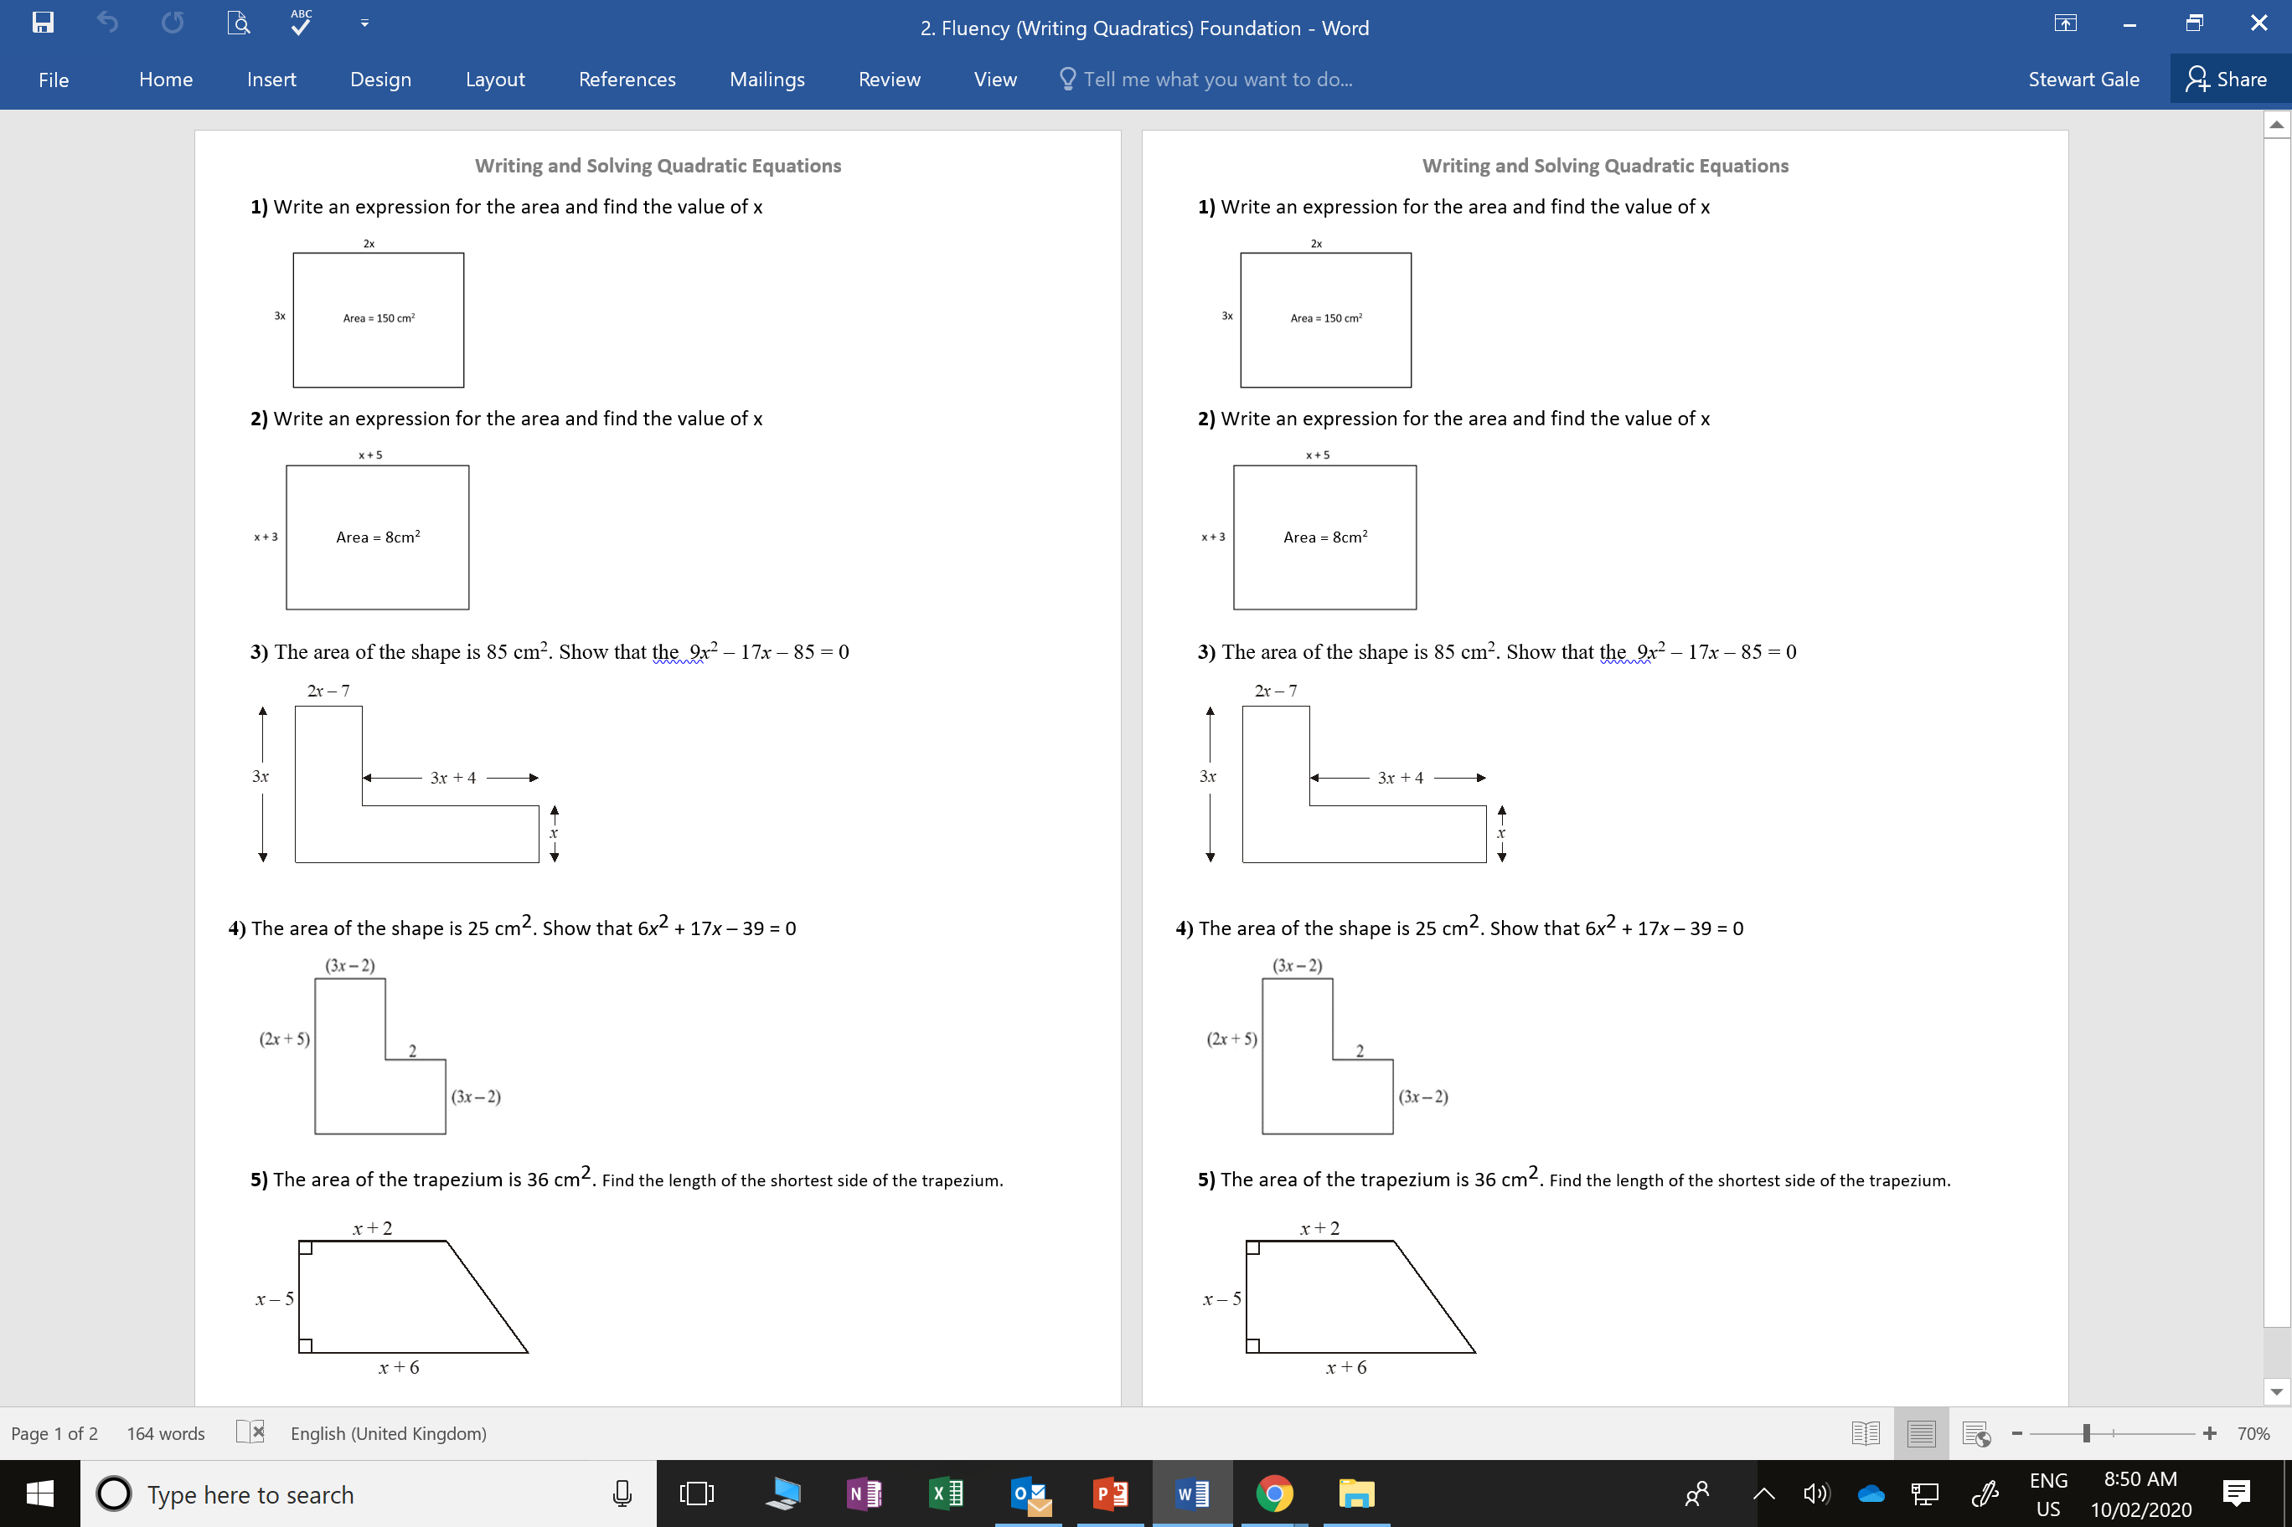

Slide 2
ANSWERS

Slide 3
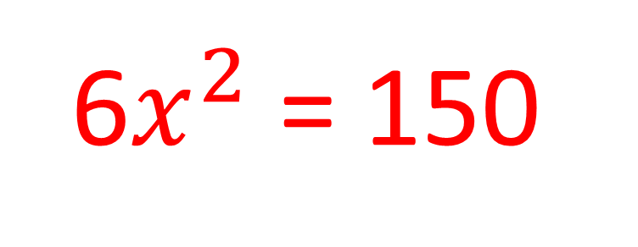
6$x^{2}$ = 150

Slide 4
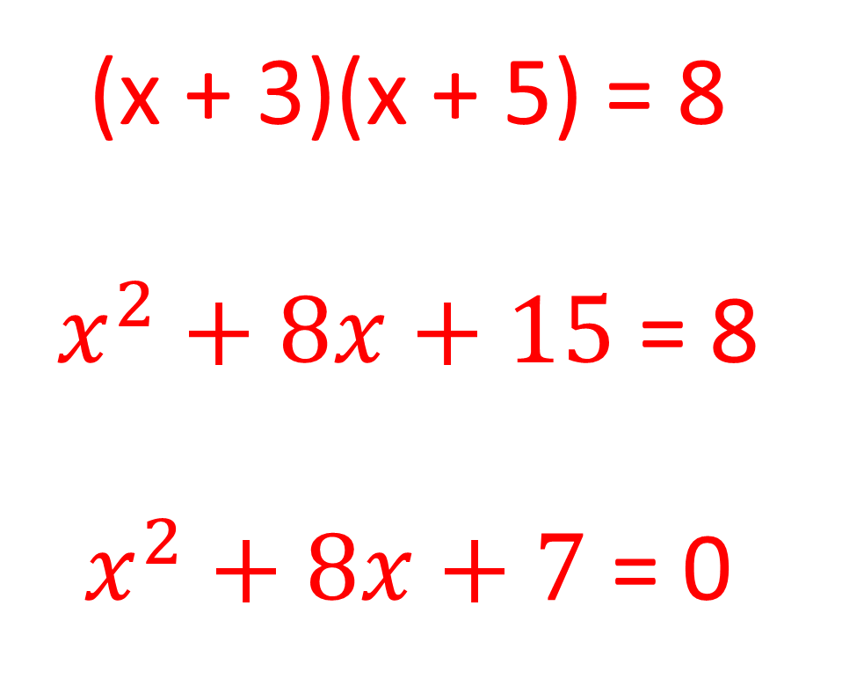
(x + 3)(x + 5) = 8
$x^{2}+8x+15$ = 8
$x^{2}+8x+7$ = 0

Slide 5
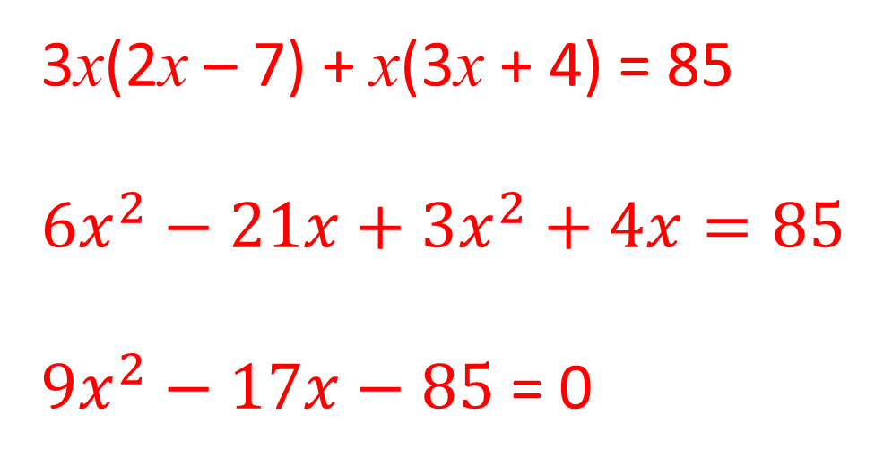
3x(2x – 7) + x(3x + 4) = 85
$${6x}^{2}−21x+{3x}^{2}+4x=85$$
${9x}^{2}−17x−85$ = 0

Slide 6
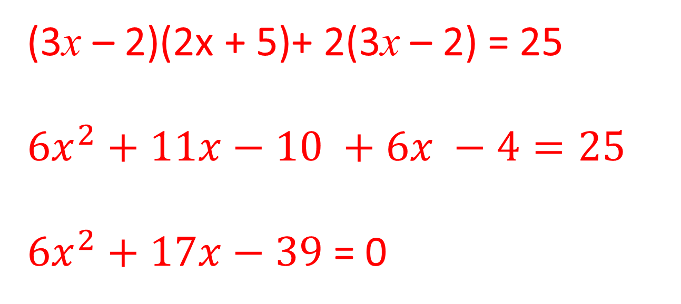
(3x – 2)(2x + 5)+ 2(3x – 2) = 25
$${6x}^{2}+11x−10 +6x −4=25$$
${6x}^{2}+17x−39$ = 0

Slide 7
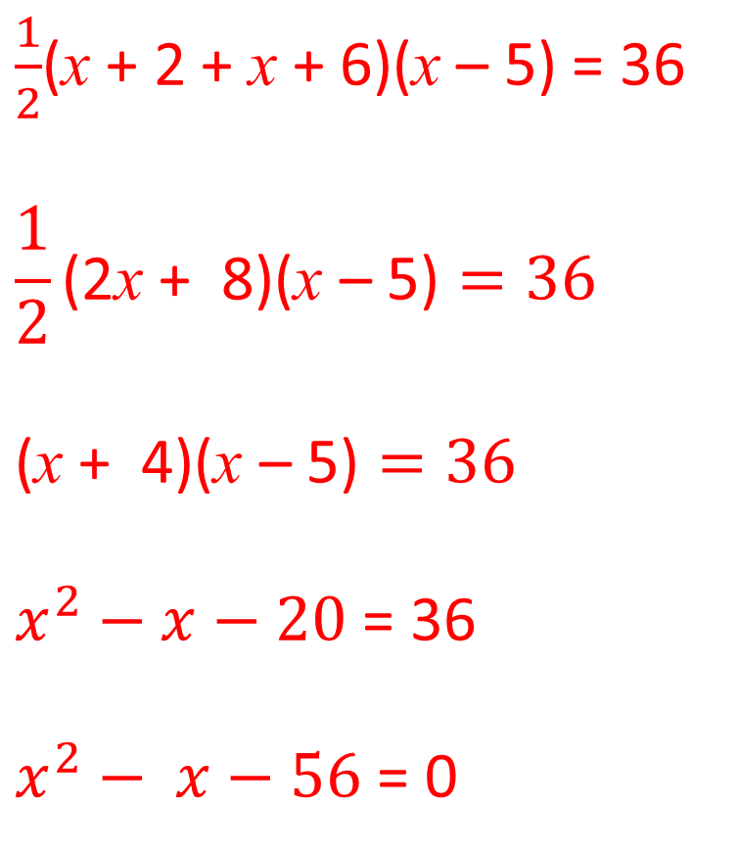
$\frac{1}{2}$(x + 2 + x + 6)(x – 5) = 36
$$\frac{1}{2}\text{(}\text{2}\text{x} \text{+} \text{8}\text{)(}\text{x} \text{–}\text{ 5}\text{)}=36$$
$$\text{(}\text{x} \text{+} \text{4}\text{)(}\text{x} \text{–}\text{ 5}\text{)}=36$$
$x^{2}−x−20$ = 36
$x^{2}− x−56$ = 0
(x – 8)(x + 7) = 0
x = 8 or -7
Shortest Side
(8 – 5) = 3

