Slide 1
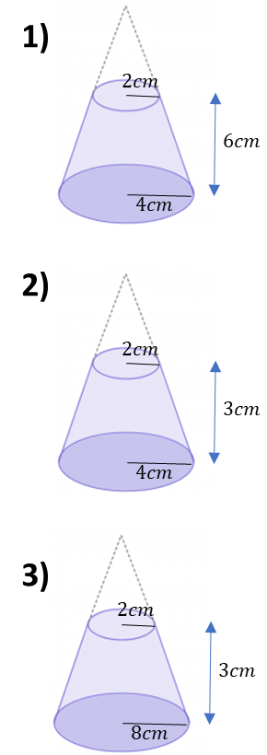
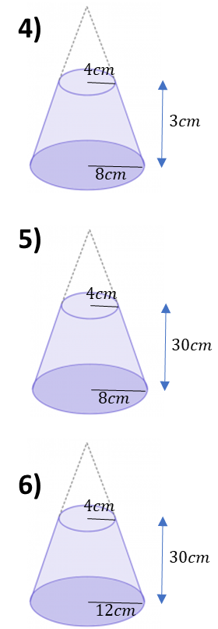
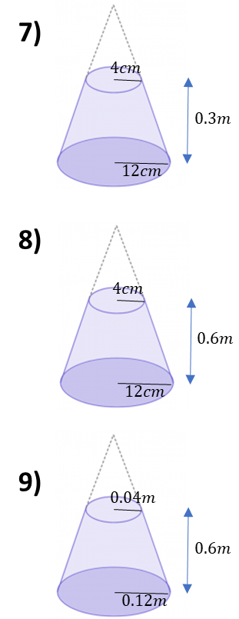
Find the volume of the frustums. Give you answers in terms of pi.

Slide 2
ANSWERS

Slide 3









Find the volume of the frustums. Give you answers in terms of pi.
$$122π cm^{3}$$
$$2080π cm^{3}$$
$$56π cm^{3}$$
$$28π cm^{3}$$
$$1120π cm^{3}$$
$$4160π cm^{3}$$
$$84π cm^{3}$$
$$2080π cm^{3}$$
$$4160π cm^{3}$$

