Slide 1
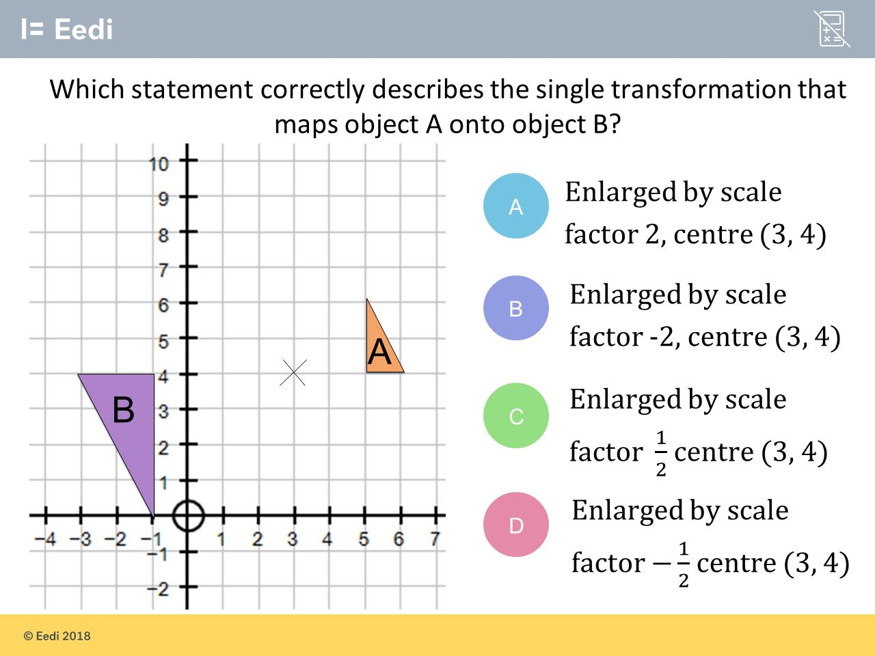
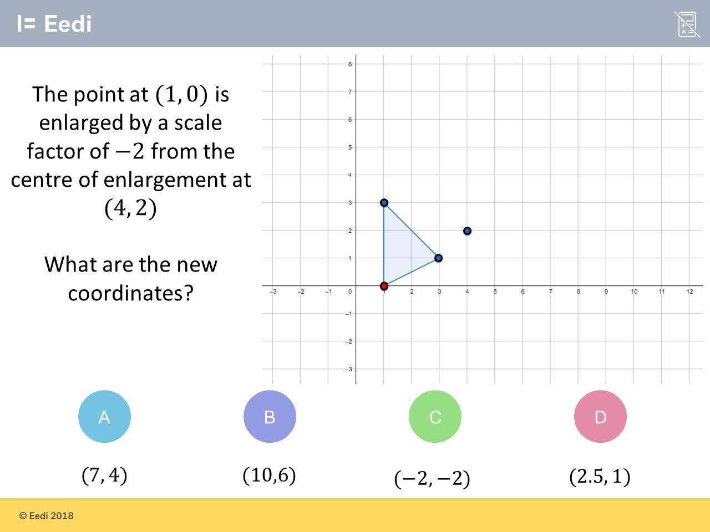
Hardest question?
Most common wrong answer?

Slide 2
ANSWERS

Slide 3
Hardest question?

Slide 4
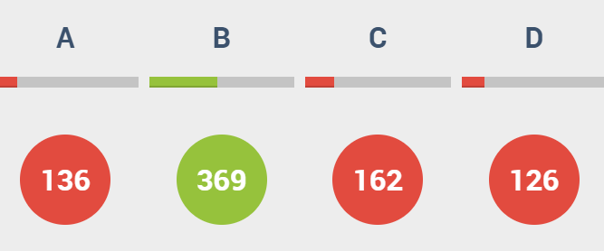
C
The student has used a scale factor of 2.

Slide 5
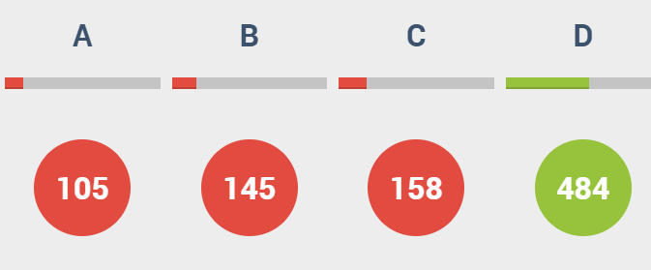
A
The student has correctly identified the size of the enlargement, but not the sign

