Slide 1
Find the HCF and LCM for:
1) 18 and 54
2) 54 and 72
3) 18 and 72
4) 40 and 180
5) 180 and 240
6) 40 and 240
7) 72 and 108
8) 72 and 540
9) 108 and 540

Slide 2
ANSWERS

Slide 3
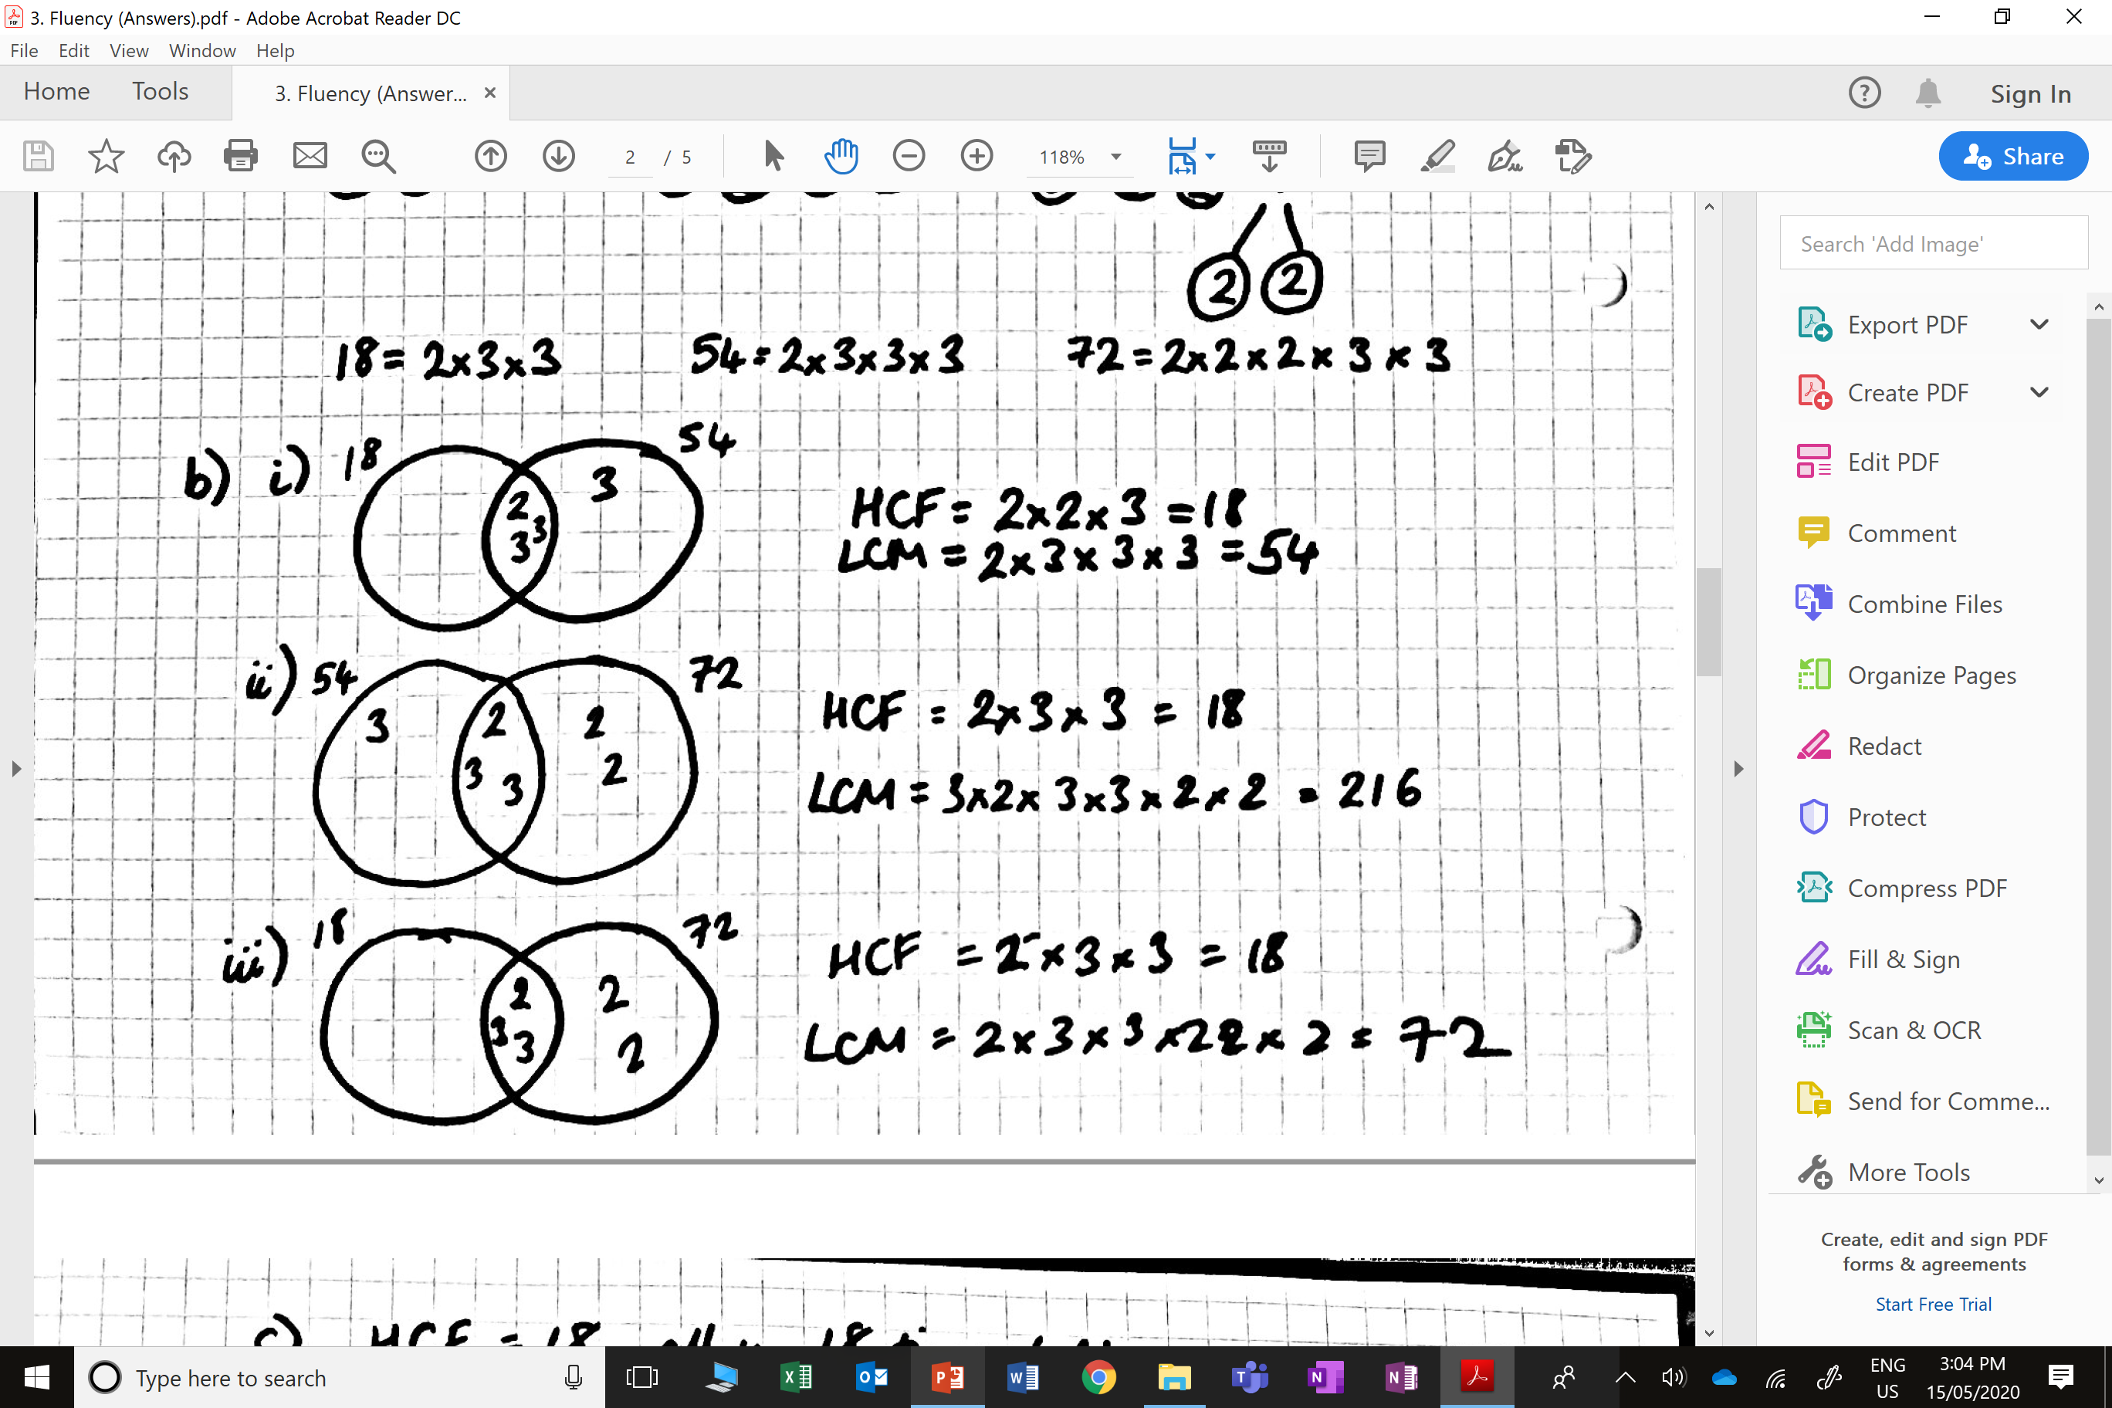
1) 18 and 54

Slide 4
2) 54 and 72

Slide 5
3) 18 and 72

Slide 6
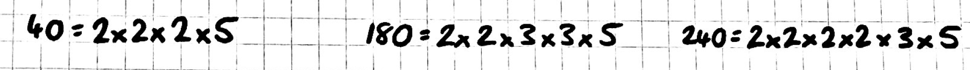
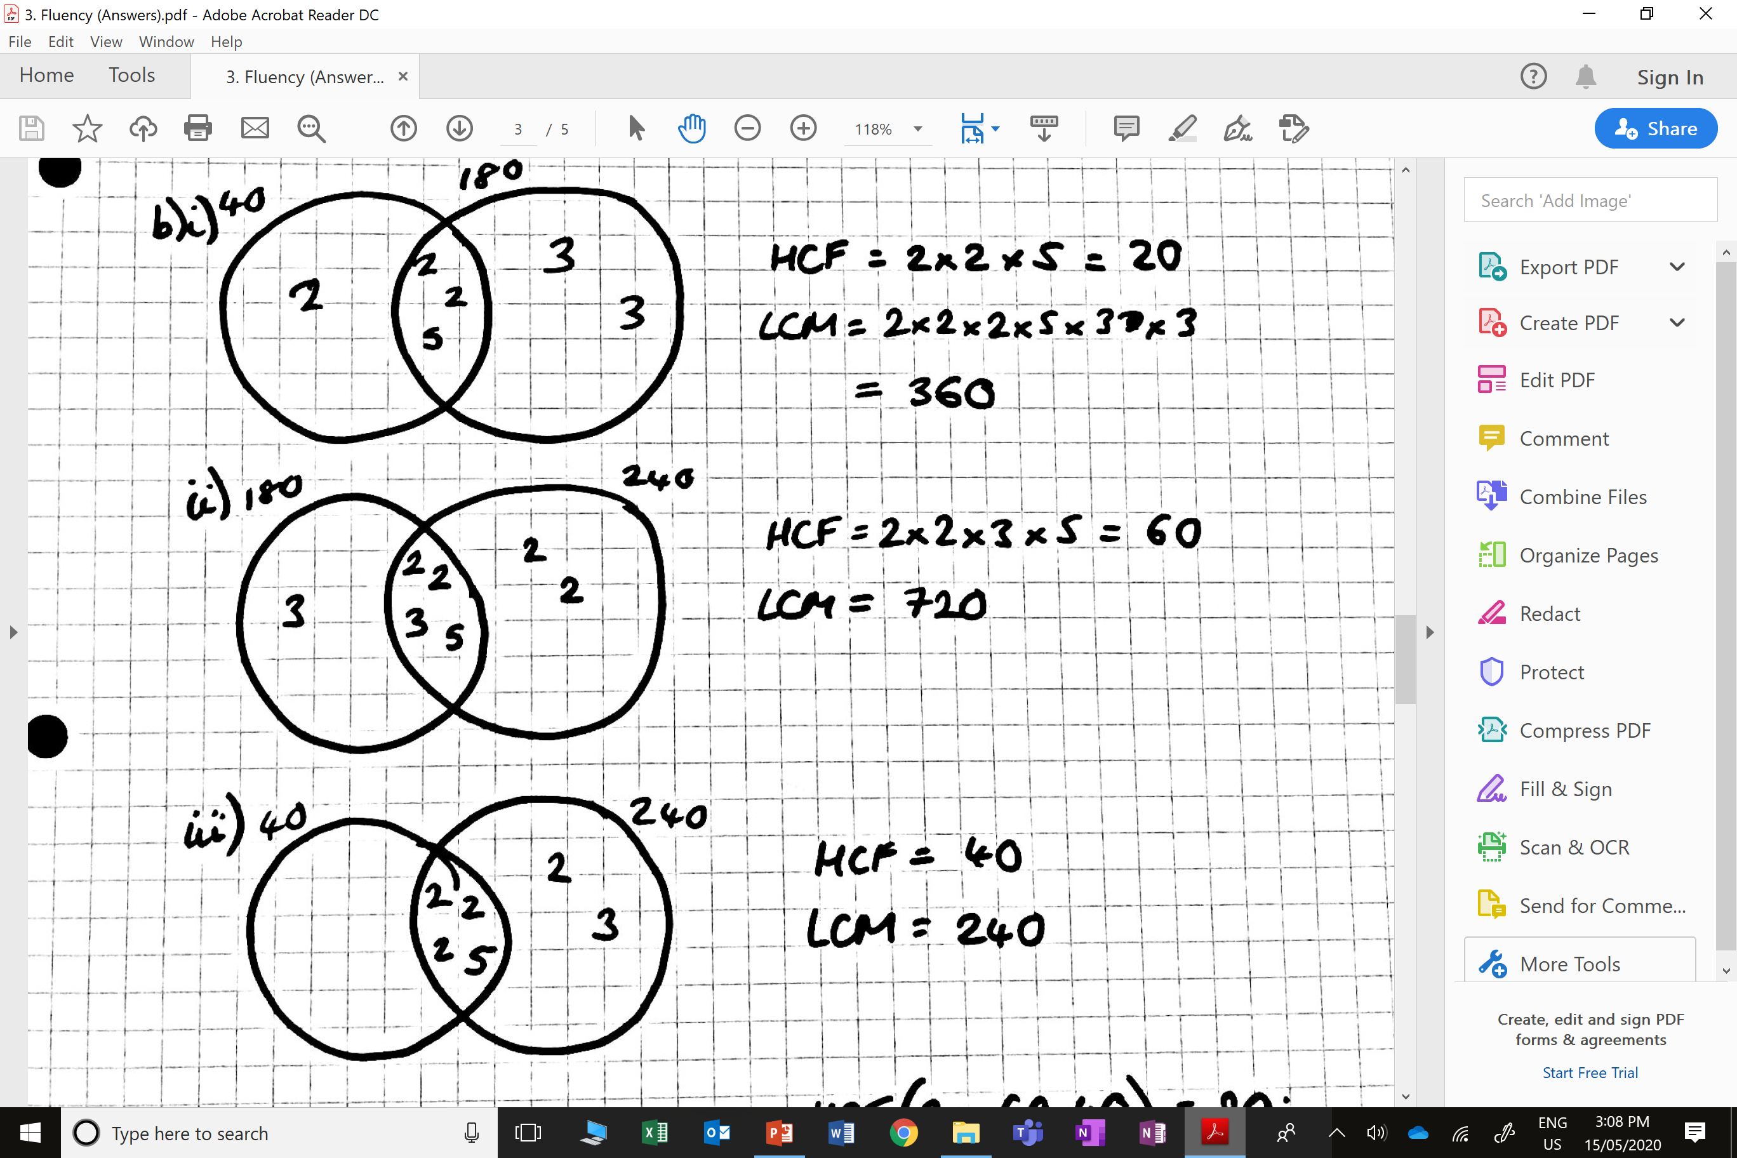
4) 40 and 180
5) 180 and 240
6) 40 and 240

Slide 7
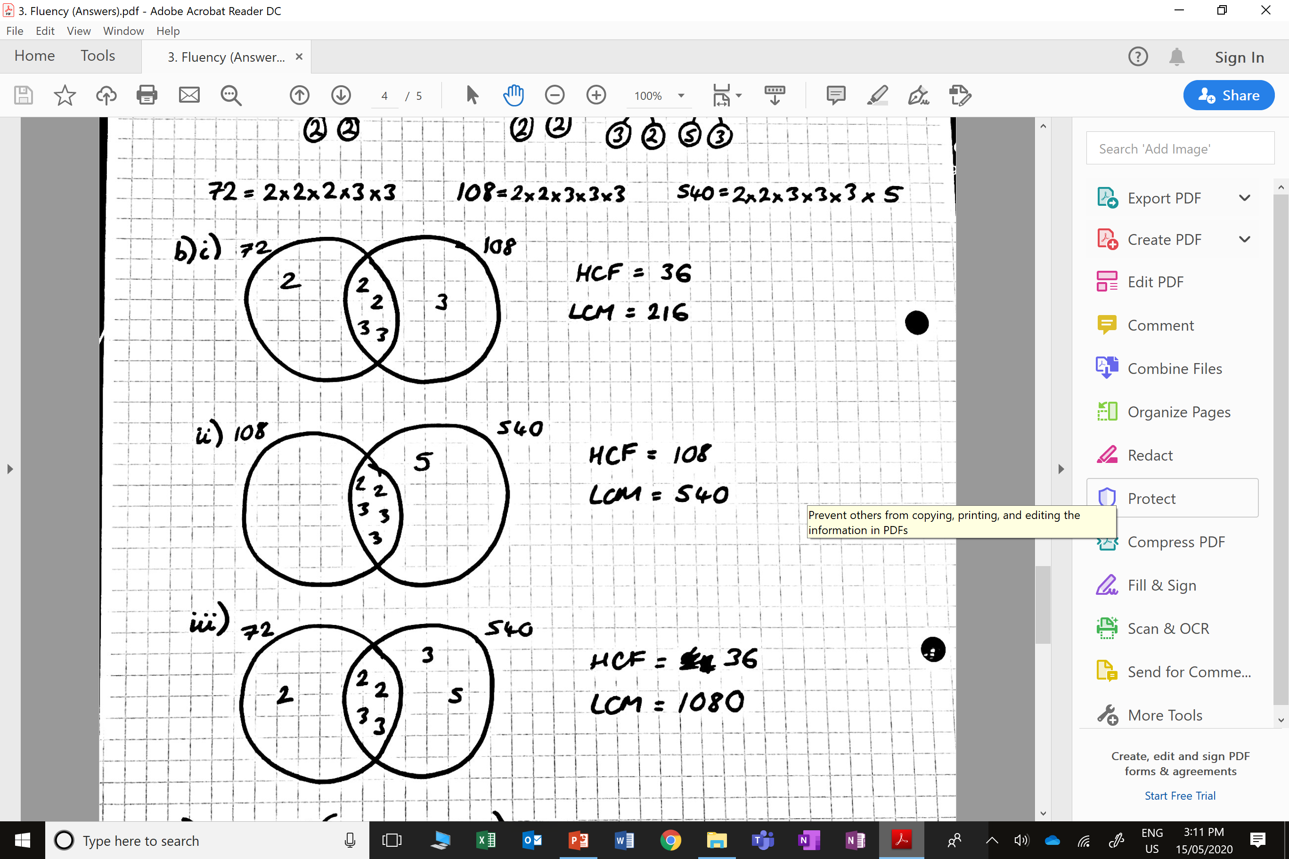
7) 72 and 108
8) 72 and 540
9) 108 and 540

