Slide 1
FM: Distance Between Two Points

Slide 2
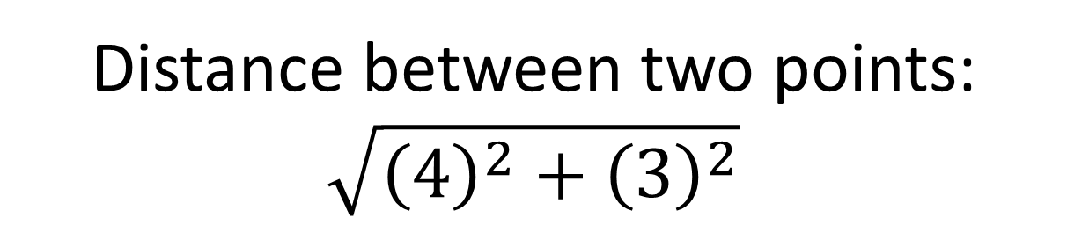
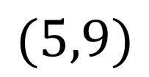

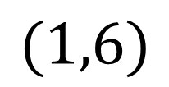



How could we find the distance between these two points?
$$(5,9)$$
$$5$$
$$Δy=3$$
$$(1,6)$$
$$Δx=4$$
$Δ$ (Greek letter ‘delta’) means “change in”
Distance between two points:
$$\sqrt{{\left(4\right)}^{2}+{\left(3\right)}^{2}}$$

Slide 3


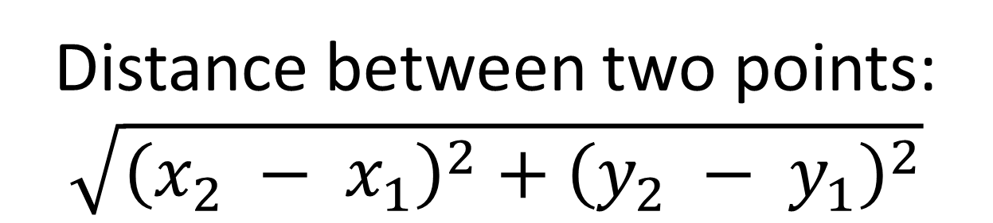
$$(x_{2},y_{2})$$
$$(x_{1},y_{1})$$
Distance between two points:
$$\sqrt{{\left(x_{2} − x_{1}\right)}^{2}+{\left(y_{2} − y_{1}\right)}^{2}}$$

Slide 4
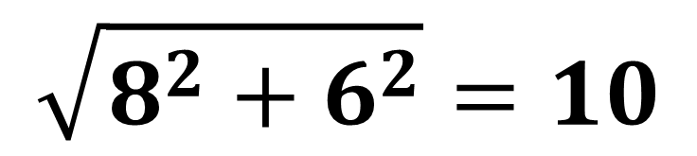
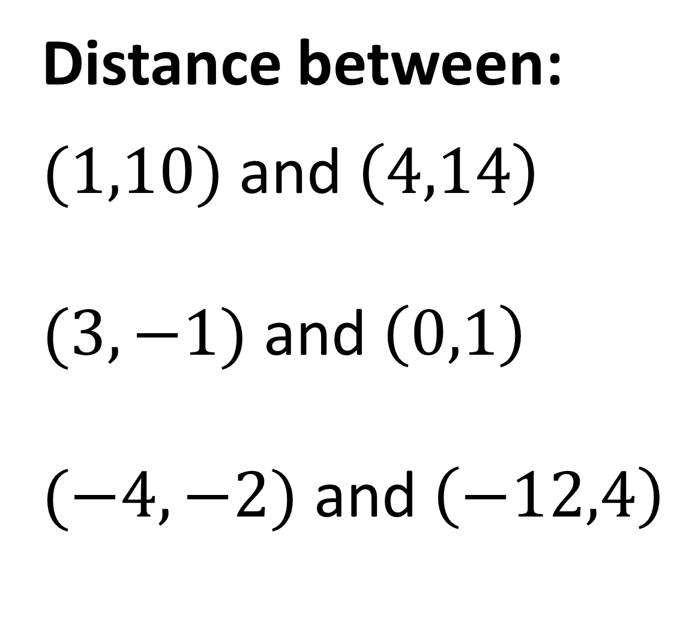
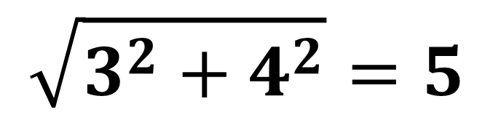
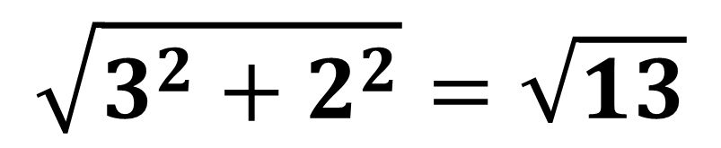
Distance between:
$(1,10)$ and $\left(4,14\right)$
and $\left(0,1\right)$
$(−4,−2)$ and $\left(−12,4\right)$
$$\sqrt{3^{2}+4^{2}}=5$$
$$\sqrt{3^{2}+2^{2}}=\sqrt{13}$$
$$\sqrt{8^{2}+6^{2}}=10$$

Slide 5
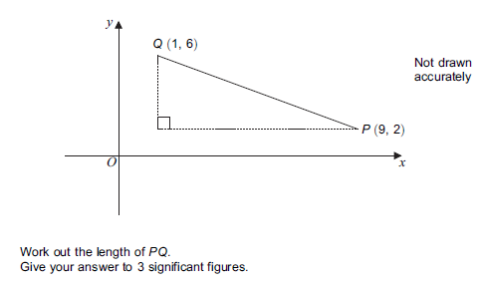
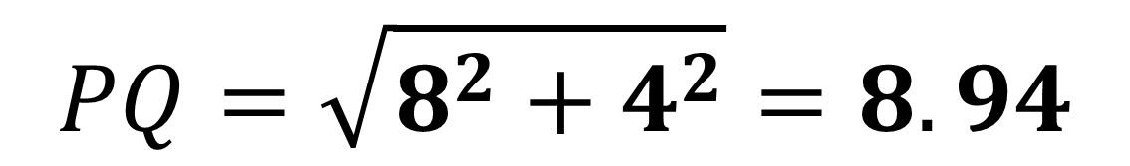
$$PQ=\sqrt{8^{2}+4^{2}}=8.94$$

