Slide 1
LO: Similar Triangles
(Extended)

Slide 2

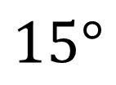
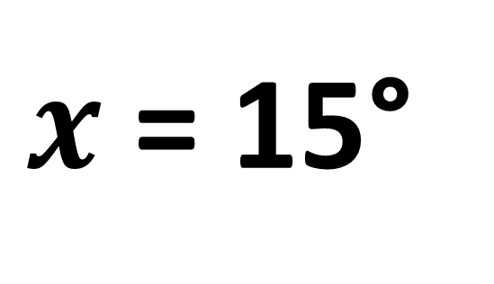
What is the size of x?
$$15°$$
$$x°$$
$x$ = 15°

Slide 3


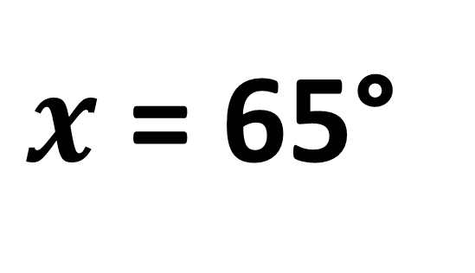
What is the size of x?
$$65°$$
$$x°$$
$x$ = 65°

Slide 4
How many triangles can you see?
Two
(Similar Triangles)

Slide 5
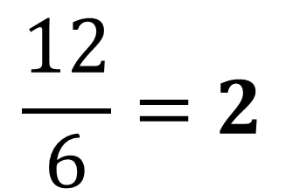
What is the scale factor ?
Scale Factor =
3
$$\frac{12}{6}=2$$
6
12
6

Slide 6
Which angles are the same?
D
E
A | =
E
F
B | =
D
C
C | =
F
A
B

Slide 7
Which sides are similar?
D
A | =
F
E
F
B | =
D
A
C
C | =
E
B

Slide 8
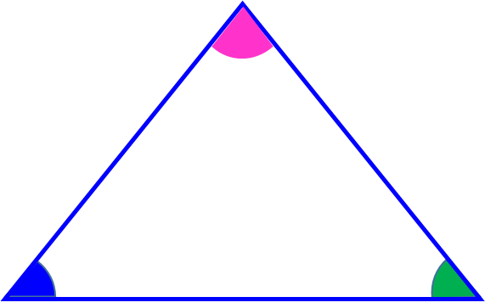

D
E
F
A
C
A
C
F
E
B
B
D

Slide 9
What is the length of x?
6
Scale Factor = 3
4
8
12
x = 18
x

Slide 10
What is the length of x?
x
Scale Factor = 2
4
5
10
x = 8.4
16.8

Slide 11
What is the length of x?
6
8
Scale Factor = 1.75
14
x
x = 10.5
20

