Slide 1



Find the circumference. Give you answer in terms of pi and to 2 decimal places.
1)
4)
7)
5cm
1.5cm
3cm
2)
8)
5)
10cm
15cm
6cm
3)
6)
9)
3cm
15cm
30cm

Slide 2
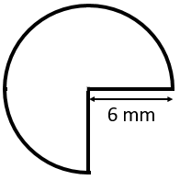
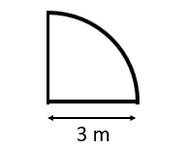
Find the perimeter. Give you answers to 2dp.
4)
7)
1)
2cm
0.2cm
8cm
5)
2)
8)
4cm
2cm
3)
6)
0.4cm
4cm
0.2cm

Slide 3
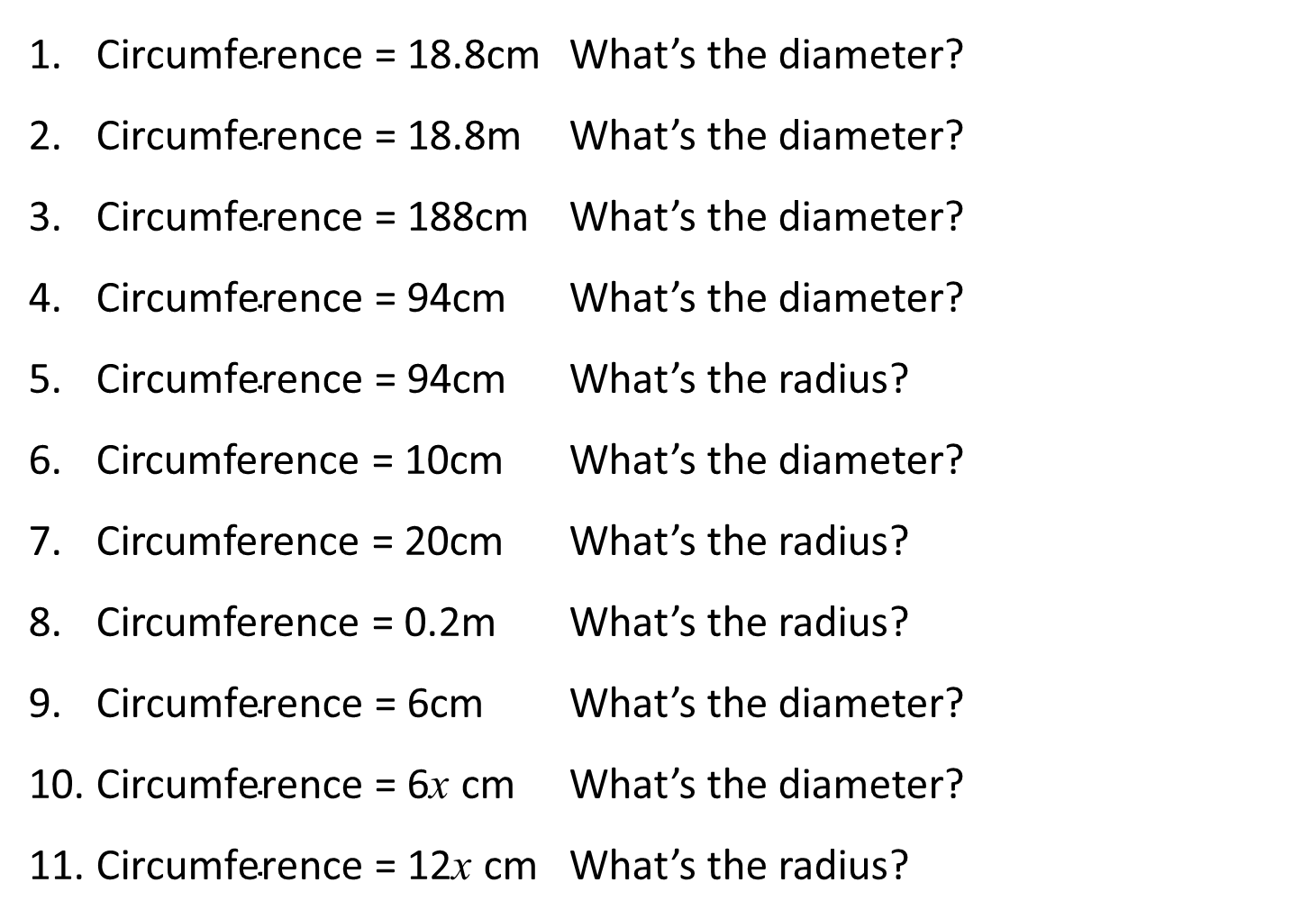
Give your answers to 2 decimal places
$\text{Circumference}\text{ =}$ 18.8cm What’s the diameter?
$\text{Circumference}\text{ =}$ 18.8m What’s the diameter?
$\text{Circumference}\text{ =}$ 188cm What’s the diameter?
$\text{Circumference}\text{ =}$ 94cm What’s the diameter?
$\text{Circumference}\text{ =}$ 94cm What’s the radius?
Circumference = 10cm What’s the diameter?
Circumference = 20cm What’s the radius?
Circumference = 0.2m What’s the radius?
$\text{Circumference}\text{ =}$ 6cm What’s the diameter?
$\text{Circumference}\text{ =}$ 6x cm What’s the diameter?
$\text{Circumference}\text{ =}$ 12x cm What’s the radius?

Slide 4
ANSWERS

Slide 5









Find the circumference. Give you answer in terms of pi and to 2 decimal places.
1)
4)
7)
5cm
1.5cm
3cm
$$3π=9.42cm$$
$$10π=31.42cm$$
$$3π=9.42cm$$
2)
8)
5)
10cm
15cm
6cm
$$6π=18.85cm$$
$$30π=94.25cm$$
$$20π=62.83cm$$
3)
6)
9)
3cm
15cm
30cm
$$6π=18.85cm$$
$$30π=94.25cm$$
$$30π=94.25cm$$

Slide 6
Find the perimeter. Give you answers to 2dp.
4)
7)
1)
10.28 cm
20.57 cm
2cm
0.2cm
8cm
5)
1.34 cm
2)
7.14 cm
8)
10.28 cm
4cm
2cm
3)
6)
0.4cm
2.68 cm
20.57 cm
0.71 cm
4cm
0.2cm

Slide 7
Give your answers to 2 decimal places
$\text{Circumference}\text{ =}$ 18.8cm What’s the diameter?
$\text{Circumference}\text{ =}$ 18.8m What’s the diameter?
$\text{Circumference}\text{ =}$ 188cm What’s the diameter?
$\text{Circumference}\text{ =}$ 94cm What’s the diameter?
$\text{Circumference}\text{ =}$ 94cm What’s the radius?
Circumference = 10cm What’s the diameter?
Circumference = 20cm What’s the radius?
Circumference = 0.2m What’s the radius?
$\text{Circumference}\text{ =}$ 6cm What’s the diameter?
$\text{Circumference}\text{ =}$ 6x cm What’s the diameter?
$\text{Circumference}\text{ =}$ 12x cm What’s the radius?
5.98cm
5.98m
59.84m
29.92cm
14.96cm
3.18cm
3.18cm
0.03m
1.91cm
1.91x cm
1.91x cm

