Slide 1
LO: Pythagorean Triples

Slide 2
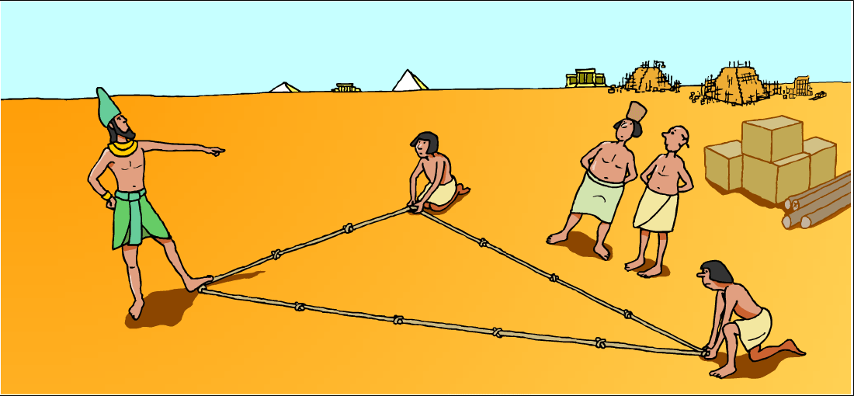
Ancient Egyptians used the fact that a triangle with sides of length 3, 4 and 5 contained a right-angle to mark out field boundaries and for building.

Slide 4
PYTHAGORAS TRIPLES
Do the following measurements make right angle triangles?
 |  |  | Yes or No
3 | 4 | 5
6 | 8 | 10
2 | 7 | 9
9 | 12 | 15
4 | 8 | 12
Can you come up with you own Pythagoras triples?

Slide 5



7cm
9cm
25cm
40cm
Can you guess which thing
Before I finish my soonnnggg.
is not like the other things
One of these things, it doesn’t belong.
One of these things is not like the other thing
32cm
15cm
33cm
17cm

Slide 6
7cm
9cm
25cm
40cm
32cm
15cm
33cm
17cm

Slide 7
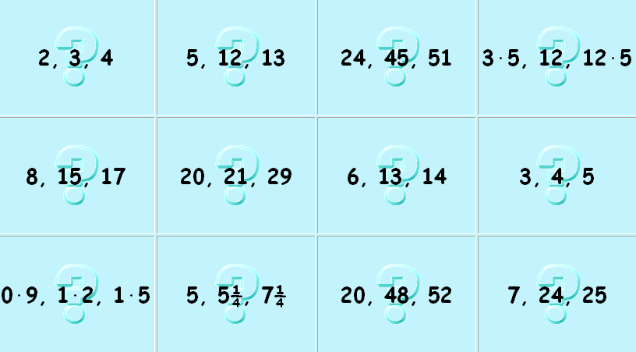
Which are right angle triangles?

