Slide 1
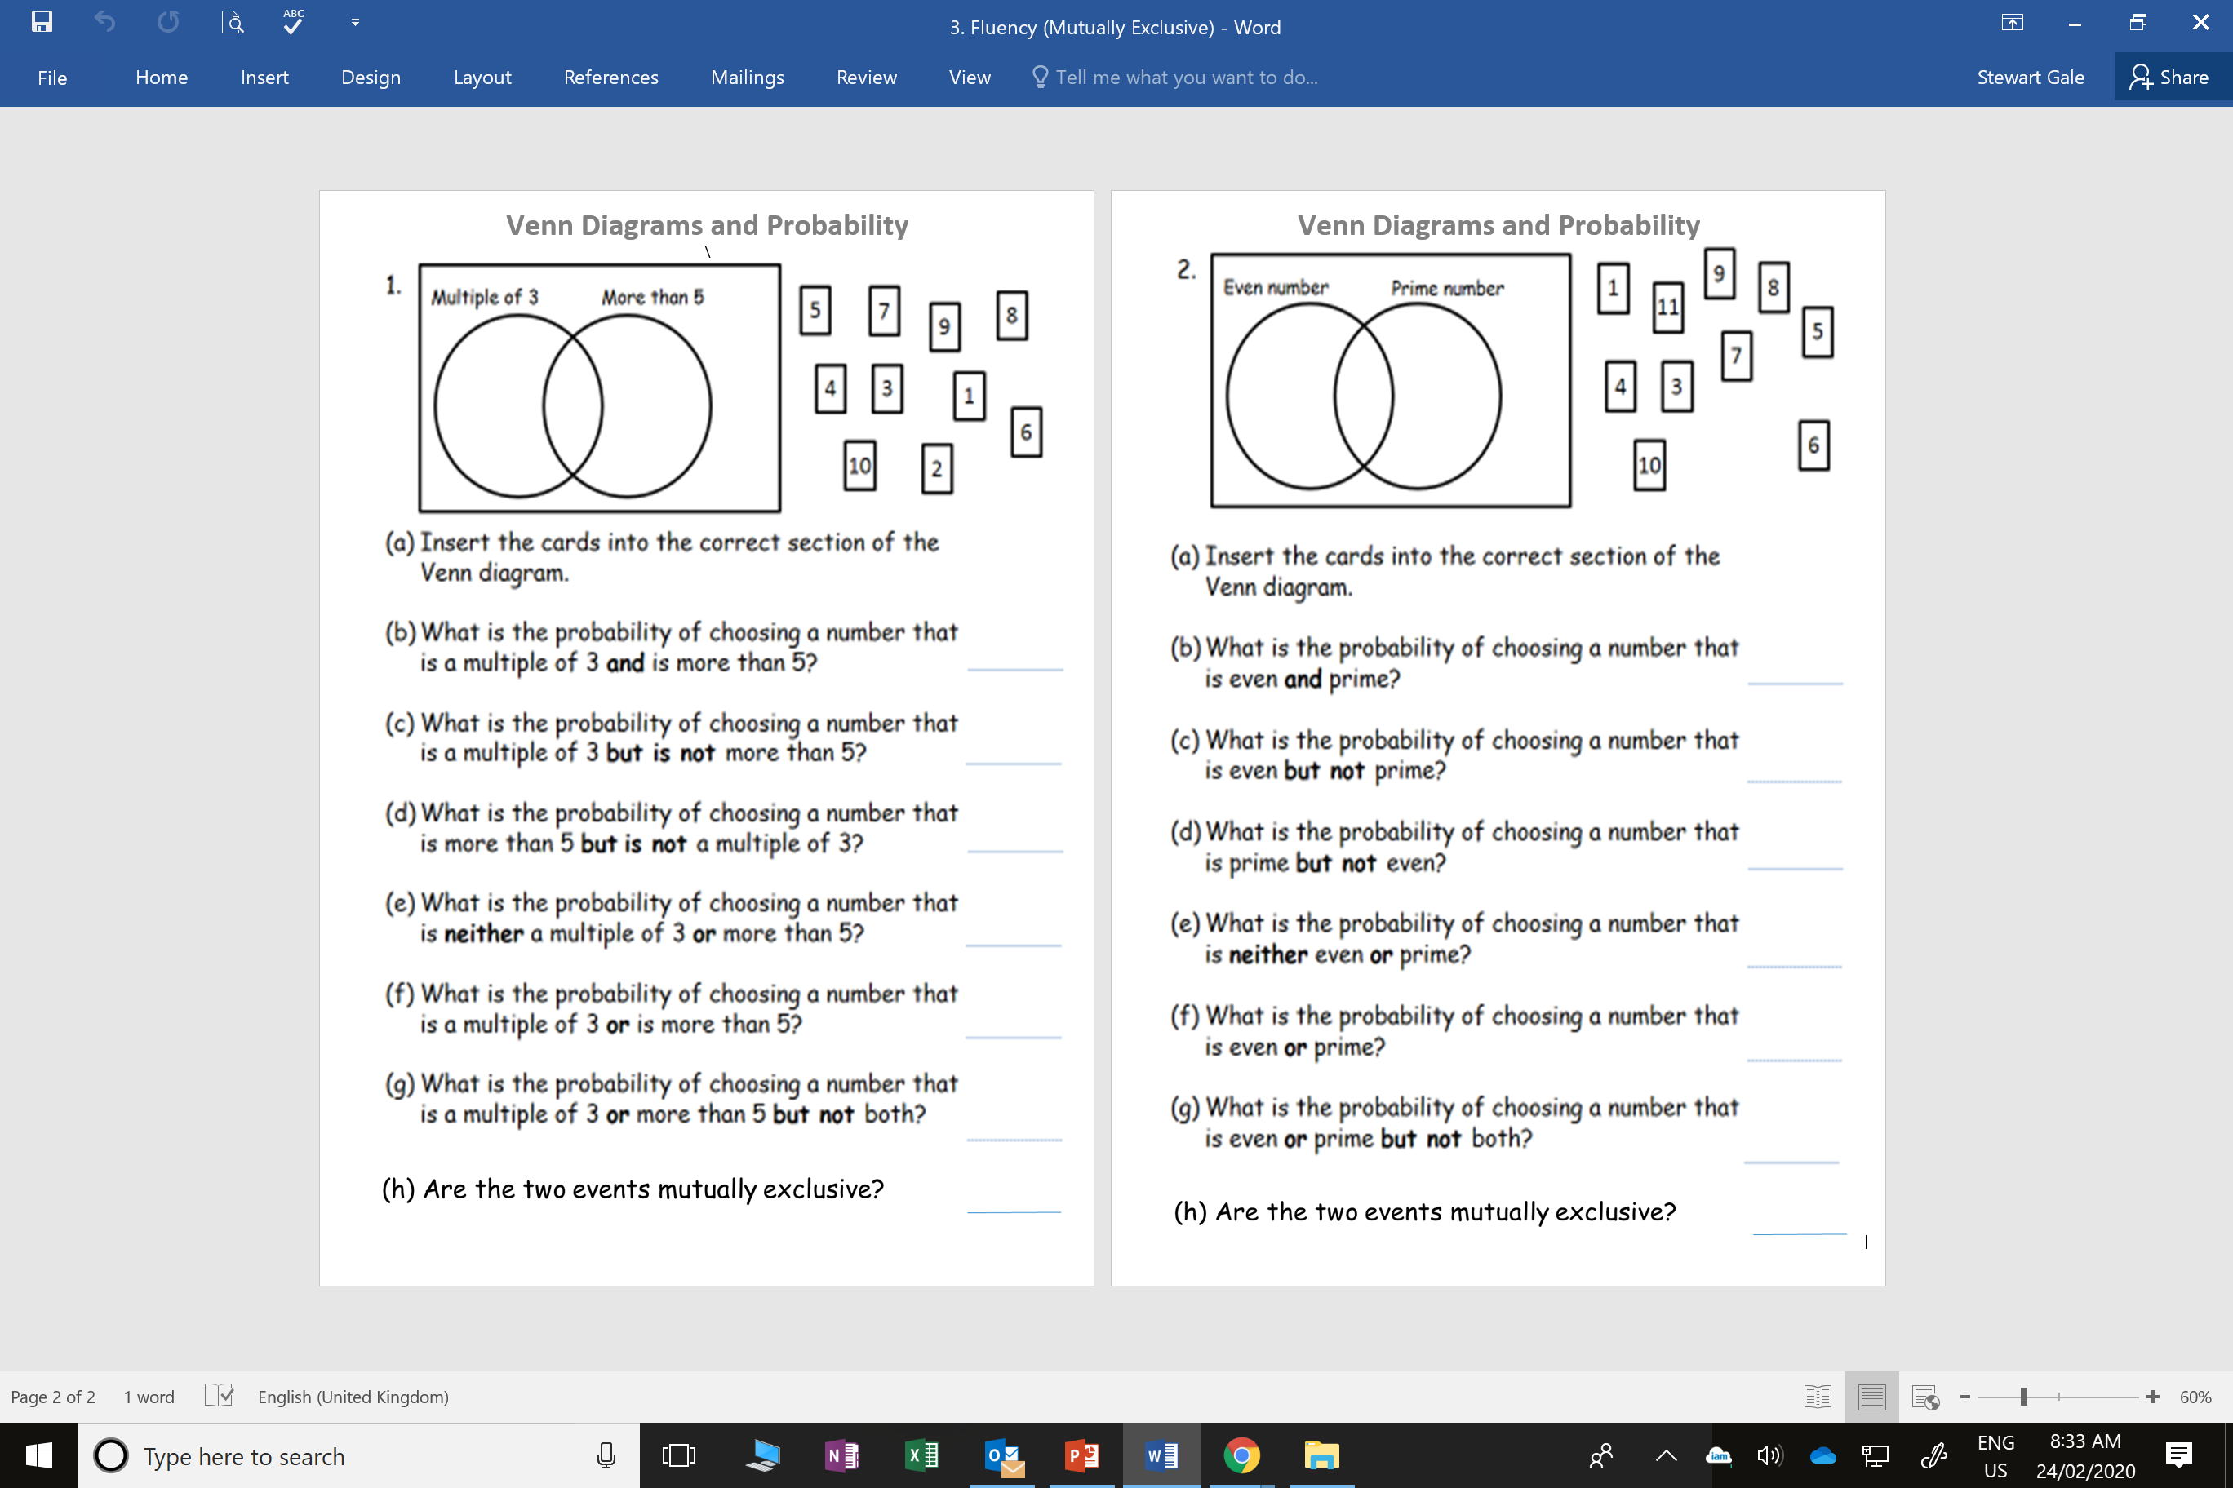

Slide 2
ANSWERS

Slide 3
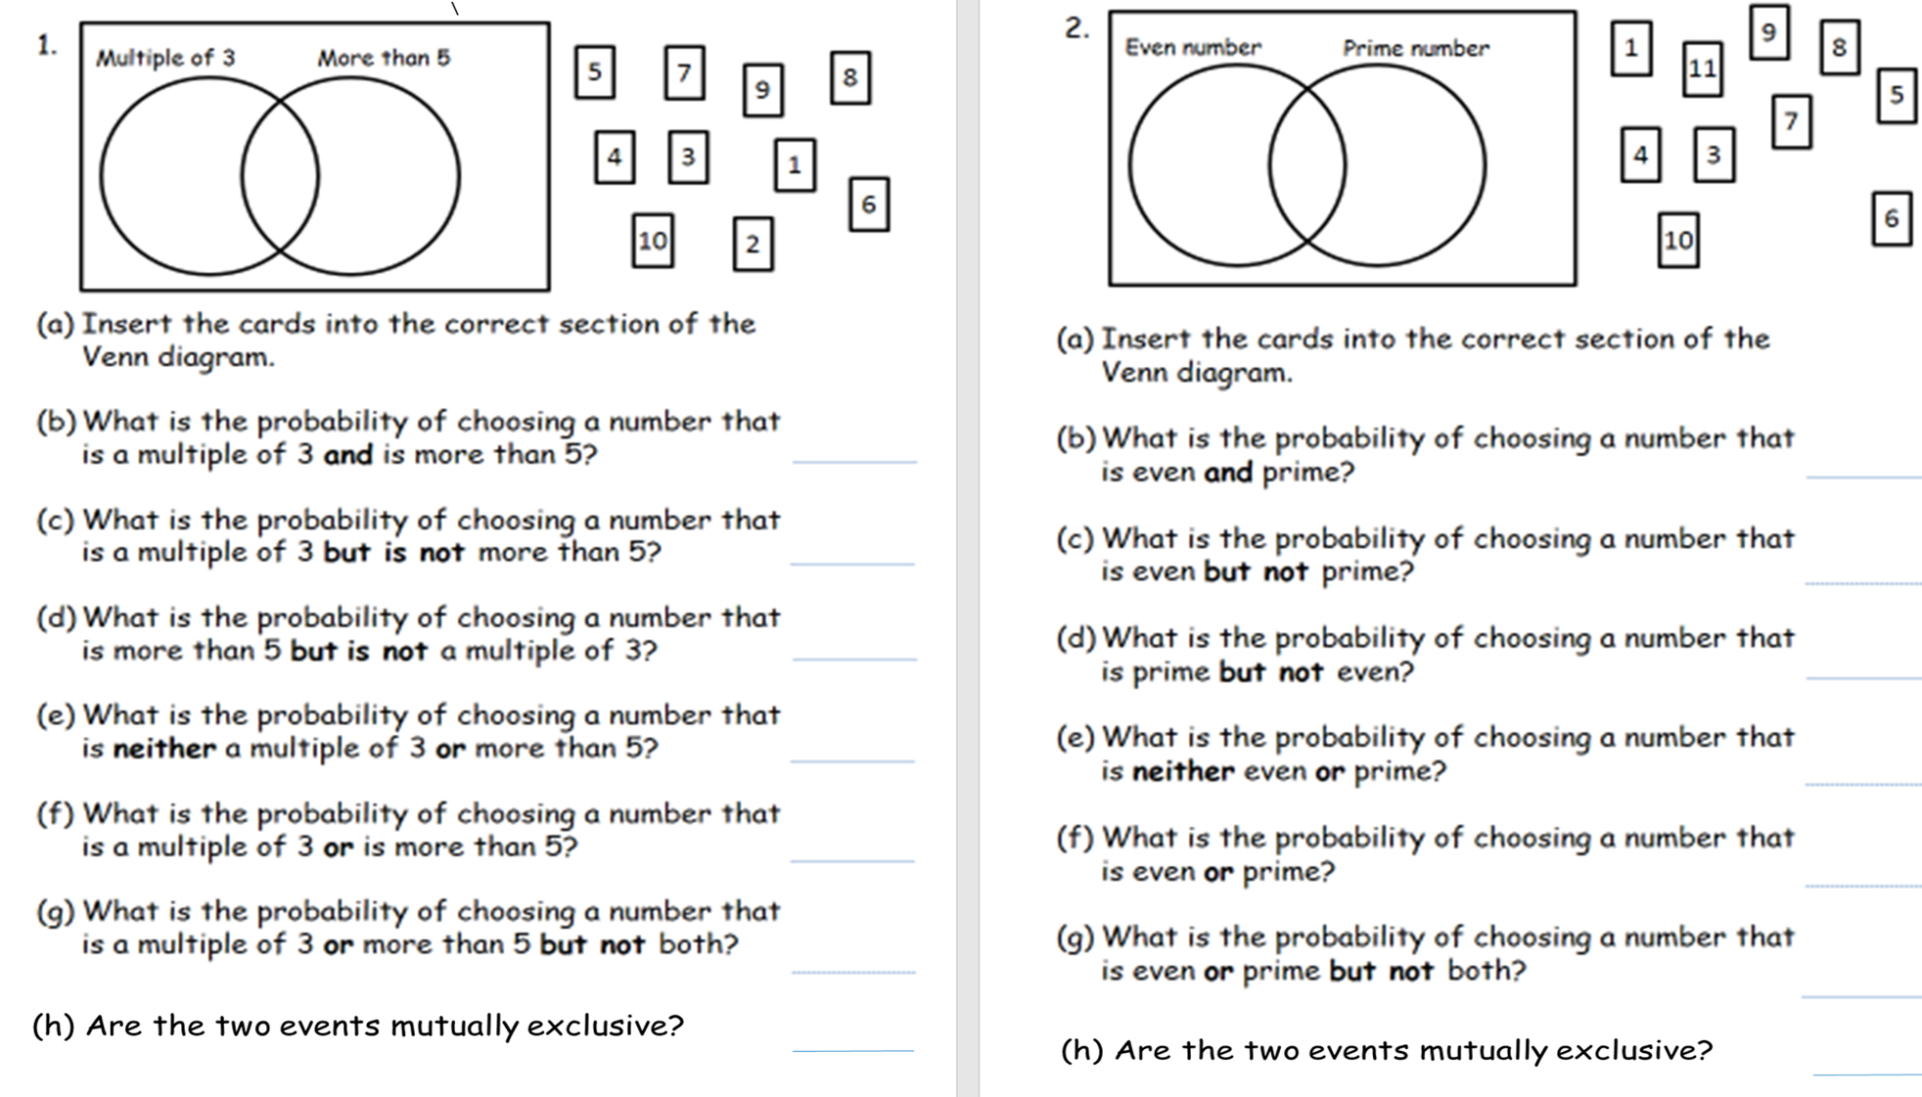
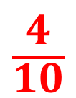
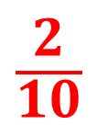
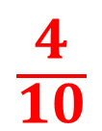
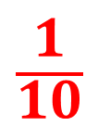
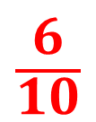
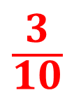
1
5
$$\frac{2}{10}$$
3
6
2
8
$$\frac{1}{10}$$
9
7
10
4
$$\frac{3}{10}$$
$$\frac{4}{10}$$
$$\frac{6}{10}$$
$$\frac{4}{10}$$
NO

Slide 4
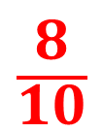
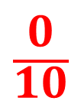

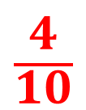
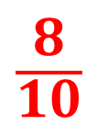
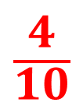
$$\frac{0}{10}$$
4
3
1
10
7
5
$$\frac{4}{10}$$
6
8
9
11
$$\frac{4}{10}$$
$$\frac{2}{10}$$
$$\frac{8}{10}$$
$$\frac{8}{10}$$
YES

