Slide 1
Integration
Partial Fractions
Chapter 11
(Part 6 of 12)

Slide 2
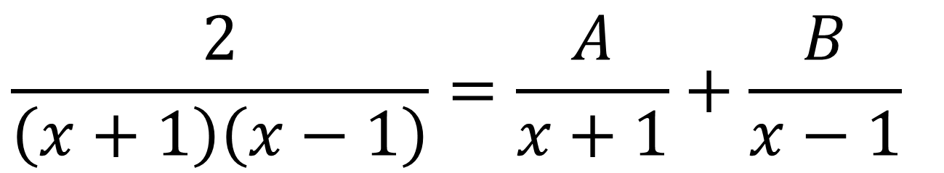
Using Partial Fractions
Splitting some expressions into
partial fractions
can make it easier to integrate.
$$\frac{2}{\left(x+1\right)\left(x−1\right)}=\frac{A}{x+1}+\frac{B}{x−1}$$

Slide 3
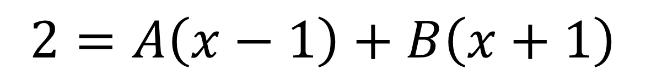
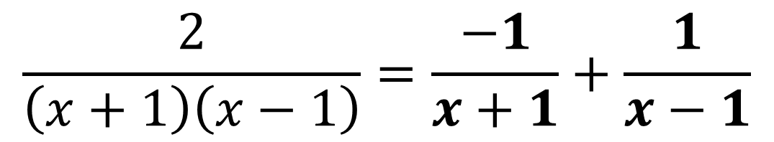
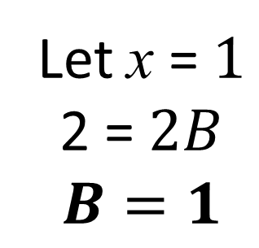
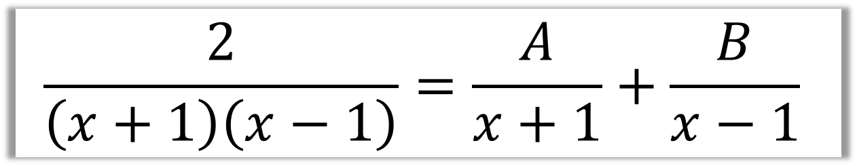
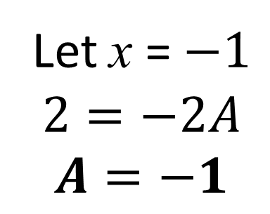
$$\frac{2}{\left(x+1\right)\left(x−1\right)}=\frac{A}{x+1}+\frac{B}{x−1}$$
Find the value of A and B
$$2=A\left(x−1\right)+B\left(x+1\right)$$
Let x = $−1$
$$2=−2A$$
$$A=−1$$
Let x = $1$
2 = $2B$
$$B=1$$
$$\frac{2}{\left(x+1\right)\left(x−1\right)}=\frac{−1}{x+1}+\frac{1}{x−1}$$

Slide 4
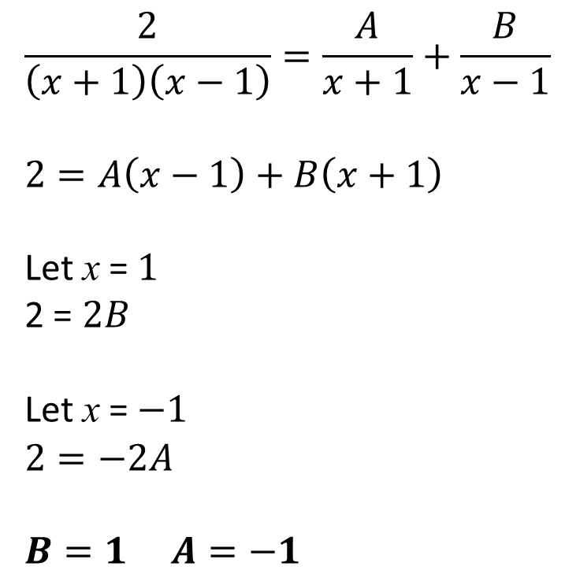
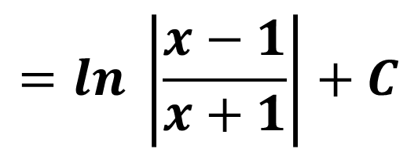
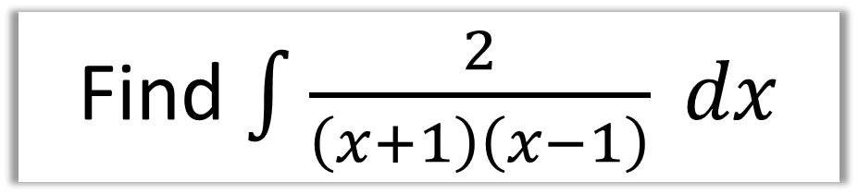

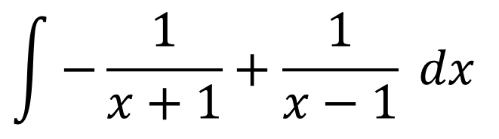

Find $\int{\frac{2}{\left(x+1\right)\left(x−1\right)} dx}$
Give you answers
as a single log.
Partial Fractions
Integration
$$\frac{2}{\left(x+1\right)\left(x−1\right)}=\frac{A}{x+1}+\frac{B}{x−1}$$
$$2=A\left(x−1\right)+B\left(x+1\right)$$
Let x = $1$
2 = $2B$
Let x = $−1$
$$2=−2A$$
$$B=1 A=−1$$
$$\int{−\frac{1}{x+1}+\frac{1}{x−1} dx}$$
$$=−\ln\left|x+1\right|+\ln\left|x−1\right|+c$$
$$=\ln\left|x−1\right|−\ln\left|x+1\right|+c$$
$$=ln \left|\frac{x−1}{x+1}\right|+C$$

Slide 5
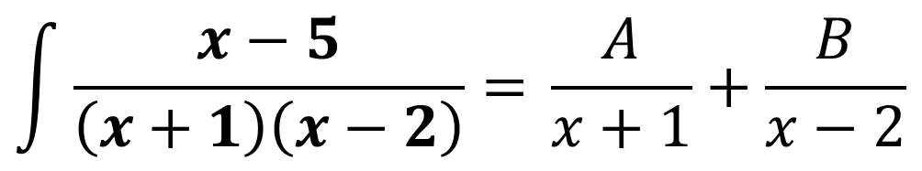
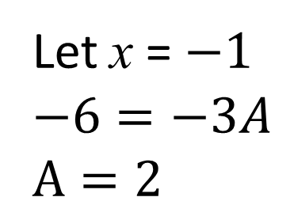
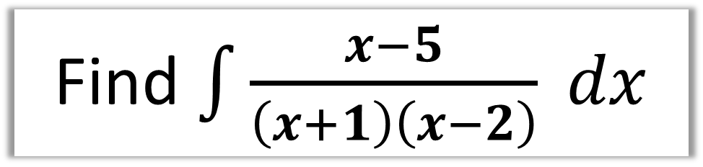
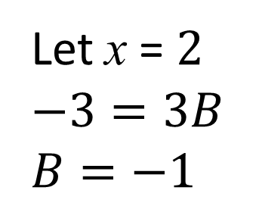

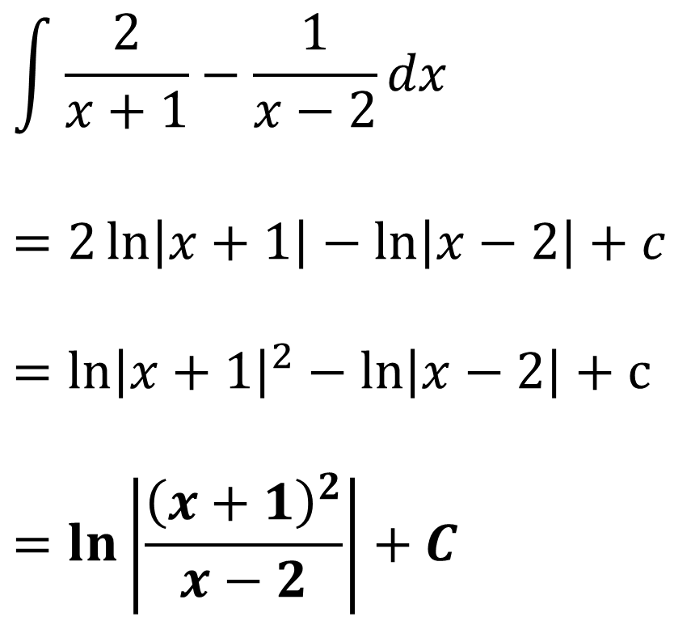
Find $\int{\frac{x−5}{\left(x+1\right)\left(x−2\right)} dx}$
Give you answers
as a single log.
Partial Fractions
Integration
$$\int{\frac{2}{x+1}−\frac{1}{x−2}dx }$$
$$=2\ln\left|x+1\right|−\ln\left|x−2\right|+c$$
$$={\ln\left|x+1\right|}^{2}−\ln\left|x−2\right|+c$$
$$=\ln\left|\frac{{\left(x+1\right)}^{2}}{x−2}\right|+C$$
$$\int{\frac{x−5}{\left(x+1\right)\left(x−2\right)}=} \frac{A}{x+1}+\frac{B}{x−2}$$
$$x−5=A\left(x−2\right)+B\left(x+1\right)$$
Let x = $−1$
$$−6=−3A$$
$$A=2$$
Let x = $2$
$$−3=3B$$
$$B=−1$$

Slide 6
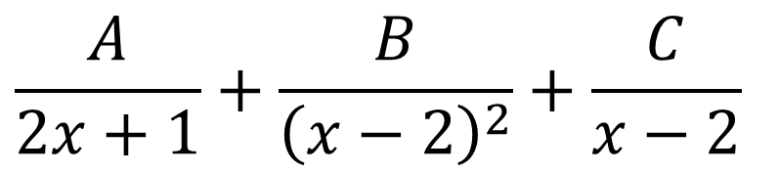
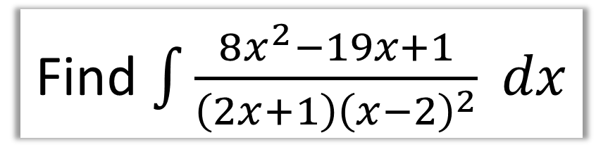
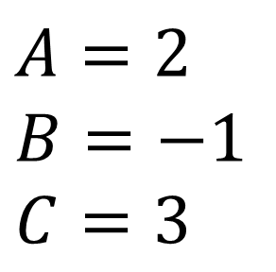
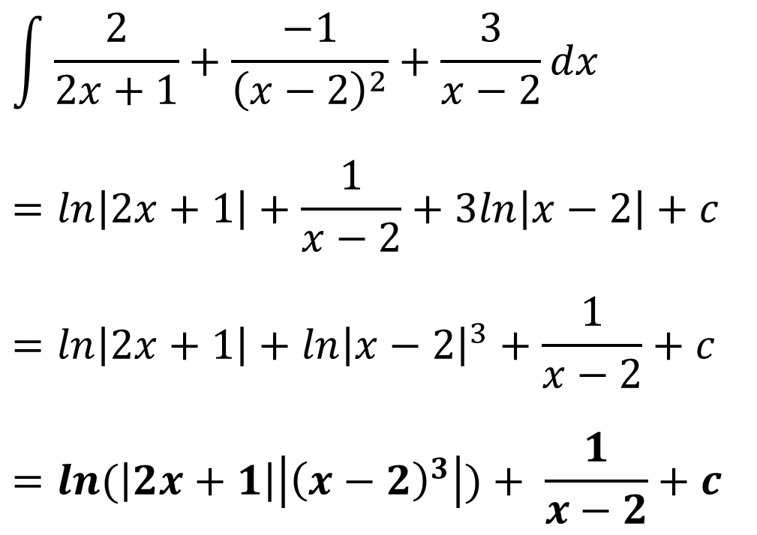
Find $\int{\frac{8x^{2}−19x+1}{\left(2x+1\right){\left(x−2\right)}^{2}} dx}$
Partial Fractions
Integration
$$\frac{A}{2x+1}+\frac{B}{{\left(x−2\right)}^{2}}+\frac{C}{x−2}$$
$$\int{\frac{2}{2x+1}+\frac{−1}{{\left(x−2\right)}^{2}}+\frac{3}{x−2}dx}$$
$$=\ln\left|2x+1\right|+\frac{1}{x−2}+3ln\left|x−2\right|+c$$
$$=\ln\left|2x+1\right|+{\ln\left|x−2\right|}^{3}+\frac{1}{x−2}+c$$
$$=\ln{(\left|2x+1\right|}\left|{\left(x−2\right)}^{3}\right|)+ \frac{1}{x−2}+c$$
$$A=2$$
$$B=−1$$
$$C=3$$

Slide 7
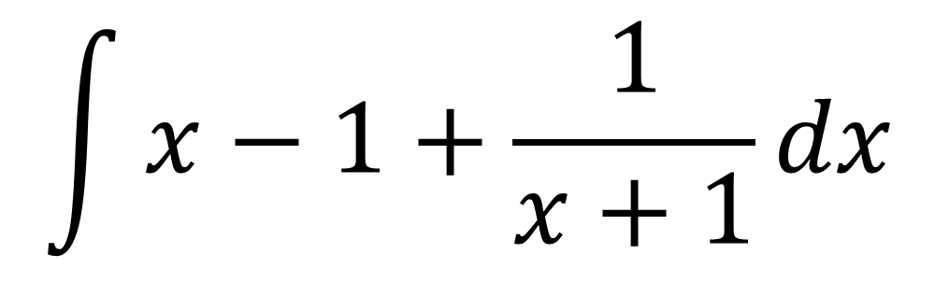
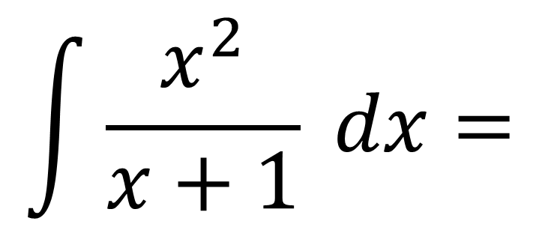
Integrating top-heavy algebraic fractions
To be able to integrate you will need to rewrite as a mixed algebraic fraction.
$$\int{\frac{x^{2}}{x+1} dx}=$$
$$\int{x−1+\frac{1}{x+1}}dx$$

Slide 8
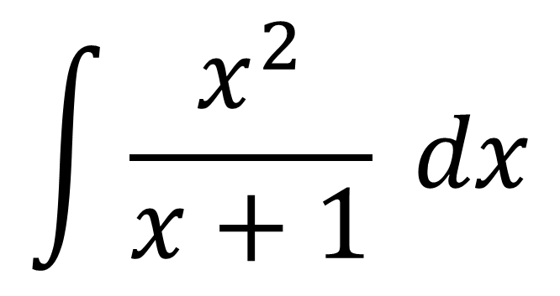
How do you know if you have a
top-heavy algebraic fraction?
Power of the numerator ≥ Power of the denominator
$$\int{\frac{x^{2}}{x+1} dx}$$

Slide 9
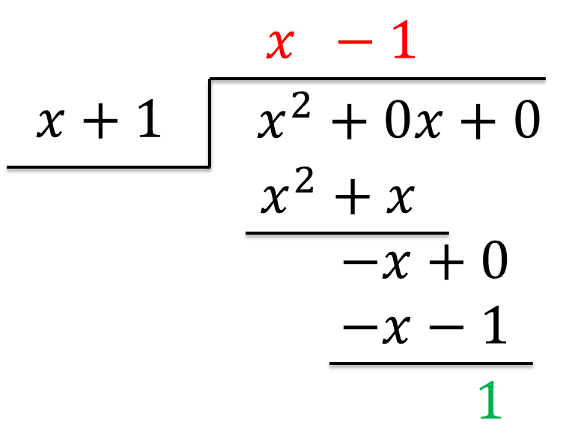
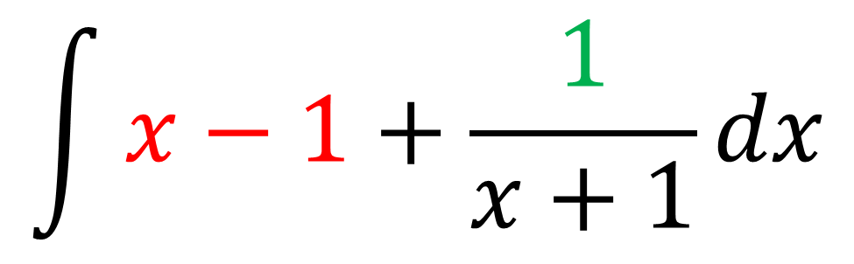
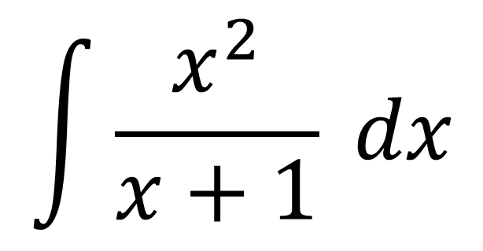
A
$$\int{\frac{x^{2}}{x+1} dx}$$
$$\int{x−1+\frac{1}{x+1}}dx$$

Slide 10
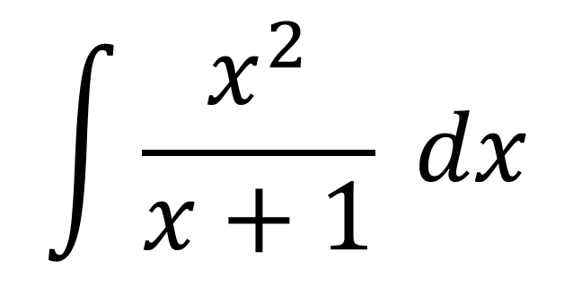
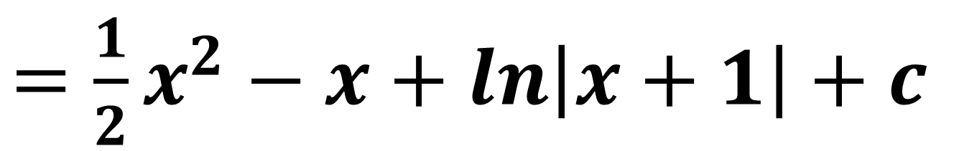
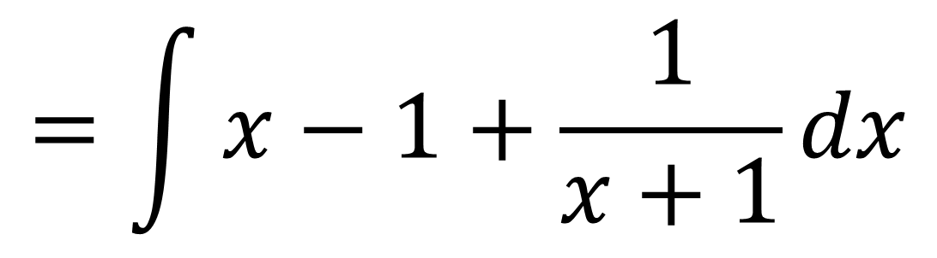
A
$$\int{\frac{x^{2}}{x+1} dx}$$
$$=\int{x−1+\frac{1}{x+1}}dx$$
$=\frac{1}{2}x^{2}−x+\ln\left|x+1\right|$ $+ c$

Slide 11
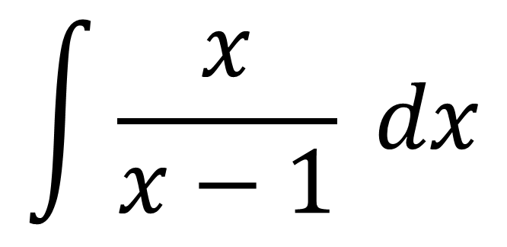
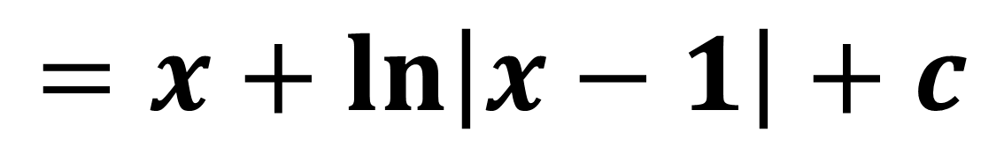
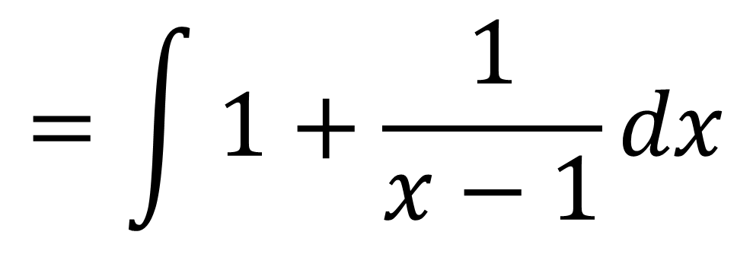
B
$$\int{\frac{x}{x−1} dx}$$
$$=\int{1+\frac{1}{x−1}dx}$$
$$=x+\ln\left|x−1\right|+c$$

Slide 12
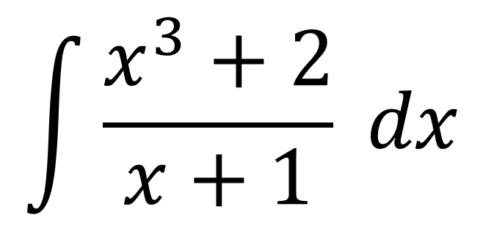
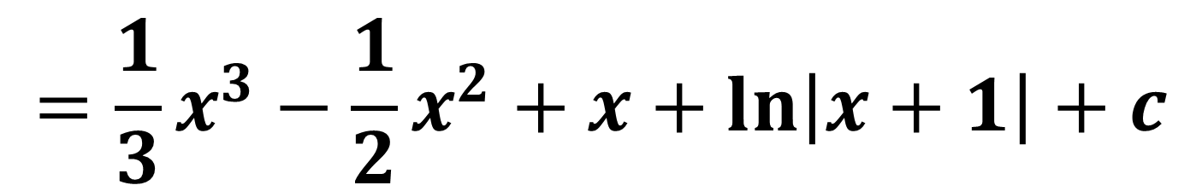
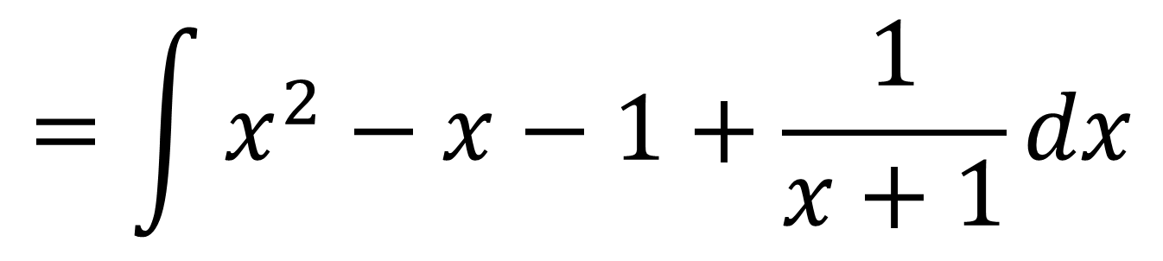
C
$$\int{\frac{x^{3}+2}{x+1} dx}$$
$$=\int{x^{2}−x−1+\frac{1}{x+1}}dx$$
$$=\frac{1}{3}x^{3}−\frac{1}{2}x^{2}+x+\ln\left|x+1\right|+c$$

Slide 13
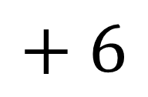
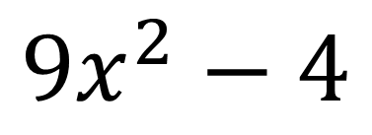
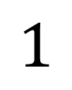
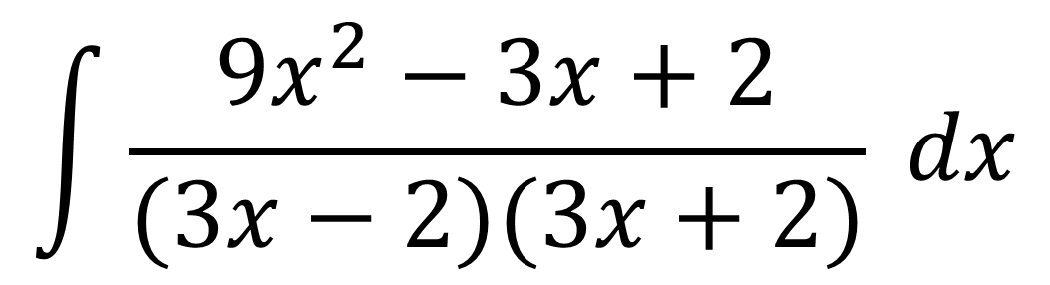
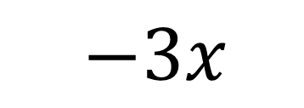
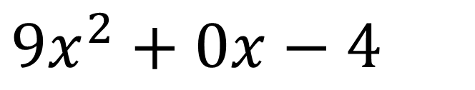
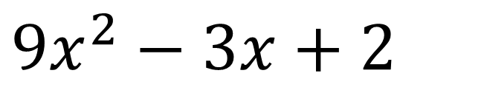
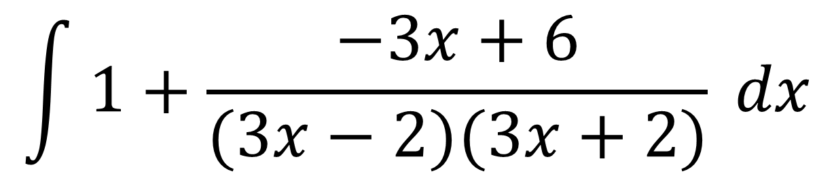
$$\int{\frac{{9x}^{2}−3x+2}{(3x−2)(3x+2)} dx}$$
D
$$1$$
$${9x}^{2}−4$$
$$9x^{2}−3x+2$$
$$9x^{2}+0x−4$$
$−3x$
$$+ 6$$
$$\int{1+\frac{−3x+6}{(3x−2)(3x+2)} dx}$$

Slide 14
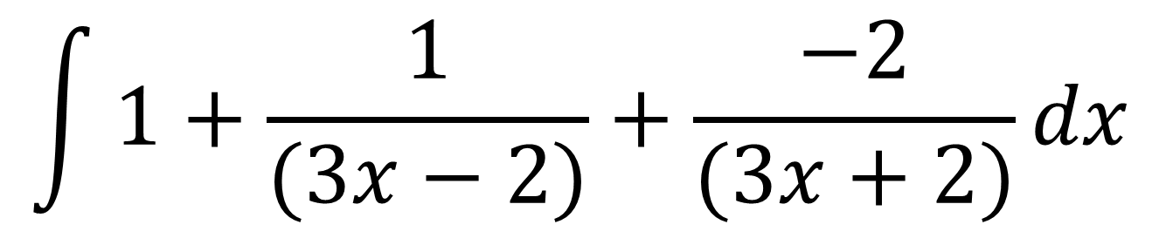
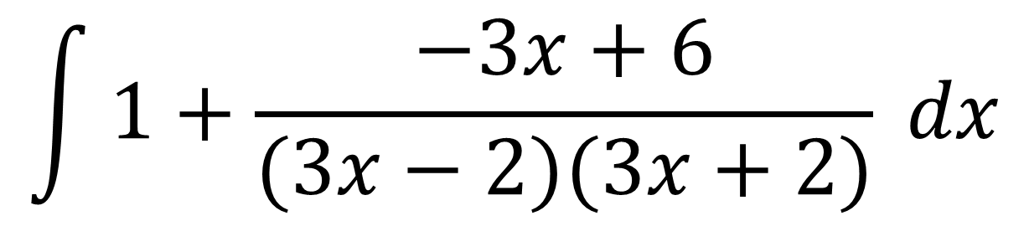
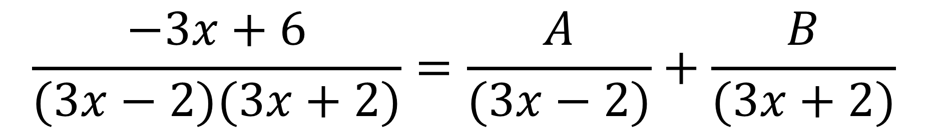
D
$$\int{1+\frac{−3x+6}{(3x−2)(3x+2)} dx}$$
$$\frac{−3x+6}{(3x−2)(3x+2)}=\frac{A}{(3x−2)}+\frac{B}{(3x+2)}$$
$$\int{1+\frac{1}{(3x−2)}+\frac{−2}{(3x+2)}dx}$$

Slide 15
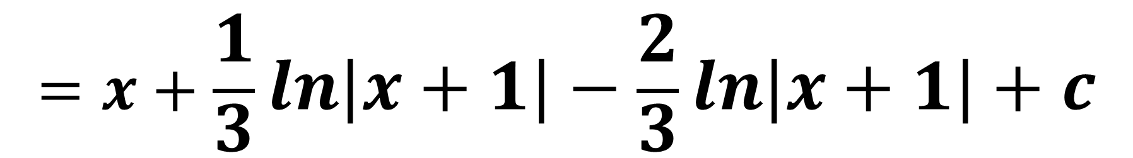
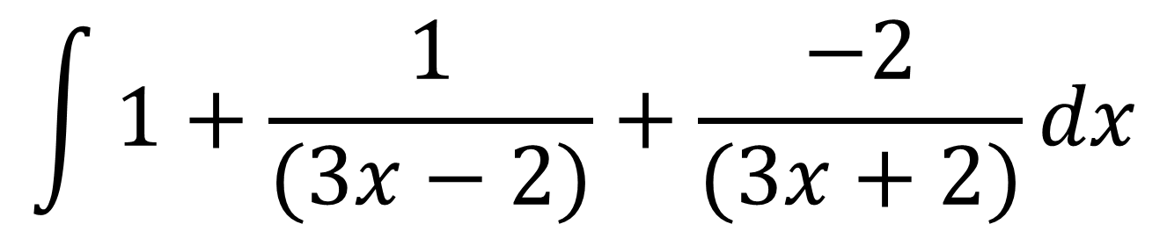
D
$$\int{1+\frac{1}{(3x−2)}+\frac{−2}{(3x+2)}dx}$$
$$=x+\frac{1}{3}ln\left|x+1\right|−\frac{2}{3}ln\left|x+1\right|+c$$

