Slide 1
Forces and Motions
Connected Particles
(Horizontally)
Chapter 10
(Part 3 of 9)

Slide 2
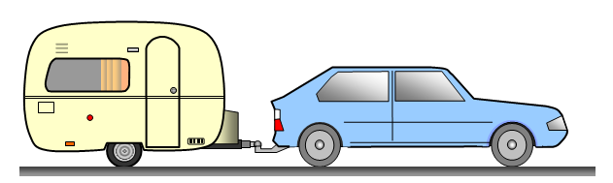
Connected Particles - Horizontally

Slide 3







$$a$$
$$Tension$$
$$force$$
$$Tension$$
$$Force$$
$$Resistance$$
$$Force$$
$$Caravan$$
m
m
$$Driving$$
$$Force$$
$$Resistance$$
$$Force$$
$$Car$$
Name the forces of each coloured arrow.

Slide 4
When dealing with horizontally connect particles
you can use one of 3 equations.
F = ma
Overall System
F = ma
Caravan Only
F = ma
Car only

Slide 5
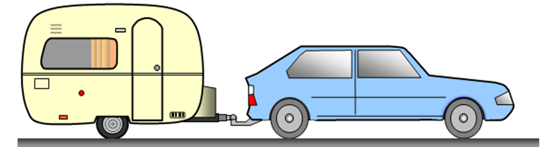




1000kg
$$T$$
$$T$$
800kg
500N
40N
20N
40N
1800kg
F = ma
500 – 60 = 1800a
500N
20N
1000kg
$$T$$
F = ma
T – 40 = 1000a
40N
$$T$$
800kg
F = ma
500 – 20 – T = 800a
500N
20N

Slide 6
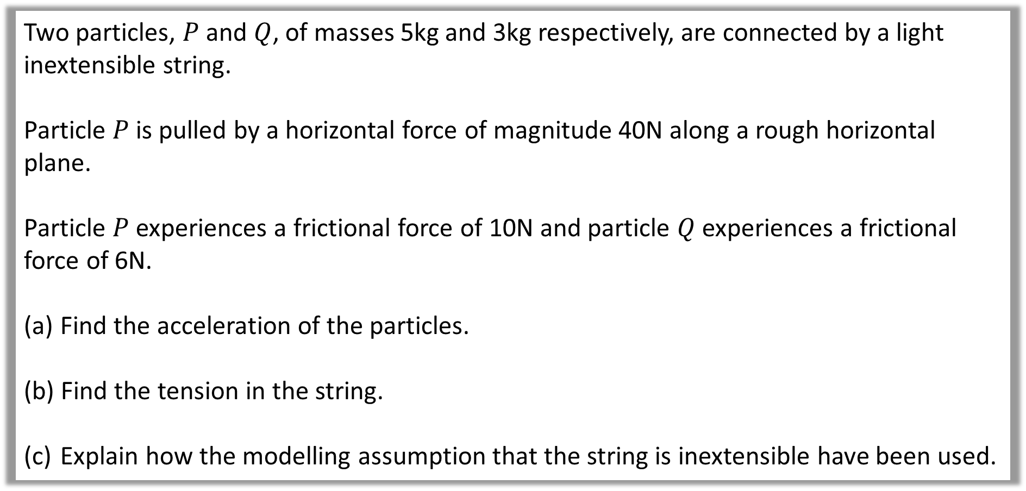
Question A
Two particles, $P$ and $Q$, of masses 5kg and 3kg respectively, are connected by a light inextensible string.
Particle $P$ is pulled by a horizontal force of magnitude 40N along a rough horizontal plane.
Particle $P$ experiences a frictional force of 10N and particle $Q$ experiences a frictional force of 6N.
Find the acceleration of the particles.
Find the tension in the string.
Explain how the modelling assumption that the string is inextensible have been used.

Slide 7
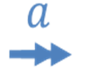
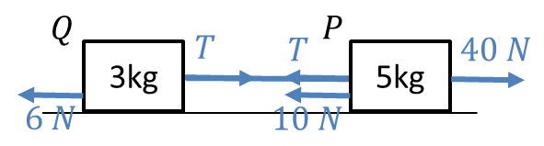
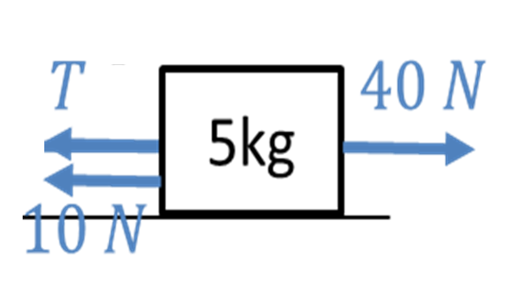
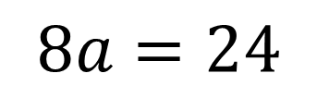
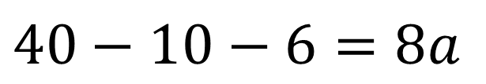
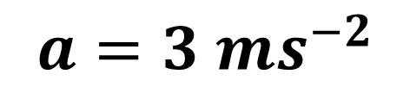
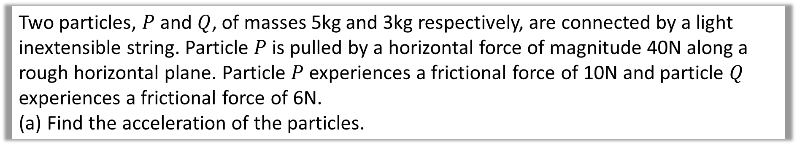
Two particles, $P$ and $Q$, of masses 5kg and 3kg respectively, are connected by a light inextensible string. Particle $P$ is pulled by a horizontal force of magnitude 40N along a rough horizontal plane. Particle $P$ experiences a frictional force of 10N and particle $Q$ experiences a frictional force of 6N.
Find the acceleration of the particles.
a.
$$40−10−6=8a$$
$$8a=24$$
$$a=3 {ms}^{−2}$$

Slide 8
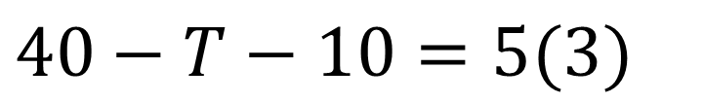
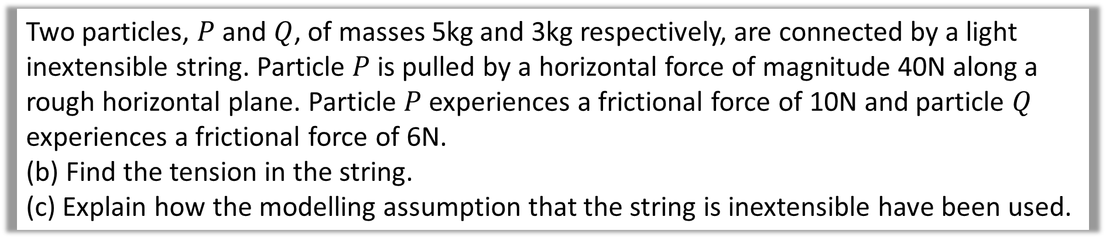
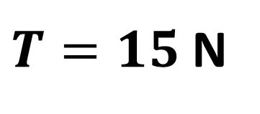
Two particles, $P$ and $Q$, of masses 5kg and 3kg respectively, are connected by a light inextensible string. Particle $P$ is pulled by a horizontal force of magnitude 40N along a rough horizontal plane. Particle $P$ experiences a frictional force of 10N and particle $Q$ experiences a frictional force of 6N.
(b) Find the tension in the string.
(c) Explain how the modelling assumption that the string is inextensible have been used.
b.
$$40−T−10=5(3)$$
$T=15$ N
c.
acceleration of the objects are the same

Slide 9
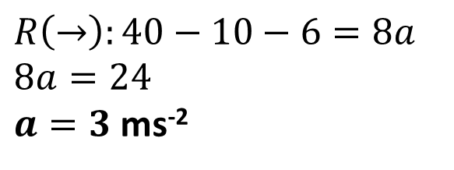
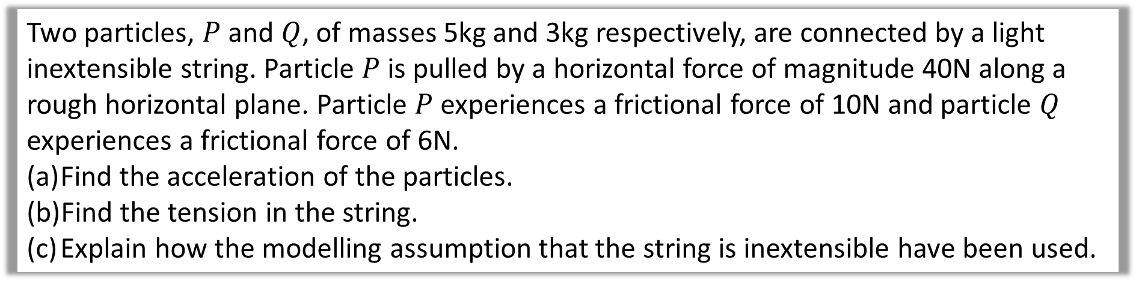

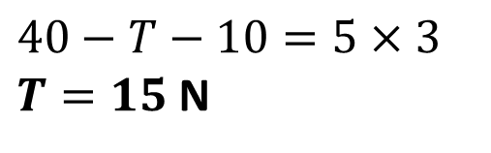
Two particles, $P$ and $Q$, of masses 5kg and 3kg respectively, are connected by a light inextensible string. Particle $P$ is pulled by a horizontal force of magnitude 40N along a rough horizontal plane. Particle $P$ experiences a frictional force of 10N and particle $Q$ experiences a frictional force of 6N.
Find the acceleration of the particles.
Find the tension in the string.
Explain how the modelling assumption that the string is inextensible have been used.
a
$$R\left(→\right):40−10−6=8a \\ 8a=24$$
$a=3$ ms⁻²
b
$$40−T−10=5×3$$
$T=15$ N
c
Inextensible $⇒$ acceleration of objects the same

Slide 10
Thrust
not
Tension

Slide 11
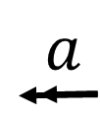
The car is now reversing

Slide 12
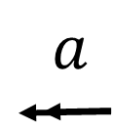





m
m
$$Thrust$$
$$Thrust$$
$$Driving$$
$$Force$$
$$Resistance$$
$$Force$$
$$Caravan$$
$$Resistance$$
$$Force$$
$$Car$$

Slide 13
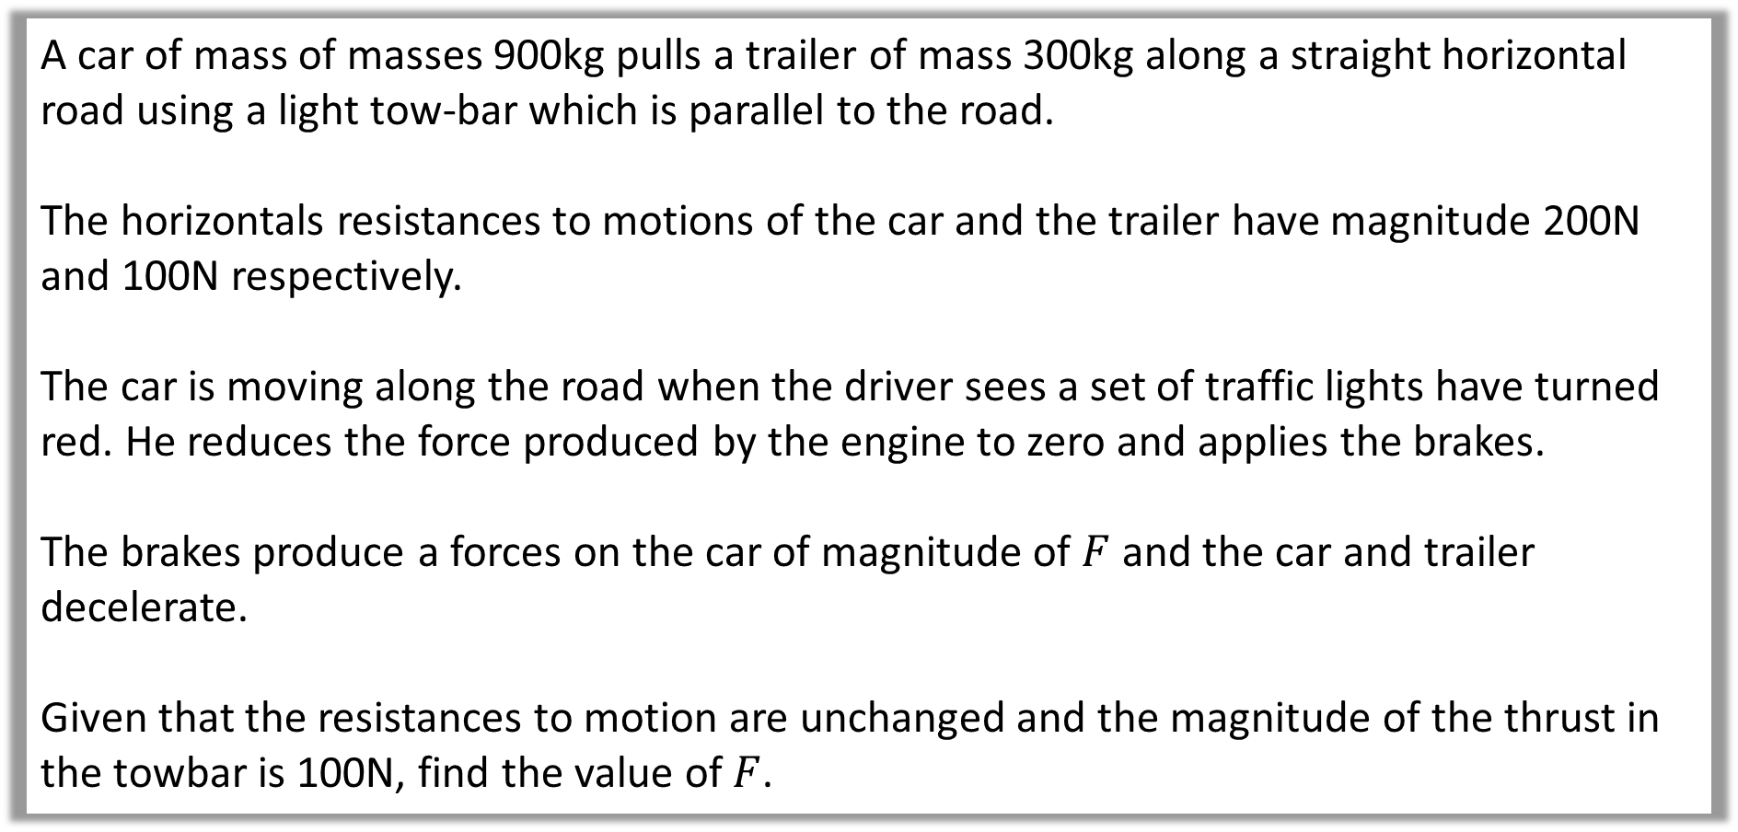
Question B
A car of mass of masses 900kg pulls a trailer of mass 300kg along a straight horizontal road using a light tow-bar which is parallel to the road.
The horizontals resistances to motions of the car and the trailer have magnitude 200N and 100N respectively.
The car is moving along the road when the driver sees a set of traffic lights have turned red. He reduces the force produced by the engine to zero and applies the brakes.
The brakes produce a forces on the car of magnitude of $F$ and the car and trailer decelerate.
Given that the resistances to motion are unchanged and the magnitude of the thrust in the towbar is 100N, find the value of $F$.

Slide 14


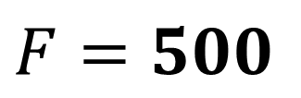

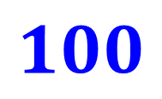

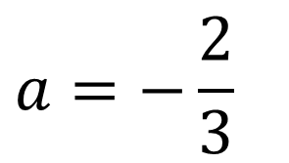






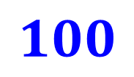


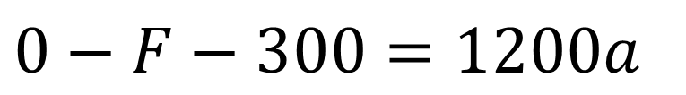
300
$$100$$
$$100$$
900
$$F$$
$$100$$
$$200$$
$$0−F−300=1200a$$
$$100$$
1200
$$F$$
$$200$$
$$F=500$$
$$0−100 −100=300a$$
300
$$100$$
$$100$$
$$a=−\frac{2}{3}$$
$$100$$
900
$$F$$
$$200$$

