Slide 1
LO: Choosing Averages

Slide 2

Which average should I choose to analyse my data?
Mode
Median
Mean
Range

Slide 3
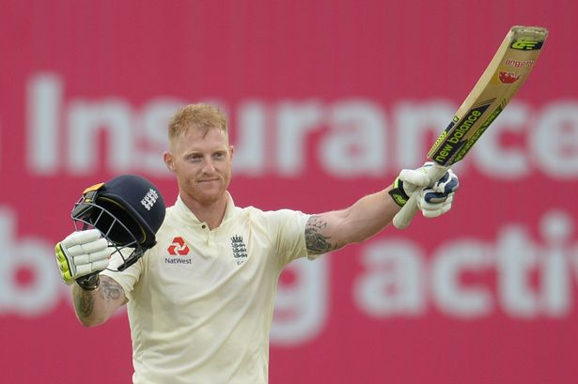
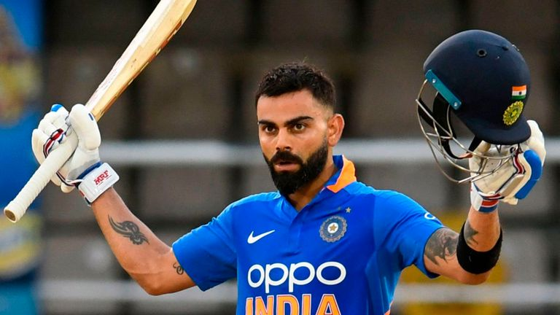
This is Ben Stokes…
This is Virat Kohli…
Use the following data to decide
who is the best batsman?

Slide 4
These are the runs
Stokes scored in his last
11 matches.
These are the runs
Kholi scored in his last
11 matches.
18
26
0
42
0
0
0
112
31
614
63
0
0
40
58
1
72
0
25
0
1
63

Slide 5
Stokes
Kholi
Mode =
63 Runs
Mode =
0 Runs
Median =
42 Runs
Median =
0 Runs
Mean =
50 Runs
Mean =
56 Runs
Range =
94 Runs
Range =
613 Runs
Who is the best batsman?

Slide 6
Choosing the Best Average
Advantages
Mode
Median
Mean
Range
Not effective by extreme values
Not effective by extreme values
Includes all Values
Shows how consistent the data maybe

Slide 7
4, 4, 4, 4, 4, 4, 4, 4, 4, 100
Which average best represents the data?
Mode
Mean
Median
Not effective by
extreme values
Includes all values
Not effective by
extreme values

Slide 8
2, 3, 5, 6, 7, 7, 7, 7, 7, 100
Which average best represents the data?
Mode
Mean
Median
Not effective by
extreme values
Includes all values
Not effective by
extreme values

Slide 9
1, 2, 3, 4, 5, 6, 7, 8, 9, 100
Which average best represents the data?
Mode
Mean
Median
Not effective by
extreme values
Includes all values
Not effective by
extreme values

Slide 10
1, 2, 3, 4, 5, 6, 7, 8, 9, 10
Which average best represents the data?
Mode
Mean
Median
Not effective by
extreme values
Includes all values
Not effective by
extreme values

Slide 11
4, 4, 5, 12, 30, 34, 44
Which average best represents the data?
Mode
Mean
Median
Not effective by
extreme values
Includes all values
Not effective by
extreme values

Slide 12

Which average best represents the data and why?
Each of the despicable characters took a test which was out of 100 marks.
34
98
4
52
75
22
4
36
88
100
Mode = 4
Median = 44
Mean = 51.3

Slide 13
Which average best represents the data and why?
Each of the despicable characters took a test which was out of 100 marks.
4
100
4
4
4
4
4
4
4
100
Mode = 4
Median = 4
Mean = 23.2

Slide 14
Which test did the class do best in?
Each of the despicable characters took a test which was out of 100 marks.
Test A
Range = 0
20
20
20
20
20
20
20
20
20
20
Test B
Range = 80
4
12
25
44
48
50
75
79
82
84
Test C
Range = 2
98
100
99
99
100
99
98
98
99
100

