Slide 1
Vectors
Angles between
vectors and an axis
Chapter 12
(Part 4 of 6)

Slide 2
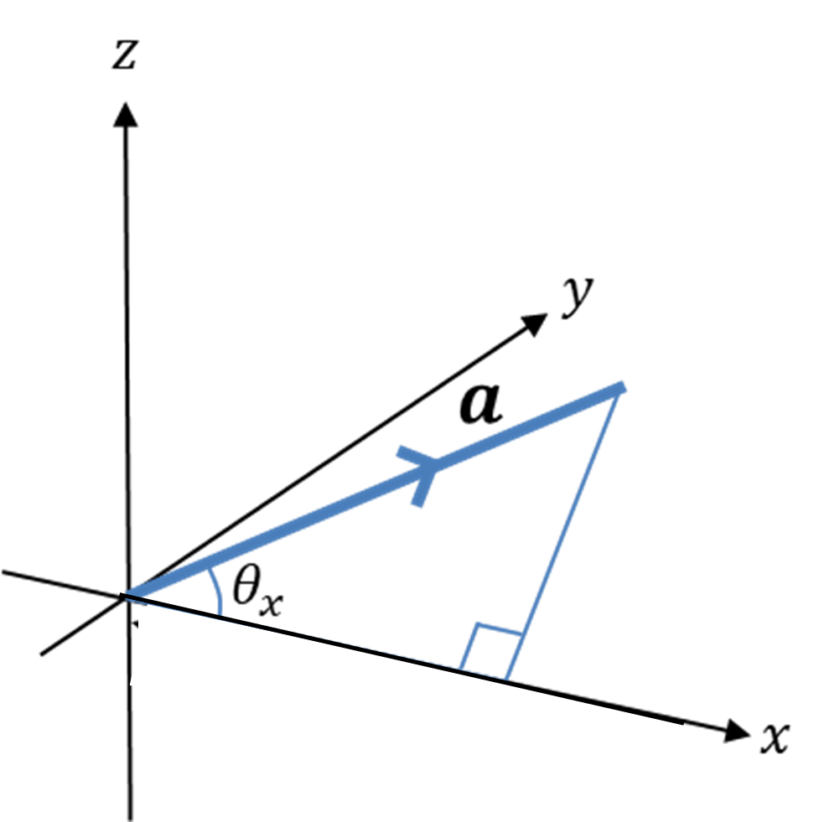



$$\cos{θ_{x}}=\frac{i component}{\left|a\right|}$$
$$\cos{θ_{y}}=\frac{j component}{\left|a\right|}$$
$$\cos{θ_{z}}=\frac{k component}{\left|a\right|}$$

Slide 3
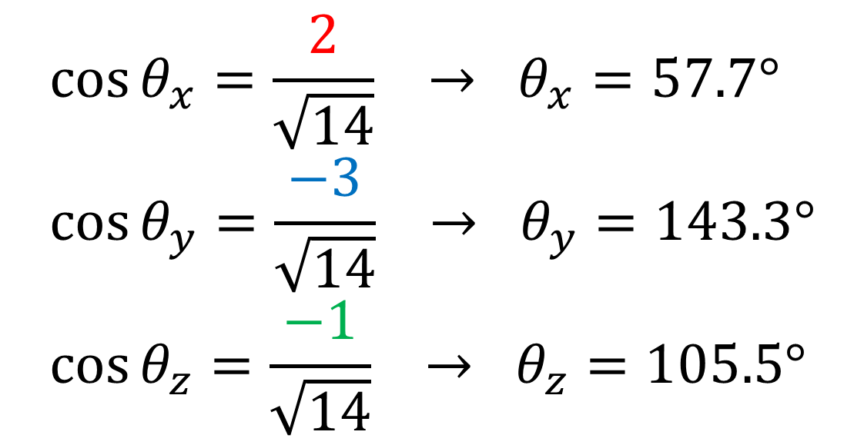


Find the angles that the vector $a=2i−3j−k$
makes with each of the positive coordinate axis.
$$\left|a\right|=\sqrt{2^{2}+{\left(−3\right)}^{2}+{\left(−1\right)}^{2}}=\sqrt{14}$$
$$\cos{θ_{x}}=\frac{2}{\sqrt{14}} → θ_{x}=57.7° \\ \cos{θ_{y}}=\frac{−3}{\sqrt{14}} → θ_{y}=143.3° \\ \cos{θ_{z}}=\frac{−1}{\sqrt{14}} → θ_{z}=105.5°$$

Slide 4
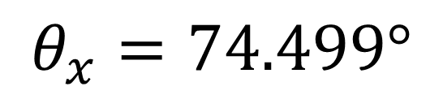

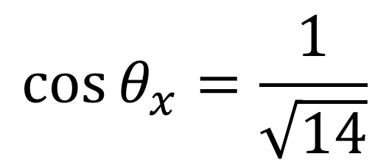
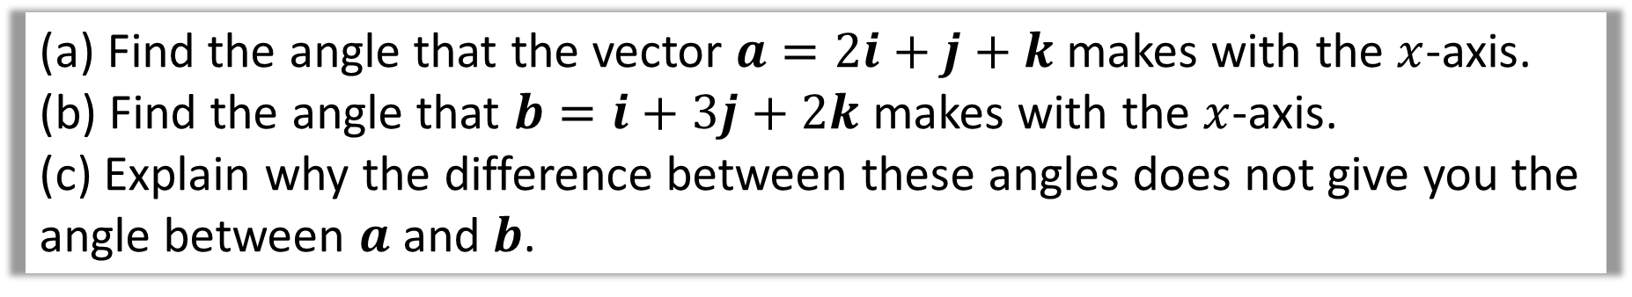
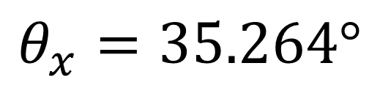
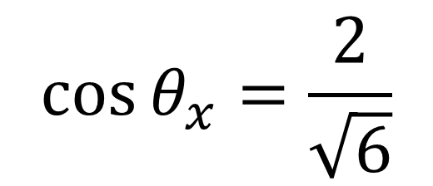

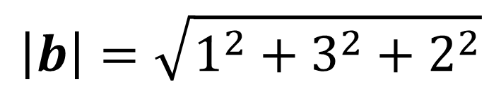

(a) Find the angle that the vector $a=2i+j+k$ makes with the $x$-axis.
(b) Find the angle that $b=i+3j+2k$ makes with the $x$-axis.
(c) Explain why the difference between these angles does not give you the angle between $a$ and $b$.
$$\left|a\right|=\sqrt{2^{2}+1^{2}+1^{2}}$$
$$\left|b\right|=\sqrt{1^{2}+3^{2}+2^{2}}$$
a)
b)
$$\left|a\right|=\sqrt{6}$$
$$\left|b\right|=\sqrt{14}$$
$$\cos{θ_{x}}=\frac{2}{\sqrt{6}}$$
$$\cos{θ_{x}}=\frac{1}{\sqrt{14}}$$
$$θ_{x}=35.264°$$
$$θ_{x}=74.499°$$

Slide 5



(a) Find the angle that the vector $a=2i+j+k$ makes with the $x$-axis.
(b) Find the angle that $b=i+3j+2k$ makes with the $x$-axis.
(c) Explain why the difference between these angles does not give you the angle between $a$ and $b$.
c)
The difference ($74.5 −35.3=39.2°$) would only be the angle between $a$ and $b$ if $a,b$ and $i$ were coplanar,
i.e. lied on the same plane.
$$74.499°$$
$$x$$

