Slide 1
LO: Linear Equations
from Two Co-ordinates

Slide 2

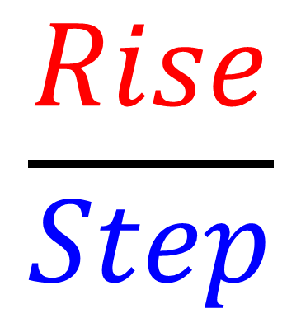
Rise
Step
$$\frac{Rise}{Step}$$
Gradient =

Slide 3
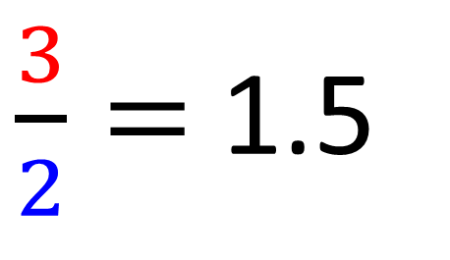
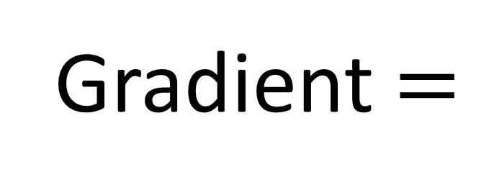
y
3
2
x
$\frac{3}{2}=$ 1.5
Gradient $=$

Slide 4
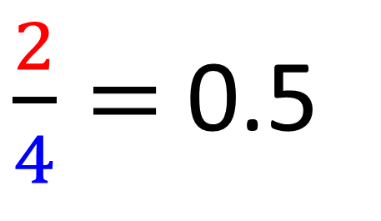

y
2
4
x
$\frac{2}{4}=$ 0.5
Gradient $=$

Slide 5
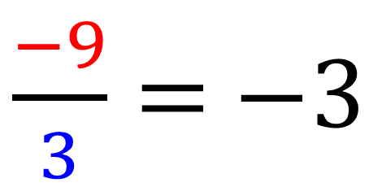

y
$\frac{−9}{3}=$ $−3$
Gradient $=$
x
–9
3

Slide 6
What is the change in x values
between (0,4) and (3,8)?
3 – 0 = 3

Slide 7
What is the change in x values
between (3,7) and (5,8)?
5 – 3 = 2

Slide 8
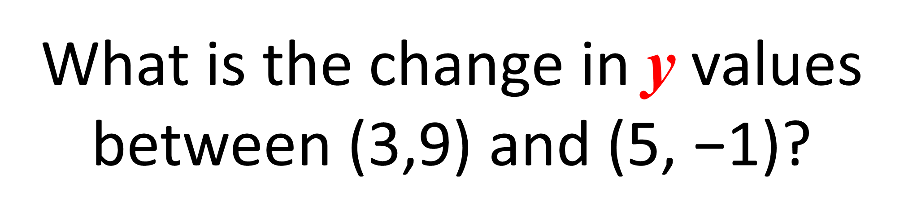
What is the change in y values
between (3,9) and (5, $\text{−}$1)?
–1 – 9 = –10

Slide 9
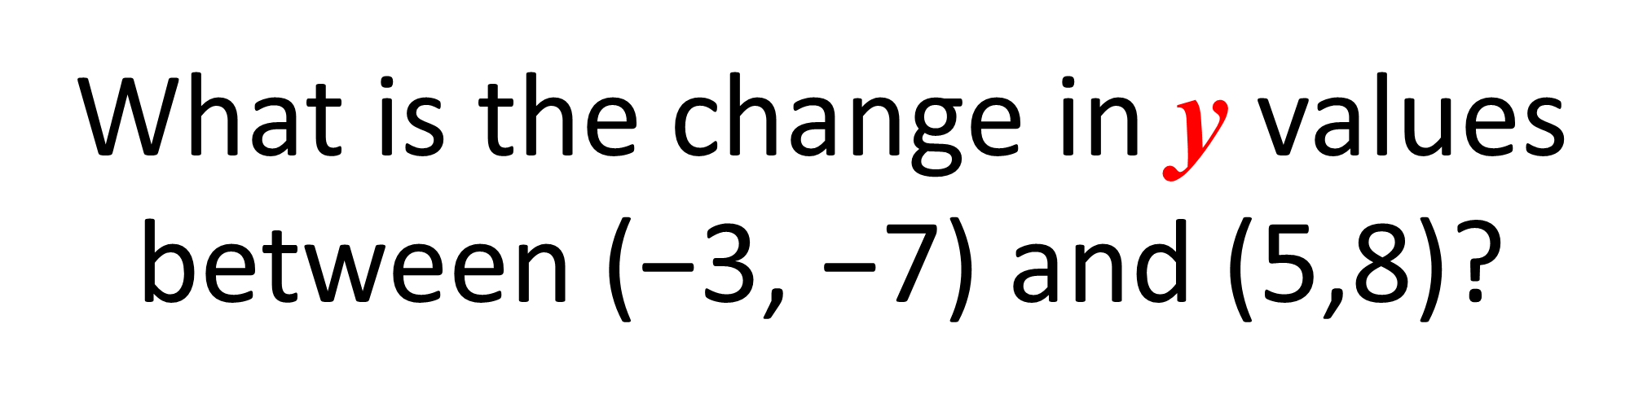
What is the change in y values
between ($\text{−}$3, $\text{−}$7) and (5,8)?
8 – –7 = 15

Slide 10
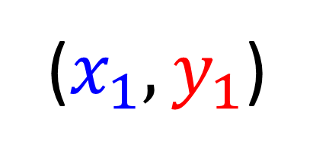
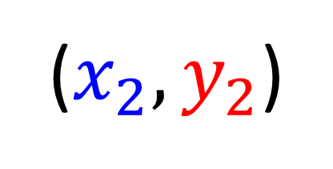
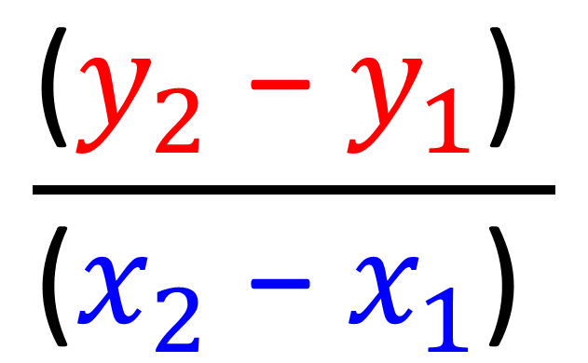
($x_{2},y_{2}$)
($x_{1},y_{1}$)
$$\frac{\text{(}y_{2}\text{ −}{ y}_{1}\text{) }}{\text{(}x_{2}\text{ −}{ x}_{1}\text{) }}$$
Gradient =

Slide 11
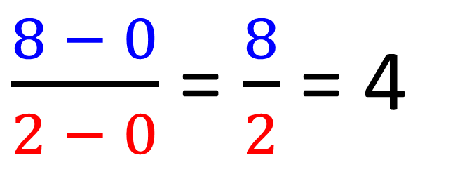
y
(2,8)
x
(0,0)
$\frac{8 − 0}{2 − 0}$ = $\frac{8}{2}$ = 4
Gradient =

Slide 12
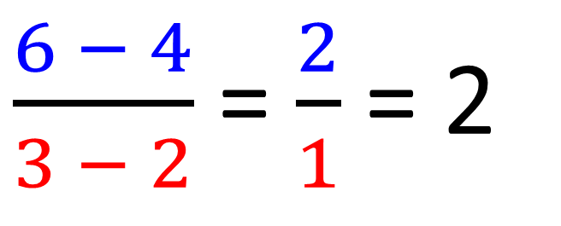
y
(3,6)
(2,4)
x
$\frac{6 − 4}{3 − 2}$ = $\frac{2}{1}$ = 2
Gradient =

Slide 13
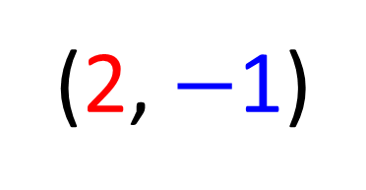
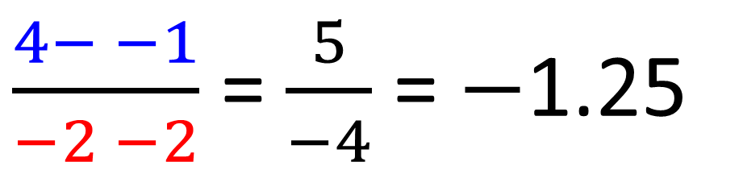
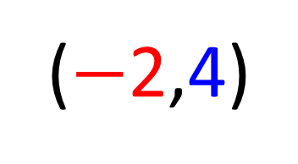
y
($−$2,4)
x
(2, $−$1)
$\frac{4− −1}{−2 −2}$ = $\frac{5}{−4}$ = $−$1.25
Gradient =

Slide 14
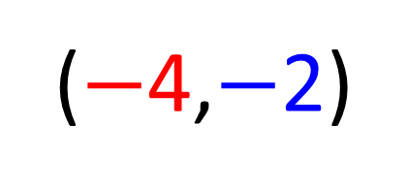
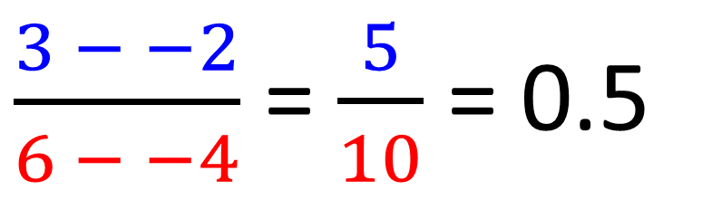
y
(6,3)
x
($−$4,$−$2)
$\frac{3 − −2}{6 − −4}$ = $\frac{5}{10}$ = 0.5
Gradient =

Slide 15
What is the equation of line?
y
(2,7)
(0,1)
x
y = 3x + 1

Slide 16
What is the equation of line?
y
(2,6)
x
(0,-2)
y = 4x – 2

Slide 17
What is the equation of line?
y
(3,3)
x
y = x
(-2,-2)

Slide 18
What is the equation of line?
y
y = 3x + c
(2,8)
8 = 3(2) + c
c = 2
x
y = 3x + 2
(-2,-4)

Slide 19
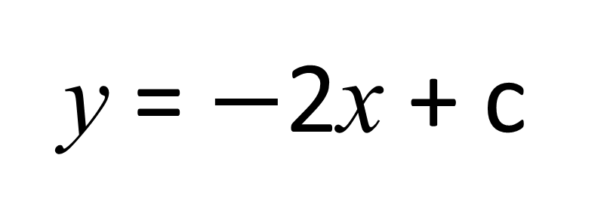
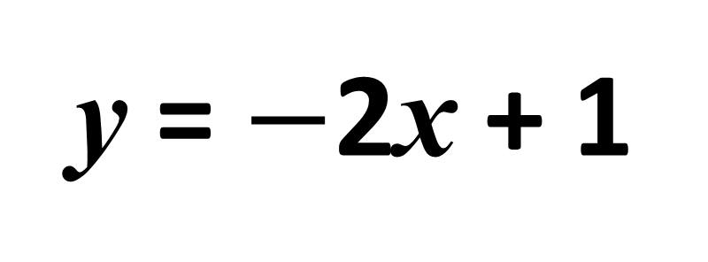
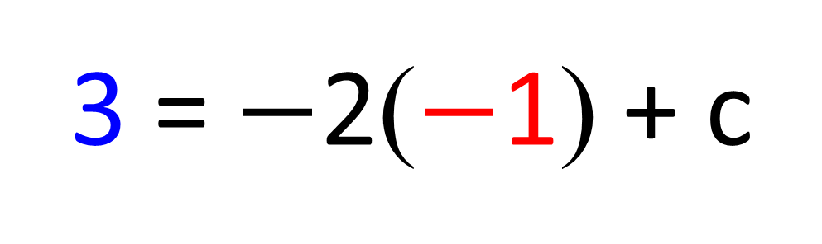
What is the equation of line?
y
y = $−$2x + c
3 = $−$2($−$1) + c
(-1,3)
c = 1
x
y = $−$2x + 1
(2,-3)

