Slide 1

Senior Challenge 5
SILVER

Slide 2
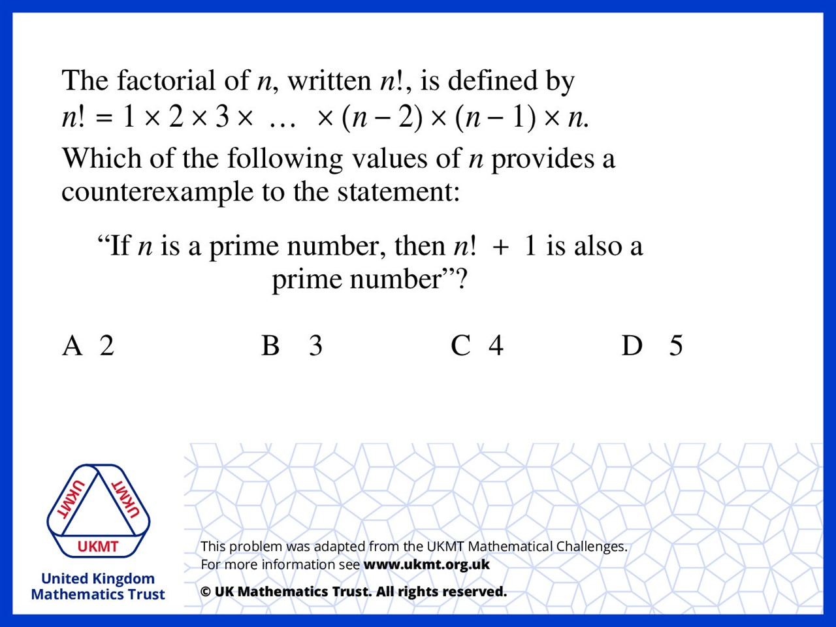
Q1.
5! + 1 = 126 not a prime number

Slide 3
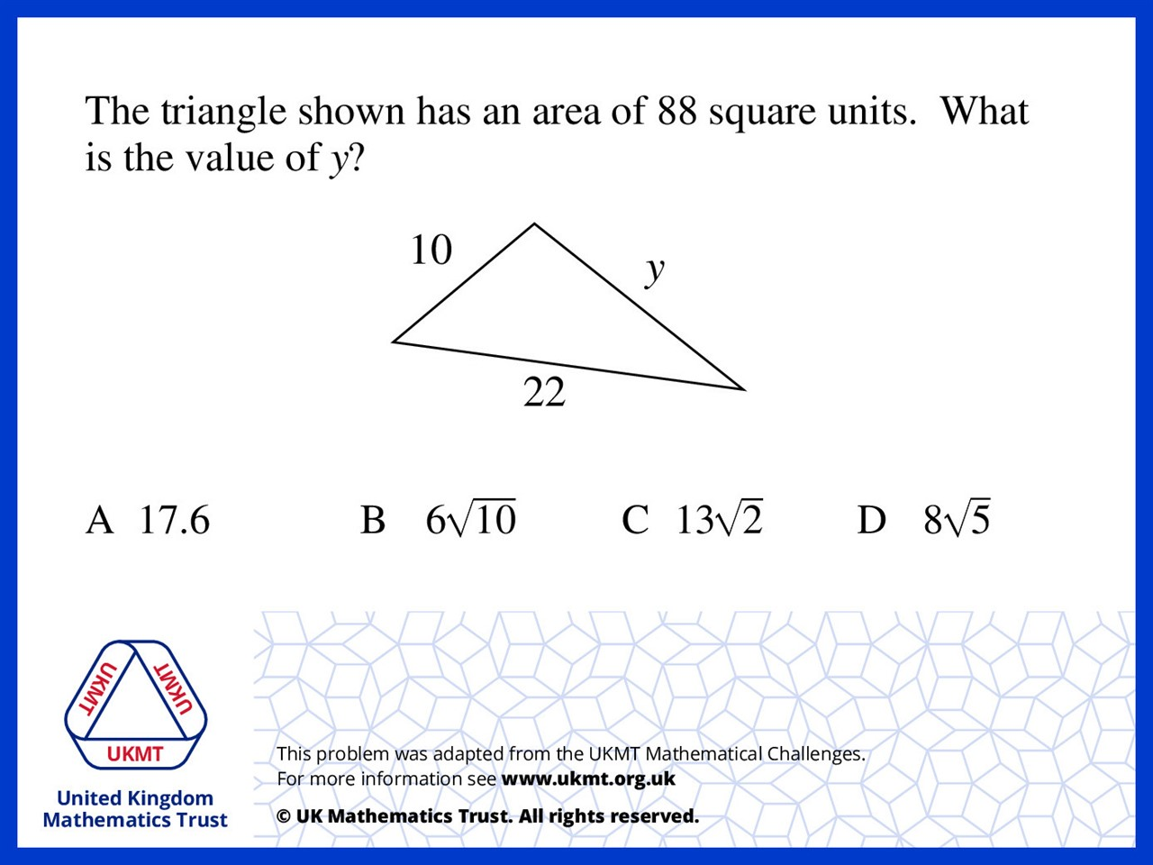
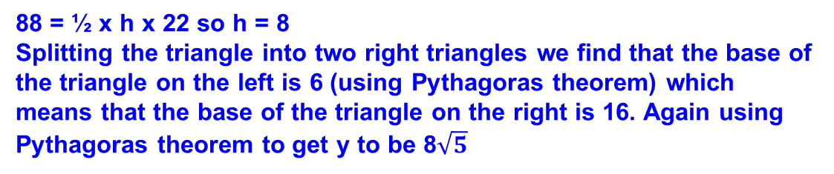
Q2.
88 = ½ x h x 22 so h = 8
Splitting the triangle into two right triangles we find that the base of the triangle on the left is 6 (using Pythagoras theorem) which means that the base of the triangle on the right is 16. Again using Pythagoras theorem to get y to be 8$\sqrt{5}$

Slide 4
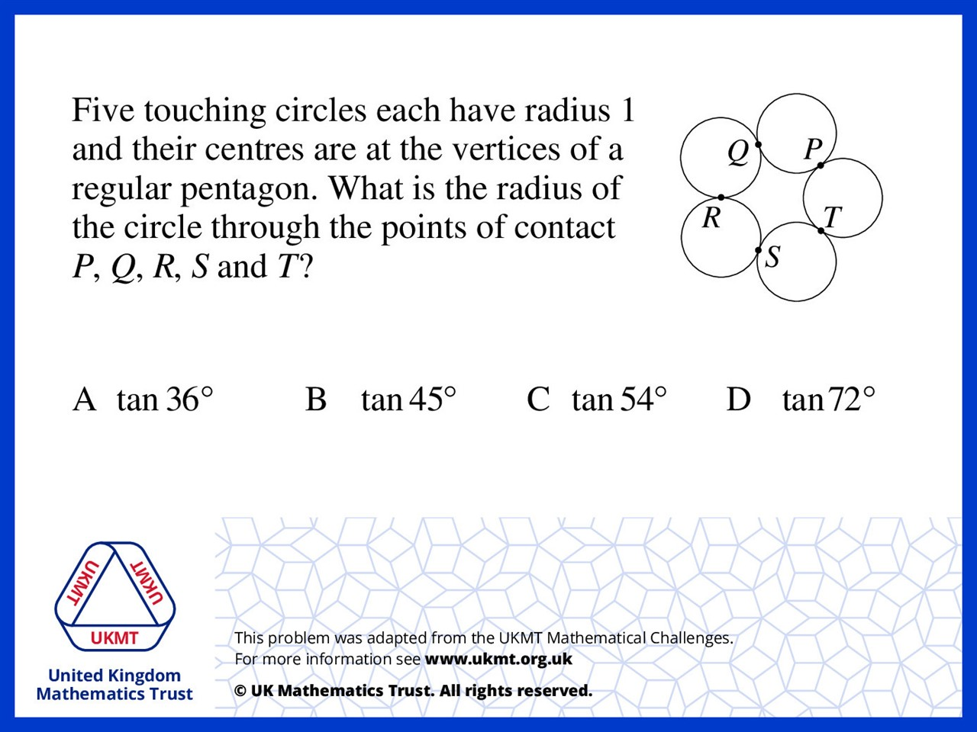
Q3.
The angle of a vertex of a pentagon is 108*.
Drawing a line from one vertex to the center of the pentagon and drawing another line from the middle of the side right next to the vertex to the center we get a right triangle. The angle of the vertex was bisected therefore the angle of one vertex of the triangle is 54. The tangent of this angle is the radius of the circle over half the length of one side of the pentagon which is one.

Slide 5
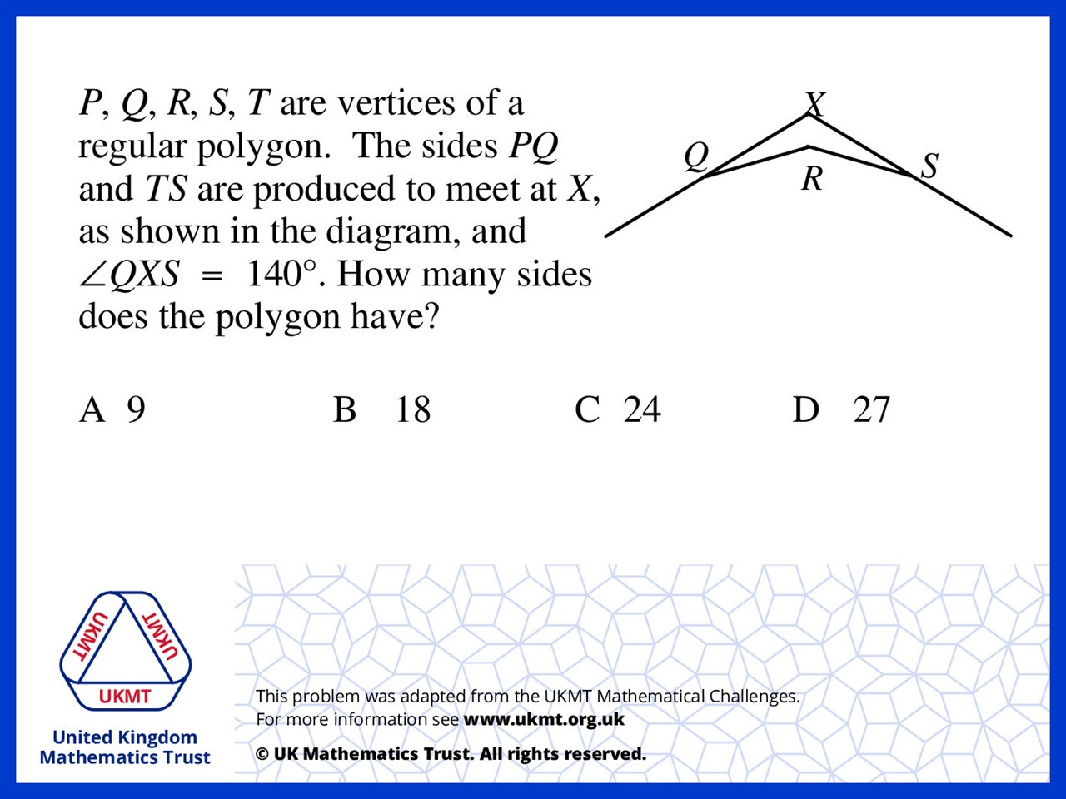
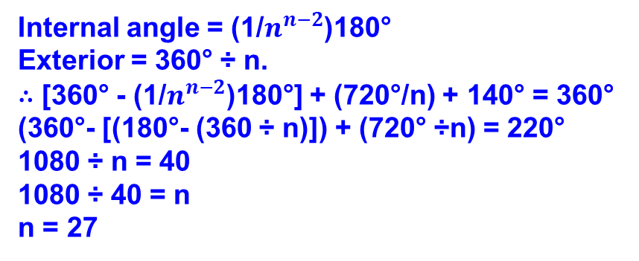
Q4.
Internal angle = (1/$n^{n−2}$)180°
Exterior = 360° ÷ n.
∴ [360° - (1/$n^{n−2}$)180°] + (720°/n) + 140° = 360°
(360°- [(180°- (360 ÷ n)]) + (720° ÷n) = 220°
1080 ÷ n = 40
1080 ÷ 40 = n
n = 27

Slide 6
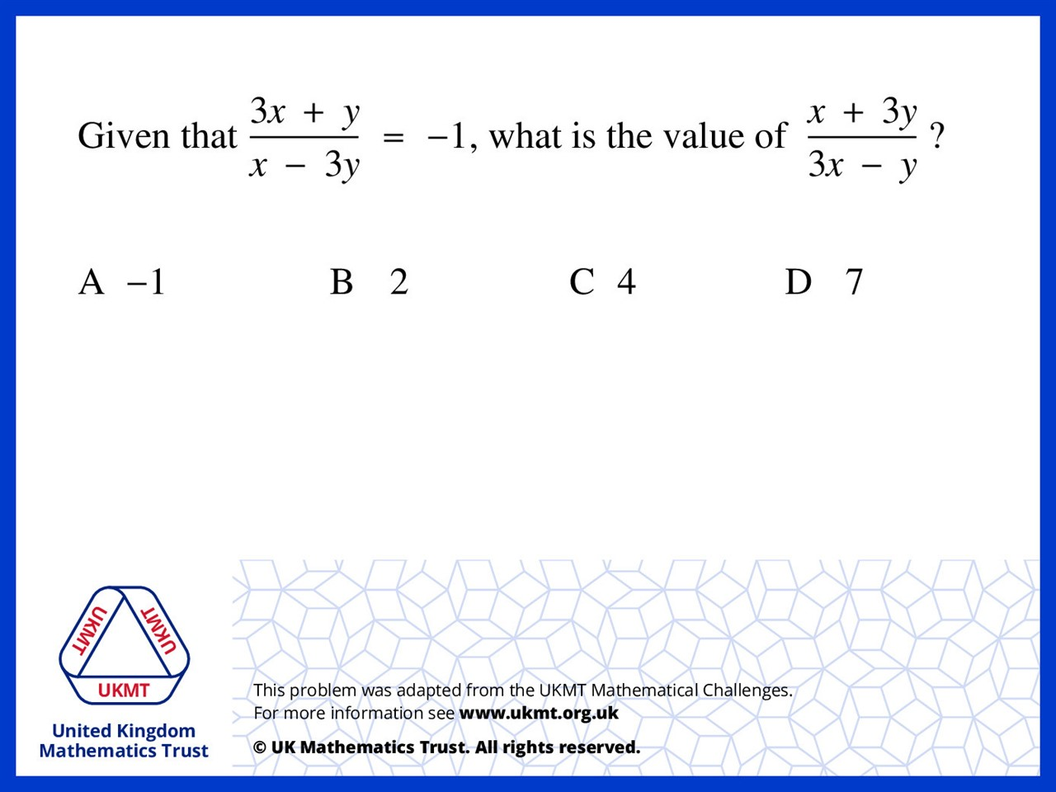
Q5.
2x = y,
So let x = ½ and y = 1
sub into equation gets
7/2 divided by 1/2 = 7

