Slide 1
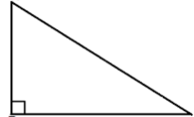
10cm
1) What is the length of the missing side?
10cm
2) What is the perimeter of the shape?
6cm
6cm
3) What is the area of the triangle?
4) What is the perimeter of the shape?
Give you answer to 1 d.p.
10cm
6cm
6cm
10cm

Slide 2
5) What is the perimeter of the shape?
8cm
6) What is the area of the triangle?
8cm
10cm
10cm
7) The triangle is the face of a triangular prism with a length of 10.
What is the volume of the prism?
8cm
8cm
8) What is the height of the triangle?
10cm
10cm

Slide 3
ANSWERS

Slide 4


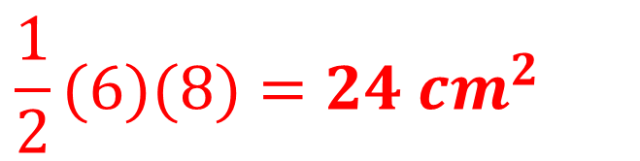

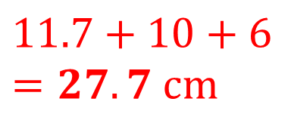




10cm
1) What is the length of the missing side?
10cm
2) What is the perimeter of the shape?
6cm
6cm
$${x^{2}=10}^{2}− 6^{2}$$
$$6+10+8=24 cm$$
$$x^{2}=64$$
$$x=\sqrt{64}=8 cm$$
3) What is the area of the triangle?
4) What is the perimeter of the shape?
Give you answer to 1 d.p.
10cm
6cm
6cm
10cm
$$\frac{1}{2}(6)(8)=24 {cm}^{2}$$
$${x^{2}=10}^{2}+ 6^{2}$$
$$11.7+10+6=27.7 cm$$
$$x^{2}=136$$
$$x=\sqrt{136}=11.7 cm$$

Slide 5




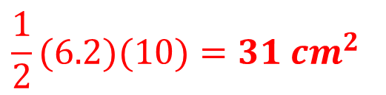


5) What is the perimeter of the shape?
8cm
6) What is the area of the triangle?
8cm
10cm
10cm
$${x^{2}=8}^{2}− 5^{2}$$
$$\frac{1}{2}(6.2)(10)=31 {cm}^{2}$$
$$8+10+8=26 cm$$
$$x^{2}=39$$
$$x=\sqrt{39}=6.2 cm$$
7) The triangle is the face of a triangular prism with a length of 10.
What is the volume of the prism?
8cm
8cm
8) What is the height of the triangle?
10cm
10cm
$$31 \text{x} 10=310 {cm}^{3}$$
$$x=\sqrt{39}=6.2 cm$$

