Slide 1
LO: Proofs
(Geometry)

Slide 2
Geometry facts that you need to know:
Angles and Parallel Line
Interior Angles
Shape Properties

Slide 3
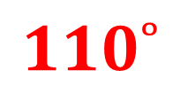
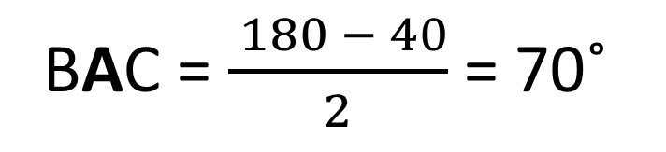
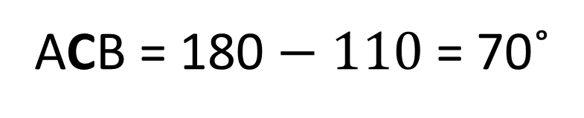
Is the triangle an equilateral,
isosceles or scalene.
B
ACB = 180 $− 110$ = 70˚
40˚
BAC = $\frac{ 180 − 40}{2}$ = 70˚
$$110˚$$
ACB = BAC hence isosceles
A
C
Notes:
3

Slide 4
What is the total of x, y and z?
y = 80˚
A
D
z = 70˚
80˚
y
80 + 70 + 30 = 180˚
70˚
30˚
z
B
C
E
Notes:
4

Slide 5
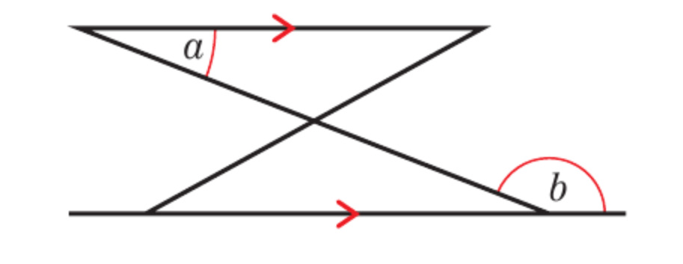
Prove that a = 180˚ - b
a
Alternative Angles
180 = a + b
a = 180 – b

Slide 6
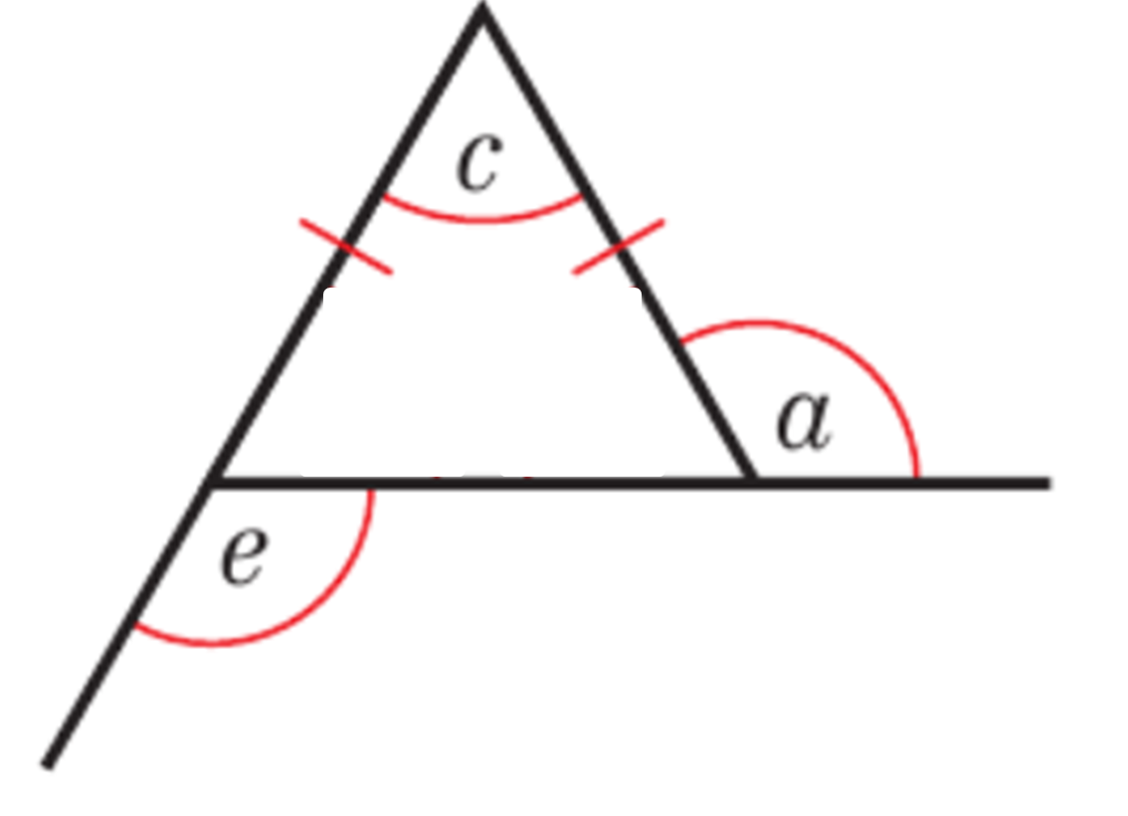
Show a = e
180 - e = 180 - a
e = a
180 - e
180 - a

Slide 7
Prove that the sum of the
interior angles of a triangle is 180˚
A
D
ACD = a
Alternative
Angles
a
DCE = b
Corresponding
Angles
a
b
c
b
B
C
E
a + b + c = 180˚
Straight Line
Notes:
7

Slide 8
Prove that the sum of the
interior angles of a triangle is 180˚
F
A
D
BAF = b
Alternative
Angles
b
c
a
CAD = c
Alternative
Angles
b
c
B
C
E
a + b + c = 180˚
Straight Line
Notes:
8

Slide 9
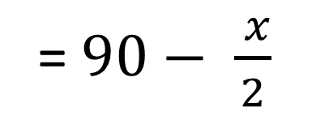
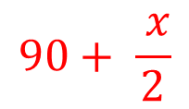
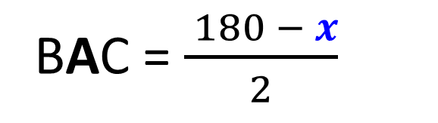
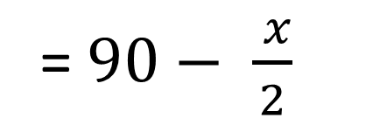
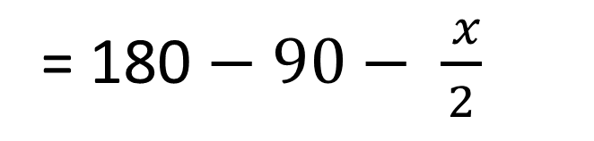
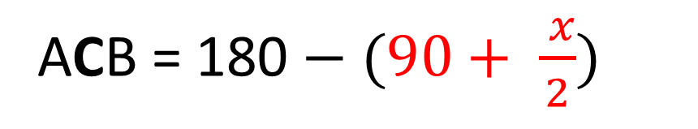
Prove that the triangle
is an isosceles.
ACB = 180 $− (90+ \frac{ x}{2})$
= 180 $− 90− \frac{ x}{2}$
B
= $90− \frac{ x}{2}$
x
BAC = $\frac{ 180 − x}{2}$
= $90− \frac{ x}{2}$
$$90+ \frac{ x}{2}$$
ACB = BAC hence isosceles
A
C
Notes:
9

