Slide 1
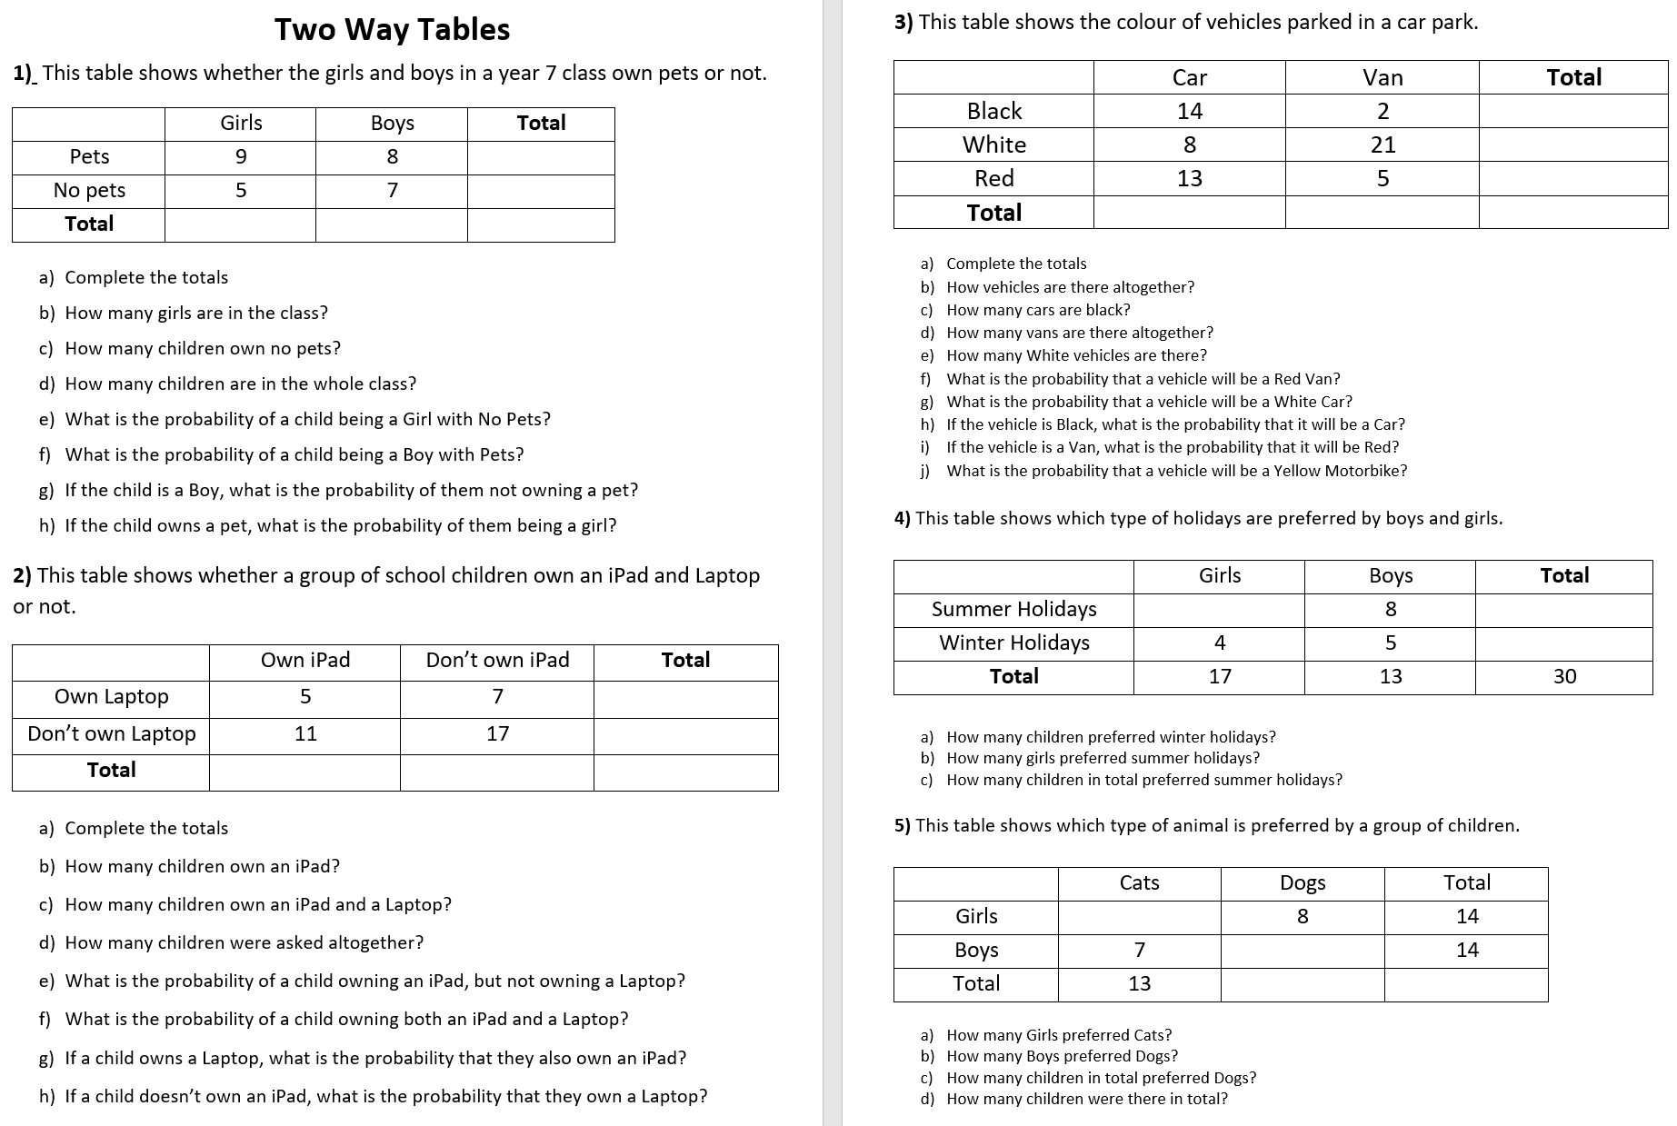

Slide 2
ANSWERS

Slide 3
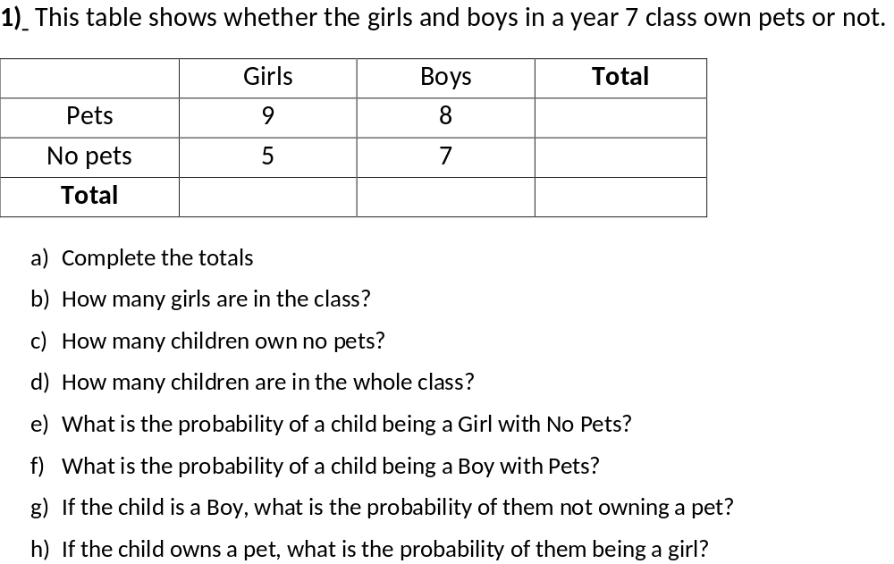
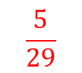
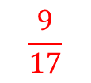
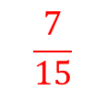
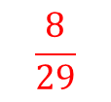
17
12
14
15
29
14
5
29
$$\frac{5}{29}$$
$$\frac{8}{29}$$
$$\frac{7}{15}$$
$$\frac{9}{17}$$

Slide 4
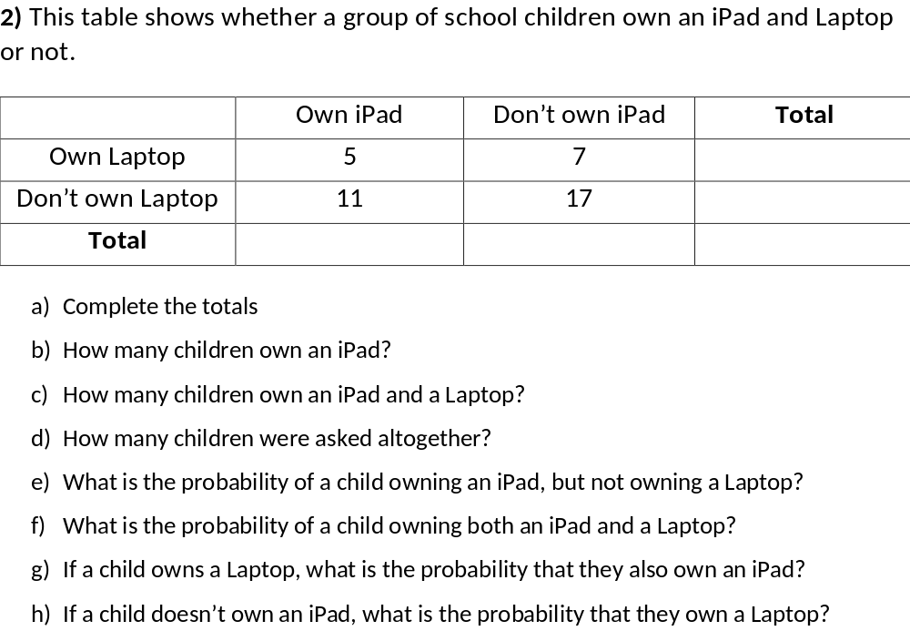
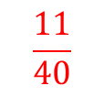
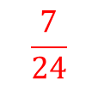
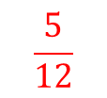
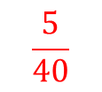
12
28
16
24
40
16
5
40
$$\frac{11}{40}$$
$$\frac{5}{40}$$
$$\frac{5}{12}$$
$$\frac{7}{24}$$

Slide 5
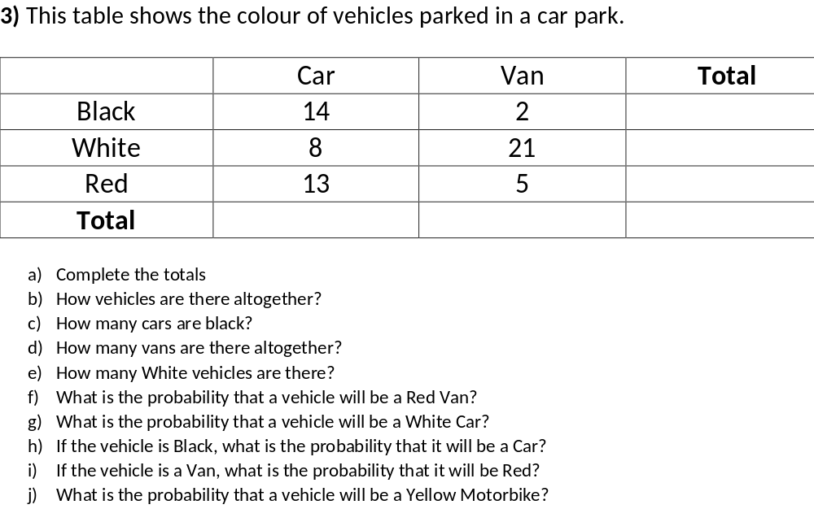
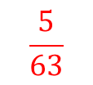

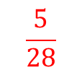
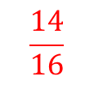
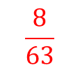
16
29
18
35
28
63
63
14
28
29
$$\frac{5}{63}$$
$$\frac{8}{63}$$
$$\frac{14}{16}$$
$$\frac{5}{28}$$
$$0$$

Slide 6
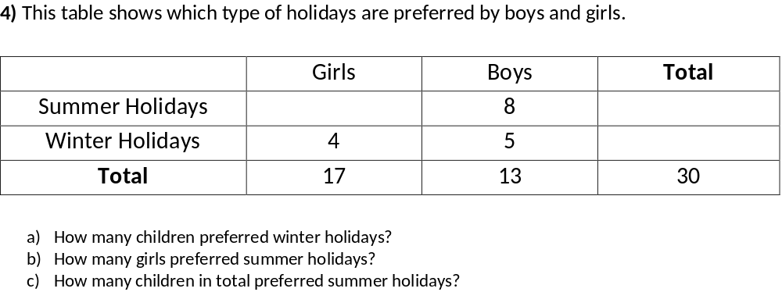
13
21
9
9
13
21

Slide 7
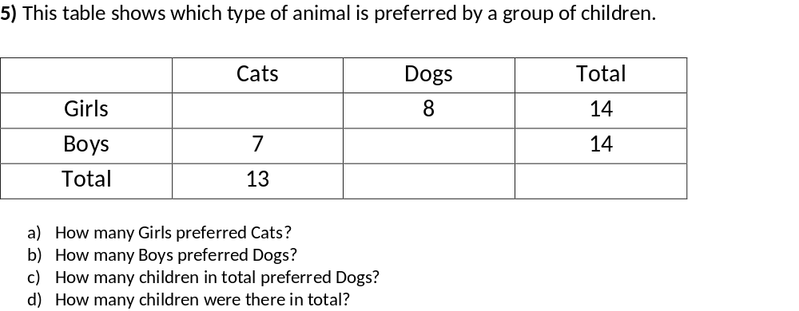
6
7
15
28
6
7
14
28

