Slide 1
LO: Simplify
Algebraic Fractions
(with Factorising)

Slide 2
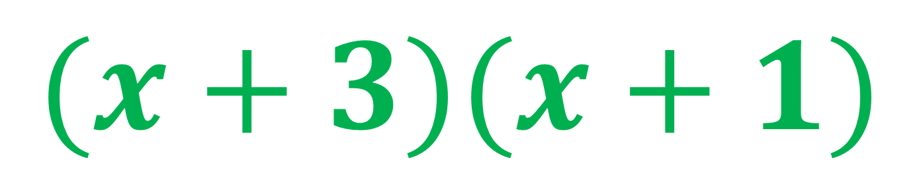
Factorise
x² + 4x + 3
$$(x+3)(x+1)$$

Slide 3
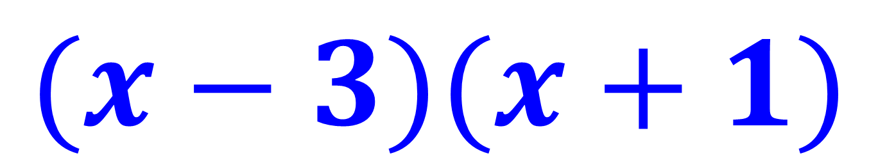
Factorise
x² – 2x – 3
$$(x−3)(x+1)$$

Slide 4
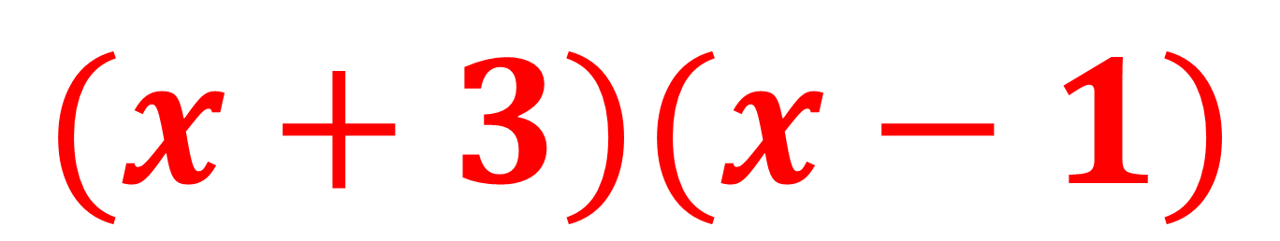
Factorise
x² + 2x – 3
$$(x+3)(x−1)$$

Slide 5
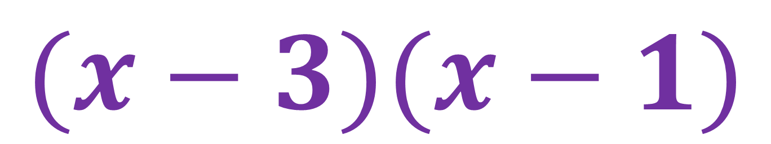
Factorise
x² – 4x + 3
$$(x−3)(x−1)$$

Slide 6
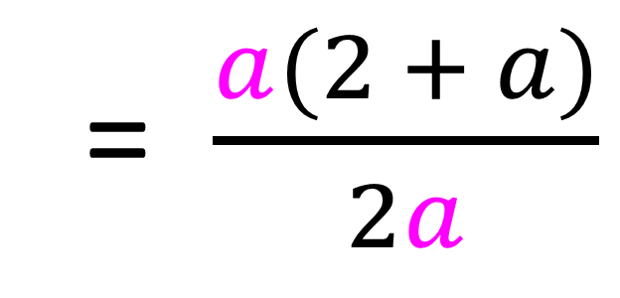
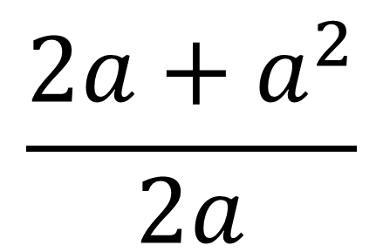
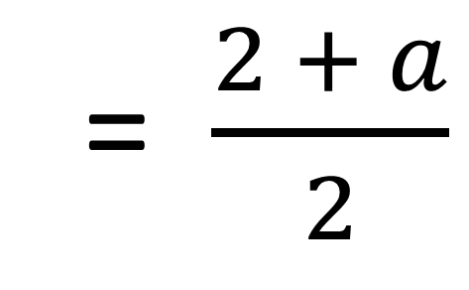
$$\frac{2a+a^{2}}{2a}$$
Simplify
= $\frac{a(2 + a)}{2a}$
= $\frac{2 + a}{2}$

Slide 7
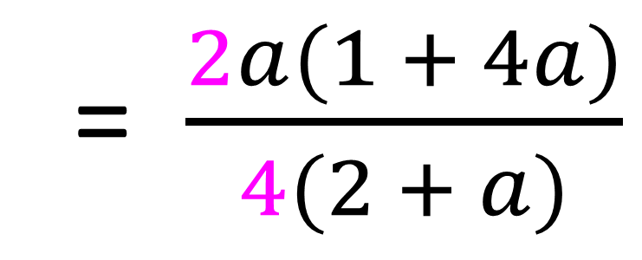
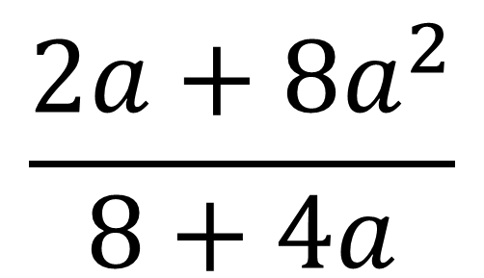
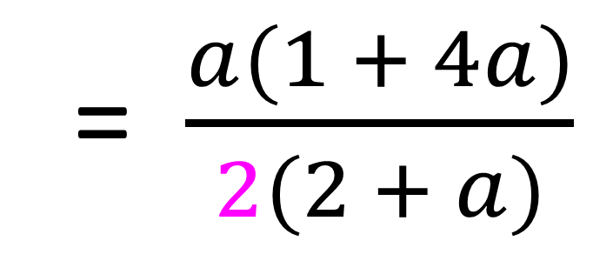
$$\frac{2a+{8a}^{2}}{8+4a}$$
Simplify
= $\frac{2a(1 + 4a)}{4(2 + a)}$
= $\frac{a(1 + 4a)}{2(2 + a)}$

Slide 8
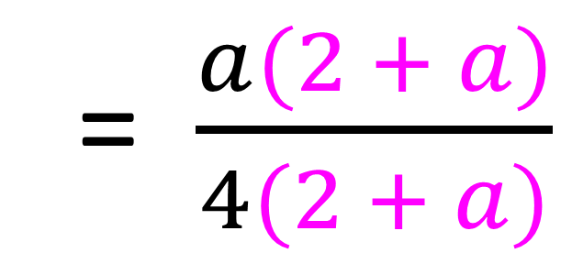
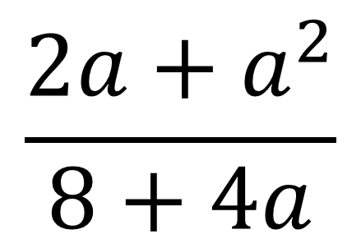
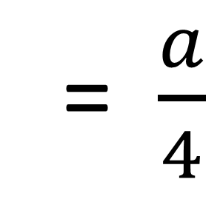
$$\frac{2a+a^{2}}{8+4a}$$
Simplify
= $\frac{a(2 + a)}{4(2 + a)}$
= $\frac{a}{4}$

Slide 9
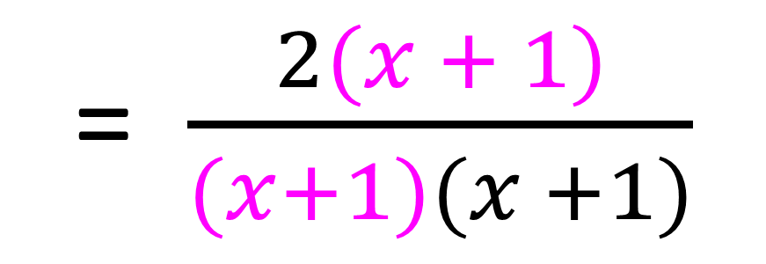
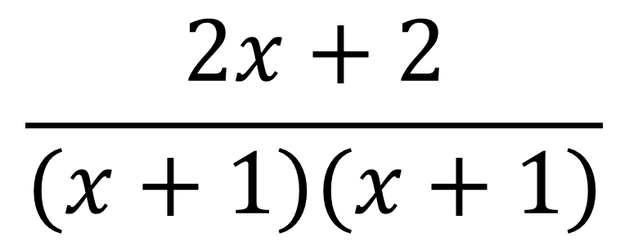
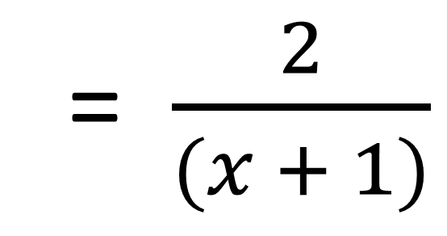
$$\frac{2x+2}{(x+1)(x+1)}$$
Simplify
= $\frac{2(x + 1)}{(x+1)(x +1)}$
= $\frac{2}{(x + 1)}$

Slide 10
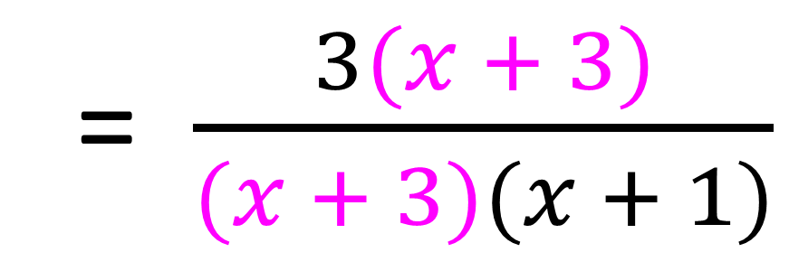
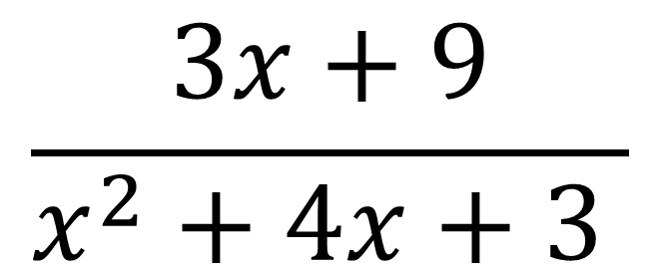
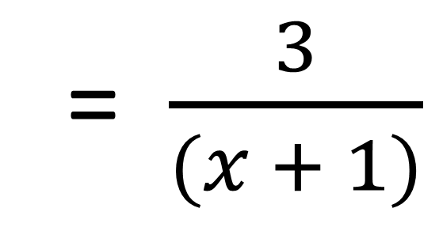
$$\frac{3x+9}{x^{2}+4x+3 }$$
Simplify
= $\frac{3(x + 3)}{(x + 3)(x + 1)}$
= $\frac{3}{(x + 1)}$

Slide 11
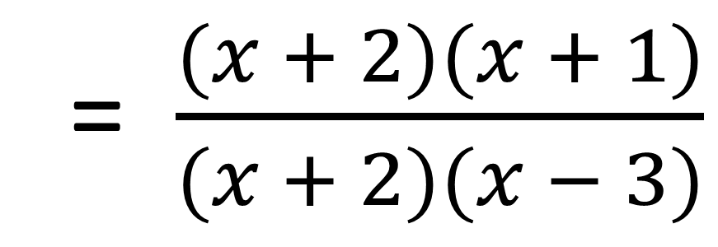
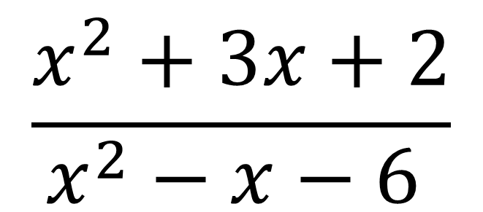
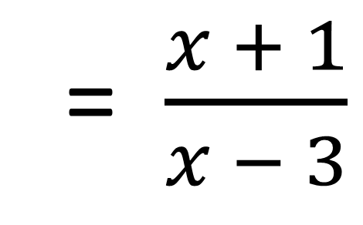
$$\frac{x^{2}+3x+2}{x^{2}−x−6 }$$
Simplify
= $\frac{(x + 2)(x + 1)}{(x + 2)(x − 3)}$
= $\frac{x + 1}{x − 3}$

Slide 12
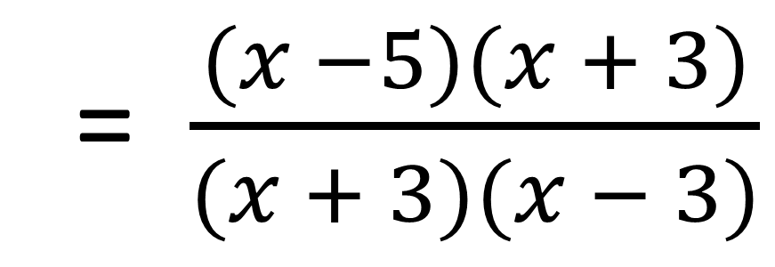
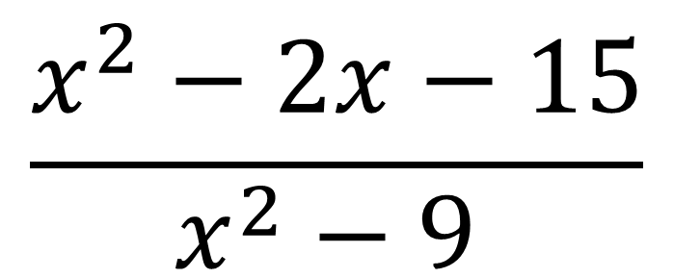
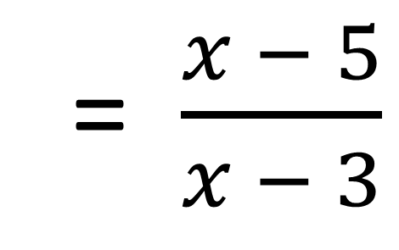
$$\frac{x^{2}−2x−15}{x^{2}−9 }$$
Simplify
= $\frac{(x −5)(x + 3)}{(x + 3)(x − 3)}$
= $\frac{x − 5}{x − 3}$

