Slide 1
Work, Energy and Power
Energy
Chapter 2
(Part 2 of 3)

Slide 2
Kinetic Energy
Kinetic Energy of an object is
the energy possessed
due to motion.

Slide 3
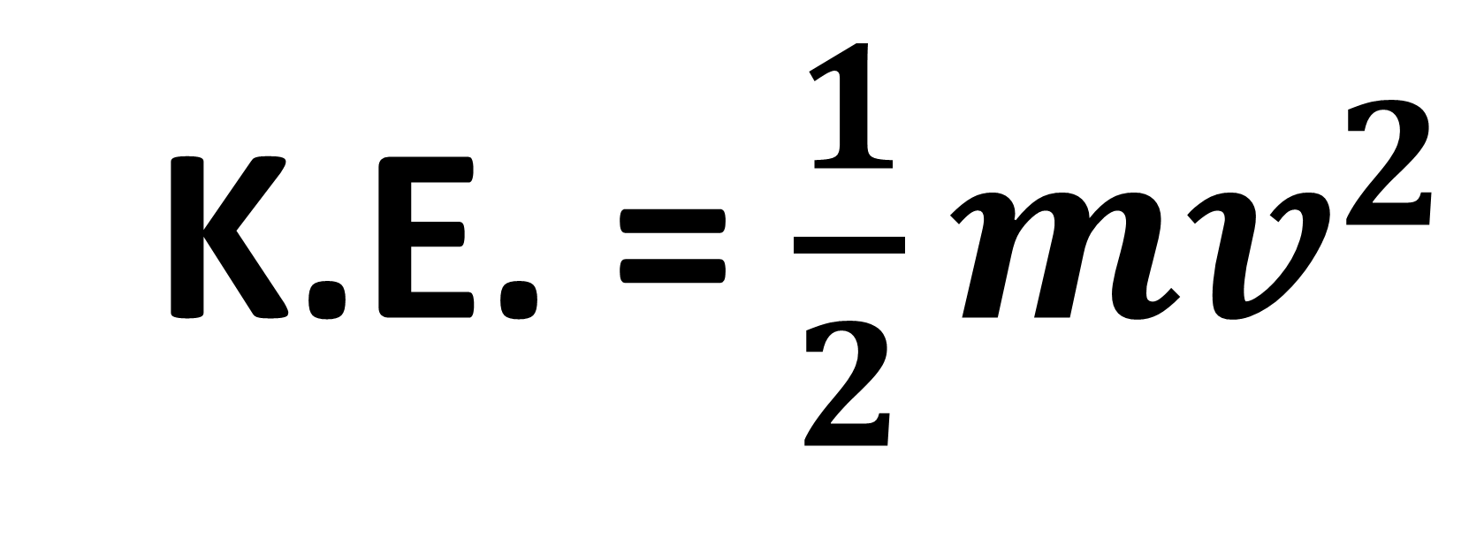
Kinetic Energy
K.E. = $\frac{1}{2}mv^{2}$

Slide 4
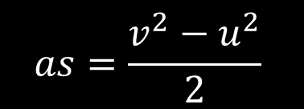

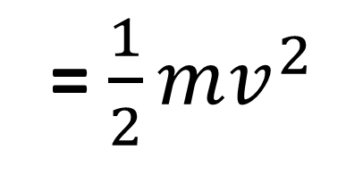


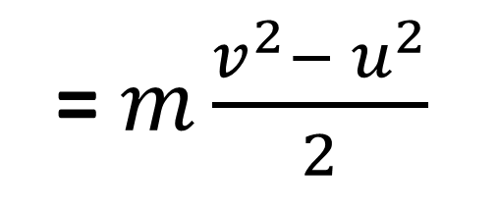

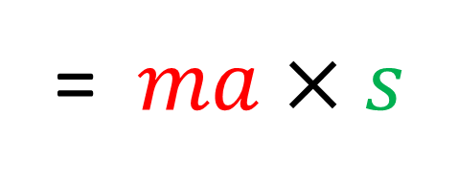

Proof
K.E. = Force $×$ Distance
= $ma$ $×s$
$$F=ma$$
$$Distance=s$$
$$v^{2}=u^{2}+2as$$
= $m\frac{v^{2}−{ u}^{2}}{2}$
$$as=\frac{v^{2}−u^{2}}{2}$$
= $\frac{1}{2}mv^{2}$
if $u^{2}=0$ (from rest)

Slide 5
Potential Energy
Potential Energy is the energy of
an object due to its height above
a level defined ground zero.

Slide 6

Potential Energy
P.E. = $mgh$

Slide 7
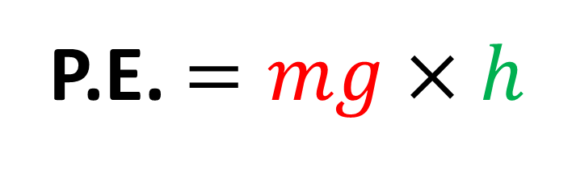


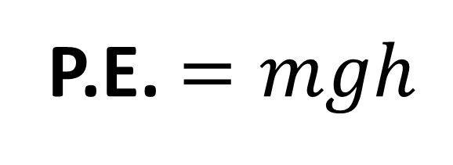


P.E. $=$ work done against gravity
P.E. $=$ Force $×$ Distance
P.E. $=mg×$ $h$
$$h$$
$$mg$$
P.E. $=mgh$

Slide 8





P.E. $=mgh$
Vertical Height
10m
$$h$$
$$=10\sin{θ°}$$
$$mg$$
$$θ°$$

Slide 9
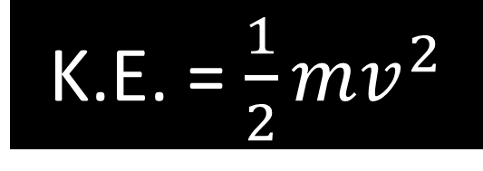
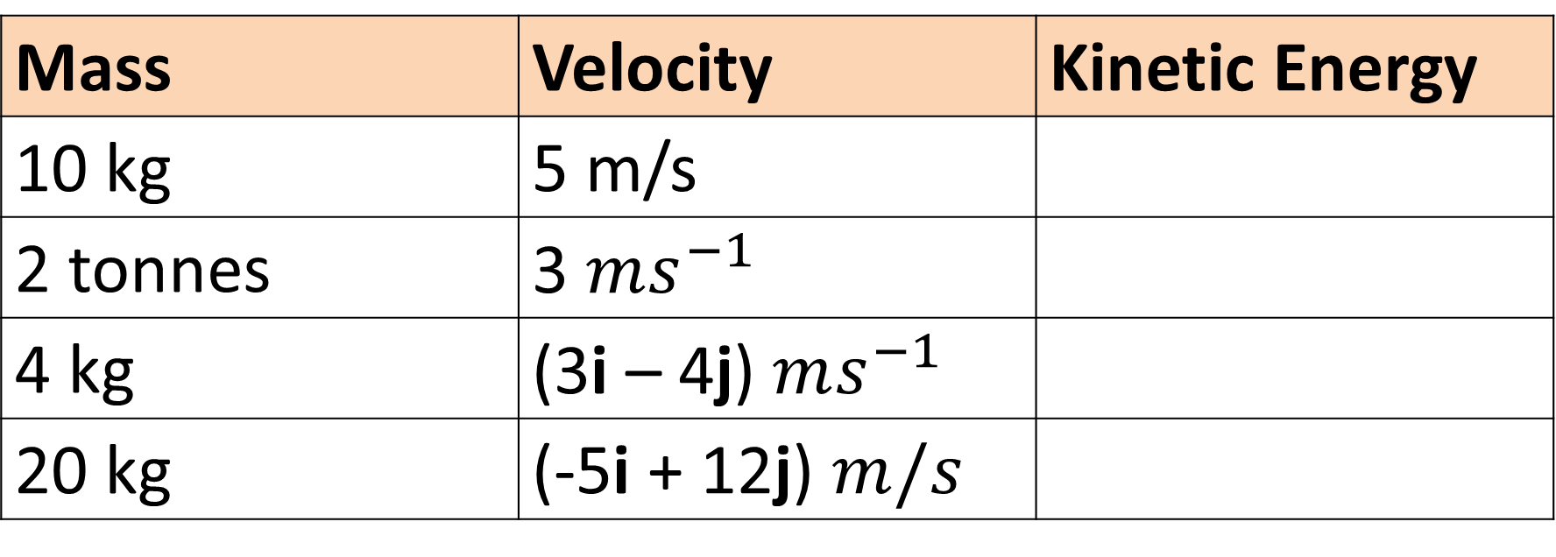
Kinetic Energy
K.E. = $\frac{1}{2}mv^{2}$
Mass | Velocity | Kinetic Energy
10 kg | 5 m/s
2 tonnes | 3 $ms^{−1}$
4 kg | (3i – 4j) $ms^{−1}$
20 kg | (-5i + 12j) $m/s$
125 J
9000 J
50 J
1690 J

Slide 10
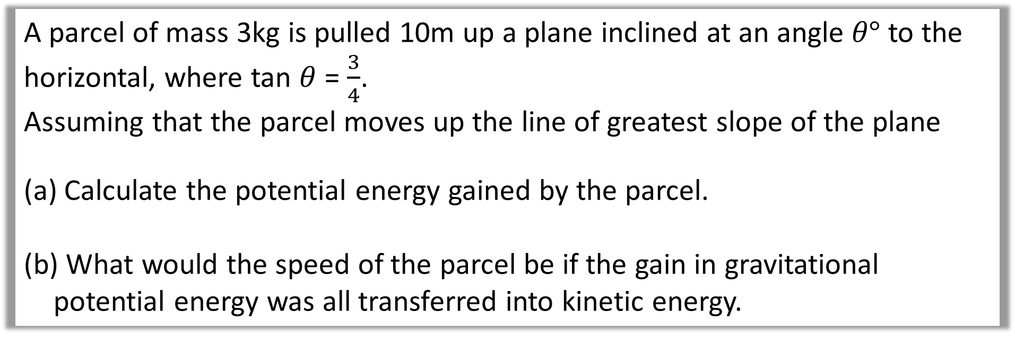
Example A: Slope
A parcel of mass 3kg is pulled 10m up a plane inclined at an angle $θ°$ to the horizontal, where tan $θ$ = $\frac{3}{4}$.
Assuming that the parcel moves up the line of greatest slope of the plane
Calculate the potential energy gained by the parcel.
What would the speed of the parcel be if the gain in gravitational potential energy was all transferred into kinetic energy.

Slide 11


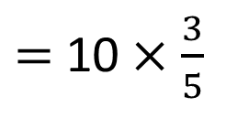
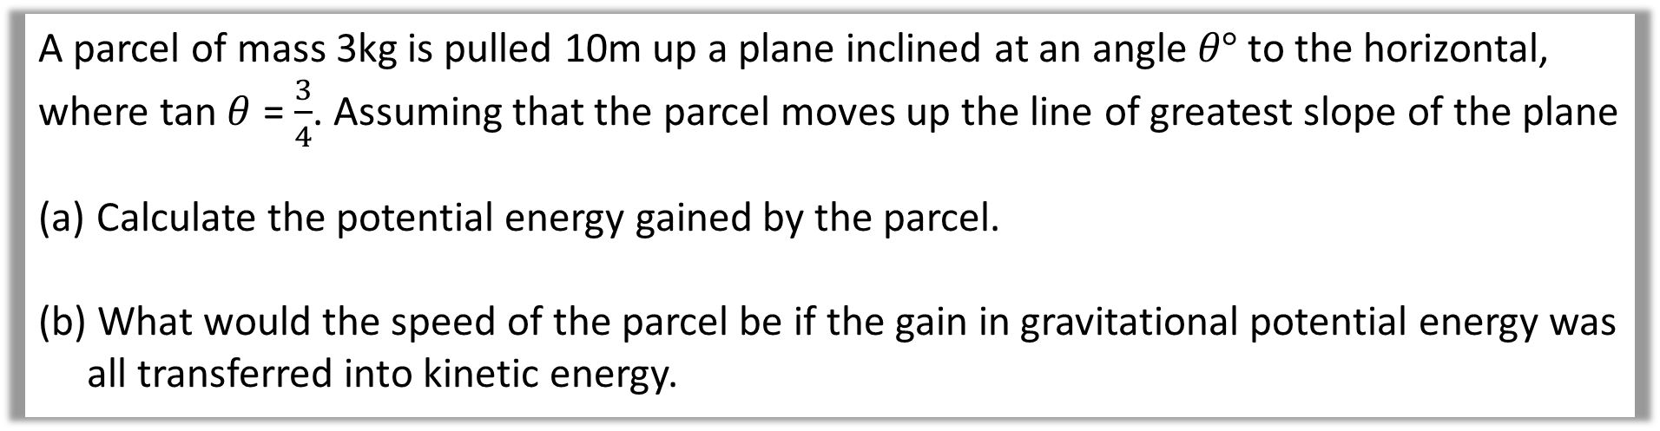
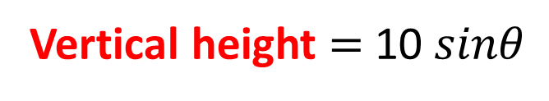

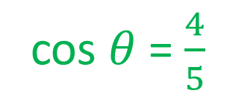
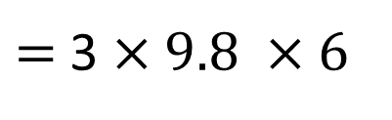
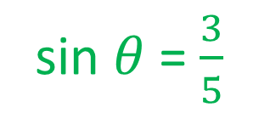
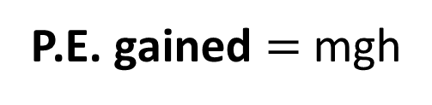
A parcel of mass 3kg is pulled 10m up a plane inclined at an angle $θ°$ to the horizontal, where tan $θ$ = $\frac{3}{4}$. Assuming that the parcel moves up the line of greatest slope of the plane
Calculate the potential energy gained by the parcel.
What would the speed of the parcel be if the gain in gravitational potential energy was all transferred into kinetic energy.
sin $θ$ = $\frac{3}{5}$
cos $θ$ = $\frac{4}{5}$
a)
Vertical height $=$10 $sinθ$
$=$ 10$×\frac{3}{5}$
10m
$$=6$$
$$θ°$$
P.E. gained $=$ mgh
$=$ 3 $×9.8 ×6$
$$=176 J$$

Slide 12
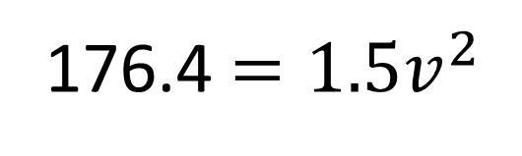

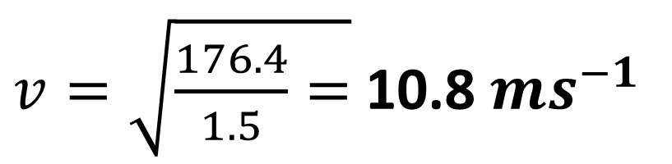
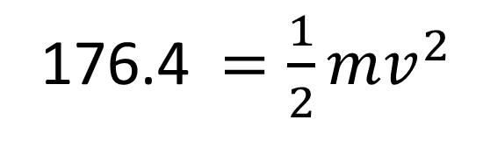

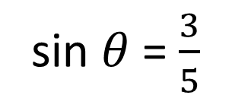
A parcel of mass 3kg is pulled 10m up a plane inclined at an angle $θ°$ to the horizontal, where tan $θ$ = $\frac{3}{4}$. Assuming that the parcel moves up the line of greatest slope of the plane
Calculate the potential energy gained by the parcel.
What would the speed of the parcel be if the gain in gravitational potential energy was all transferred into kinetic energy.
sin $θ$ = $\frac{3}{5}$
cos $θ$ = $\frac{4}{5}$
b)
176.4 $=\frac{1}{2}mv^{2}$
10m
176.4 $=1.5v^{2}$
$$θ°$$
$v=\sqrt{\frac{176.4}{1.5}=}$ 10.8$ms^{−1}$

Slide 13
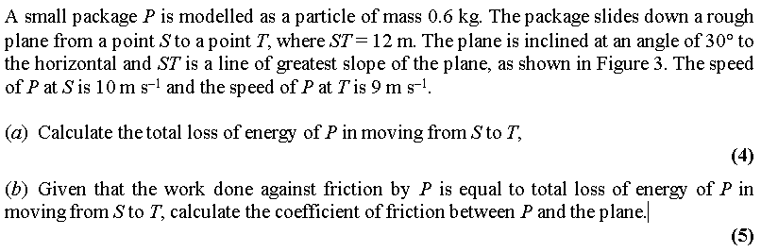
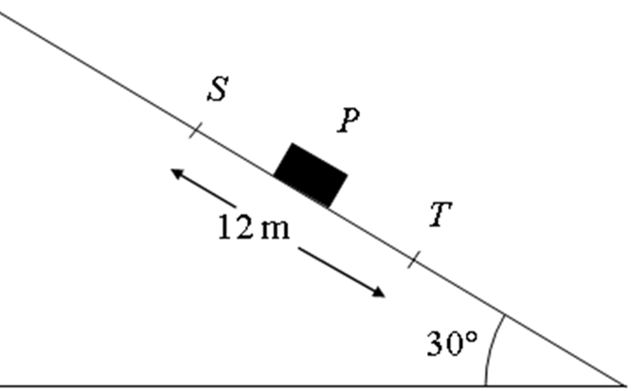
Example B: Slope

Slide 14
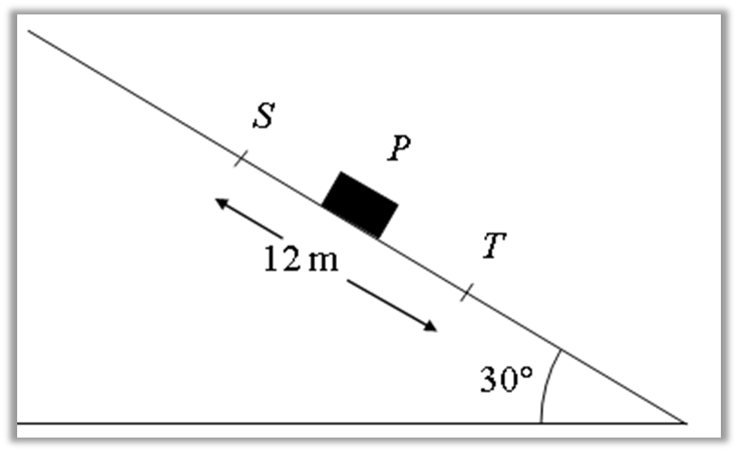


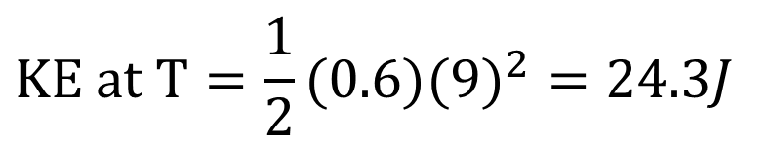
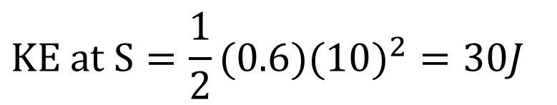
$$KE at S=\frac{1}{2}(0.6)({10)}^{2}=30J$$
a)
$$KE at S=0.6(9.8)(12\sin{30})=35.28J$$
$$KE at T=\frac{1}{2}(0.6)({9)}^{2}=24.3J$$
$$KE at T=0.6(9.8)(0)=35.28J$$
$$KE Lost=5.7J$$
$$PE Lost=35.28J$$
$$Total Energy Lost=5.7+35.28=40.98J$$

Slide 15



b)
$Work Done Agaisnt Friction= Friction Force×Distance$
$$40.98=μR×12$$
$$40.98=μ0.6g\cos{30}×12$$
$$μ=0.671$$

