Slide 1

Diagnostic Assessment .Delta 1
Unit 7
Equations
Unknown on One Side
Brackets
Unknown on Both Sides
Involving Fractions
Writing Equations
Trail and Improvement

Slide 2
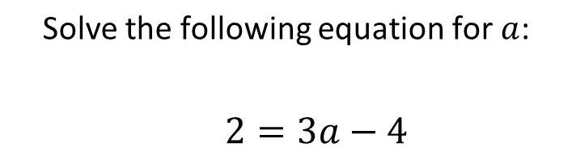
Question 1 – Unknown on One Side

Slide 3
Answer 1 – Unknown on One Side
CORRECT ANSWER | CORRECT EXPLANATION
2 | We add 4 to both sides to get 6 = 3a, then divide by 3 to get a = 2.
COMMON MISTAKES | WHAT MIGHT BE YOUR MISTAKE
$$−\frac{2}{3}$$ | The student has subtracted 4, rather than adding.
-6 | The student has subtracted 4, and then multiplied by 3.
-2 | The student has subtracted by 4, and has then forgotten to divide by 3.

Slide 4
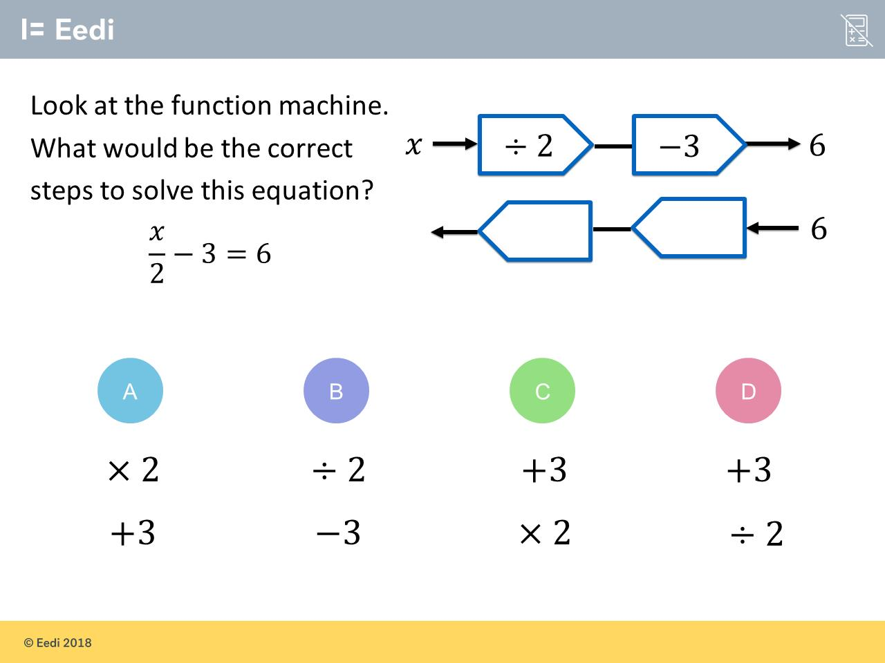
Question 2 – Unknown on One Side

Slide 5
Answer 2 – Unknown on One Side
CORRECT ANSWER | CORRECT EXPLANATION
+3 x2 | The inverse operation for -3 is +3, and the inverse operation for ÷ 2 is ×2.
COMMON MISTAKES | WHAT MIGHT BE YOUR MISTAKE
x2 +3 | The student has mixed up the order of operations.
÷2 –3 | The student has just repeated the operations.
+3 ÷2 | The student has divided by 2, rather than multiplying.

Slide 6
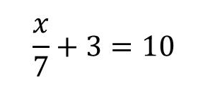
Question 3 – Unknown on One Side
Solve

Slide 7
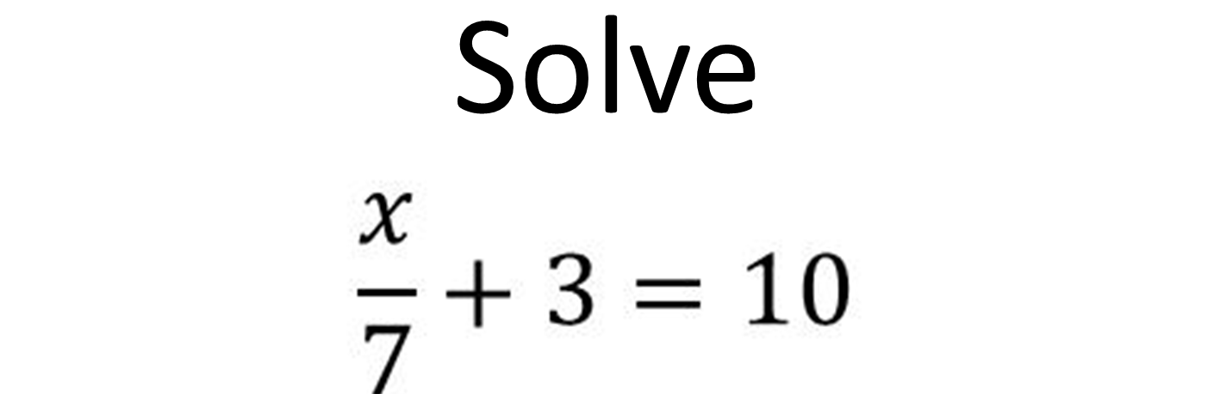
Answer 3 – Unknown on Both and Fractions
CORRECT ANSWER | CORRECT EXPLANATION
49 | x ÷ 7 = 7, and then x = 7 × 7 = 49.
COMMON MISTAKES | WHAT MIGHT BE YOUR MISTAKE
42 | The student may have miscalculated the division.
56 | The student may have miscalculated the division.
0 | The student may have found the solution to x + 7 + 3 = 10.

Slide 8
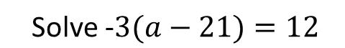
Question 4 – Brackets

Slide 9
Answer 4 – Brackets
CORRECT ANSWER | CORRECT EXPLANATION
17 | -21 = 12/(-3) = -4, and then a = -4 + 21 = 17
COMMON MISTAKES | WHAT MIGHT BE YOUR MISTAKE
36 | The student may have added 3, rather than dividing.
-11 | The student has added 21 before dividing by -3.
3 | The student may have subtracted 21, rather than adding, and has done this before dividing by -3.

Slide 10
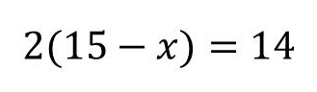
Question 5 – Brackets
Solve

Slide 11
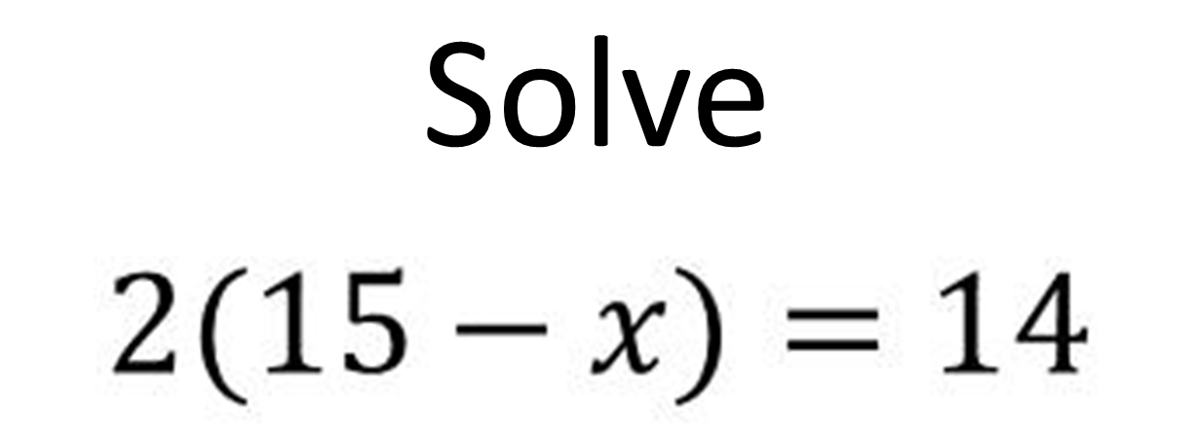
Answer 5 – Brackets
CORRECT ANSWER | CORRECT EXPLANATION
8 | 15 - x = 14/2 = 7, and then x = 15 - 7 = 8
COMMON MISTAKES | WHAT MIGHT BE YOUR MISTAKE
201 | The student may have solved 215 - 14.
1 | The student may have solved 15 - x = 1.
7 | The student may have solved 2x = 14.

Slide 12
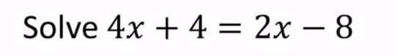
Question 6 – Unknown on Both Sides

Slide 13
Answer 6 – Unknown on Both Side
CORRECT ANSWER | CORRECT EXPLANATION
-6 | 2x + 4 = -8 then 2x = -12 which gives x = -6
COMMON MISTAKES | WHAT MIGHT BE YOUR MISTAKE
6 | You forgot about the negative
-2 | You added the 2x to 4x instead of subtracting or you added 4 to -8 instead of subtracting
-12 | You found the value of 2x and forgot to divide by 2.

Slide 14
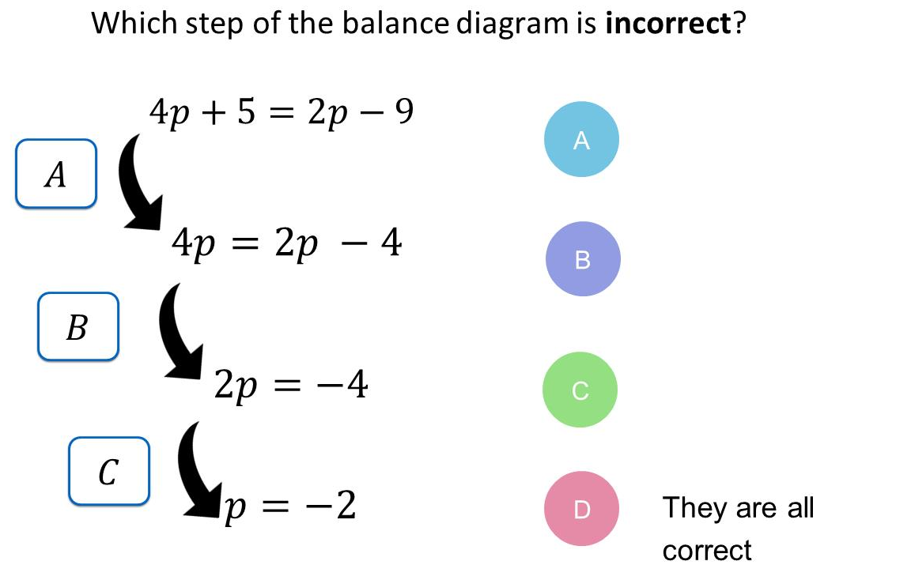
Question 7 – Unknown on Both Sides

Slide 15
Answer 7 – Unknown on Both Sides
CORRECT ANSWER | CORRECT EXPLANATION
A | Here we have added 5, rather than subtracting 5.
COMMON MISTAKES | WHAT MIGHT BE YOUR MISTAKE
B | The student has picked a correct step.
C | The student has picked a correct step.
D | The student has not noticed that A is incorrect.

Slide 16

Question 8 – Unknown on Both Sides
Solve

Slide 17
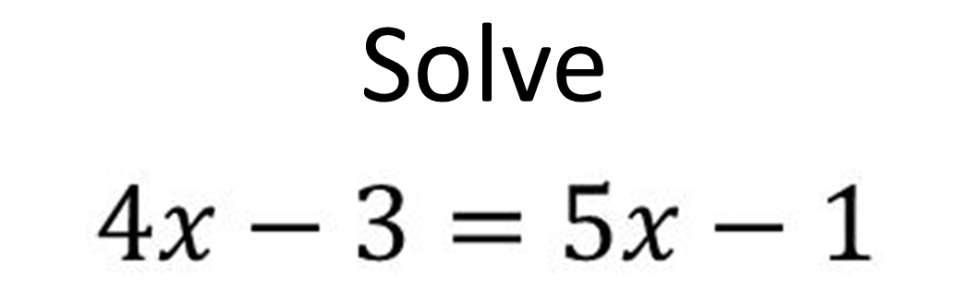
Answer 8 – Unknown on Both Sides
CORRECT ANSWER | CORRECT EXPLANATION
-2 | 4x – 5x = -1 – 3 then -1x = 2 so x = -2
COMMON MISTAKES | WHAT MIGHT BE YOUR MISTAKE
2 | You have forgot about he negative or you did 4x – 5x = x
$$\frac{2}{9}$$ | You added 5x to 4x instead of subtracting
4 | You got -1x – 3 = -1 but then subtracted 3 rather than adding

Slide 18
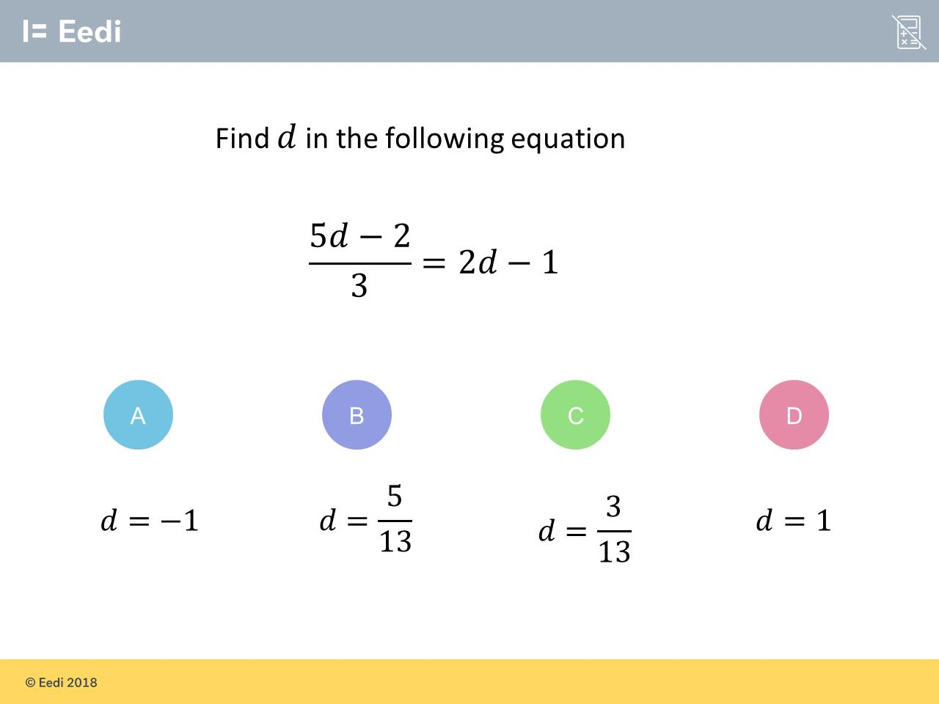
Question 9 – Fractions

Slide 19
Answer 9 – Fractions
CORRECT ANSWER | CORRECT EXPLANATION
1 | Multiplying both sides by 3 gives 5d - 2 = 6d - 3, then we have 6d - 5d = -2 + 3, and so d = 1
COMMON MISTAKES | WHAT MIGHT BE YOUR MISTAKE
-1 | The student may have added, instead of subtracting.
$$\frac{5}{13}$$ | The student has added 5d, instead of subtracting.
$$\frac{3}{13}$$ | The student has added 5d, instead of subtracting, and has forgotten to multiply 1 by 3.

Slide 20
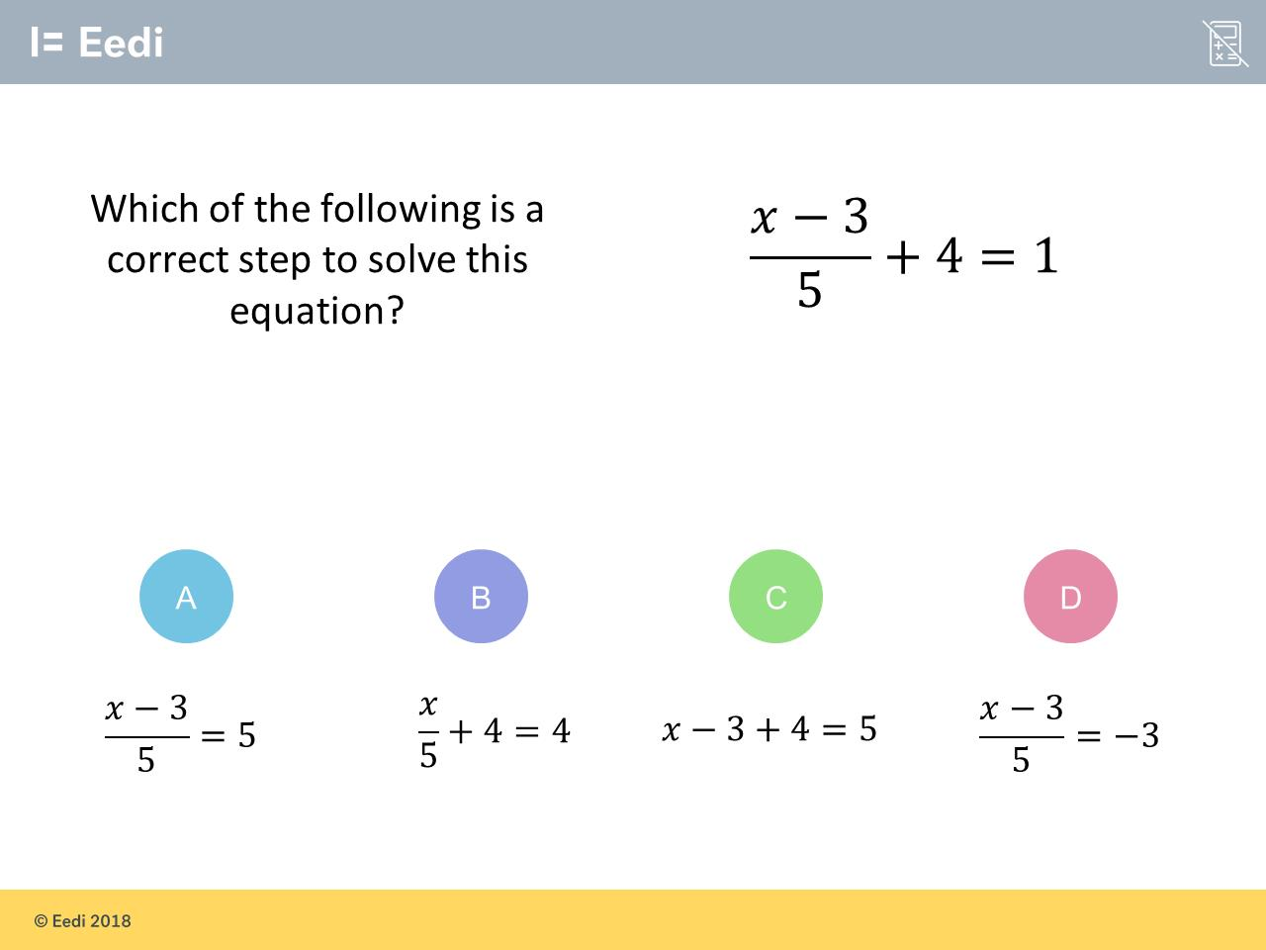
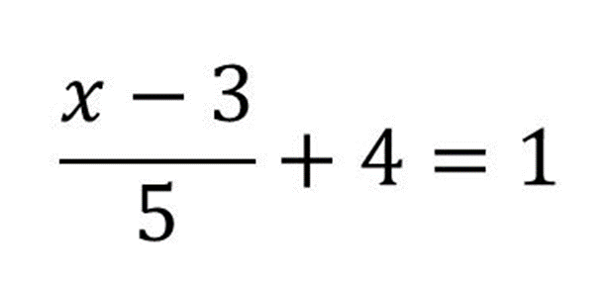
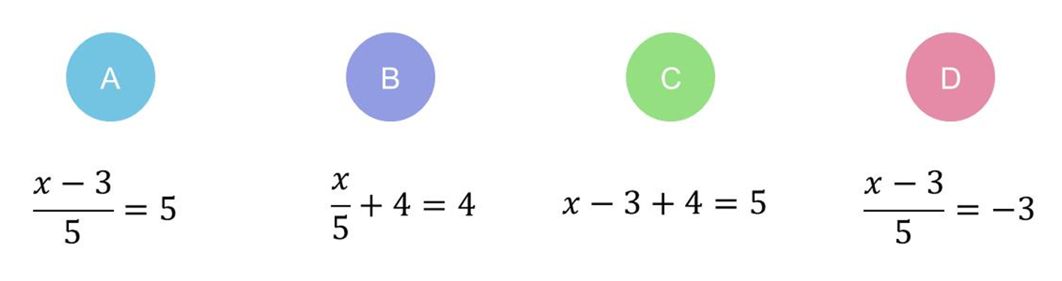
Question 10 – Fractions

Slide 21
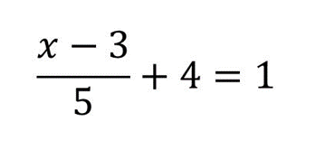
Answer 10 – Fractions
CORRECT ANSWER | CORRECT EXPLANATION
$$\frac{x −3}{5}=−3$$ | Subtract 4 from 1
COMMON MISTAKES | WHAT MIGHT BE YOUR MISTAKE
$$\frac{x −3}{5}=5$$ | The student has added 4 to 1 instead of subtracting
$$\frac{x}{5}+4=4$$ | The student has moved the -3 first. You need to do the reverse order of BIDMAN
x – 3 + 4 = 5 | The student has moved the 5 first. You need to do the reverse order of BIDMAS

Slide 22
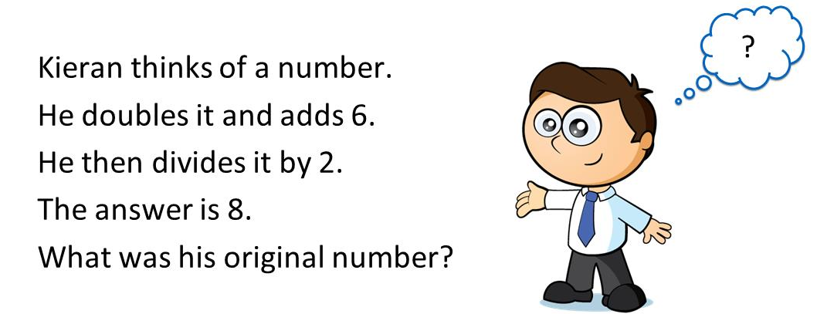
Question 11 – Writing Equations

Slide 23
Answer 11 – Writing Equations
CORRECT ANSWER | CORRECT EXPLANATION
5 | Performing the operations backwards gives (8 × 2 - 6)/2 = 5.
COMMON MISTAKES | WHAT MIGHT BE YOUR MISTAKE
11 | The student has answered as if 8 were the original number.
20 | The student has not used the inverse operations.
-2 | The student may have made an arithmetic error.

Slide 24
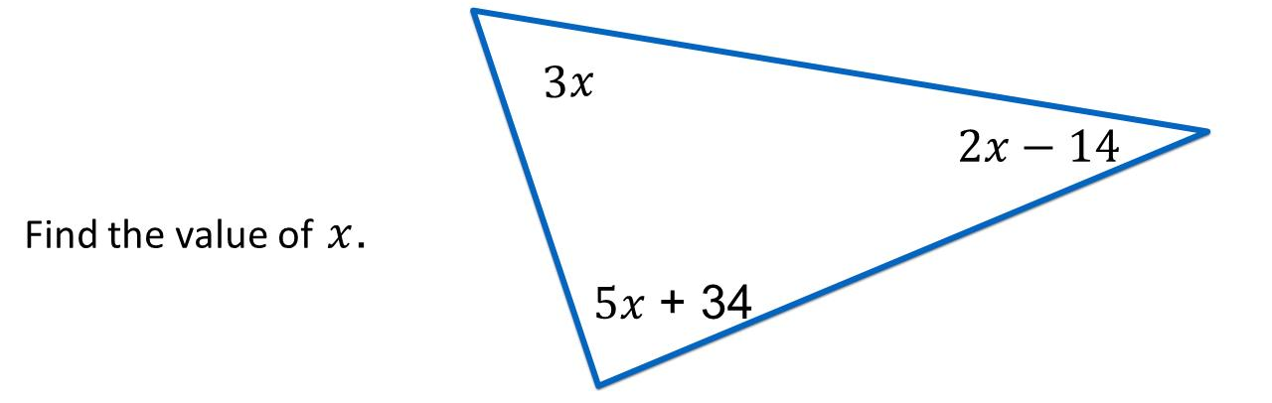
Question 12 – Writing Equations

Slide 25
Answer 12 – Writing Equations
CORRECT ANSWER | CORRECT EXPLANATION
16˚ | We have 180 = 3x + 2x - 14 + 5x -+34 = 10x + 20, and so 10x = 180 - 20 = 160. Dividing by 10 gives x = 16.
COMMON MISTAKES | WHAT MIGHT BE YOUR MISTAKE
20˚ | The student has added 20, rather than subtracting
13.6˚ | The student may have made an arithmetic error.
34˚ | The student may believe that there are 360 degrees in a triangle.

Slide 26
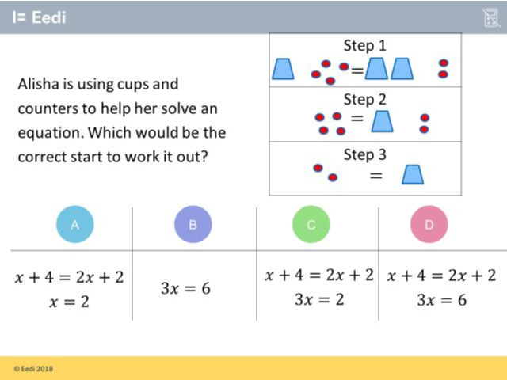
Question 13 – Writing Equations

Slide 27
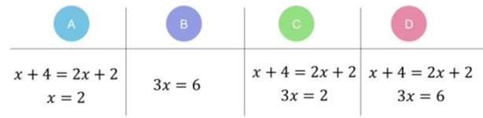
Answer 13 – Writing Equations
CORRECT ANSWER | CORRECT EXPLANATION
A | If x is a cup, and a counter is a number, then the equation in Step 1 is x + 4 = 2x + 2. The equation in Step 3 is then x = 2.
COMMON MISTAKES | WHAT MIGHT BE YOUR MISTAKE
B | The student has not used the inverse operations when trying to solve the equation.
C | The student has added x, rather than subtracting.
D | The student has not used the inverse operations when trying to solve the equation.

Slide 28
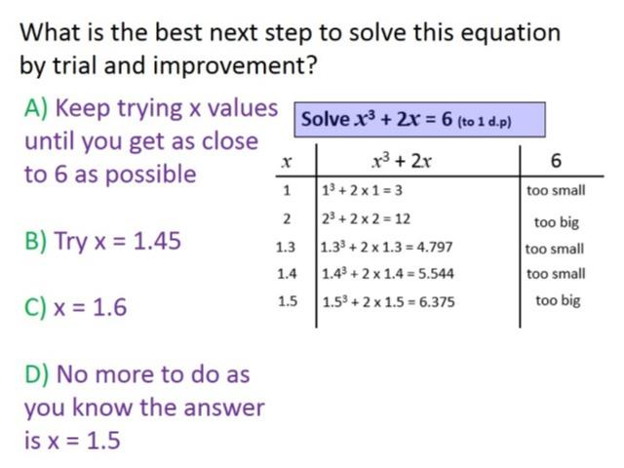
Question 14 – Trial and Improvement
Which trail of x is needed next or do you not need any more?

Slide 29
Answer 14 – Trial and Improvement
Which trail of x is needed next or do you not need any more?
CORRECT ANSWER | CORRECT EXPLANATION
1.45 | Trial between the x values that are too big and too small
COMMON MISTAKES | WHAT MIGHT BE YOUR MISTAKE
1.6 | No need to keep increasing x as 1.5 is already too big.
No more needed | You need to trail between 1.4 and 1.5 to decided on which is the best answer
1.35 | You are right to trail a mid value but you have chosen the wrong one.

Slide 30
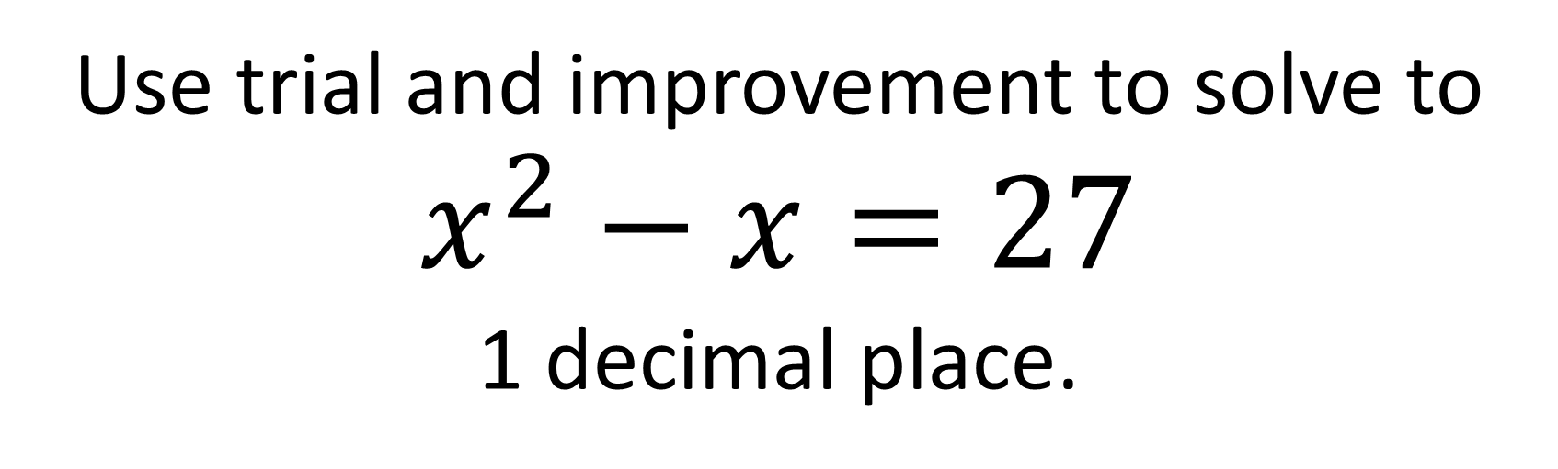
Question 15 – Trial and Improvement
Use trial and improvement to solve to
$$x^{2}−x=27$$
1 decimal place.

Slide 31
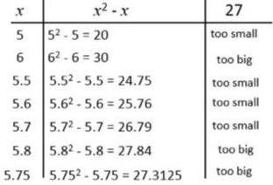
Answer 15 – Trial and Improvement
Use trial and improvement to solve to
$$x^{2}−x=27$$
1 decimal place.
CORRECT ANSWER | CORRECT EXPLANATION
5.7 | Make sure you trailed 5.75 to get full marks.
COMMON MISTAKES | WHAT MIGHT BE YOUR MISTAKE
5.75 | You have given an answers to 2 decimal places. You use this value to help you decided between 5.6 and 5.7
5.8 | If 5.75 is too big you need to go with the smaller answers.
27.8 | You need to find the x value to 1 decimal place not the value of the equation

