Slide 1
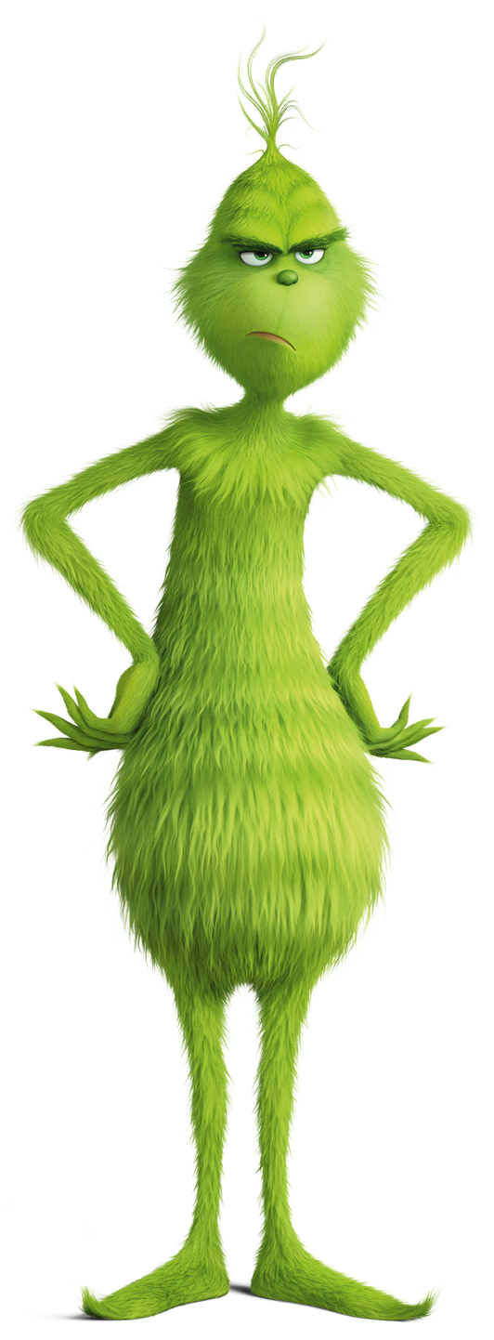

WHO IS THE CHRISTMAS GRINCH?

Slide 2
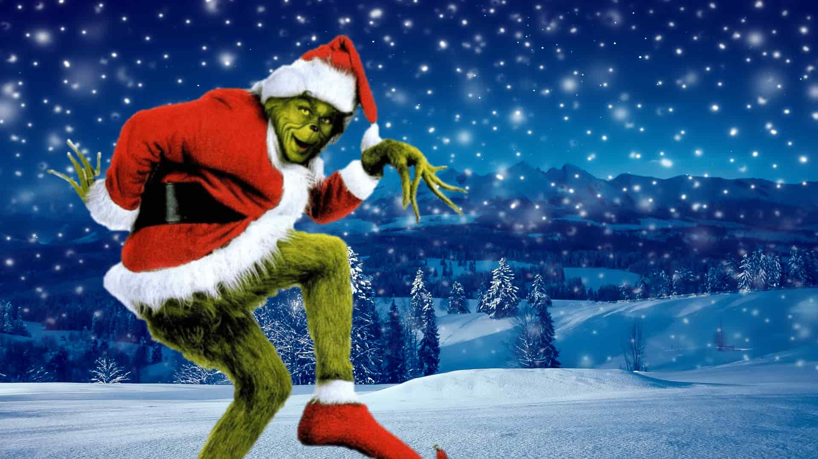
Which Maths teacher hates Christmas Cracker Jokes, never wears a Christmas Jumper and does not even like Brussel Sprouts?

Slide 3
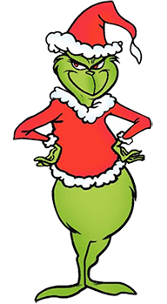
To eliminate the suspects simply work out the answers to the 6 clues
and then calculate the digital root (see next slide) of each answer.
The clues will eliminate 6 suspects leaving the Grinch!
THE SUSPECTS
Number 1 Mr Gale
Number 2 Mr James
Number 3 Ms Winters
Number 4 Ms Tragett
Number 5 Mr Almond
Number 6 Mr Cottom
Number 7 Ms McMenamin
When you give your answers, you must also give the order that you eliminated the other suspects.

Slide 4

DIGITAL ROOTS
To calculate a digital root, add the digits of a number until you reach a single digit.
Examples:
45 = 4 + 5 = 9
123 = 1 + 2 + 3 = 6
5,037 = 5 + 0 + 3 + 7 = 15 = 1 + 5 = 6

Slide 5
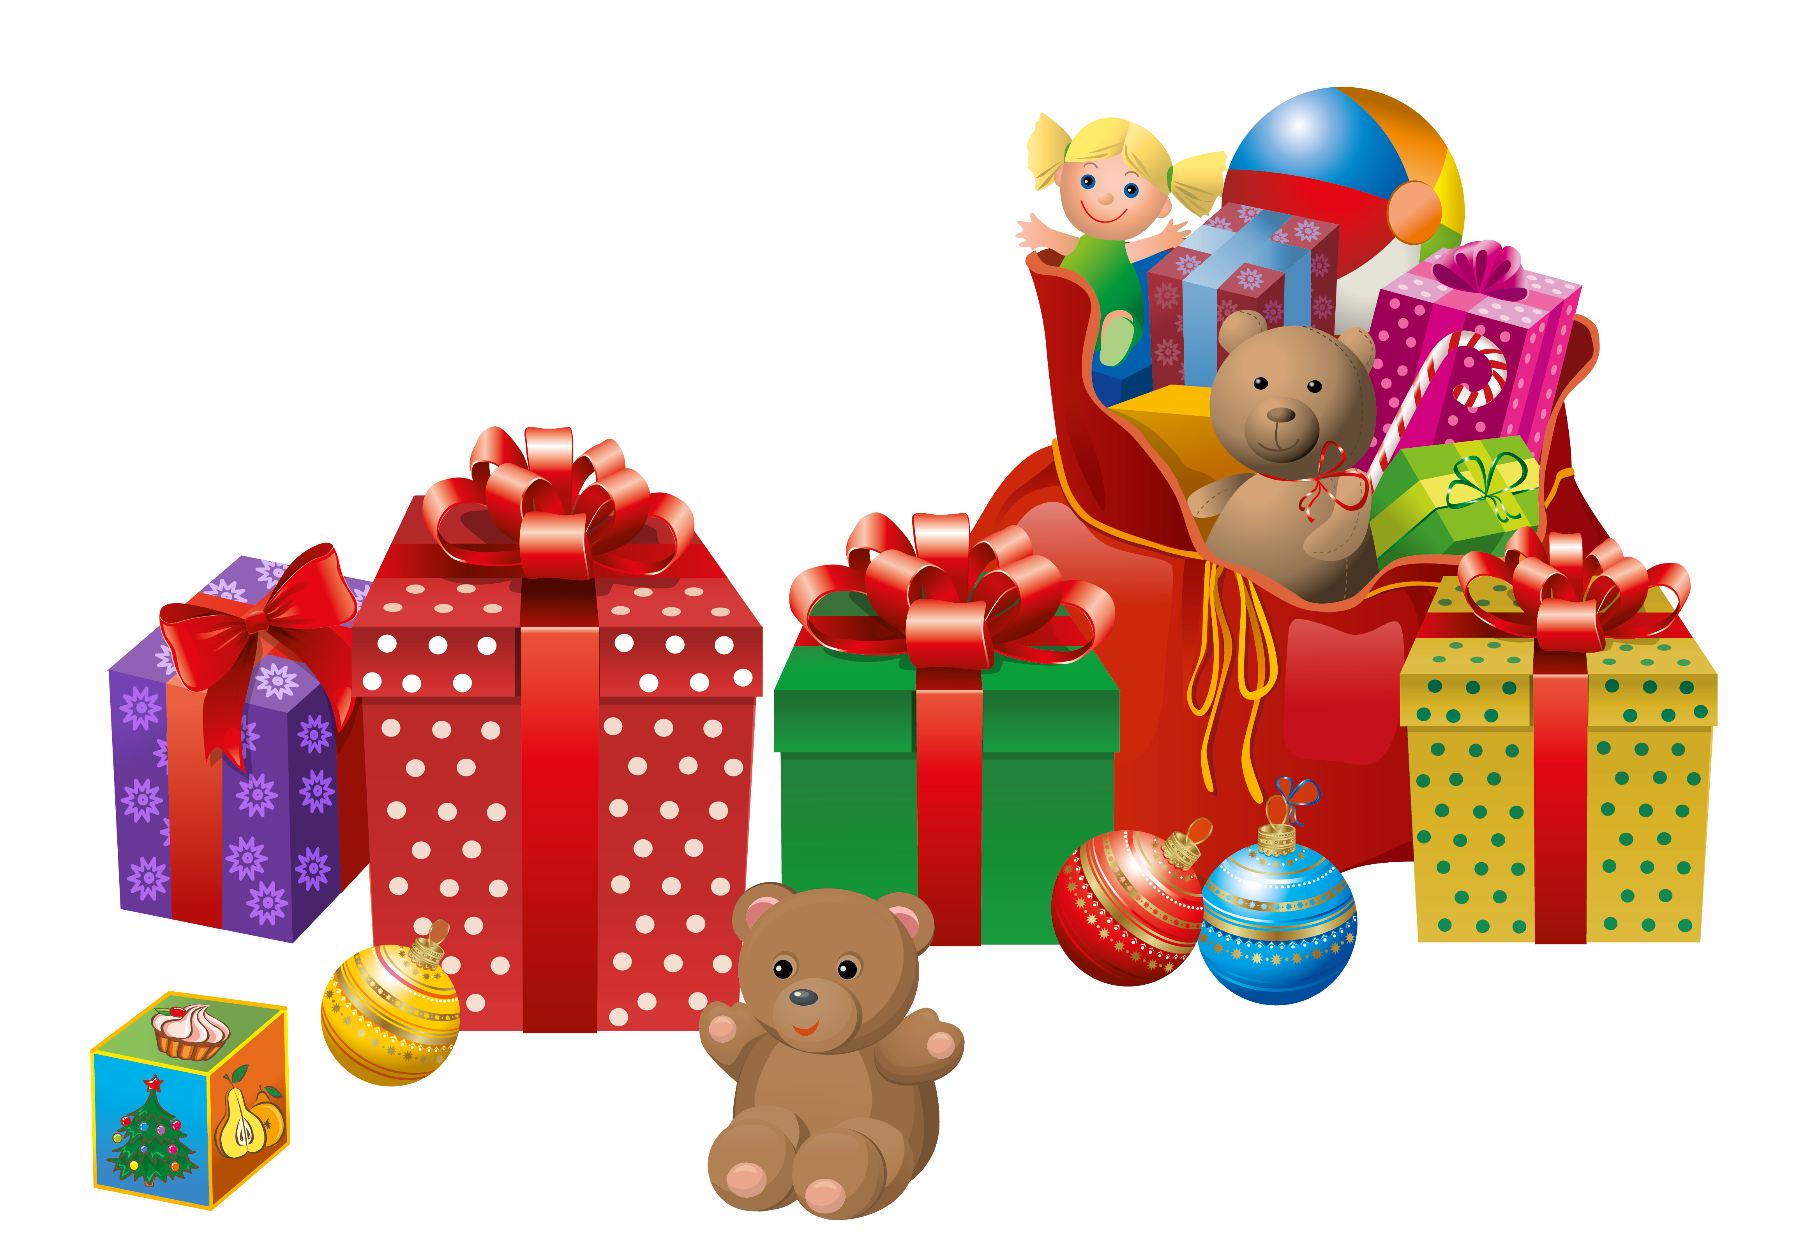
SANTA’S ELVES ARE GETTING VERY FUSSY
Elf 1 will only deliver multiple of 3 number presents!
Elf 2 will only deliver square number presents!
Elf 3 will only deliver factors of 1,000 number presents!
Elf 4 will only deliver presents whose digits add up to 6 or less!
SANTA’S ELVES
1 | 2 | 3 | 4 | 5
6 | 7 | 8 | 9 | 10
11 | 12 | 13 | 14 | 15
16 | 17 | 18 | 19 | 20
21 | 22 | 23 | 24 | 25
Now add up the remaining numbers and work out the digital root.

Slide 6





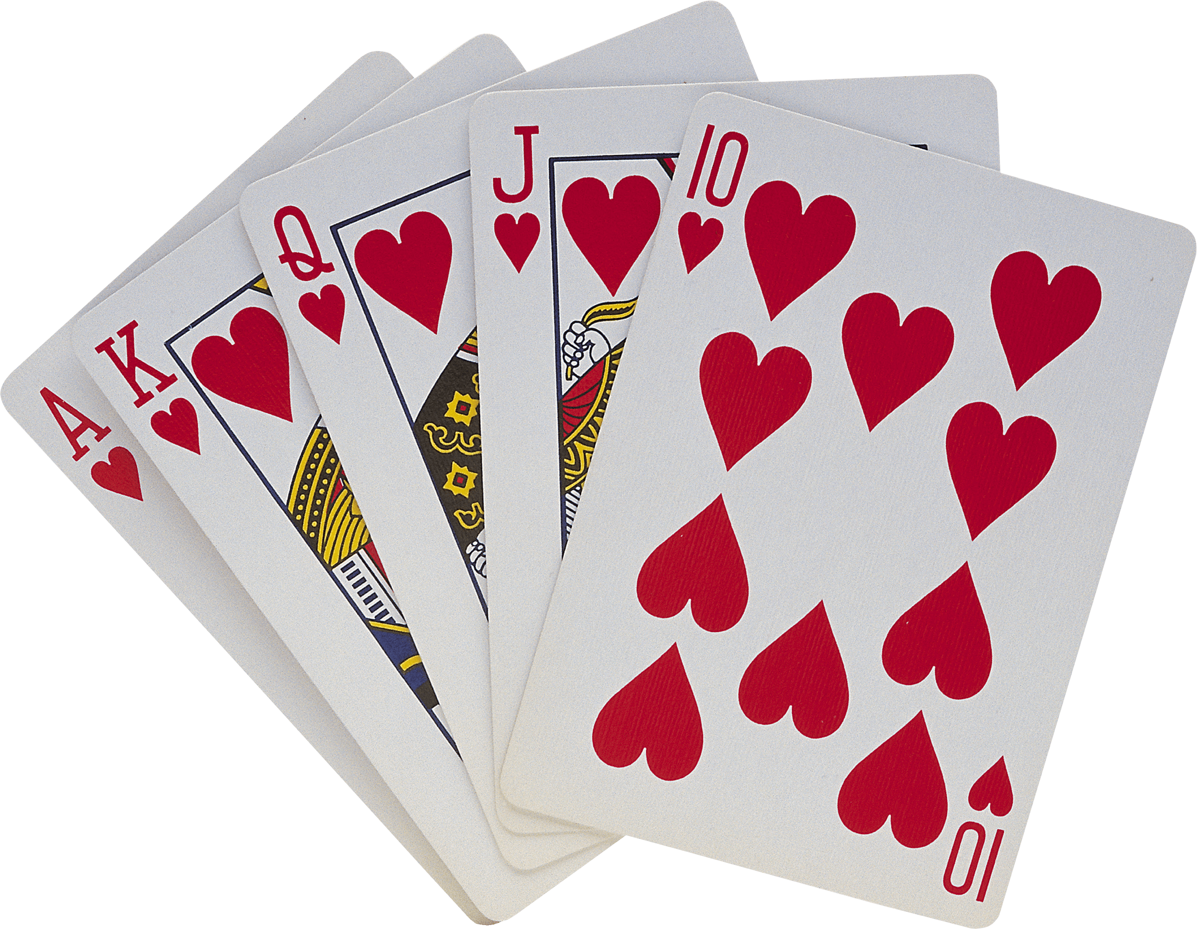
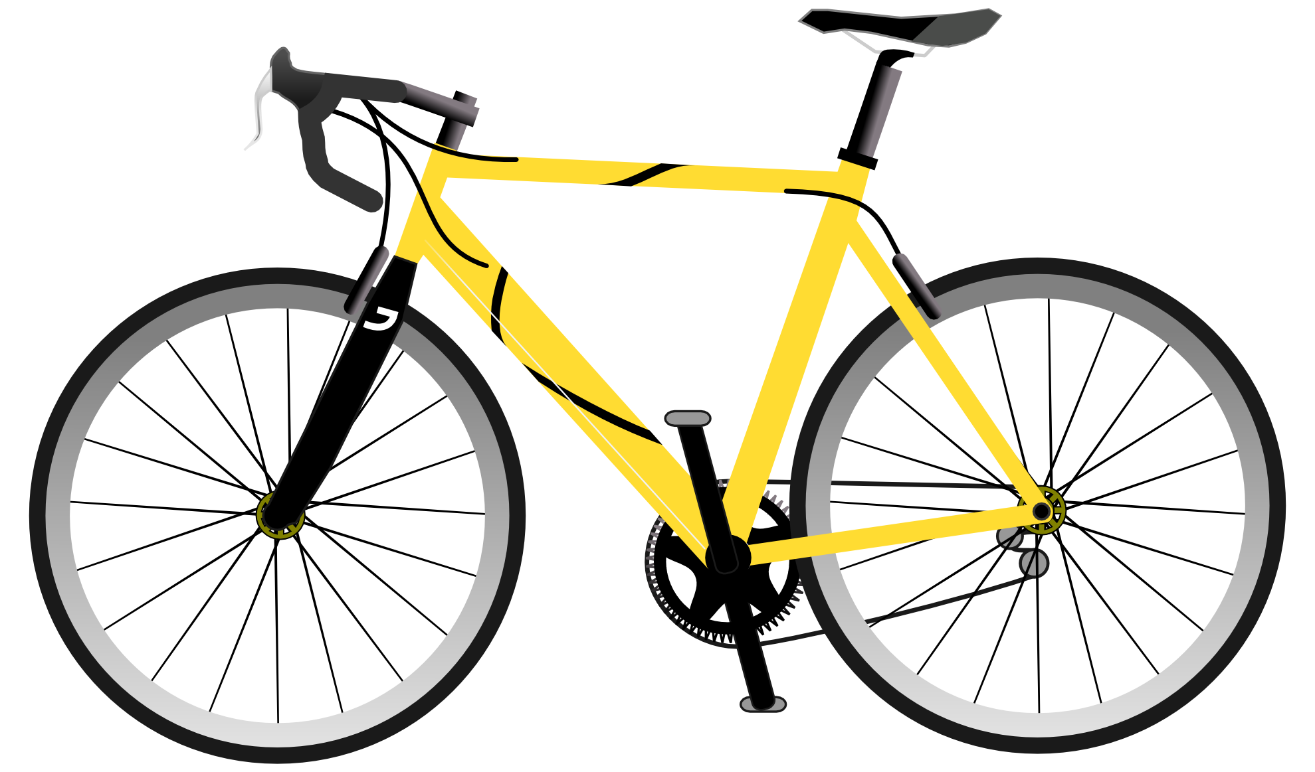

Use the pictures clues to help you work out all the missing numbers.
Then add them up and work out the digital root!
1,000,000
Monday - Sunday
(______) D_____________ in a C__________
(______) D________ of C_________________
(______) D_____________ in a W__________
(______) C_____________ in a P__________
(______) L__________ on a S__________
(______) C_____________ in a R__________
(______) S_______ in the U________ S_________ of A_________
(______) Z_____________ in a M__________
(______) W_____________ on a B_____________
(______) H_____________ in a D__________

Slide 7
Find the answers to the Christmas Cracker Jokes in the grid below!
Why did nobody bid for Rudolph and Vixen on Ebay?
What do you call a cat who works for Santa?
What does Adam say the day before Christmas?
What is white and minty?
What do snowmen like to do at the weekend?
What do snowmen wear on their heads?
Add up all the digit coordinates and then find the digital root.
What comes at the end of Christmas day?
What do Elves post on social Media?
What vehicle does an elf use?
What do you call a rich elf?
4 | An Icicle | No Idea | Truth or deer | Welfy
3 | The Elf a bet | The Letter Y | Mary Christmas | It's Christmas Eve
2 | They were too dear | Santa Paws | Chill | Ice Caps
1 | Elfies | Claus - traphobia | Santa Claws | A Polo Bear
 | 1 | 2 | 3 | 4

Slide 8


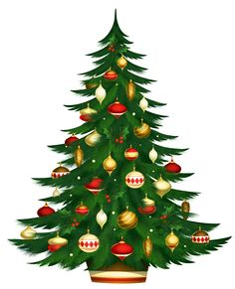

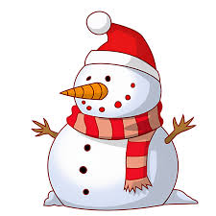

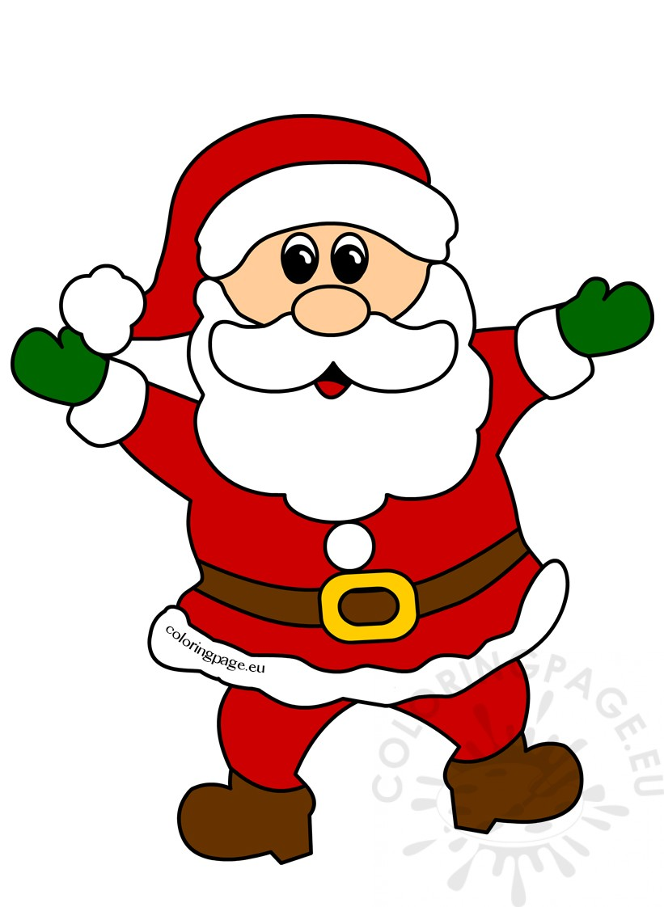
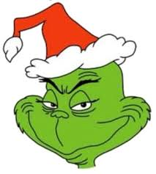
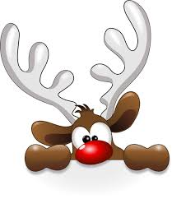

Match the 10 Christmas Items to the digits 0, 1, 2, 3, 4, 5, 6, 7, 8 & 9
CHRISTMAS PUZZLE
= ___
= ___
+
+
+
+
=
=
= ___
= ___
+
+
=
= ___
= ___
+
+
+
=
= ___
= ___
x
=
= ___
= ___
-
=
What is Hat x Santa x Holly?
Then work out the digital root.
+
=

Slide 9

Christmas - Love is in the Air
Mother Christmas Loves Father Christmas
Count the L’s, O’s, V’s, E’s and S’s
0 1 0 2 4
1 1 2 6
2 3 8
5 1 1
6 2
8
0 = Great Dislike
1 = Dislike
2 = Not Friends
3 = Kinda Like
4 = Like
5 = Really Like
6 = Like a Lot
7 = Adore
8 = Love
9 = Madly in Love
Keep adding adjacent numbers until you arrive at a single digit.
Work out the Love score for the 4 couples below. Then add all 5 Love scores and find the digital root.
Frosty the
Snowman
LOVES
The Abominable Snowman
Ebeneezer
Scrooge
LOVES
Tiny Tim
Cratchit
Rudolph
LOVES
Santa Claus
The Grinch
LOVES
Christmas

Slide 10

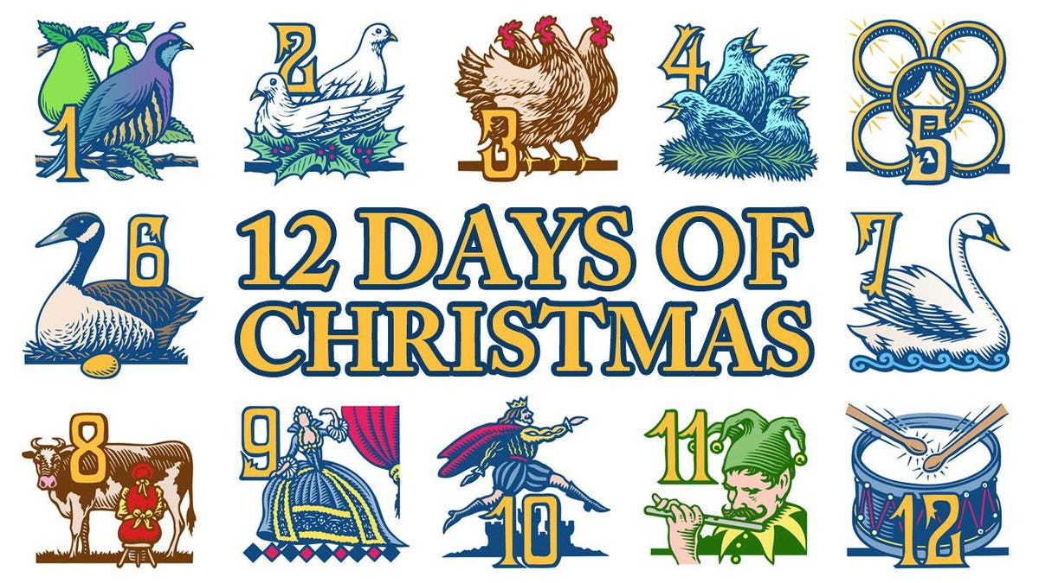
The 12 Days of Christmas
Click the Icon to play the 12 Days of Christmas.
1) How many gifts did I receive on the 2nd day?
2) How many gifts did I receive on the 12th day?
3) How many gifts did I receive altogether?
4) How many golds rings did I receive in total?
5) How many birds did I receive on day 12?

