Slide 1
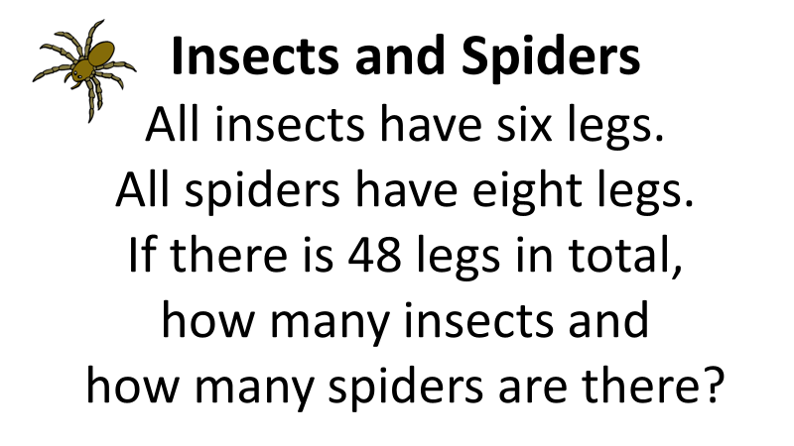
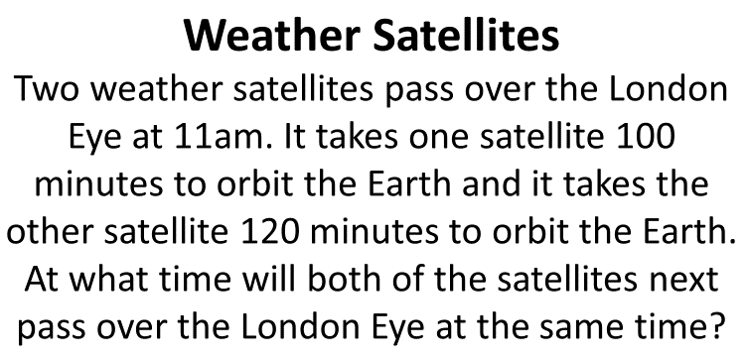
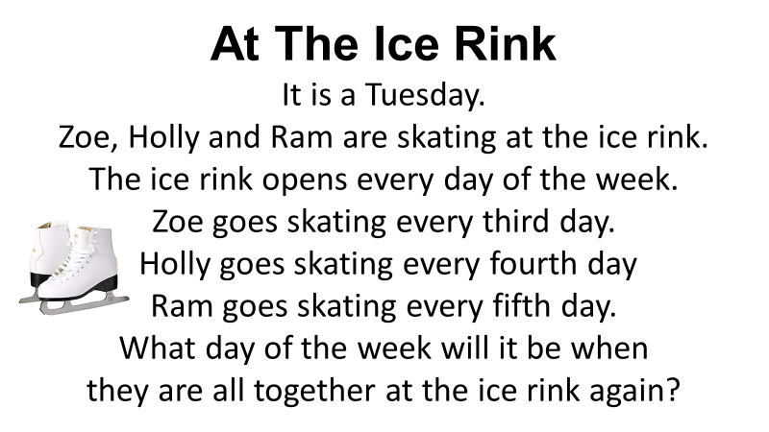

Slide 2
ANSWERS

Slide 3

Insects and Spiders
Insects |  | 4
Spiders |  | 3

Slide 4
At The Ice Rink
Saturday
The lowest common multiple of 3, 4 and 5 is 60.
60 days is 8 weeks and 4 days.
Counting on 4 days from Tuesday
takes you to Saturday.

Slide 5
Weather Satellites
9pm

