Slide 1
LO: Exterior Angles in Polygons

Slide 2
What makes a shape
a polygon?
The shape only has
straight lines.

Slide 3

Polygon or Not?

Slide 4

Polygons or Not?

Slide 5
Polygon or Not?

Slide 6
Polygons or Not?

Slide 7
What is meant by a
regular shape?
All sides are the same length.
All angles are the same size.

Slide 8
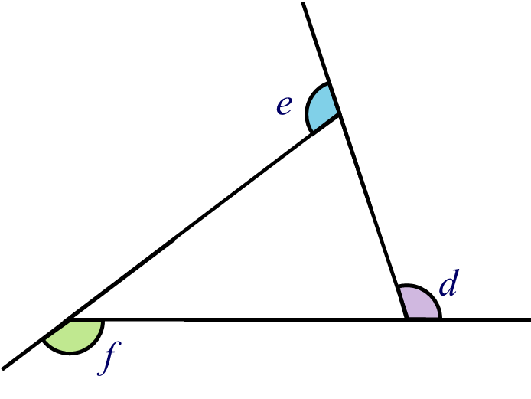
Extend the sides of a polygon
and exterior angles are formed.

Slide 9
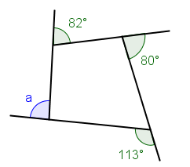
What is the total of the exterior angles?
85°
Notes:
Use this activity to demonstrate that the sum of the exterior angles in a convex polygon is always 360º.
Select the polygon required by choosing the number of sides and drag the vertices to make a convex polygon.
Hitting the turtle button will make Turtle walk around the outside of the shape.
As Turtle walks around the outside of the shape ask pupils to estimate the size of the next exterior angle.
This activity is ideal for getting pupils to think about the size of exterior angles and would make a good introduction to drawing polygons using Logo.

Slide 10
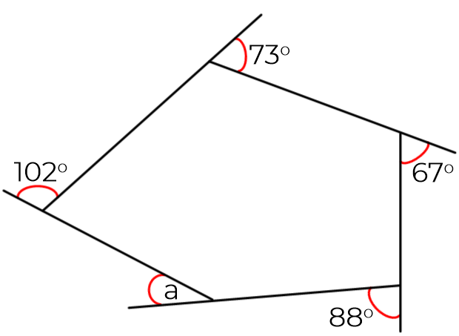
What is the total of the exterior angles?
30°
Notes:
Use this activity to demonstrate that the sum of the exterior angles in a convex polygon is always 360º.
Select the polygon required by choosing the number of sides and drag the vertices to make a convex polygon.
Hitting the turtle button will make Turtle walk around the outside of the shape.
As Turtle walks around the outside of the shape ask pupils to estimate the size of the next exterior angle.
This activity is ideal for getting pupils to think about the size of exterior angles and would make a good introduction to drawing polygons using Logo.

Slide 11
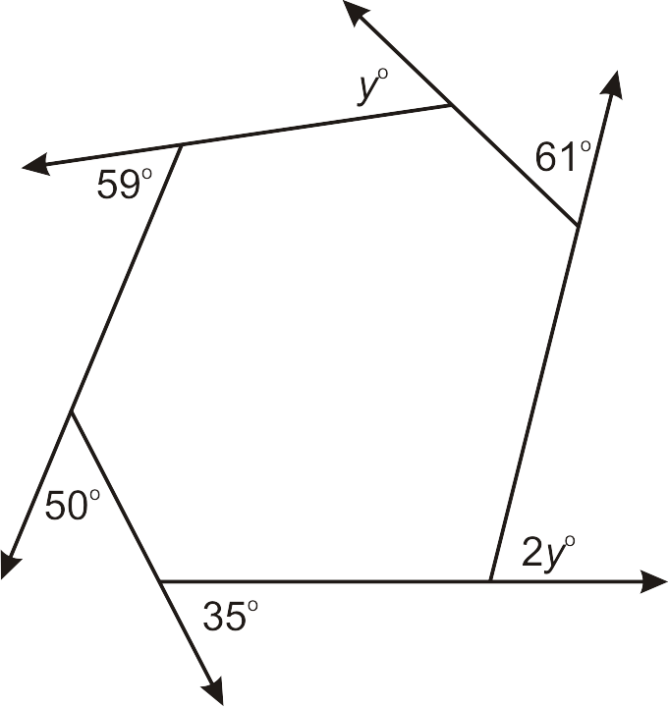
What is the total of the exterior angles?
75°
80°
Notes:
Use this activity to demonstrate that the sum of the exterior angles in a convex polygon is always 360º.
Select the polygon required by choosing the number of sides and drag the vertices to make a convex polygon.
Hitting the turtle button will make Turtle walk around the outside of the shape.
As Turtle walks around the outside of the shape ask pupils to estimate the size of the next exterior angle.
This activity is ideal for getting pupils to think about the size of exterior angles and would make a good introduction to drawing polygons using Logo.

Slide 12
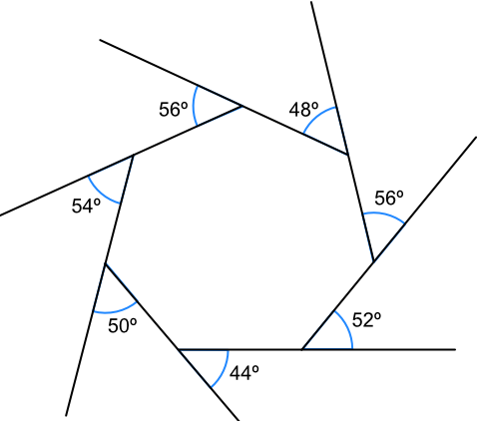
What is the total of the exterior angles?
Notes:
Use this activity to demonstrate that the sum of the exterior angles in a convex polygon is always 360º.
Select the polygon required by choosing the number of sides and drag the vertices to make a convex polygon.
Hitting the turtle button will make Turtle walk around the outside of the shape.
As Turtle walks around the outside of the shape ask pupils to estimate the size of the next exterior angle.
This activity is ideal for getting pupils to think about the size of exterior angles and would make a good introduction to drawing polygons using Logo.

Slide 13
All exterior angles
add up to 360˚
for all polygons.

Slide 14
Find the missing exterior angle of the polygon.
150°
75°
x
135°

Slide 15
Find the missing exterior angle of the polygon.
120°
85°
80˚
x
75°

Slide 16
Find the missing exterior angle of the polygon.
50°
130°
80°
85°
70°
x
75°

Slide 17


How many sides does the regular polygon have?
$\frac{360}{60}$ = 6 sides
60˚

Slide 18

How many sides does the regular polygon have?
$\frac{360}{30}$ = 12 sides
30˚

Slide 19

How many sides does the regular polygon have?
$\frac{360}{36}$ = 10 sides
36˚

Slide 20

How many sides does the regular polygon have?
$\frac{360}{72}$ = 5 sides
108˚
72˚

Slide 21

How many sides does the regular polygon have?
$\frac{360}{5}$ = 72 sides
175˚
5˚

Slide 22

How many sides does the regular polygon have?
$\frac{360}{60}$ = 8 sides
135˚
45˚

