Slide 1
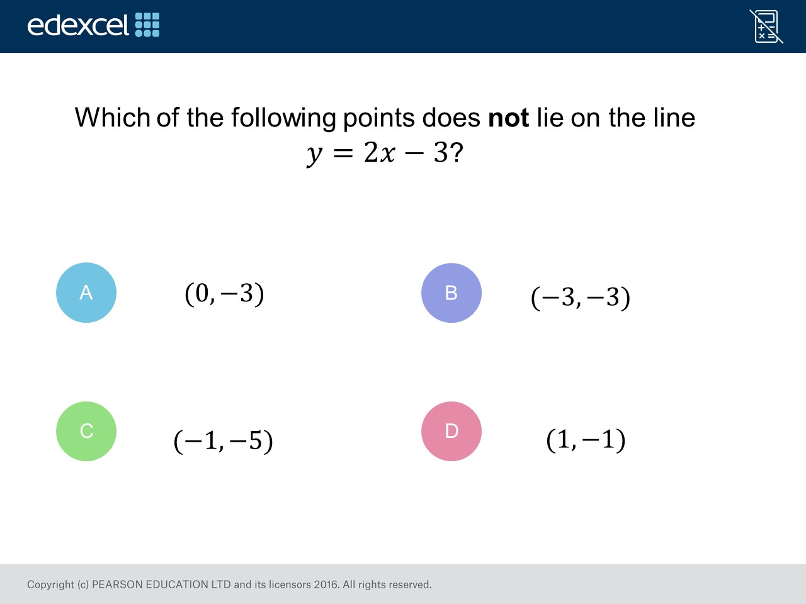
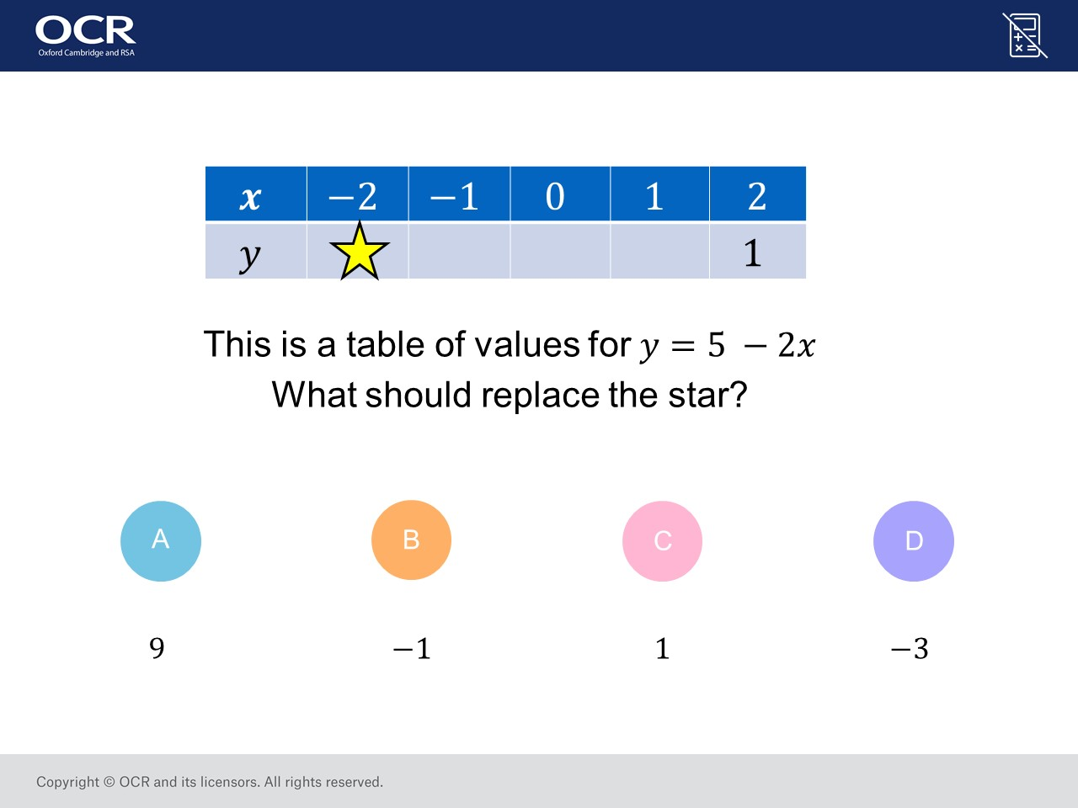
Worst answered question?
Most common wrong answer?

Slide 2
ANSWERS

Slide 3
Worst answered question?

Slide 4

C
They calculated
5 – 2(–2) = 4
5 – 4 = 1

Slide 5
C
2(– 1) – 3 = – 5
therefore it is a point.

