Slide 1
FM: Exact Trig Values

Slide 2
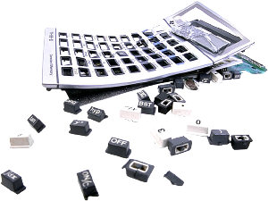
You calculator is broken.
However you still need to calculate angles
and lengths using trigonometry ratios!
But how?

Slide 3
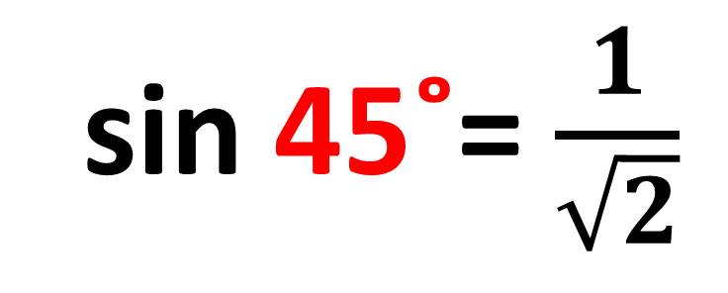

What is the exact value of sin 45˚?
sin 45˚= $\frac{1}{\sqrt{2}}$
45˚
$$\sqrt{2}$$
1
45˚
1

Slide 4
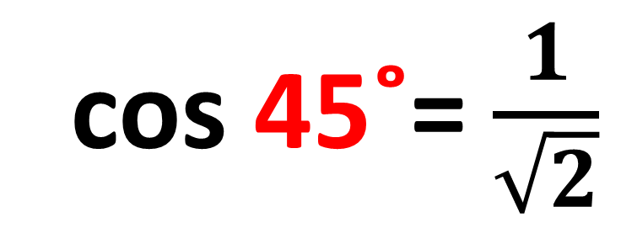
What is the exact value of cos 45˚?
cos 45˚= $\frac{1}{\sqrt{2}}$
45˚
$$\sqrt{2}$$
1
45˚
1

Slide 5


What is the exact value of tan 45˚?
tan 45˚= $\frac{1}{1}$
45˚
$$\sqrt{2}$$
1
tan 45˚= $1$
45˚
1

Slide 6

Split the equilateral triangle in half.
60˚
30˚
30˚
2
2
$$\sqrt{3}$$
60˚
60˚
1
2

Slide 7
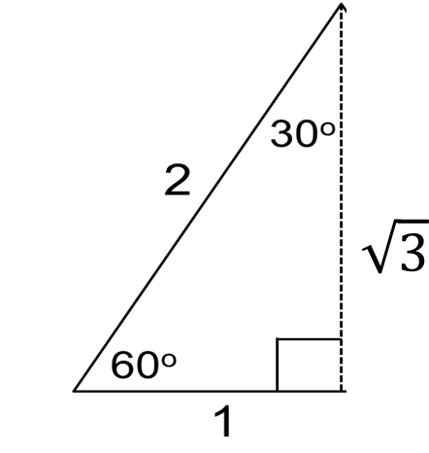
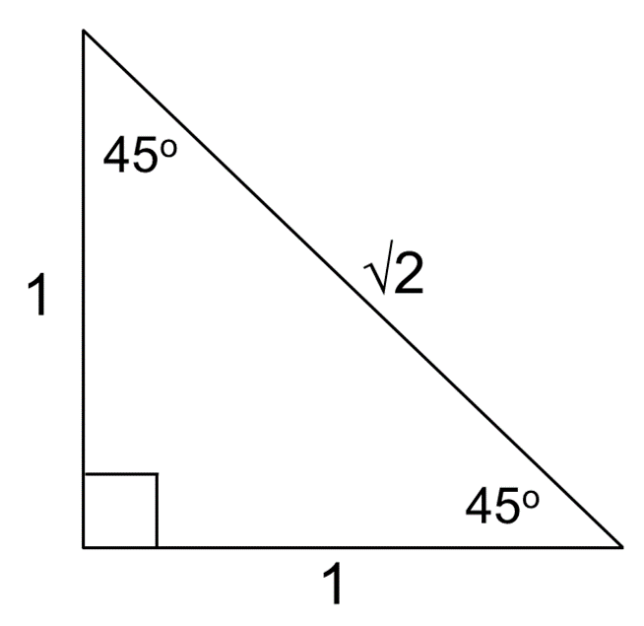
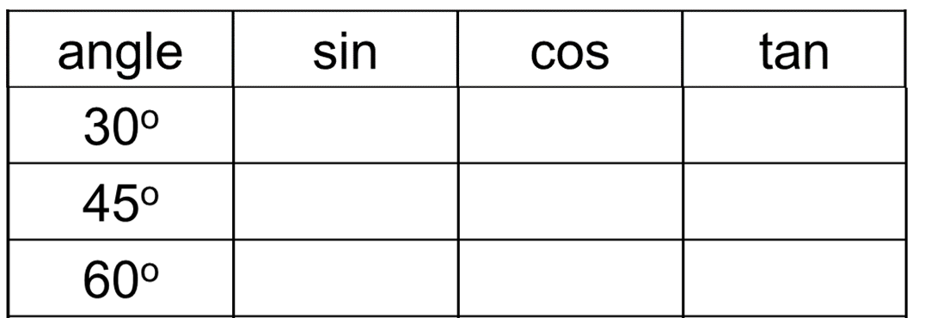








$$\frac{1}{2}$$
$$\frac{\sqrt{3}}{2}$$
$$\frac{1}{\sqrt{3}}$$
$$\frac{1}{\sqrt{2}}$$
$$\frac{1}{\sqrt{2}}$$
1
$$\frac{\sqrt{3}}{2}$$
$$\frac{1}{2}$$
$$\sqrt{3}$$

Slide 8
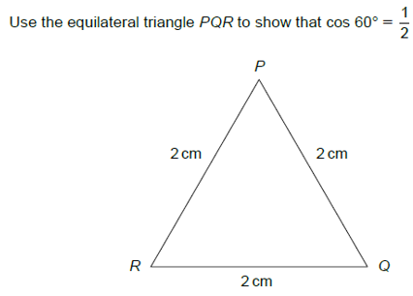
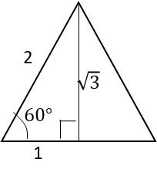
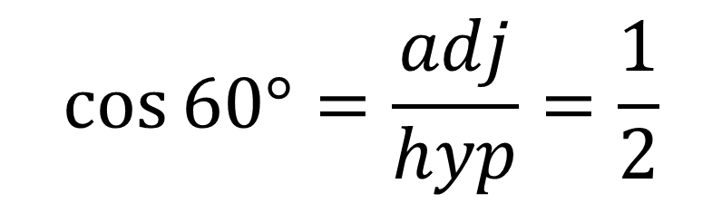
$$\cos{60°}=\frac{adj}{hyp}=\frac{1}{2}$$

Slide 9
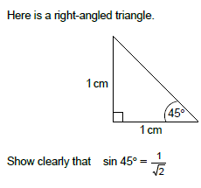
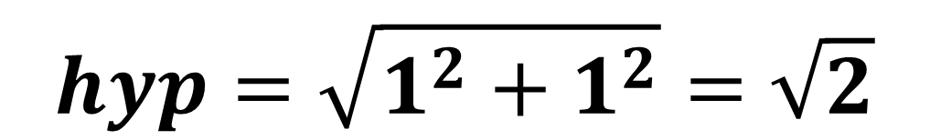
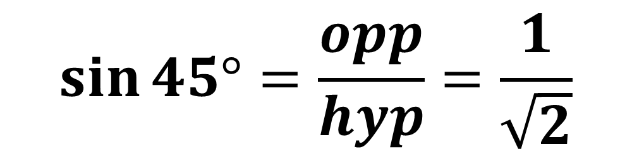
$$hyp=\sqrt{1^{2}+1^{2}}=\sqrt{2}$$
$$\sin{45°}=\frac{opp}{hyp}=\frac{1}{\sqrt{2}}$$

Slide 10
