Slide 1
Equations and Inequalities
Inequalities
Chapter 3
(Part 2 of 3)

Slide 2
Linear Inequalities
When solving inequalities,
you will get an inequality answer.

Slide 3
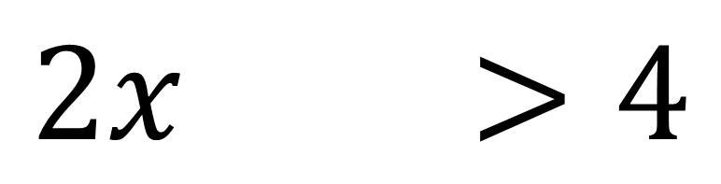
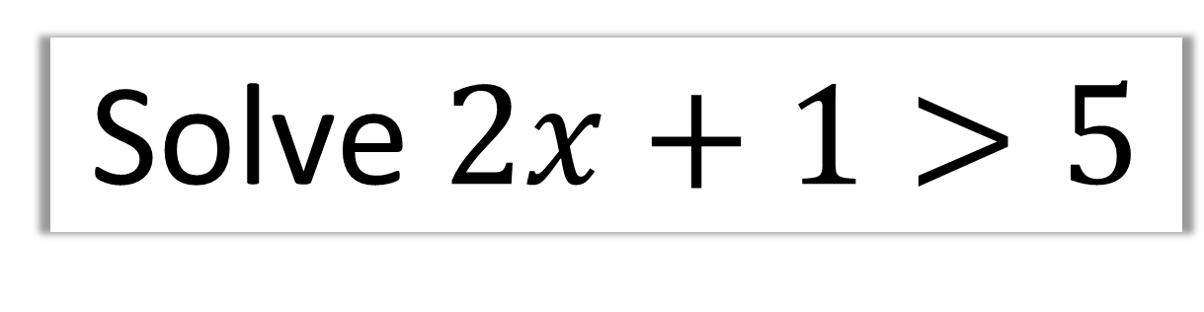
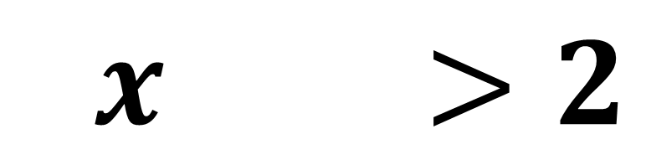
Solve $2x+1>5$
$$2x+1>4$$
$$2x+1>2$$

Slide 4
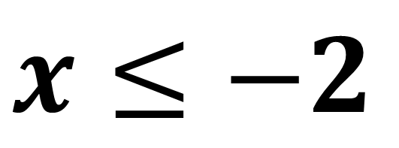
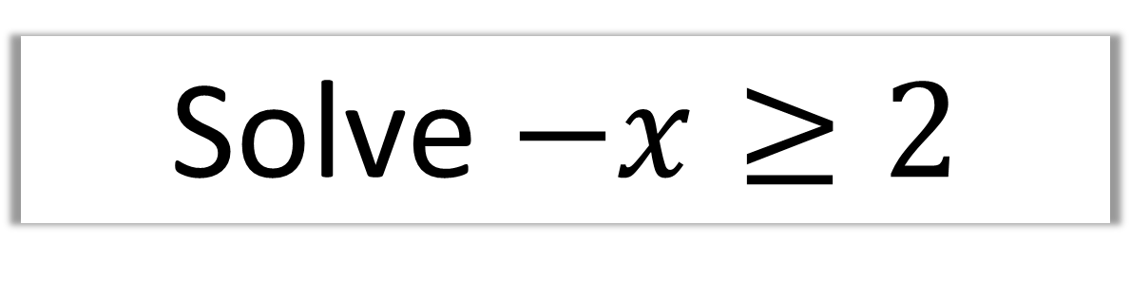
Solve $−x≥2$
$$x≤−2$$
Note:
Multiply or divide both sides of an inequality
by a negative number
reverses the direction of the inequality.

Slide 5
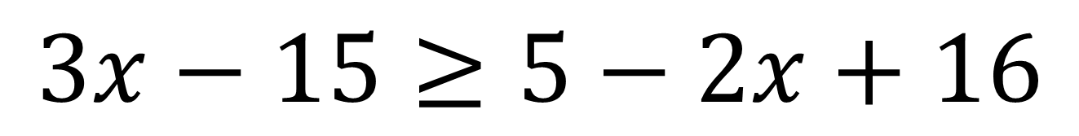
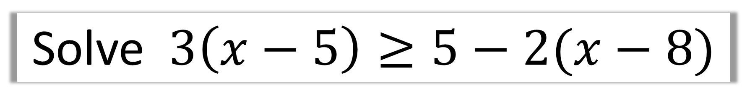
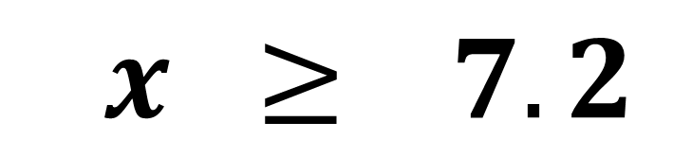
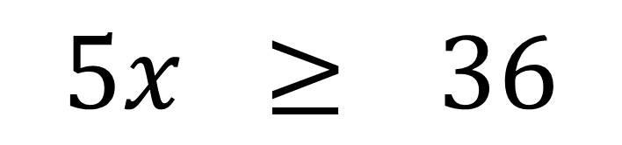
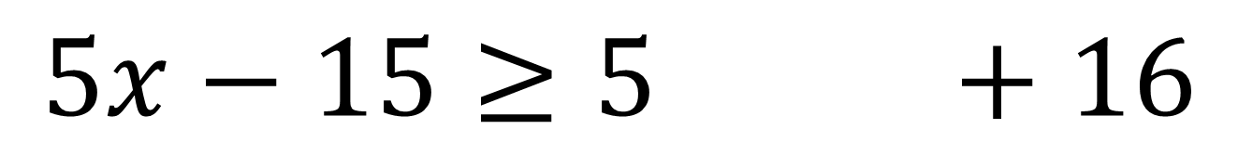
Solve $3\left(x−5\right)≥5−2(x−8)$
$$3x−15≥5−2x+16$$
$$5x−15≥5−2x+16$$
$$5x ≥536$$
$$5x ≥77.2$$

Slide 6
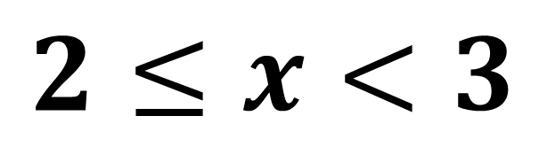
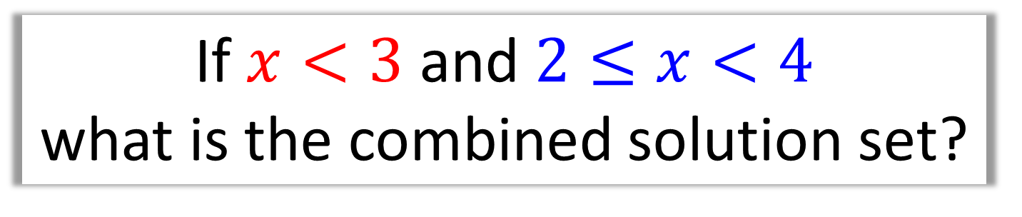
Combining Inequalities
If $x<3$ and $2≤x<4$
what is the combined solution set?
2
3
4
$$2≤x<3$$

Slide 7



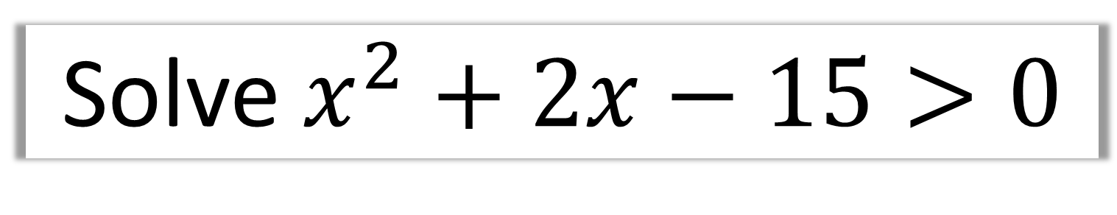



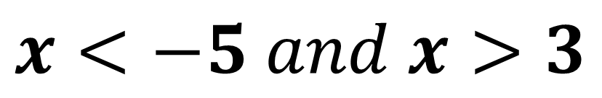
Solve $x^{2}+2x−15>0$
Sketch and Reason
$$y$$
$$x<−5$$
$$x>3$$
$$x$$
$$−5$$
$$3$$
$$x<−5 and x>3$$

Slide 8
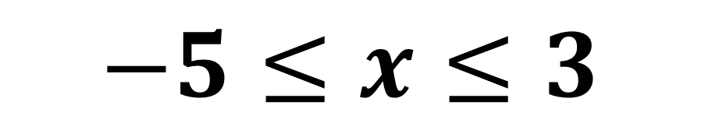





Solve $x^{2}+2x−15≤0$
$$y$$
$$−5$$
$$3$$
$$x$$
$$−5≤x≤3$$

Slide 9

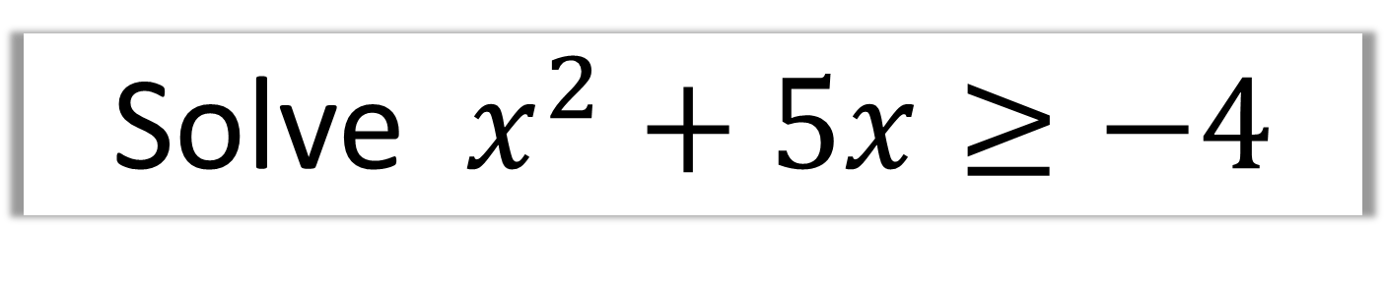

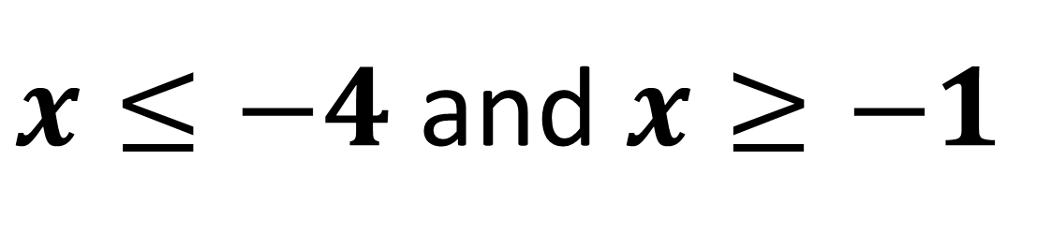


Solve $x^{2}+5x≥−4$
$$y$$
$$x$$
$$−4$$
$$−1$$
$x≤−4$ and $x≥−1$

Slide 10
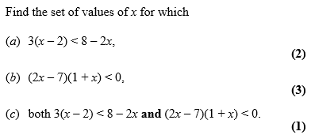
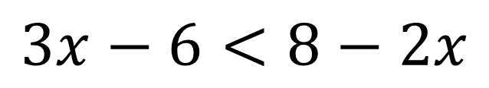
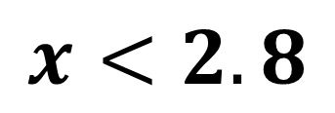
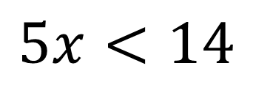
a)
$$3x−6<8−2x$$
$$5x<14$$
$$x<2.8$$

Slide 11
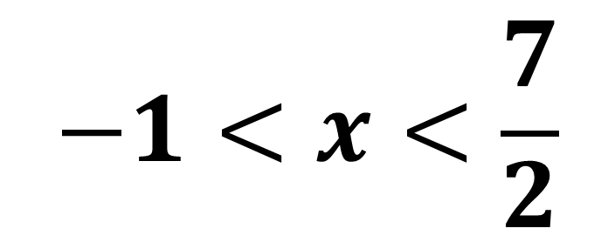
b)
$$−1<x<\frac{7}{2}$$

Slide 12
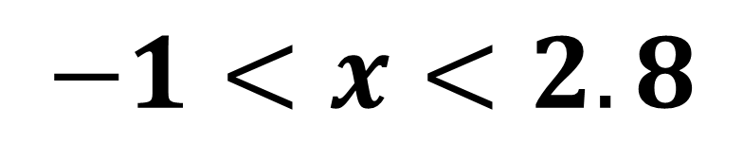
c)
$$−1<x<2.8$$

Slide 13
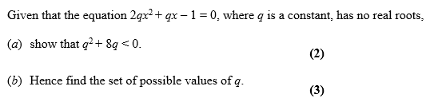
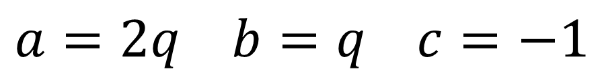
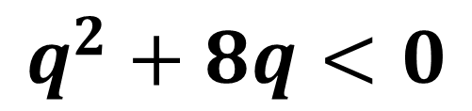
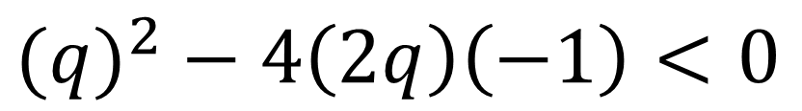
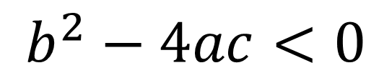
a)
$$a=2q b=q c=−1$$
$$b^{2}−4ac<0$$
$${(q)}^{2} − 4\left(2q\right)\left(−1\right)<0$$
$$q^{2}+8q<0$$

Slide 14
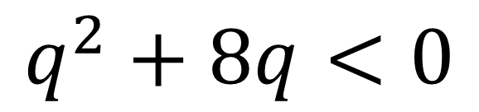
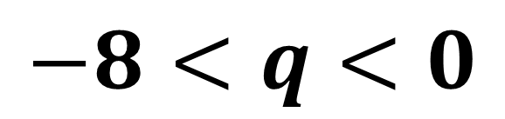
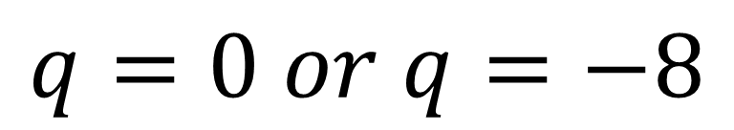
b)
$$q^{2}+8q<0$$
$$q=0 or q=−8$$
$$−8<q<0$$

Slide 15
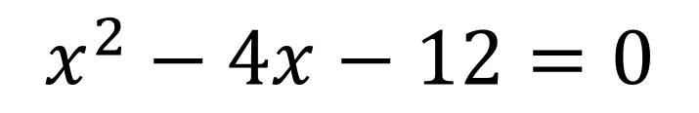

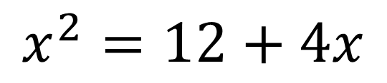
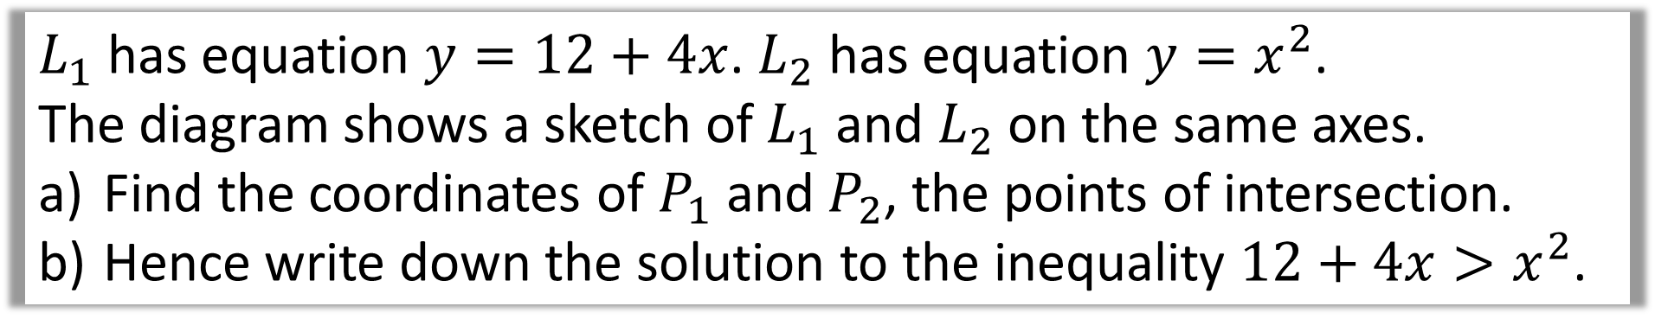



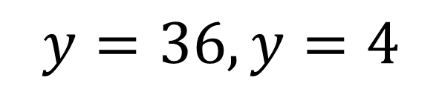

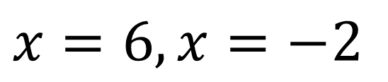
$L_{1}$ has equation $y=12+4x$. $L_{2}$ has equation $y=x^{2}$.
The diagram shows a sketch of $L_{1}$ and $L_{2}$ on the same axes.
Find the coordinates of $P_{1}$ and $P_{2}$, the points of intersection.
Hence write down the solution to the inequality $12+4x>x^{2}$.
a)
$$x^{2}=12+4x$$
$$y$$
$$P_{2}$$
$$x^{2}−4x−12=0$$
$$x=6, x=−2$$
$$y=36, y=4$$
$$P_{1}$$
$$x$$
$$P_{1}\left(−2,4\right), P_{2}\left(6,36\right)$$

Slide 16
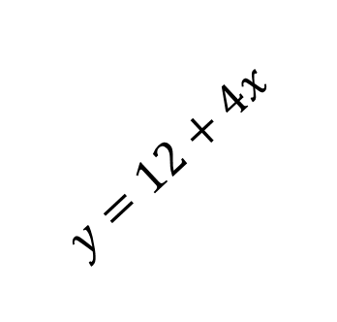


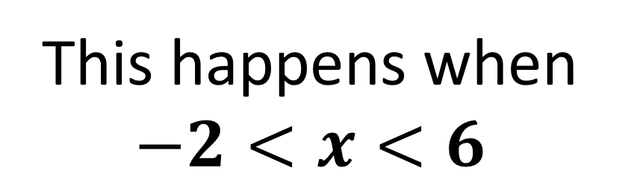
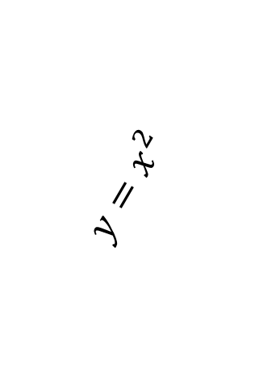
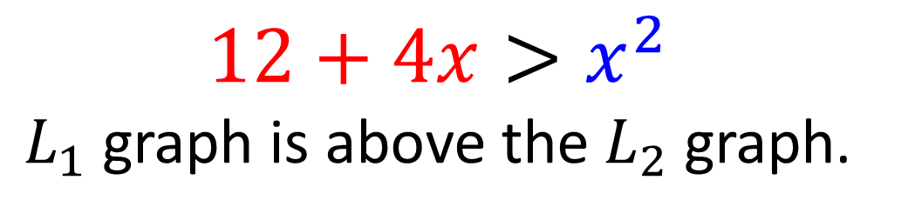




$L_{1}$ has equation $y=12+4x$. $L_{2}$ has equation $y=x^{2}$.
The diagram shows a sketch of $L_{1}$ and $L_{2}$ on the same axes.
Find the coordinates of $P_{1}$ and $P_{2}$, the points of intersection.
Hence write down the solution to the inequality $12+4x>x^{2}$.
$$y$$
$$P_{2}$$
$12+4x>x^{2}$
$L_{1}$ graph is above the $L_{2}$ graph.
$$y=12+4x$$
$$P_{1}$$
$$y=x^{2}$$
This happens when
$$−2<x<6$$
$$x$$
$$−2$$
$$6$$

Slide 17
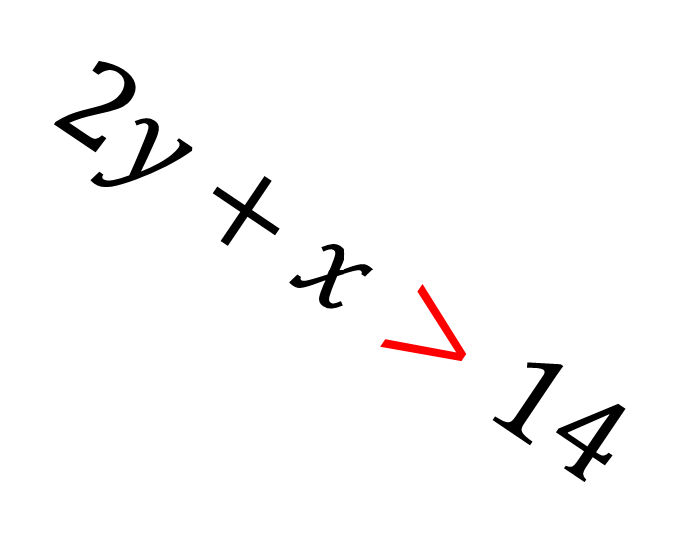
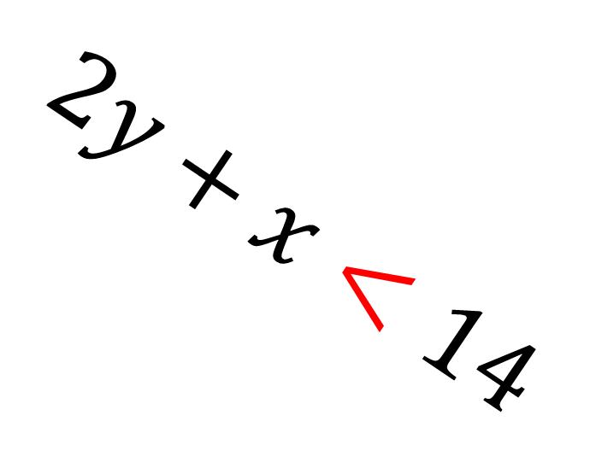
Shading Inequality Regions
$$2y+x<14$$
$$2y+x>14$$

Slide 18
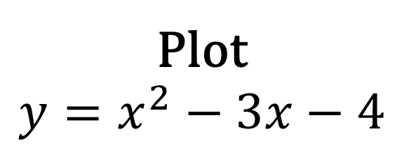
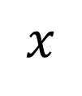
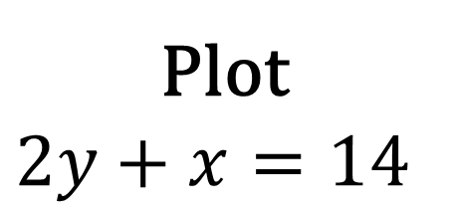
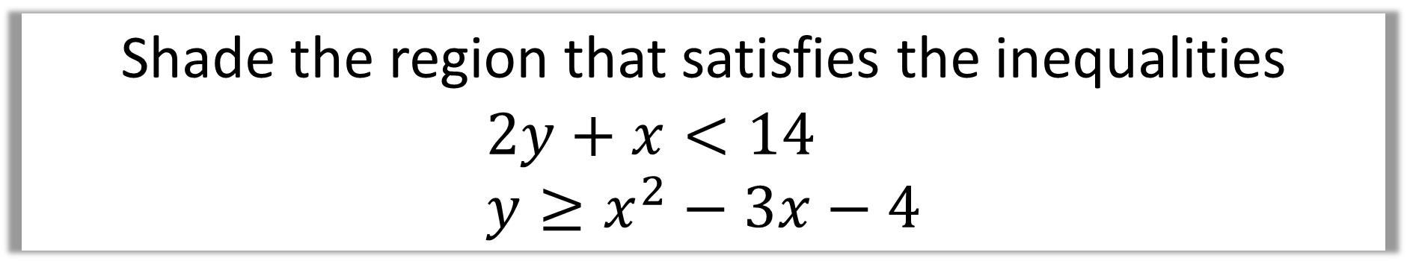


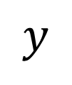
Shade the region that satisfies the inequalities
$$2y+x<14 \\ y≥x^{2}−3x−4$$
$$y$$
Plot
$$y=x^{2}−3x−4$$
Plot
$$2y+x=14$$
$$x$$
$$−1$$
$$4$$
Then shade

