Slide 1
Answers
1) 6 18/35
2) 17 7/12
3) 5/16
4) 4 1/5
5) 1 3/7
6) 6
7) 8
8) 4 ¾
9) 5 2/5
10) 16
11) 1 5/8
12) 3 1/6

Slide 2
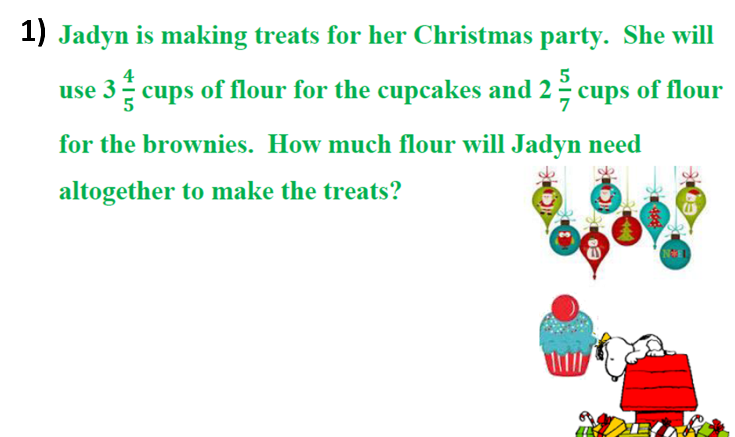
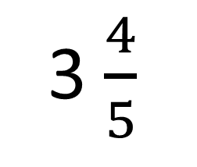
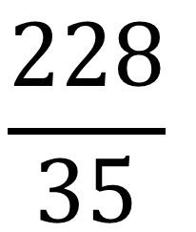
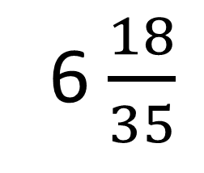
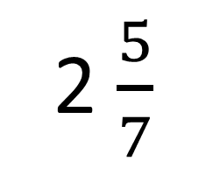
3 $\frac{4}{5}$
+
2 $\frac{5}{7}$
$$\frac{228}{35}$$
6 $\frac{18}{35}$
=
=

Slide 3
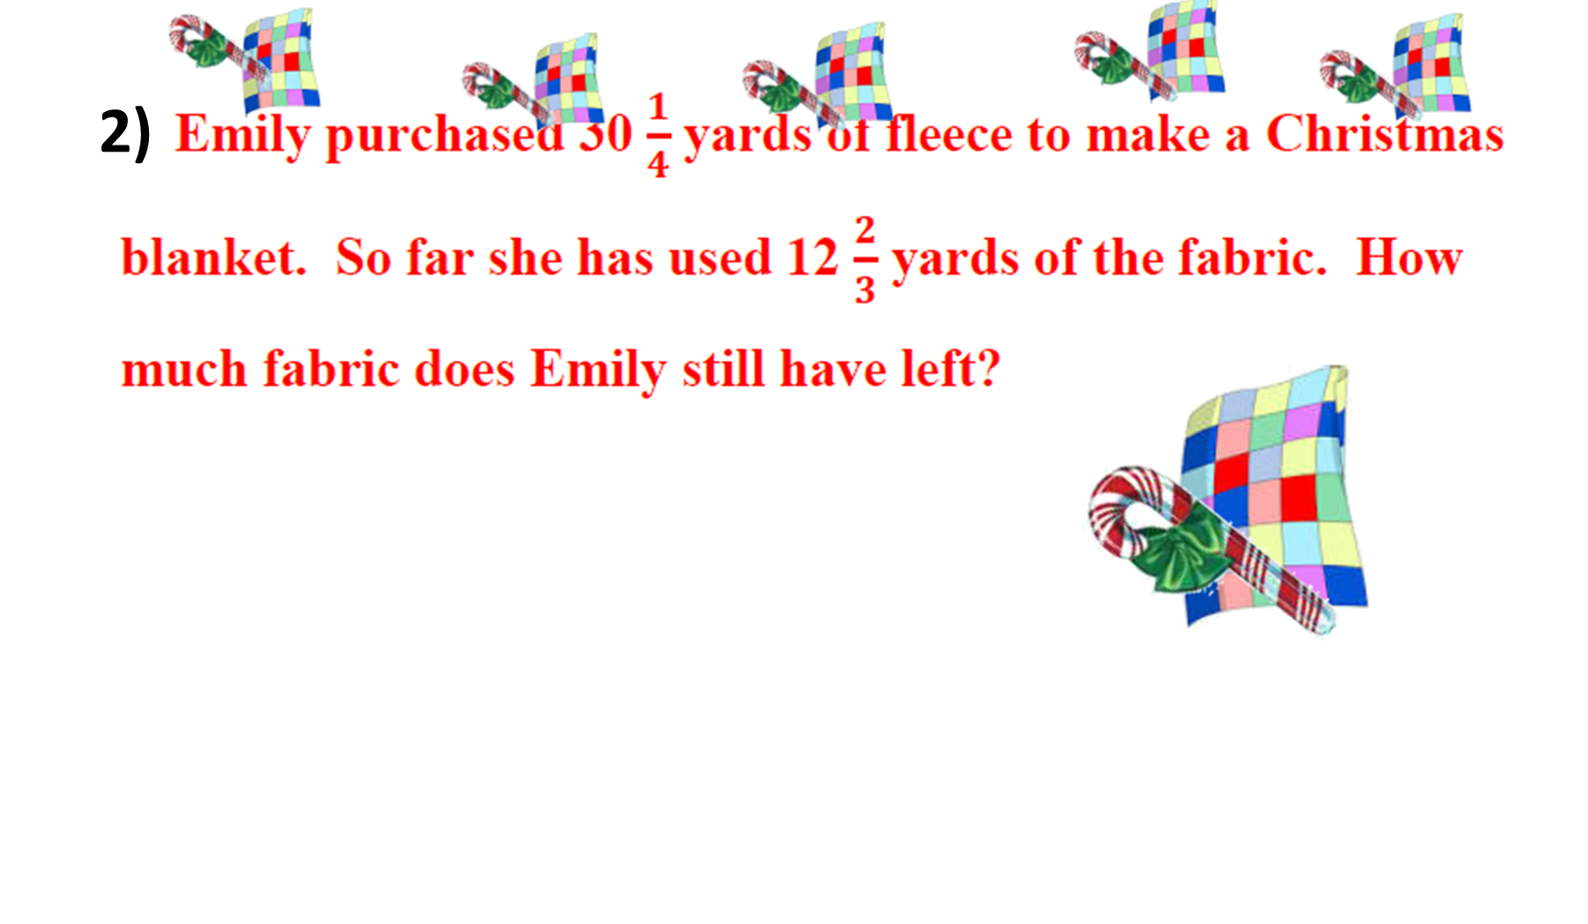
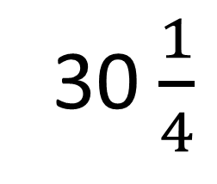
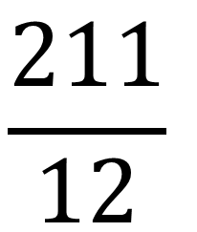
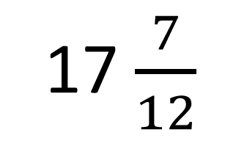
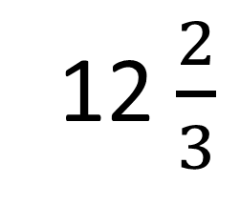
30 $\frac{1}{4}$
-
12 $\frac{2}{3}$
$$\frac{211}{12}$$
17 $\frac{7}{12}$
=
=

Slide 4
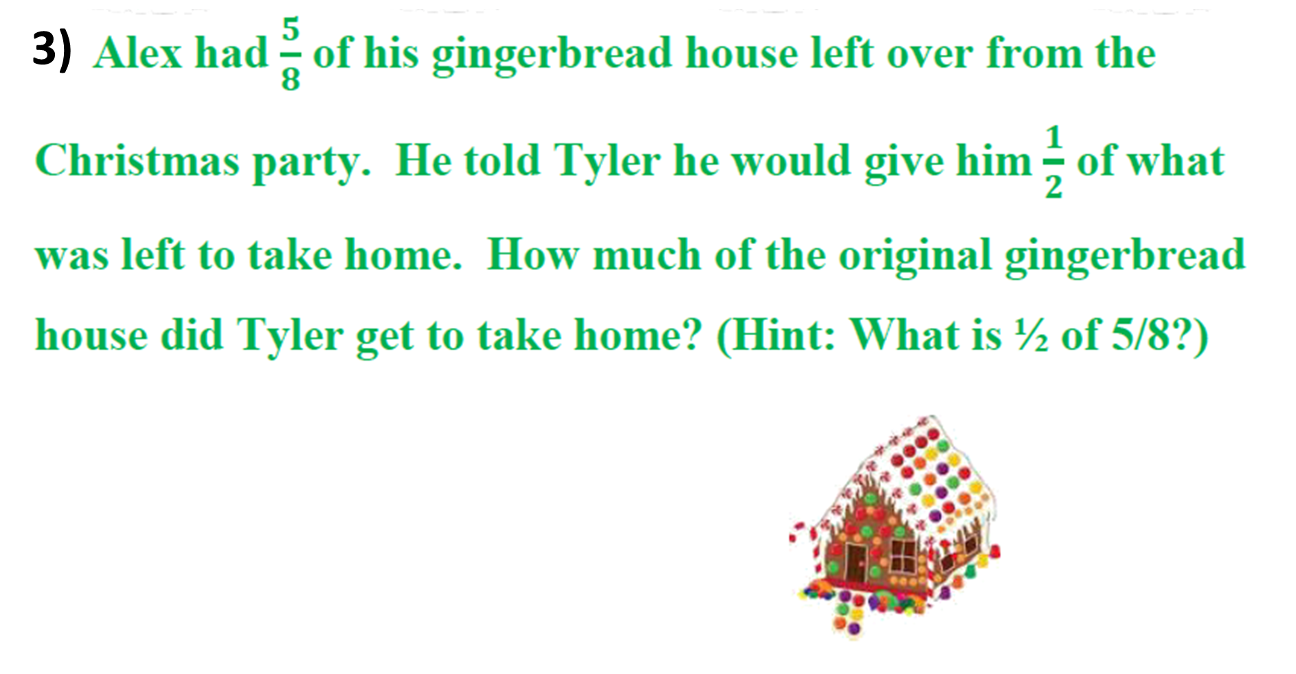
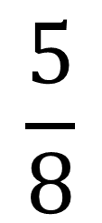
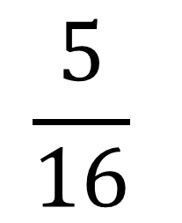
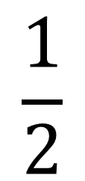
$$\frac{5}{8}$$
$$\frac{1}{2}$$
$$\frac{5}{16}$$
x
=

Slide 5
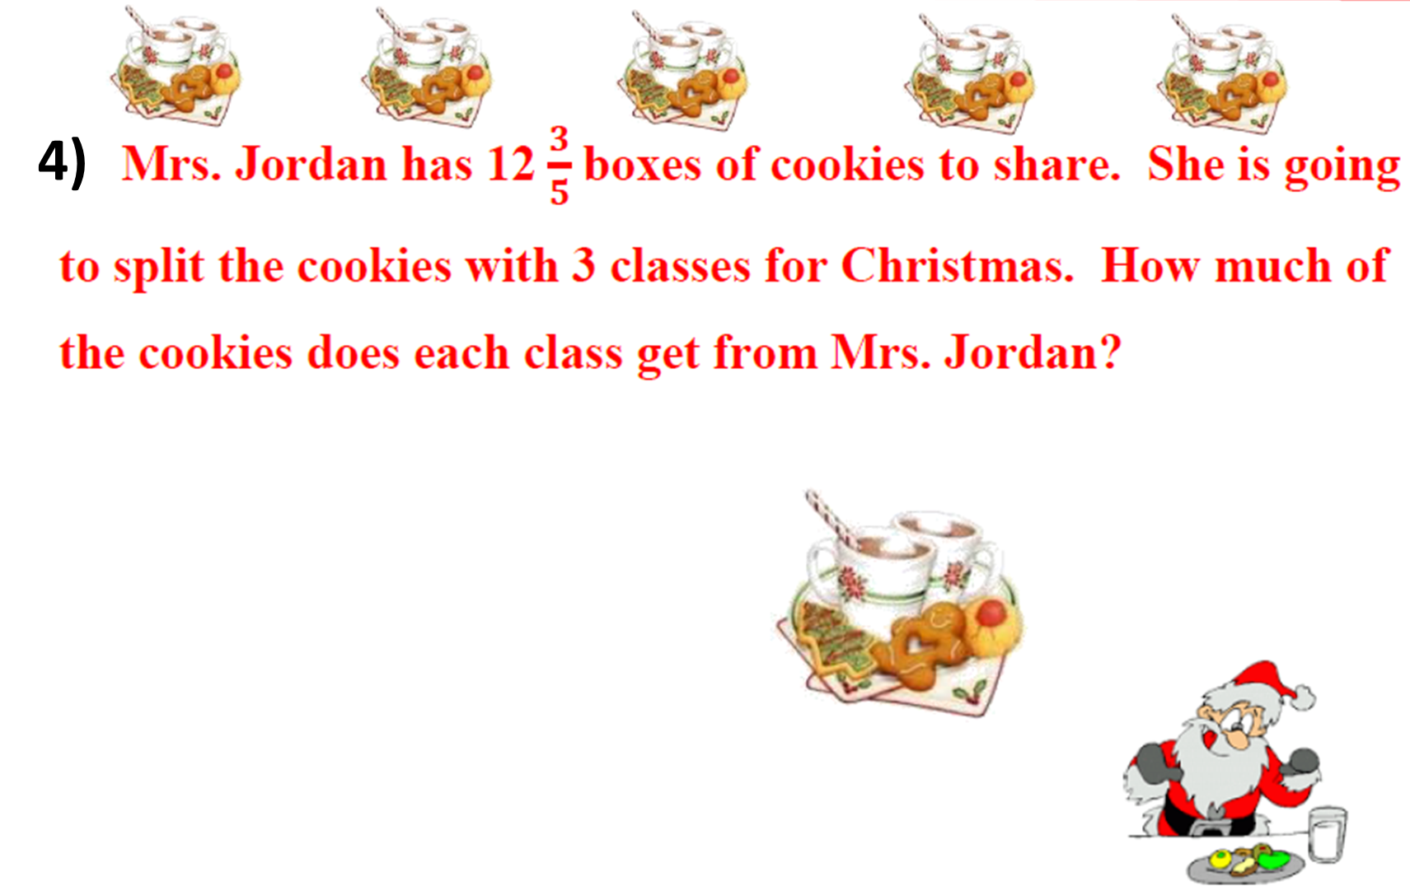
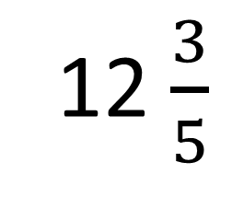
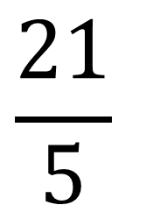
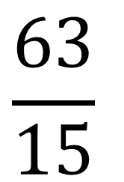
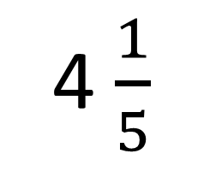
$$\frac{63}{15}$$
12 $\frac{3}{5}$
÷
=
=
4 $\frac{1}{5}$
3
$$\frac{21}{5}$$
=

Slide 6
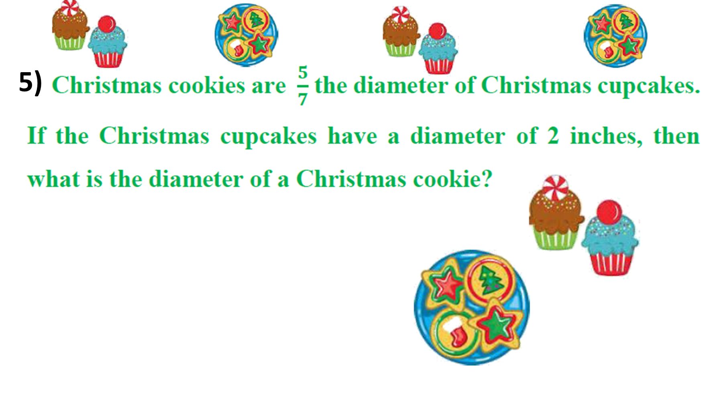
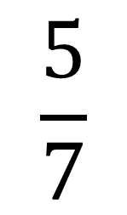
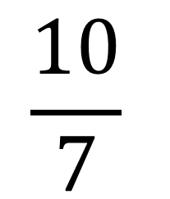
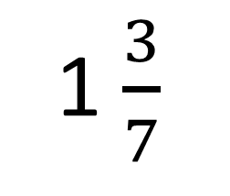
$$\frac{5}{7}$$
$$\frac{10}{7}$$
x
=
=
1 $\frac{3}{7}$
2

Slide 7
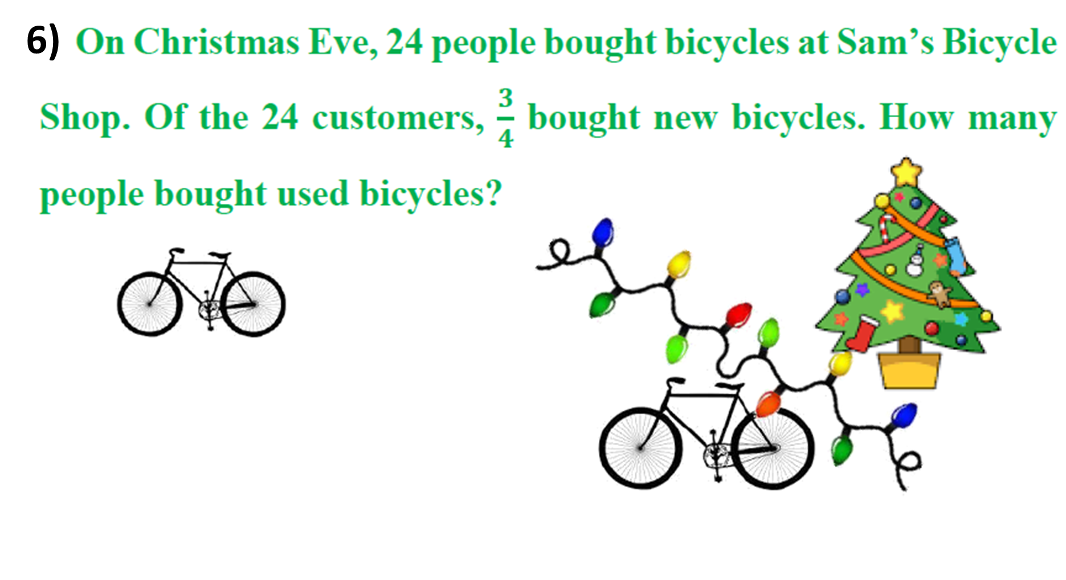
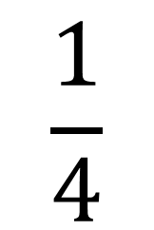
$$\frac{1}{4}$$
x
=
24
6

Slide 8
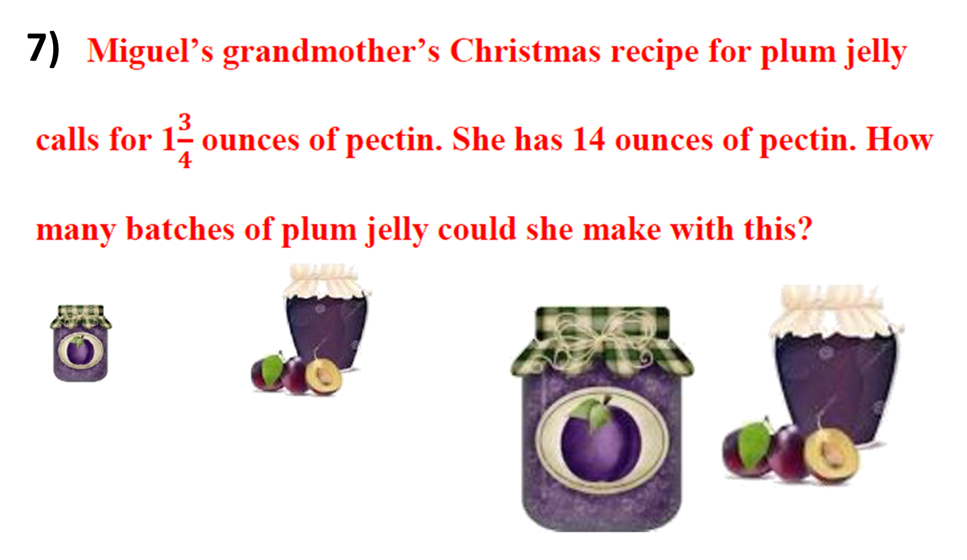
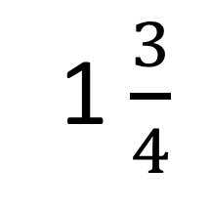
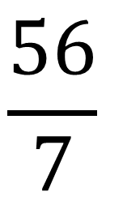
÷
1 $\frac{3}{4}$
$$\frac{56}{7}$$
14
=
=
8

Slide 9
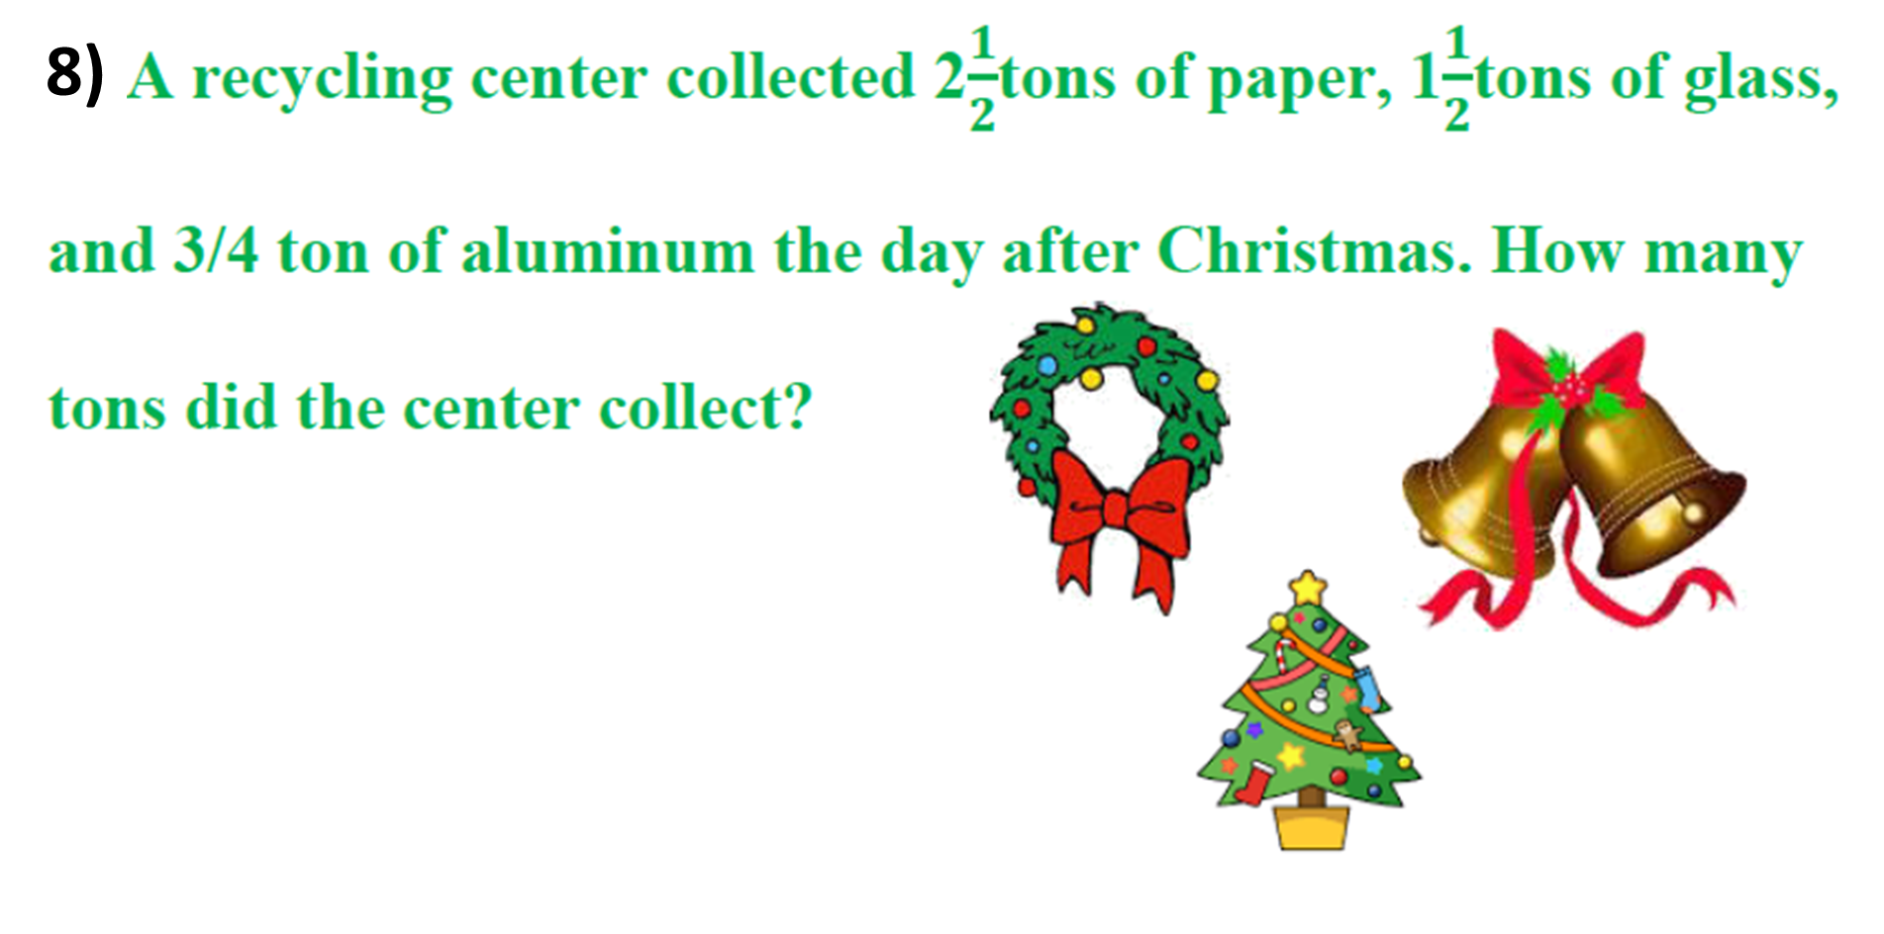
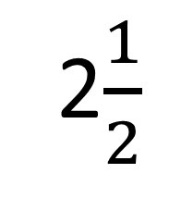
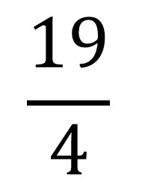
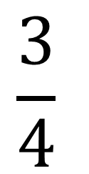
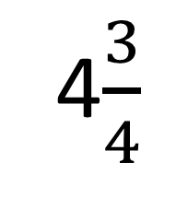
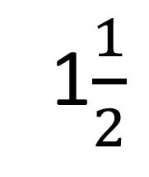
$$\frac{3}{4}$$
$$\frac{19}{4}$$
2$\frac{1}{2}$
+
1$\frac{1}{2}$
+
=
=
4$\frac{3}{4}$

Slide 10
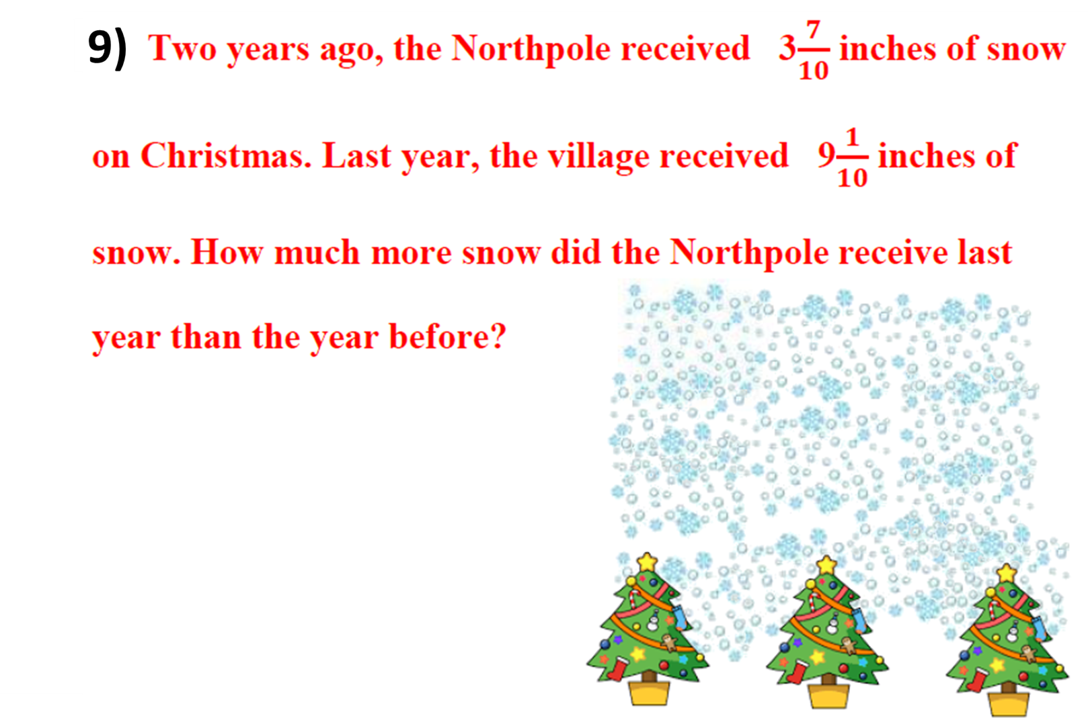
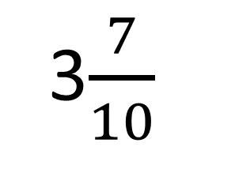
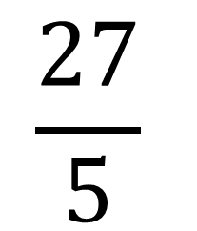
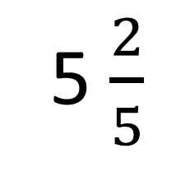
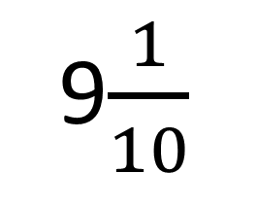
$$\frac{27}{5}$$
9$\frac{1}{10}$
3$\frac{7}{10}$
5 $\frac{2}{5}$
-
=
=

Slide 11
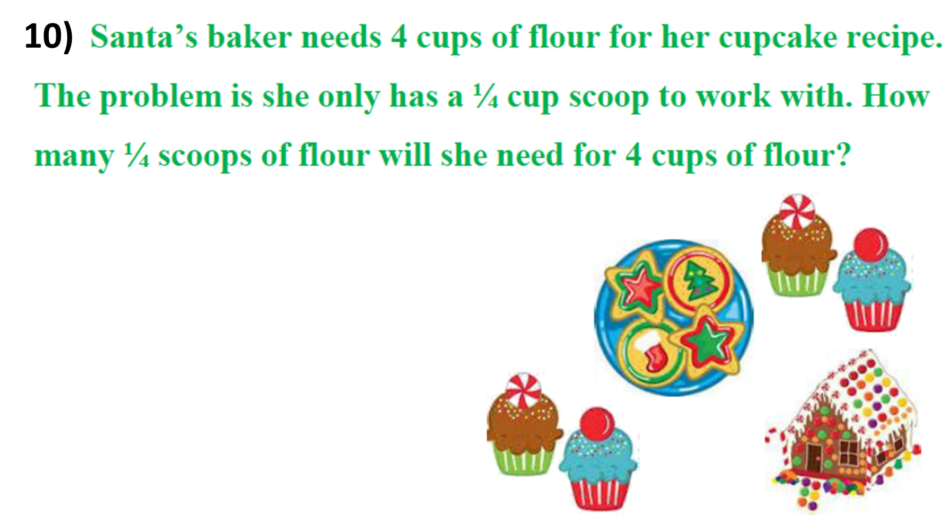
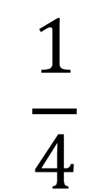
$$\frac{1}{4}$$
4
÷
=
16

Slide 12
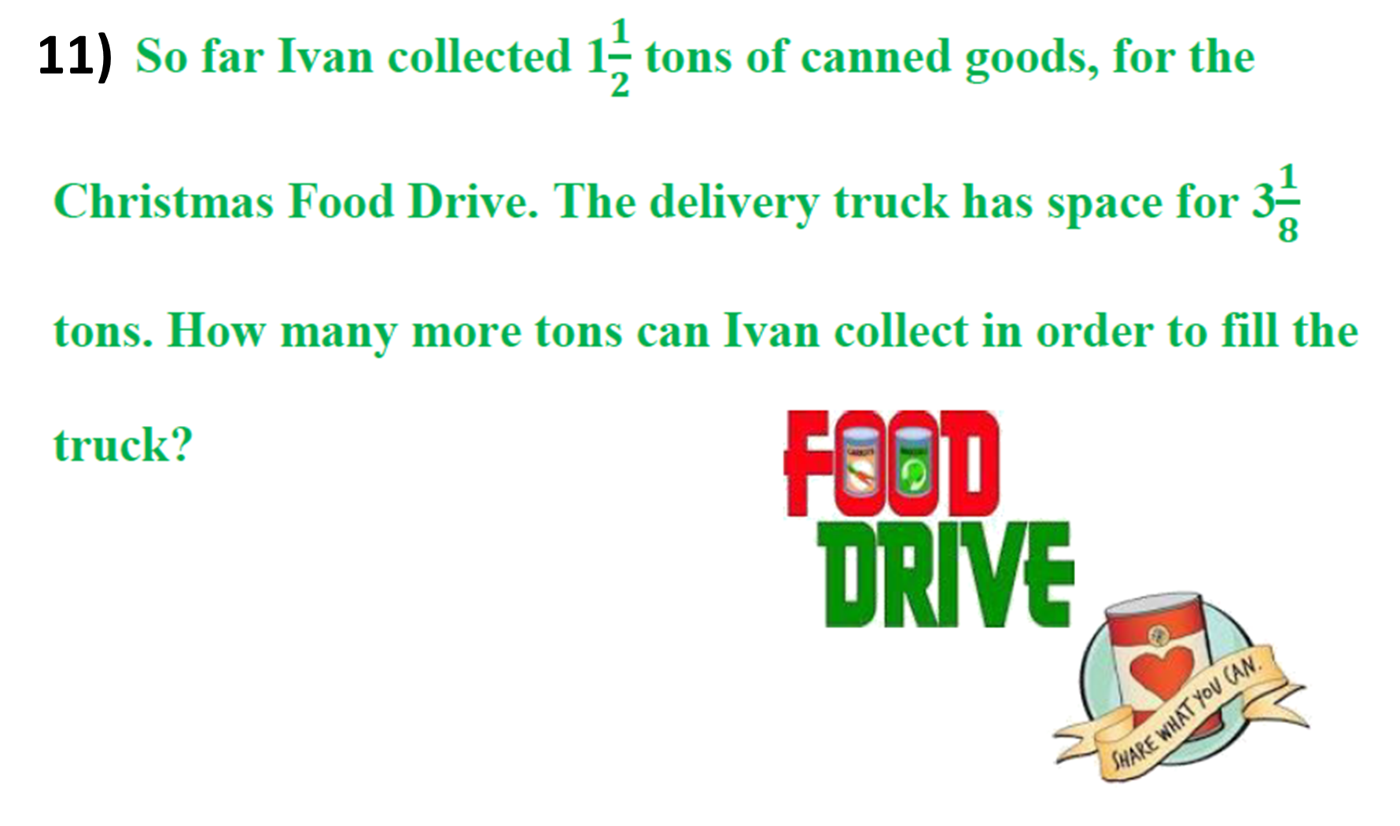
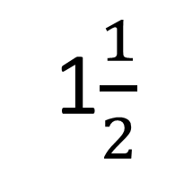
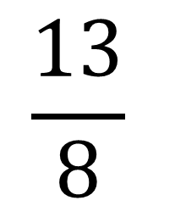
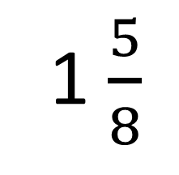
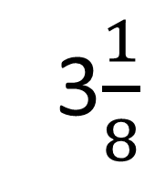
$$\frac{13}{8}$$
3$\frac{1}{8}$
-
1$\frac{1}{2}$
=
=
1 $\frac{5}{8}$

Slide 13
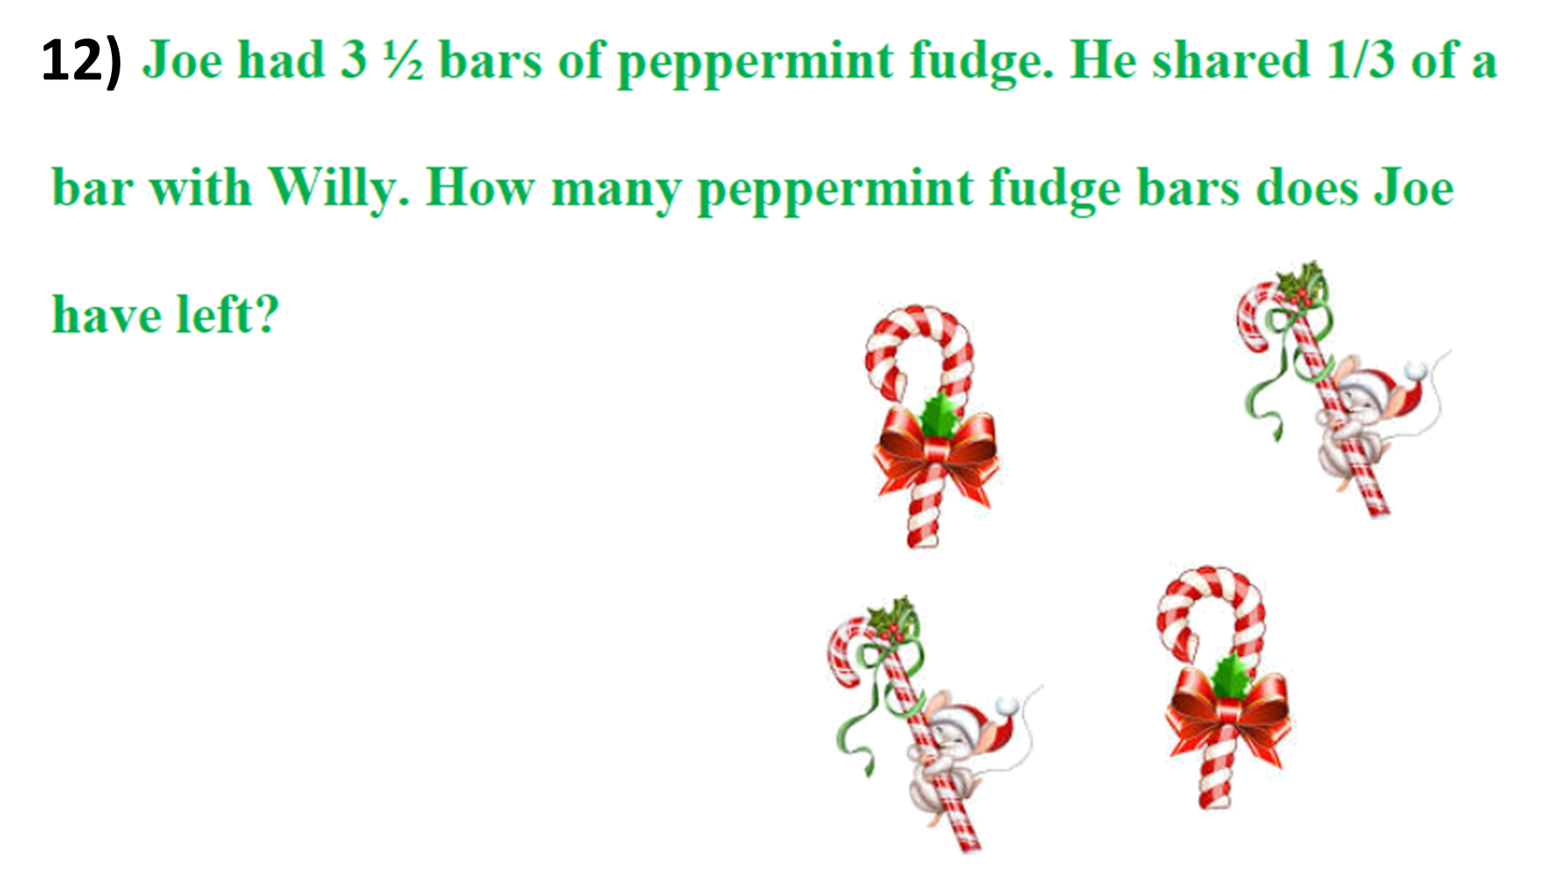
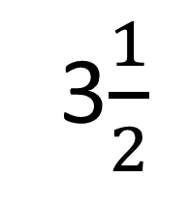
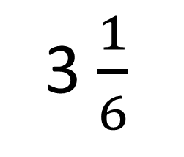
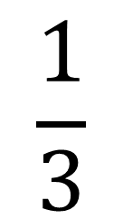
$$\frac{1}{3}$$
3$\frac{1}{2}$
-
=
3 $\frac{1}{6}$

