Slide 1
LO: Solving Quadratics
(Completing the Square)

Slide 2
$\sqrt{9}$ $=$
$$±3$$

Slide 3
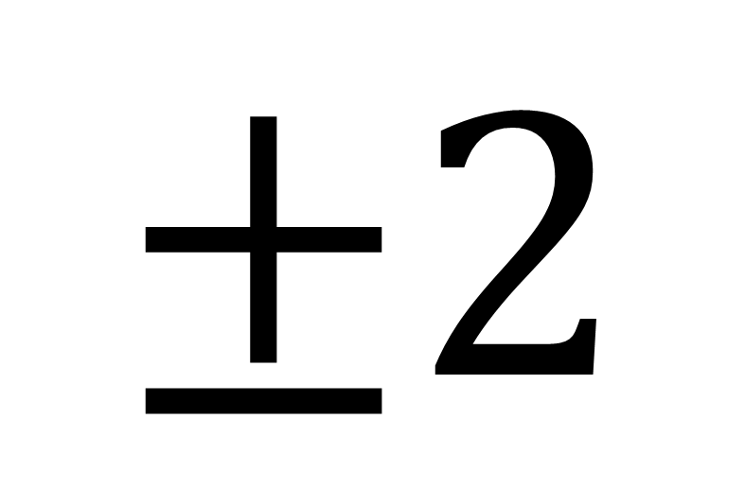
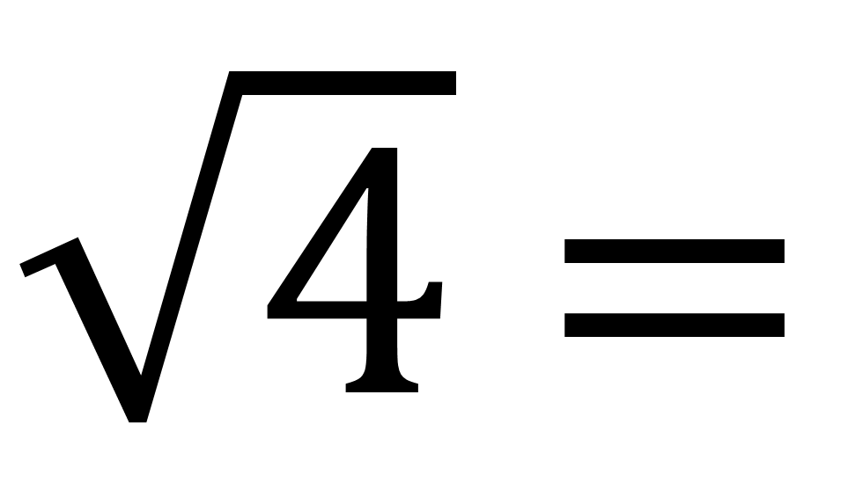
$\sqrt{4}$ $=$
$$±2$$

Slide 4
Write in the form (x + a)² + b
x² + 10x + 24 =
(x + 5)²
– 1

Slide 5
Write in the form (x + a)² + b
x² + 12x + 40 =
(x + 6)²
+ 4

Slide 6
Write in the form (x + a)² + b
x² – 16x + 60 =
(x – 8)²
– 4

Slide 7
Step 1:
Complete the Square
Step 2:
Make x the subject of the formula

Slide 8
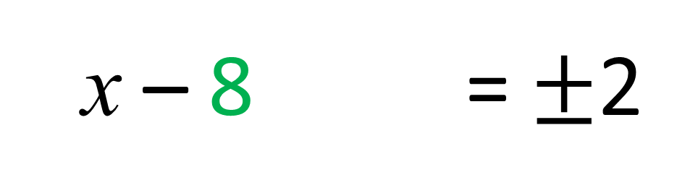
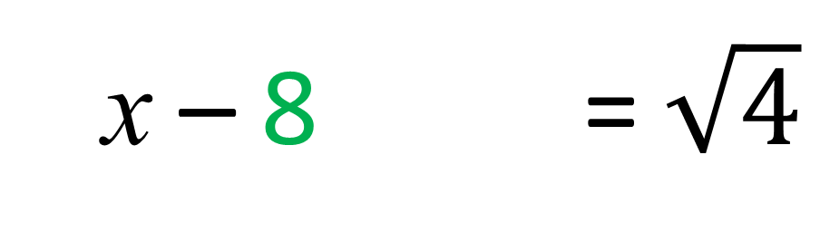
Solve the Quadratic
(x – 8)² – 4 = 0
(x – 8)² – 4 = 4
(x – 8)² – 4 = $\sqrt{4}$
(x – 8)² – 4 = $±$2
(x – 8)² – 4 = 10 or 6

Slide 9
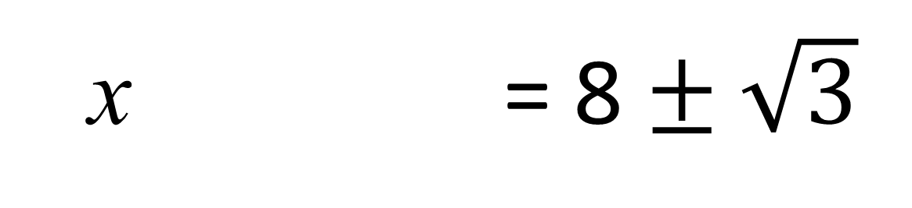
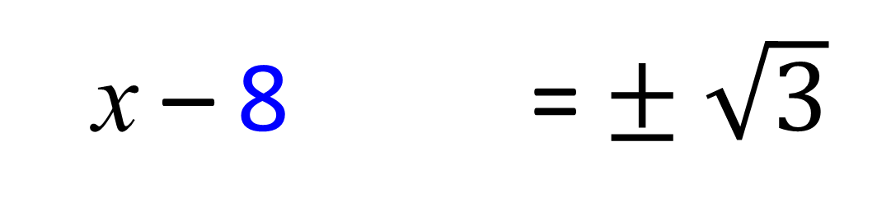
Solve the Quadratic
(x – 8)² – 3 = 0
(x – 8)² – 4 = 3
(x – 8)² – 4 = $± \sqrt{3}$
(x – 8)² – 4 = 8 $± \sqrt{3}$

Slide 10
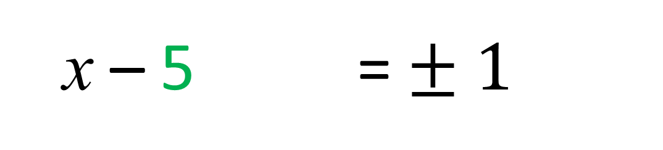
Solve x² – 10x + 24 = 0
by completing the square.
(x – 5)² – 1 = 0
(x – 5)² – 4 = 1
(x – 5)² – 4 = $± 1$
(x – 8)² – 4 = 6 or 4

Slide 11
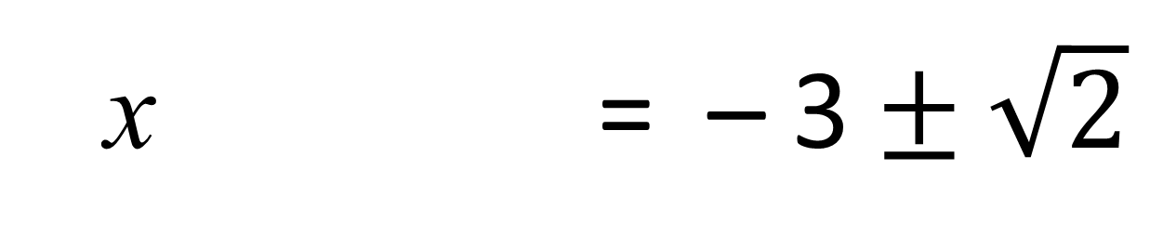
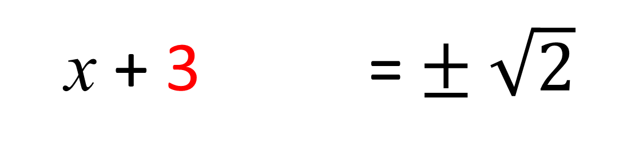
Solve x² + 6x + 7 = 0
by completing the square.
(x + 3)² – 2 = 0
(x + 3)² – 4 = 2
(x + 3)² – 4 = $± \sqrt{2}$
(x – 8)² – 4 = – 3$± \sqrt{2}$

Slide 12
The coefficient of x² must be 1
$${2x}^{2}+16x+16= 0$$
Divide through by 2
$$x^{2}+8x+8= 0$$
Now solve

