Slide 1
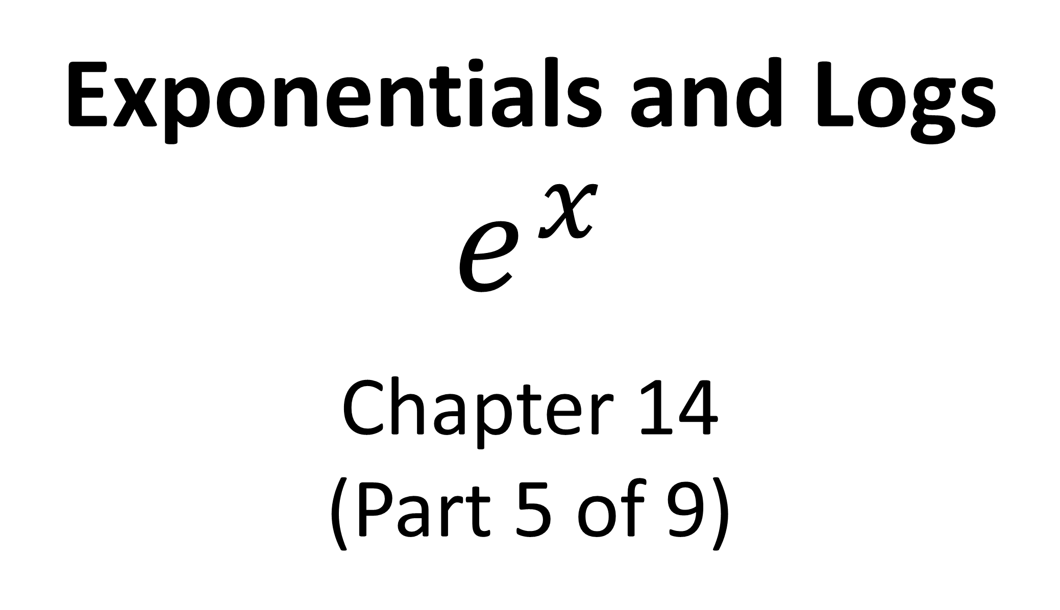
Exponentials and Logs
$$e^{x}$$
Chapter 14
(Part 5 of 9)

Slide 2

$$e^{x}$$
e ≈ 2.71821

Slide 3
What makes e a special numbers?
The function is equal to
its gradient function.

Slide 4
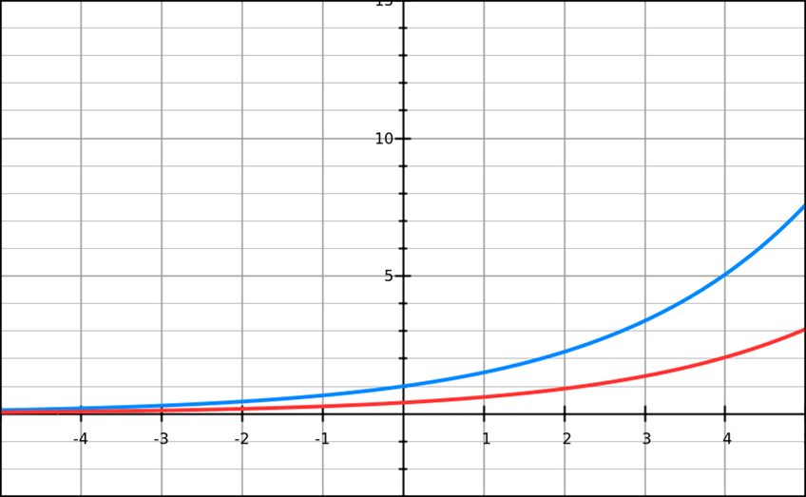
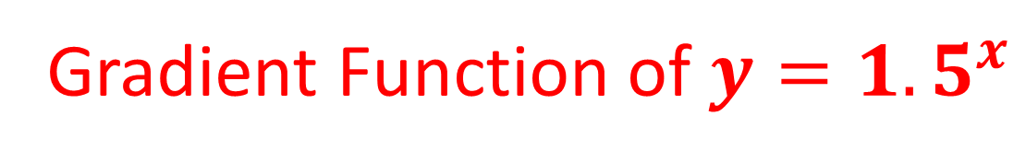
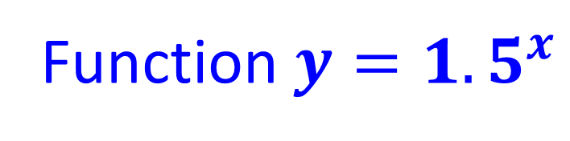
Function $y={1.5}^{x}$
Gradient Function of $y={1.5}^{x}$

Slide 5
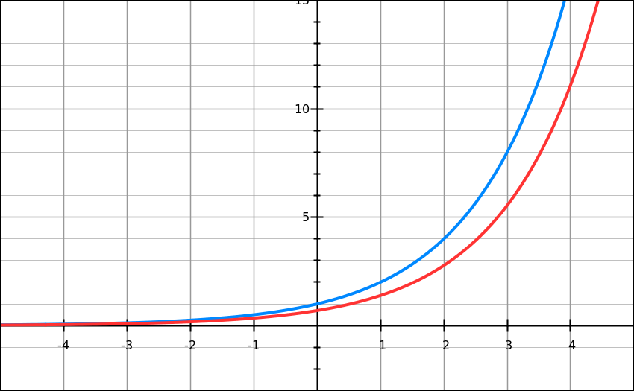
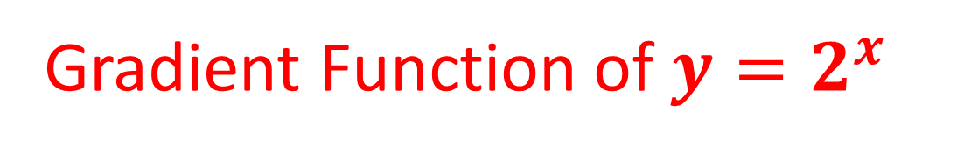
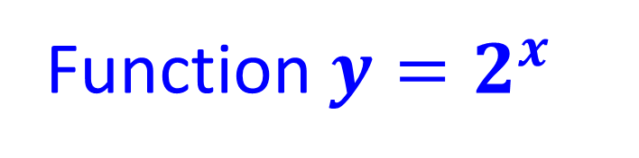
Function $y=2^{x}$
Gradient Function of $y=2^{x}$

Slide 6
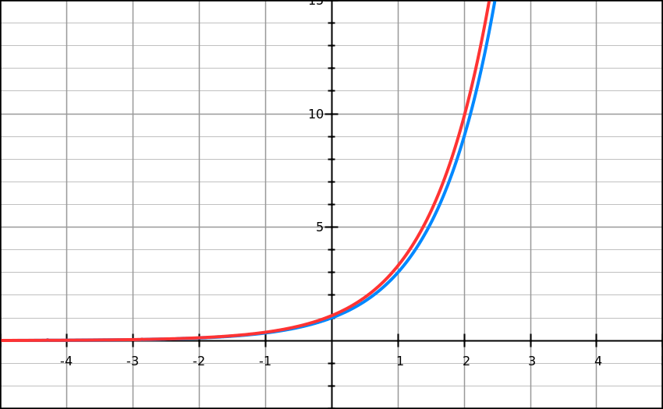
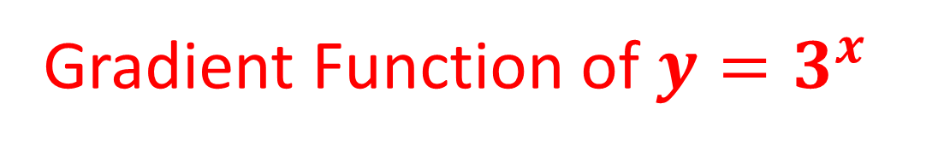
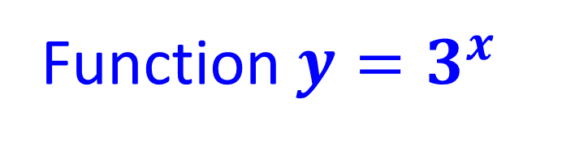
Function $y=3^{x}$
Gradient Function of $y=3^{x}$

Slide 7
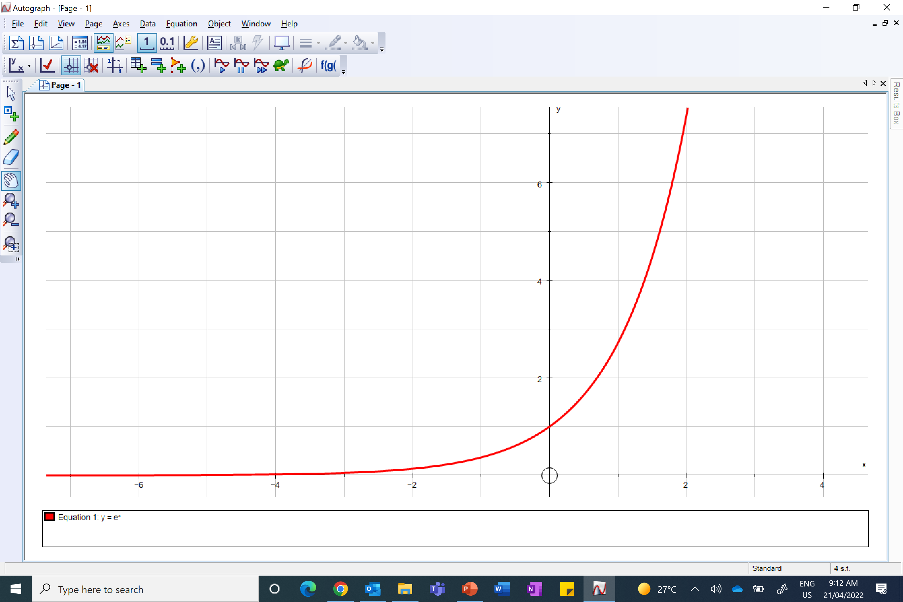
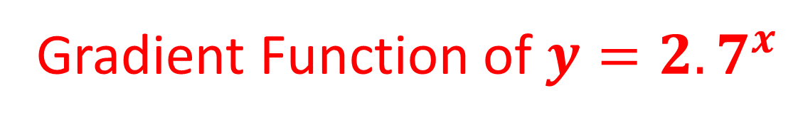
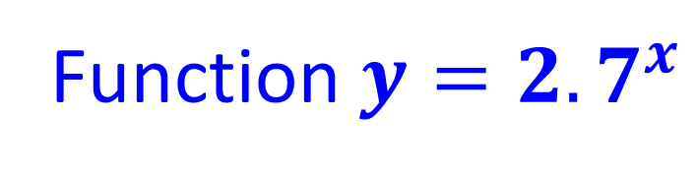
Function $y={2.7}^{x}$
Gradient Function of $y={2.7}^{x}$

Slide 8
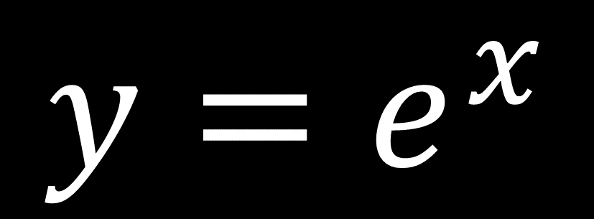
$${y=e}^{x}$$
is special because of the
graph it produces.
It is used to model real situations
such as population growth
and radioactive decay.

Slide 9
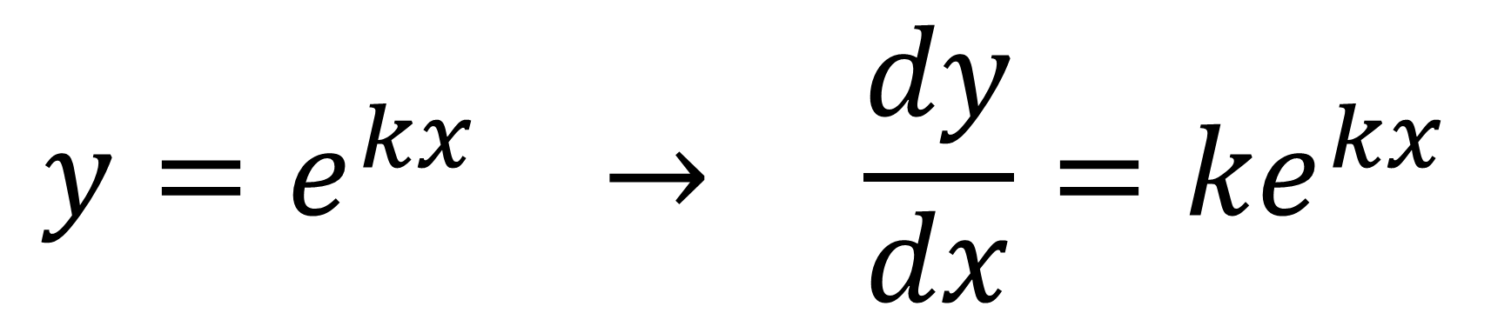

Differentiation of $e^{x}$
$$y=e^{kx} → \frac{dy}{dx}={ke}^{kx}$$

Slide 10
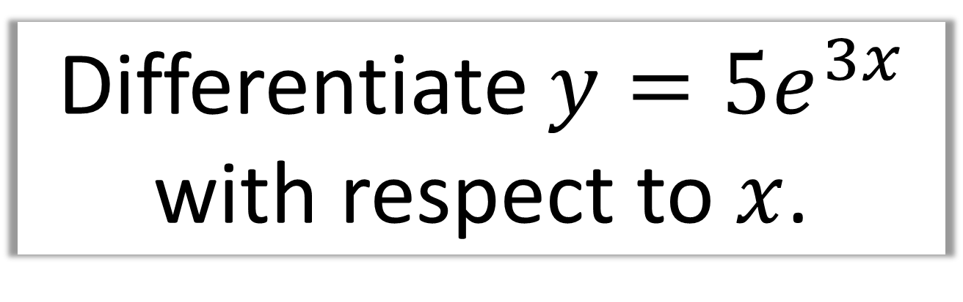
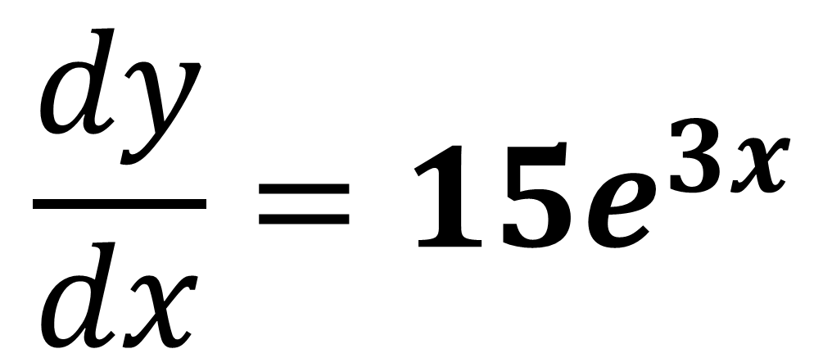
Differentiate $y={5e}^{3x}$
with respect to $x$.
$$\frac{dy}{dx}={15e}^{3x}$$

Slide 11
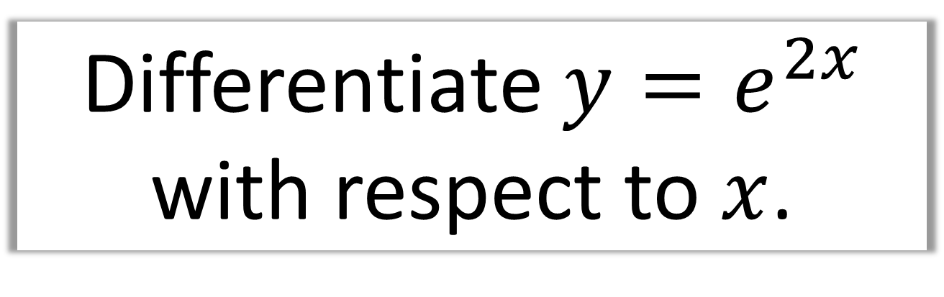
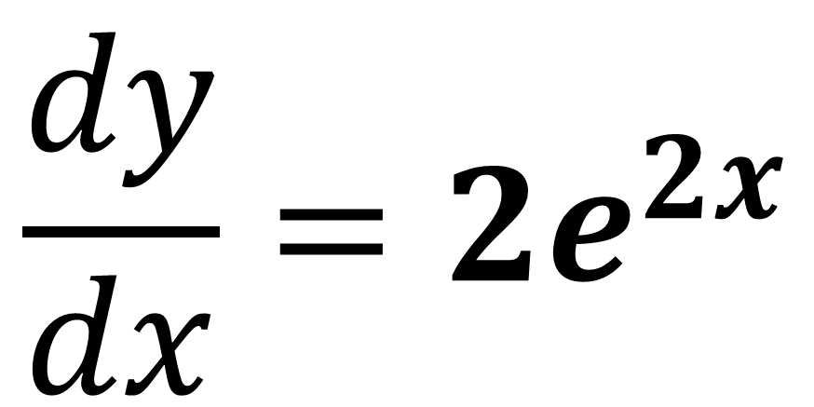
Differentiate $y=e^{2x}$
with respect to $x$.
$$\frac{dy}{dx}={2e}^{2x}$$

Slide 12
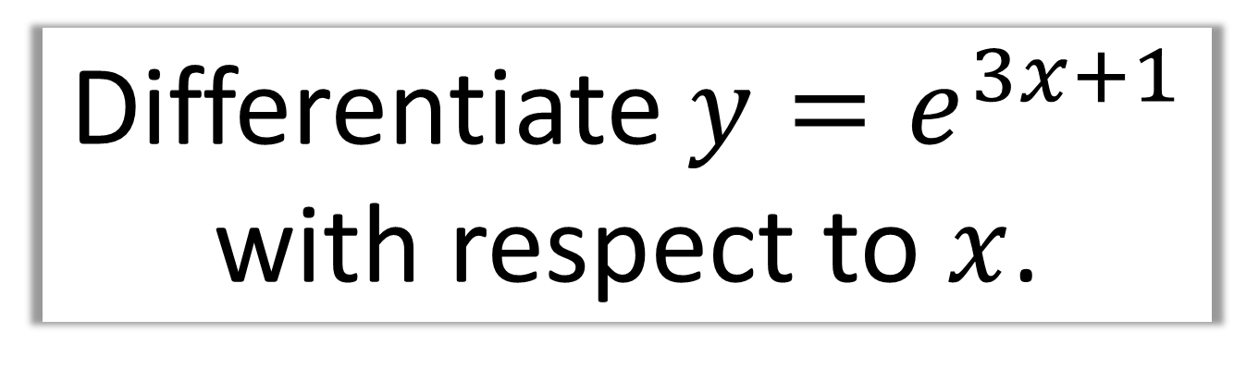
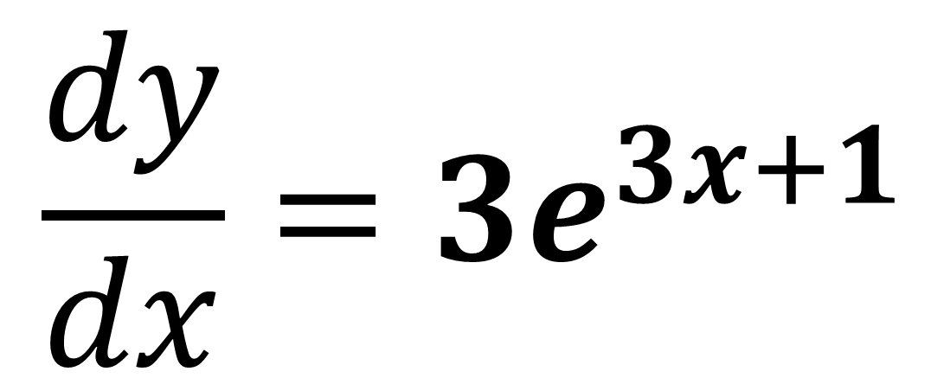
Differentiate $y=e^{3x+1}$
with respect to $x$.
$$\frac{dy}{dx}={3e}^{3x+1}$$

Slide 13
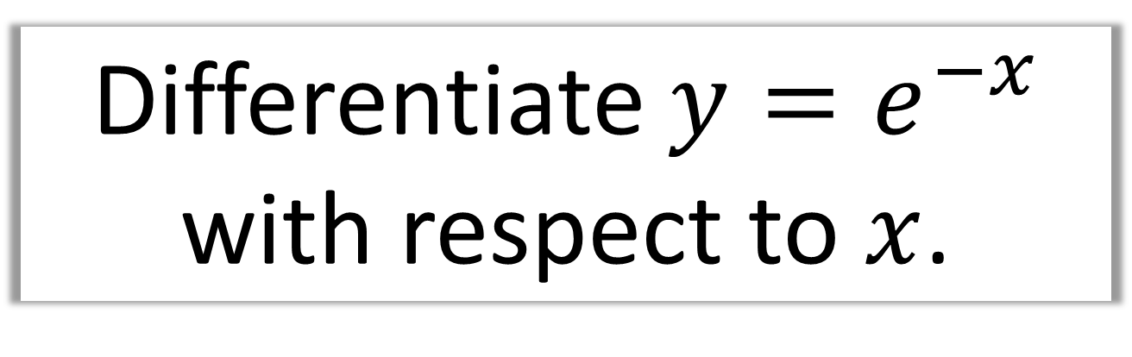
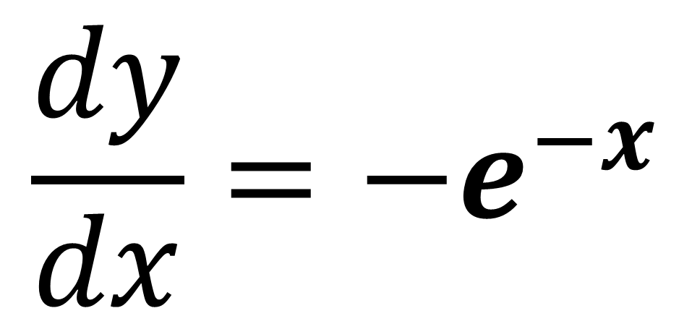
Differentiate $y=e^{−x}$
with respect to $x$.
$$\frac{dy}{dx}={−e}^{−x}$$

