Slide 1
Question | Finding K | Equation
A is inversely Proportional to B When A = 5 and B = 6
Z is directly proportional to Y When Z = 55 and Y = 5
N is directly proportional to L When N = 6 and L = 12
y is inversely proportional to then square of x When y = 0.03 and x = 10
A is indirectly proportional to B When A = 12 B = 3
h is directly proportional to V When h = 36 V = 8
y is directly proportional to the cube of x y = 250 when x = 5
A is inversely proportional to B When A = -4 B = 8

Slide 2
Question | Finding K | Equation | Missing Value (2 decimal places if needed)
g is inversely proportional to v ² If g = 8 when v = 5, find v when g = 12.5.
e varies directly as f ². If e = 12 when f = 1, find f when e = 432.
x is inversely proportional to the square of n. If x = 10 when n = 4, find n when x = 40.
If a=10 and b=6 and a is inversely proportional to b, write an equation linking a and b. Find b when a=4.
y is directly proportional to x³. When x = 5, y = 700. Find x when y = 520.
The pressure (p) of water from a hose is inversely proportional to the square of the hose radius (r) For a hose of radius 1.5cm, the water pressure is 40. What hose radius do you need for a pressure of 70?
y is directly proportional to the square root of x. When x = 4, y = 17. Find x when y = 40.
p is found to be inversely proportional to t. When p = 34.2, t =0.9. Find t when p = 47.8 .

Slide 3
ANSWERS

Slide 4
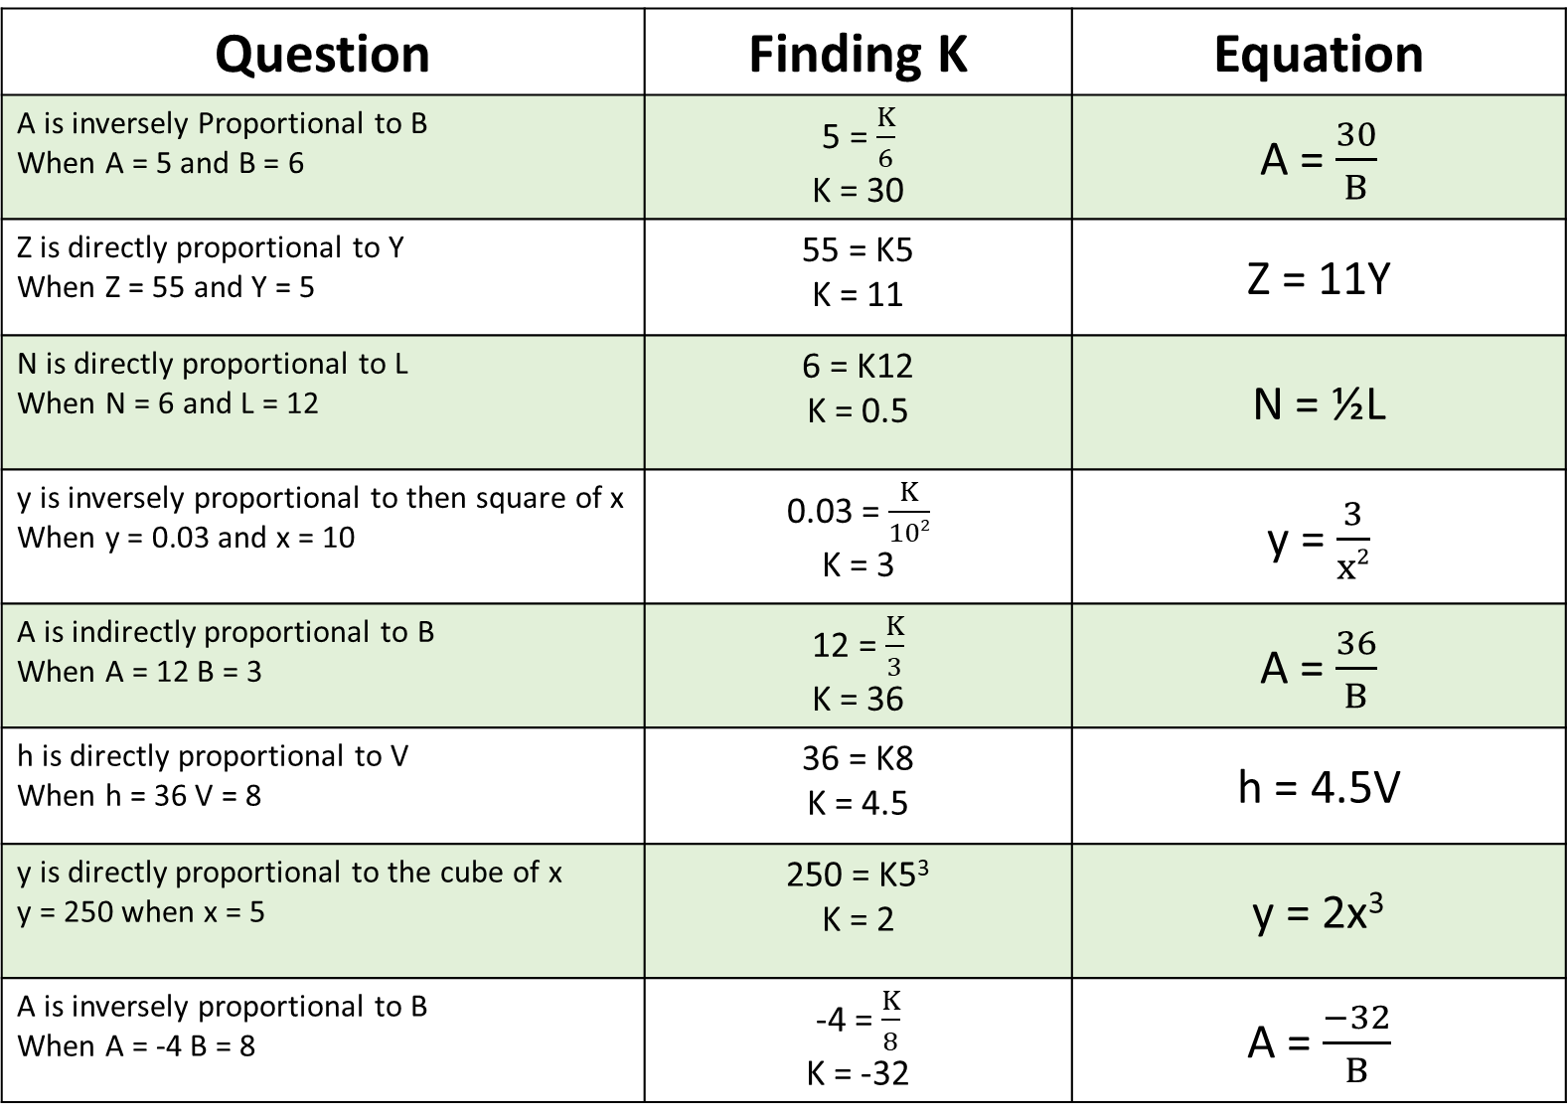
Question | Finding K | Equation
A is inversely Proportional to B When A = 5 and B = 6 | 5 = $\frac{K}{6}$ K = 30 | A = $\frac{30}{B}$
Z is directly proportional to Y When Z = 55 and Y = 5 | 55 = K5 K = 11 | Z = 11Y
N is directly proportional to L When N = 6 and L = 12 | 6 = K12 K = 0.5 | N = ½L
y is inversely proportional to then square of x When y = 0.03 and x = 10 | 0.03 = $\frac{K}{102}$ K = 3 | y = $\frac{3}{x2}$
A is indirectly proportional to B When A = 12 B = 3 | 12 = $\frac{K}{3}$ K = 36 | A = $\frac{36}{B}$
h is directly proportional to V When h = 36 V = 8 | 36 = K8 K = 4.5 | h = 4.5V
y is directly proportional to the cube of x y = 250 when x = 5 | 250 = K5³ K = 2 | y = 2x³
A is inversely proportional to B When A = -4 B = 8 | -4 = $\frac{K}{8}$ K = -32 | A = $\frac{−32}{B}$

Slide 5
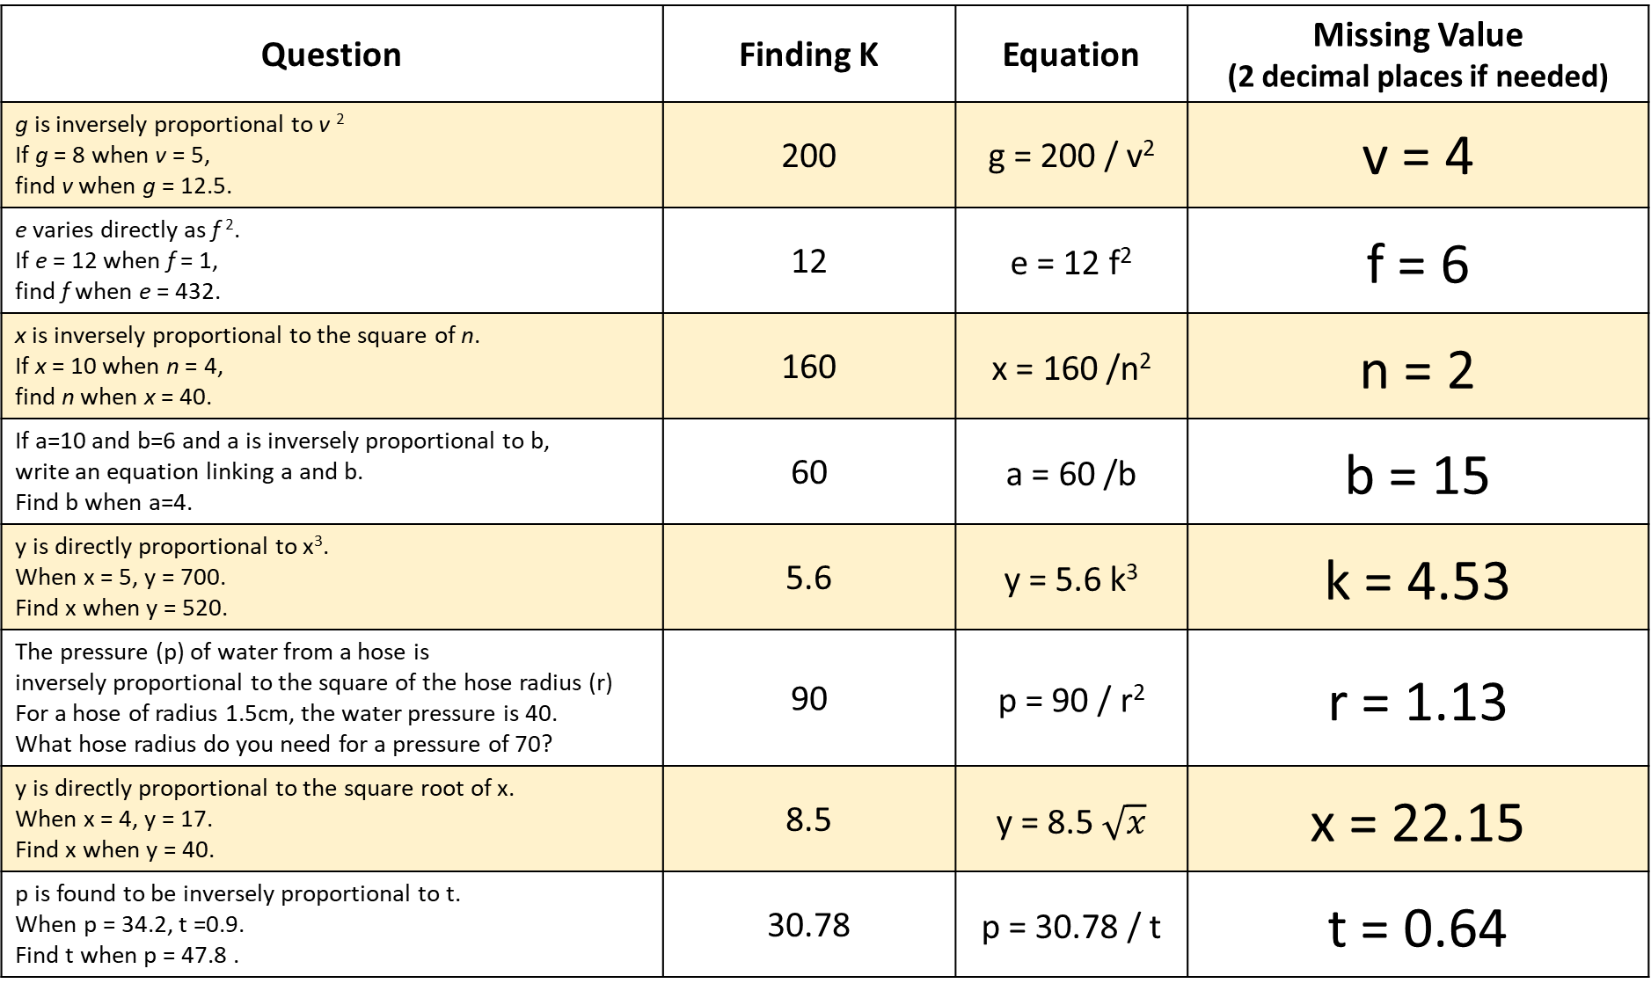
Question | Finding K | Equation | Missing Value (2 decimal places if needed)
g is inversely proportional to v ² If g = 8 when v = 5, find v when g = 12.5. | 200 | g = 200 / v² | v = 4
e varies directly as f ². If e = 12 when f = 1, find f when e = 432. | 12 | e = 12 f² | f = 6
x is inversely proportional to the square of n. If x = 10 when n = 4, find n when x = 40. | 160 | x = 160 /n² | n = 2
If a=10 and b=6 and a is inversely proportional to b, write an equation linking a and b. Find b when a=4. | 60 | a = 60 /b | b = 15
y is directly proportional to x³. When x = 5, y = 700. Find x when y = 520. | 5.6 | y = 5.6 k³ | k = 4.53
The pressure (p) of water from a hose is inversely proportional to the square of the hose radius (r) For a hose of radius 1.5cm, the water pressure is 40. What hose radius do you need for a pressure of 70? | 90 | p = 90 / r² | r = 1.13
y is directly proportional to the square root of x. When x = 4, y = 17. Find x when y = 40. | 8.5 | y = 8.5 $\sqrt{x}$ | x = 22.15
p is found to be inversely proportional to t. When p = 34.2, t =0.9. Find t when p = 47.8 . | 30.78 | p = 30.78 / t | t = 0.64

