Slide 1
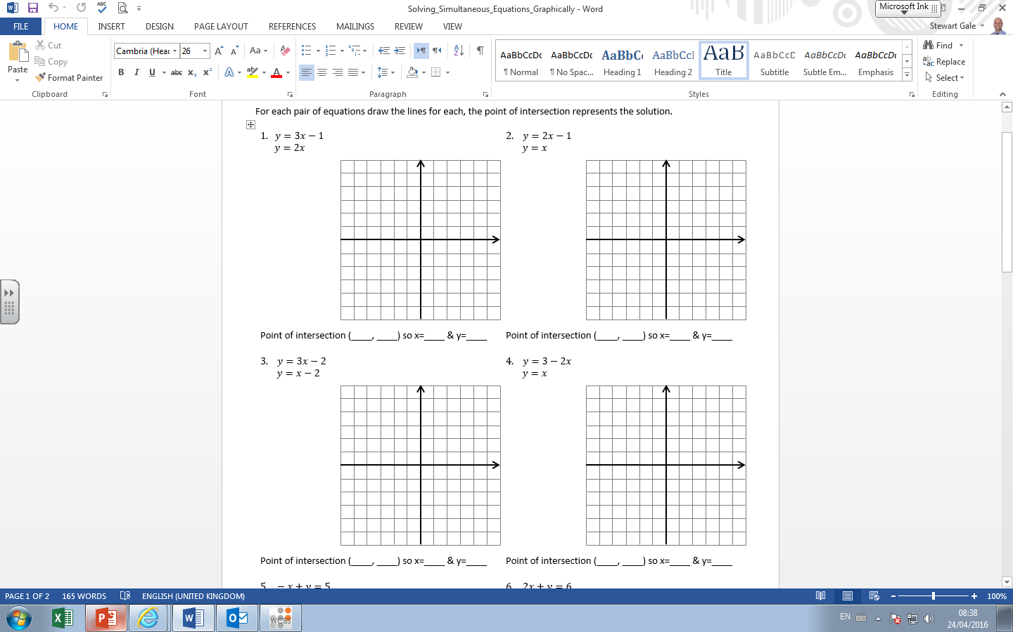
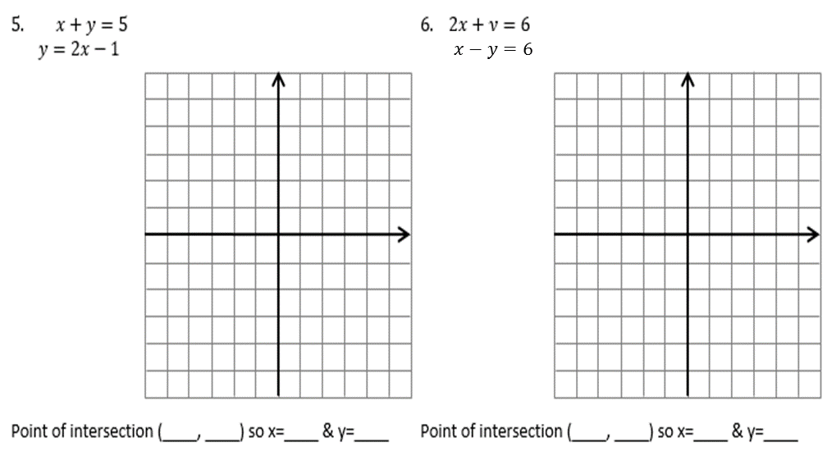

Slide 2
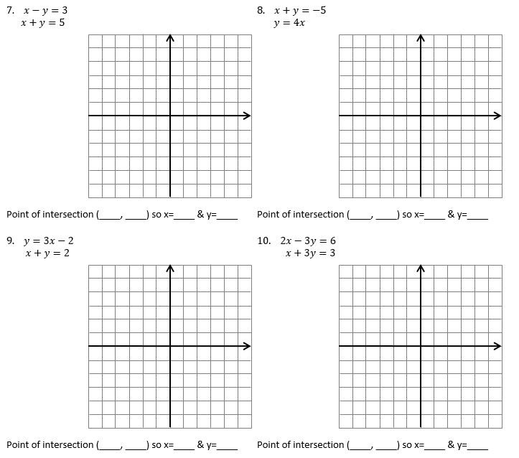
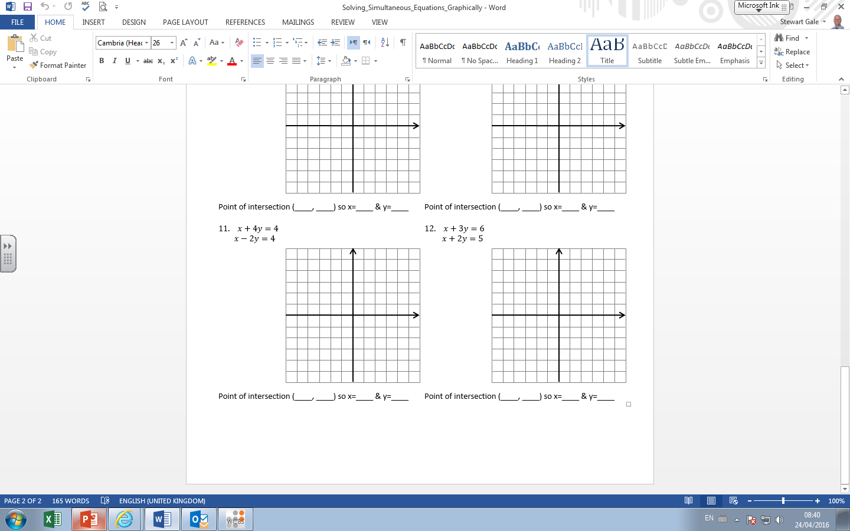

Slide 3
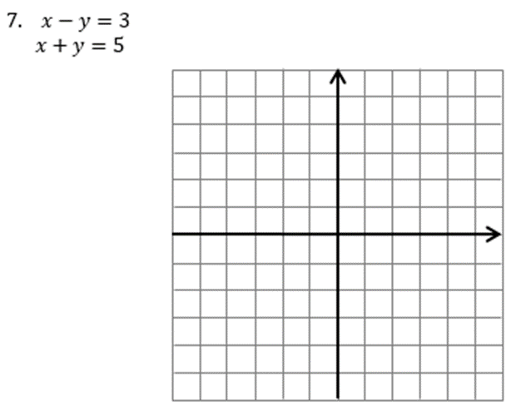

Slide 4
ANSWERS

Slide 5
1. (1,2) | 2. (1,1) | 3. (0,-2)
4. (1,1) | 5. (2,3) | 6. (4,-2)
7. (4,1) | 8. (-1,-4) | 9. (1,1)
10. (3,0) | 11. (4,0) | 12. (3,1)
?
?
?
?
?
?
?
?
?
?
?
?

