Slide 1
Differentiation
Fractions and Brackets
Chapter 12
(Part 2 of 8)

Slide 2
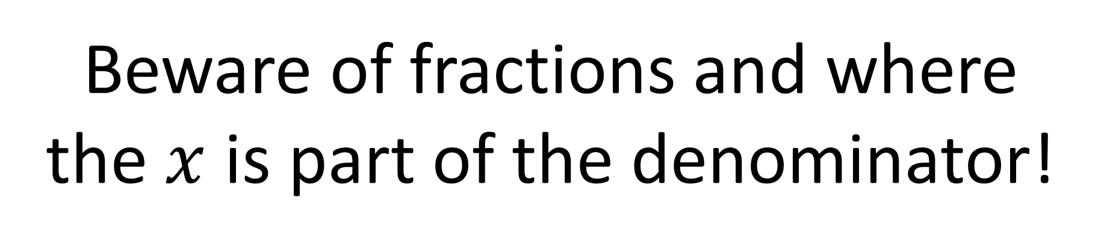
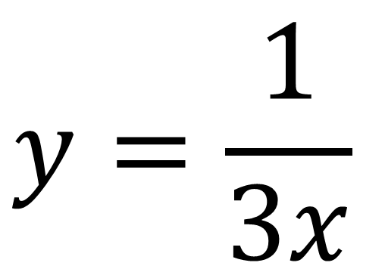
Differentiation and Denominators
Beware of fractions and where
the $x$ is part of the denominator!
$$y=\frac{1}{3x}$$

Slide 3
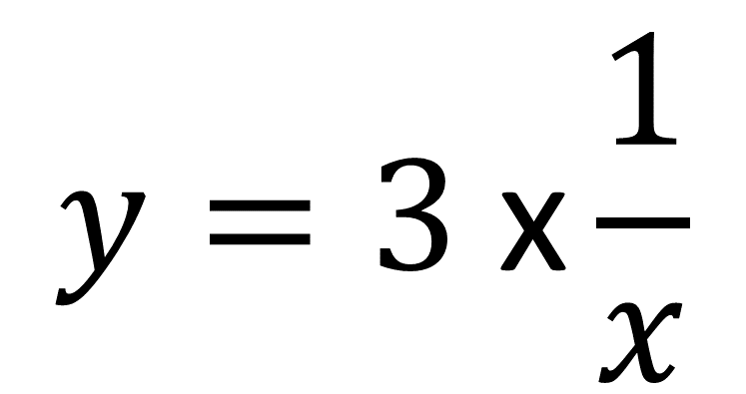
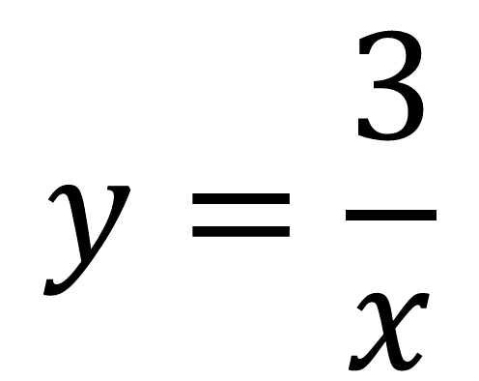
Are they equivalent?
$$y=\frac{3}{x}$$
$$y=3 \text{x}\frac{1}{x}$$
YES

Slide 4
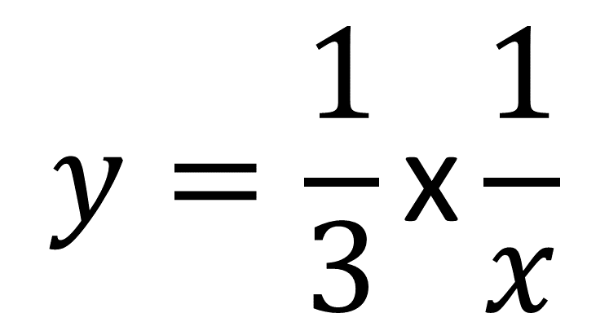
Are they equivalent?
$$y=\frac{3}{x}$$
$$y=\frac{1}{3}\text{x}\frac{1}{x}$$
NO

Slide 5
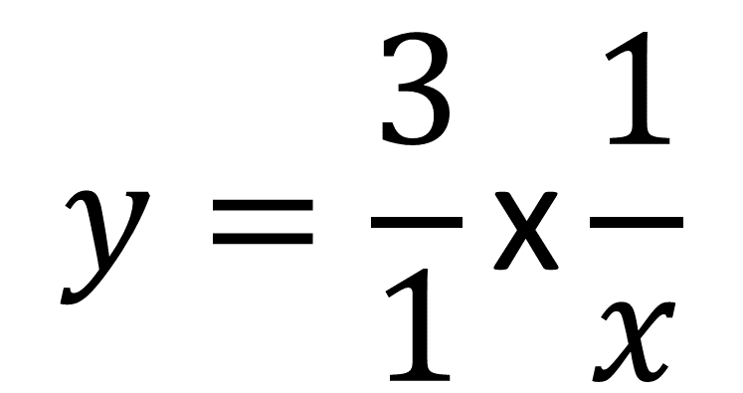
Are they equivalent?
$$y=\frac{3}{x}$$
$$y=\frac{3}{1}\text{x}\frac{1}{x}$$
YES

Slide 6
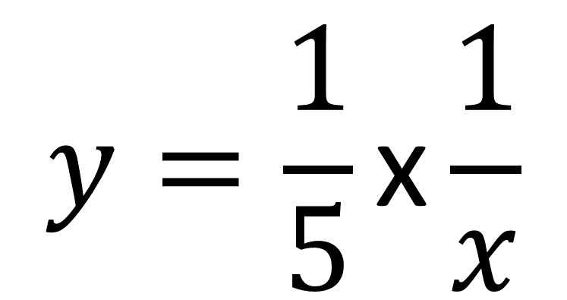
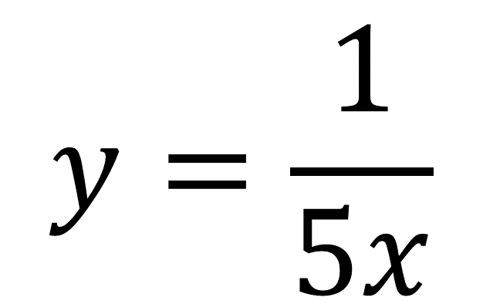
Are they equivalent?
$$y=\frac{1}{5x}$$
$$y=\frac{1}{5}\text{x}\frac{1}{x}$$
YES

Slide 7

Are they equivalent?
$$y=\frac{1}{5x}$$
$$y=5 \text{x}\frac{1}{x}$$
NO

Slide 8
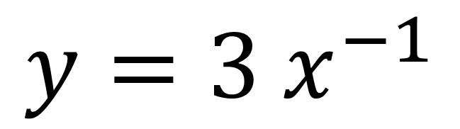
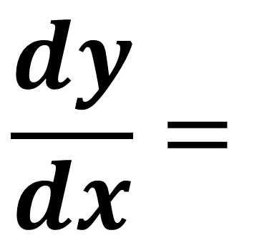
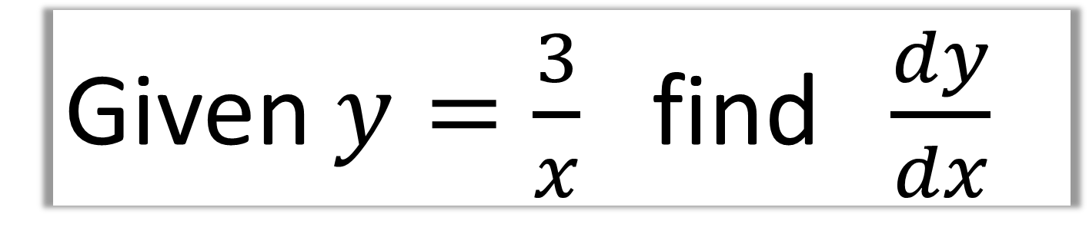
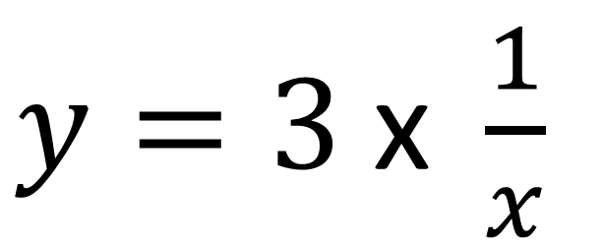
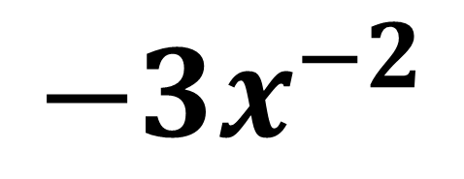
Given $y=\frac{3}{x}$ find $\frac{dy}{dx}$
$y=3 \text{x} \frac{1}{x}$
$$\frac{dy}{dx}=$$
$$−3x^{−2}$$
$$y=3 x^{−1}$$

Slide 9
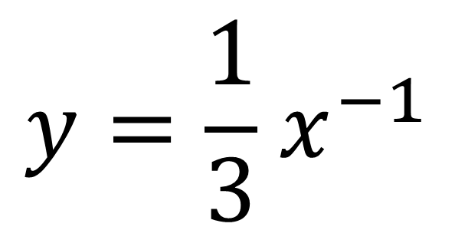
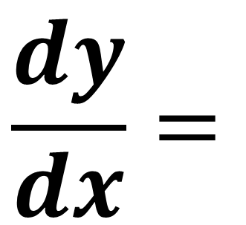
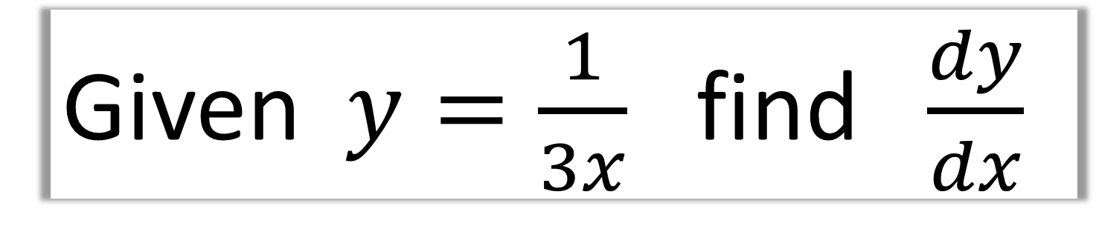
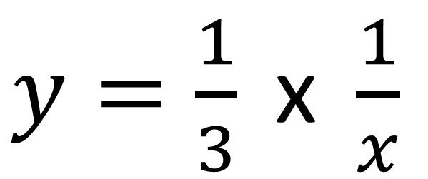
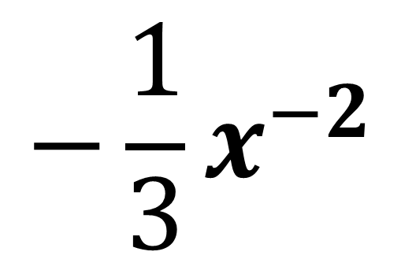
Given $y=\frac{1}{3x}$ find $\frac{dy}{dx}$
$y=\frac{1}{3} \text{x} \frac{1}{x}$
$$\frac{dy}{dx}=$$
$$−\frac{1}{3}x^{−2}$$
$$y=\frac{1}{3}{ x}^{−1}$$

Slide 10
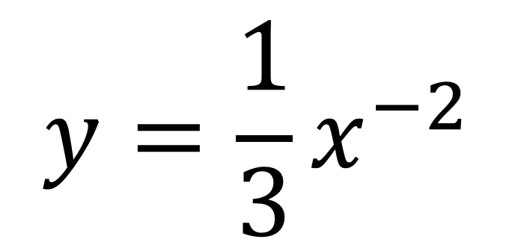
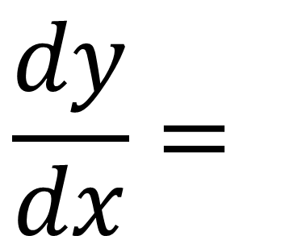
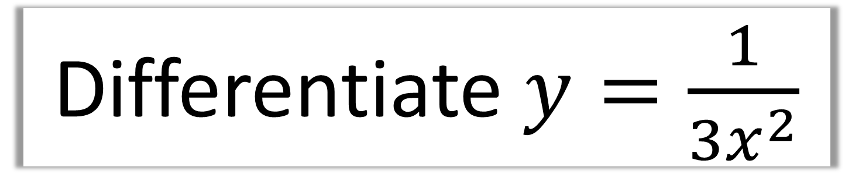
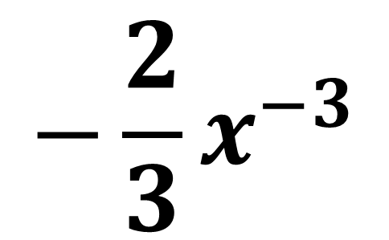
Differentiate $y=\frac{1}{3x^{2}}$
$$y=\frac{1}{3}x^{−2}$$
$$\frac{dy}{dx}=$$
$$−\frac{2}{3}x^{−3}$$

Slide 11
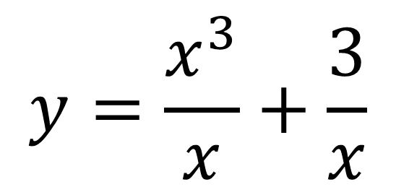
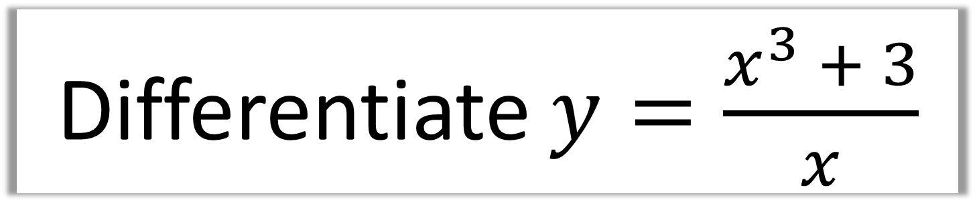
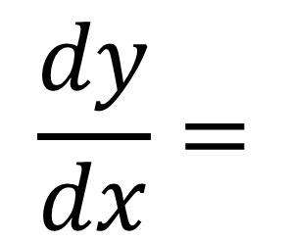
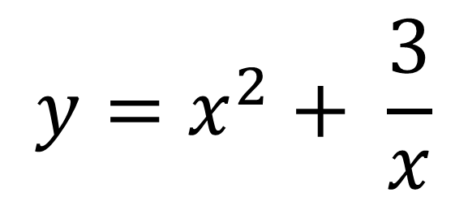
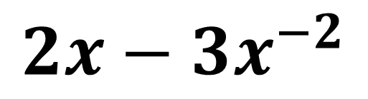
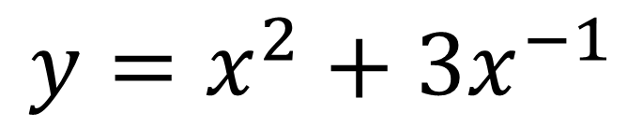
Differentiate $y=\frac{x^{3} + 3}{x}$
Split the fraction
$$y=x^{2}+3x^{−1}$$
$$y=\frac{x^{3}}{x}+\frac{3}{x}$$
$$\frac{dy}{dx}=$$
$$2x−3x^{−2}$$
$$y=x^{2}+ \frac{3}{x}$$

Slide 12
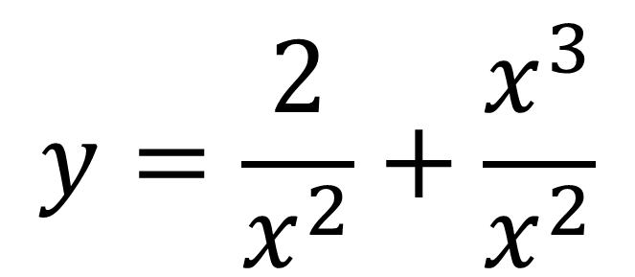
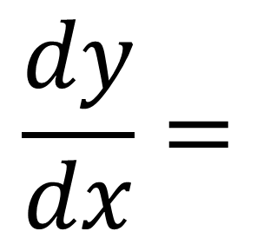
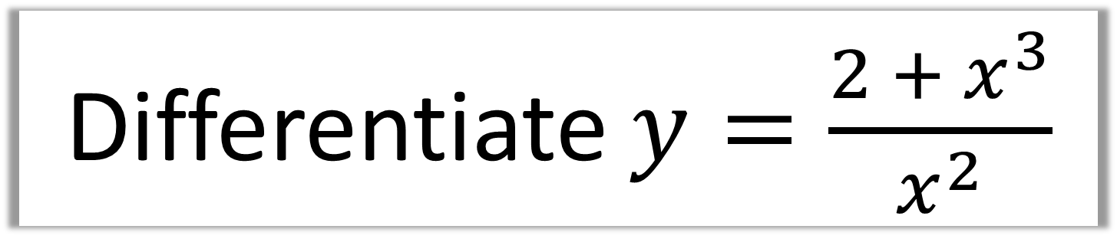
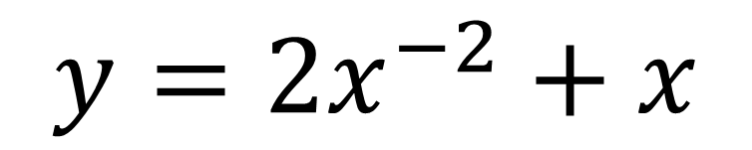
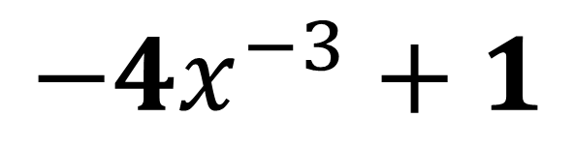
Differentiate $y=\frac{2 + x^{3}}{x^{2}}$
$$y=\frac{2}{x^{2}}+\frac{x^{3}}{x^{2}}$$
$$\frac{dy}{dx}=$$
$$−4x^{−3}+1$$
$$y={2x}^{−2}+x$$

Slide 13
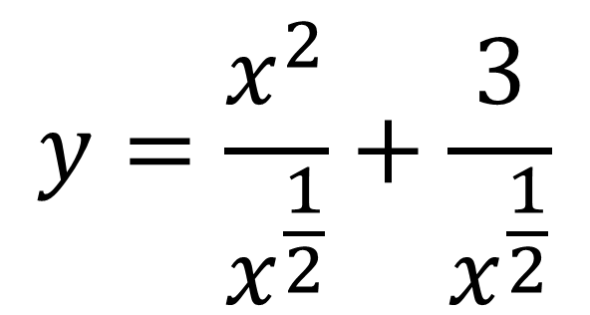
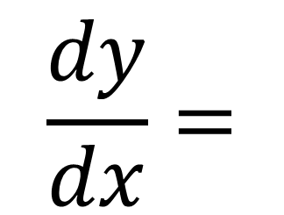
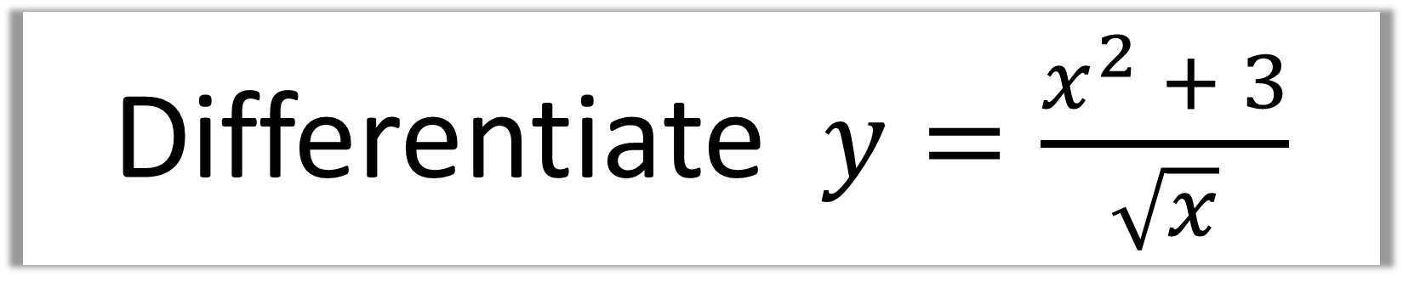
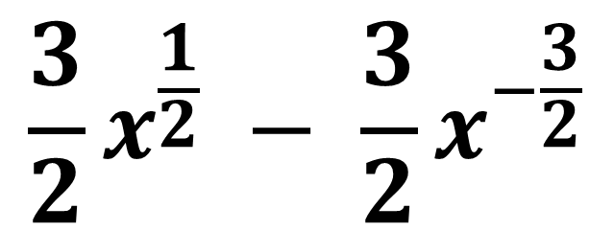
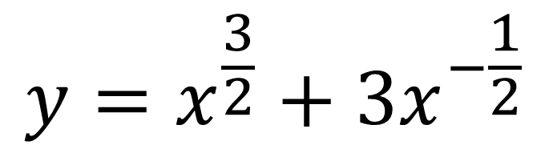
Differentiate $y=\frac{x^{2} + 3}{\sqrt{x}}$
$$y=\frac{x^{2}}{x^{\frac{1}{2}}}+\frac{3}{x^{\frac{1}{2}}}$$
$$\frac{dy}{dx}=$$
$$\frac{3}{2}x^{\frac{1}{2}} − \frac{3}{2}x^{−\frac{3}{2}}$$
$$y=x^{\frac{3}{2}}+3x^{−\frac{1}{2}}$$

Slide 14
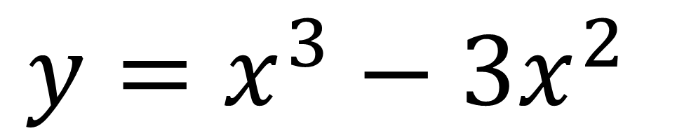
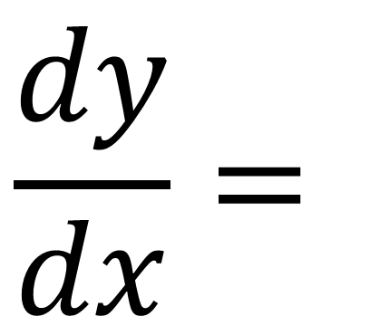
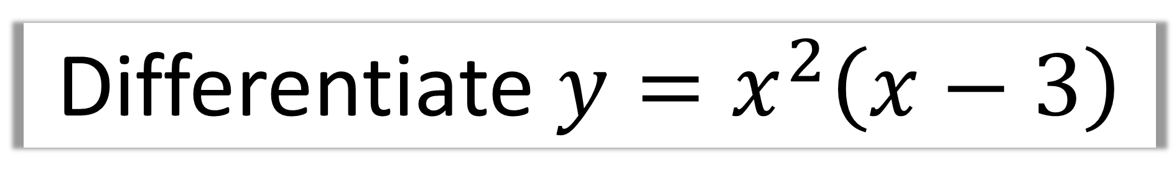
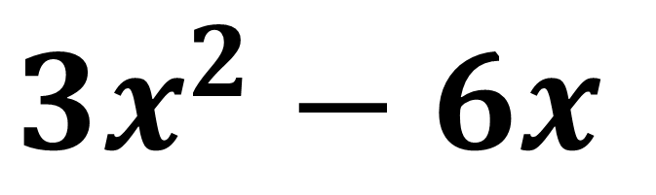
Differentiate $y=x^{2}\left(x−3\right)$
$$y=x^{3}−3x^{2}$$
$$\frac{dy}{dx}=$$
$$3x^{2}−6x$$

