Slide 1
Quadratics
Functions
Chapter 2
(Part 2 of 4)

Slide 2
Functions
A function is something which provides a rule on how to
map inputs to outputs.

Slide 3
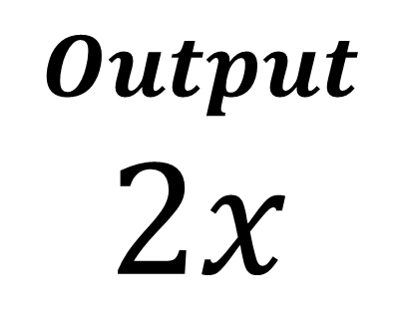
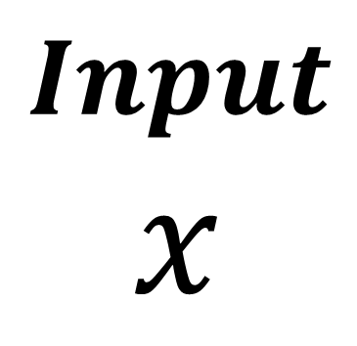
Function Machine
$$Input$$
$$x$$
$$Output$$
$$2x$$
x 2

Slide 4
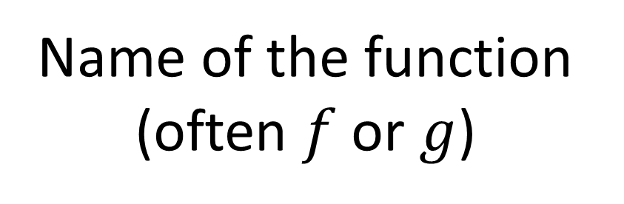
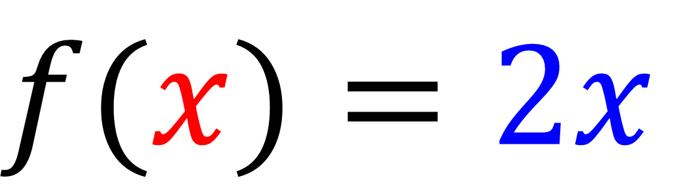
Function Notation
$$f(x)=2x$$
Name of the function (often $f$ or $g$)
Output
Input

Slide 5
Input
Domain
Outputs
Range
2
4
4
8
8
16
10
20
31
62

Slide 6
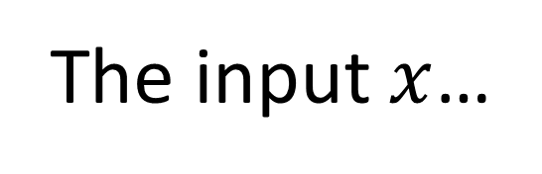
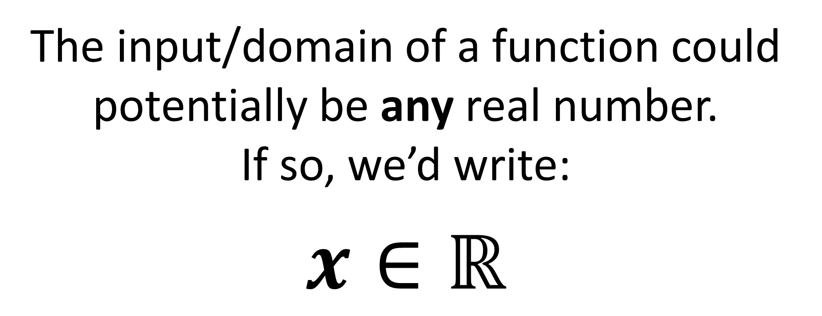
The input/domain of a function could potentially be any real number.
If so, we’d write:
$$x∈ℝ$$
The input $x$…
the set of
real numbers
is a member of…

Slide 7





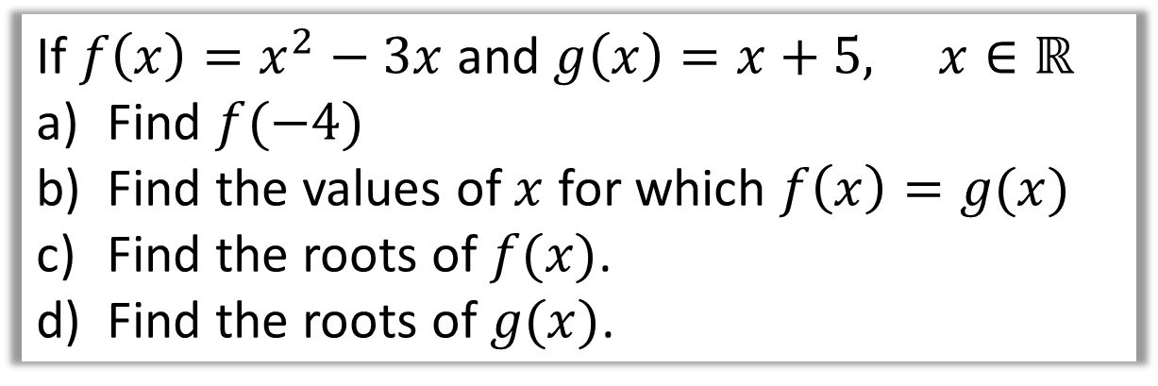






If $f\left(x\right)=x^{2}−3x$ and $g\left(x\right)=x+5, x∈ℝ$
Find $f(−4)$
Find the values of $x$ for which $f\left(x\right)=g(x)$
Find the roots of $f(x)$.
Find the roots of $g(x)$.
a
$f\left(−4\right)$ $={\left(−4\right)}^{2}−3\left(−4\right)$
c
$$f\left(x\right)=0$$
$$x^{2}−3x=0$$
$$f\left(−4\right)=28$$
$$x\left(x−3\right)=0$$
b
$$x^{2}−3x=x+5$$
d
$$g\left(x\right)=0$$
$$x^{2}−4x−5=0$$
$$x+5=0$$
$$x=5 or x=−1$$
$$x=−5$$

Slide 8
But the best way to find the
minimum/maximum value of a quadratic is to
complete the square.

Slide 9
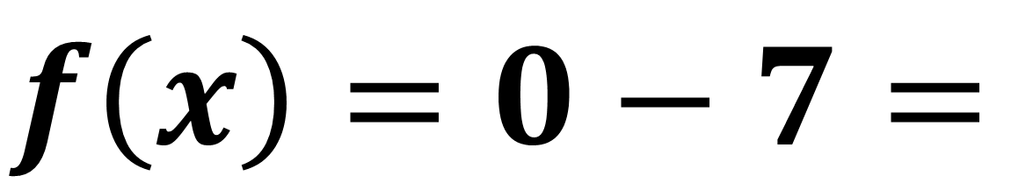
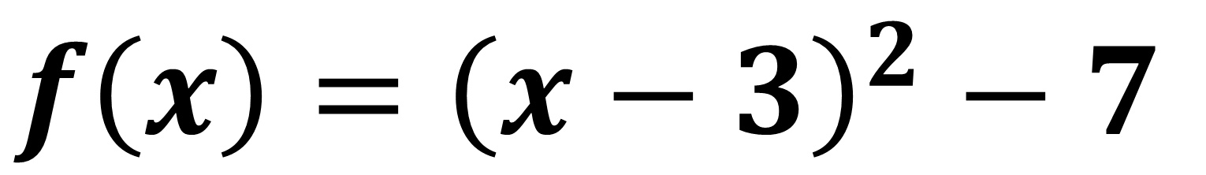

$$f\left(x\right)={\left(x−3\right)}^{2}−7$$
The lowest value of
a squared number is zero.
$$f\left(x\right)=0−7=$$
$$7$$

Slide 10
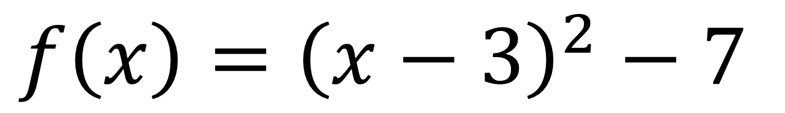
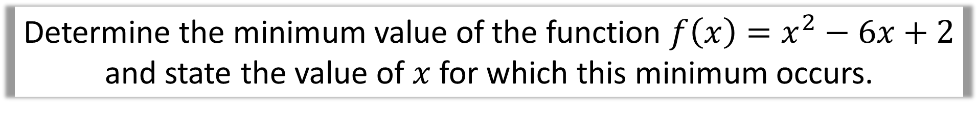
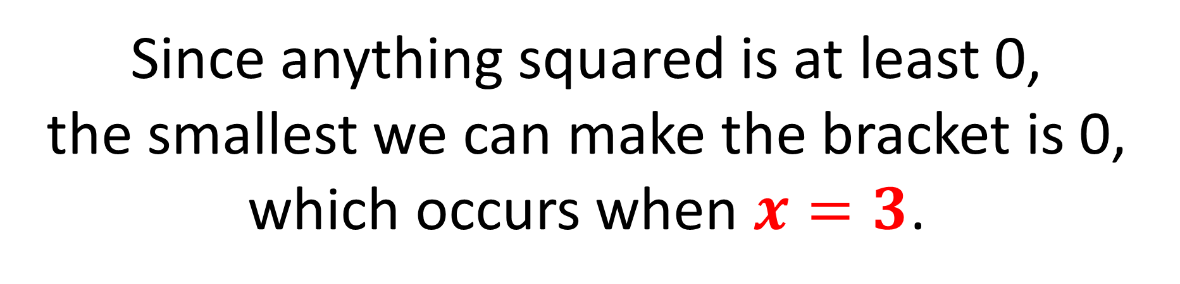
Determine the minimum value of the function $f\left(x\right)=x^{2}−6x+2$
and state the value of $x$ for which this minimum occurs.
$$f\left(x\right)={\left(x−3\right)}^{2}−7$$
Since anything squared is at least 0,
the smallest we can make the bracket is 0,
which occurs when $x=3$.

Slide 11





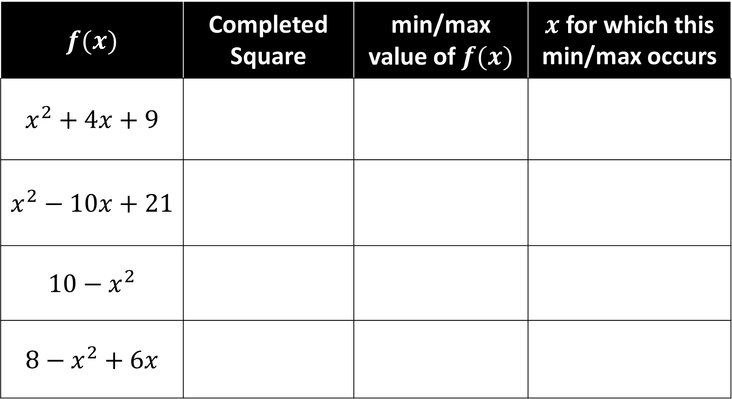






$$f(x)$$ | Completed Square | min/max value of $f(x)$ | $x$ for which this min/max occurs
$$x^{2}+4x+9$$
$$x^{2}−10x+21$$
$$10−x^{2}$$
$$8−x^{2}+6x$$
$$5$$
$$−2$$
$${\left(x+2\right)}^{2}+5$$
$${\left(x−5\right)}^{2}−4$$
$$−4$$
$$5$$
Already completed
$$10$$
$$0$$
$$17−{\left(x−3\right)}^{2}$$
$$17$$
$$3$$

Slide 12
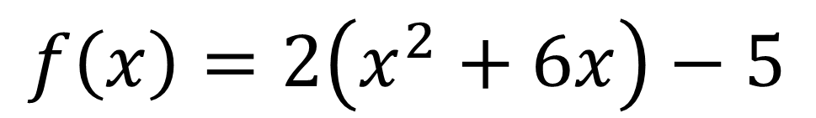
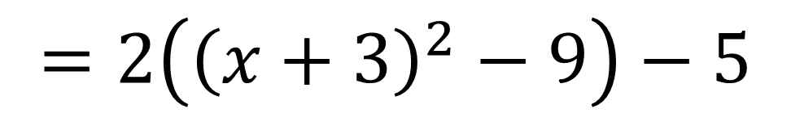
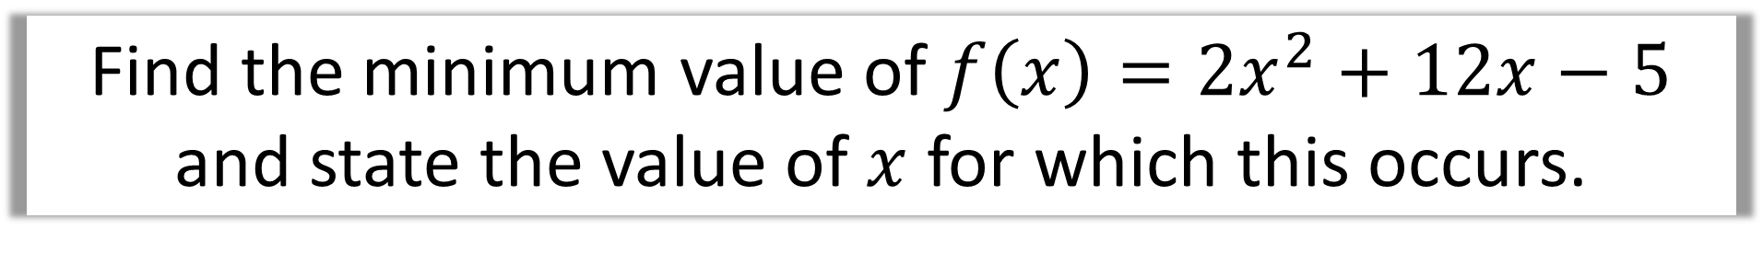
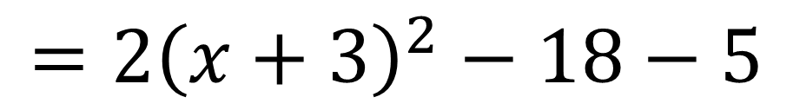
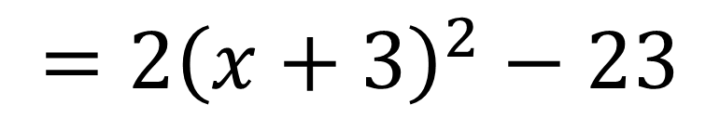
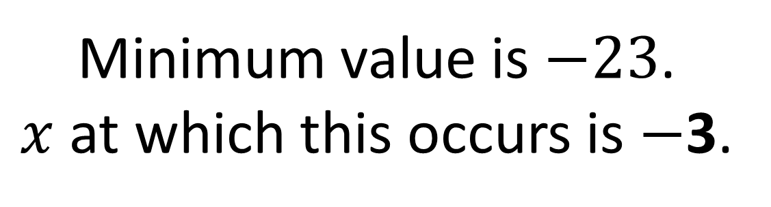
Find the minimum value of $f\left(x\right)=2x^{2}+12x−5$ and state the value of $x$ for which this occurs.
$$f\left(x\right)=2\left(x^{2}+6x\right)−5$$
$$=2\left({\left(x+3\right)}^{2}−9\right)−5$$
$$=2{\left(x+3\right)}^{2}−18−5$$
$$=2{\left(x+3\right)}^{2}−23$$
Minimum value is $−23$.
$x$ at which this occurs is $−$3.

