Slide 1
LO: Converting
Imperial to Metric

Slide 2
Can you name any imperial measurements?
feet
yard
gallons
ounces
inches
pounds
stone

Slide 3
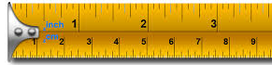
In the UK, the imperial system,
was adopted by royal decree in 1824.
The UK used Imperial until
about 1975 when it decided
to adopt the metric system.

Slide 4
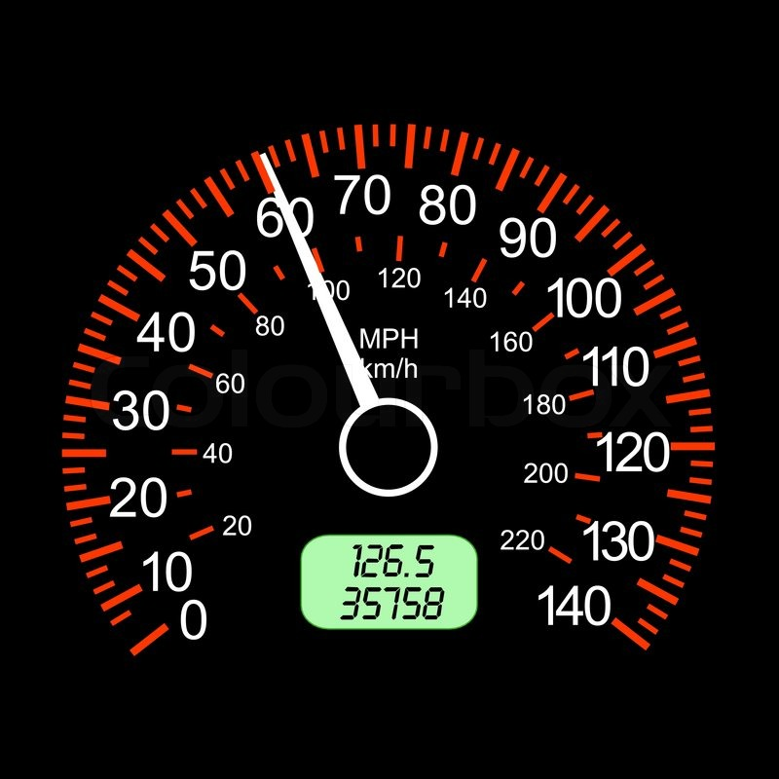
What imperial and metric measurements
are used for this speedo?

Slide 5
What imperial and metric measurements
are used for this tape measure?

Slide 6
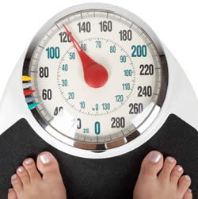
What imperial and metric measurements
are used with the weighing scales?
LBS
KG

Slide 7
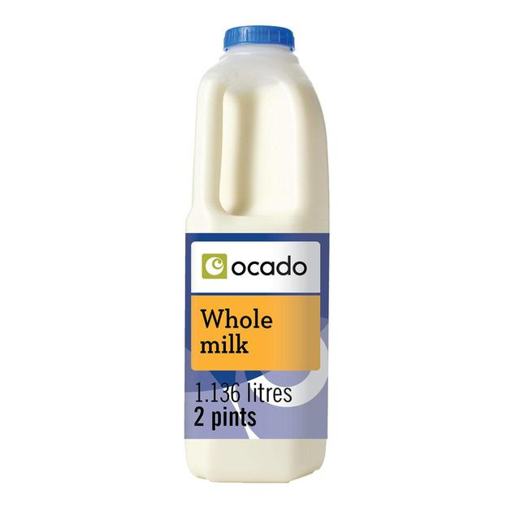
What imperial and metric measurements
are used on this milk bottle?

Slide 8
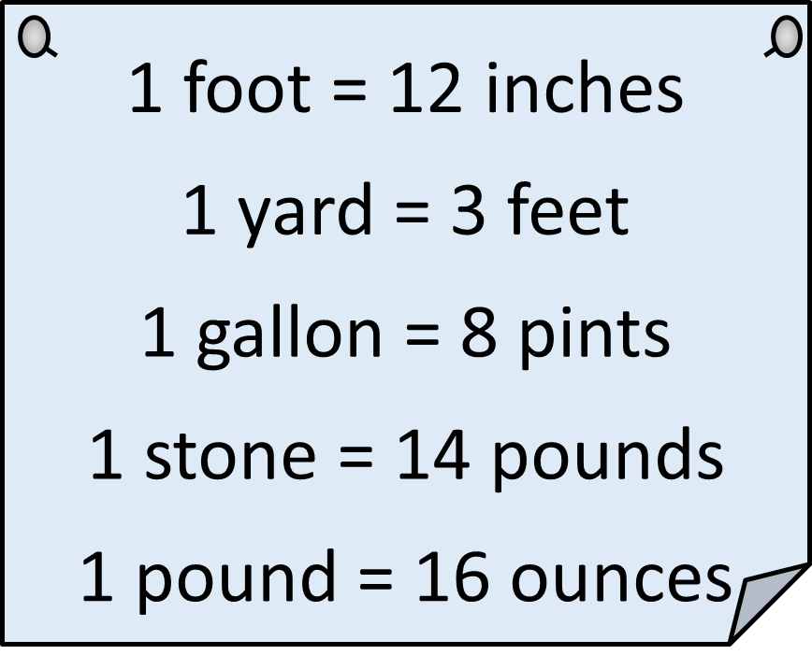
Imperial to Imperial

Slide 9
Metric to Imperial (≈ approx)
1.6 km ≈ 1 mile
1 foot ≈ 30cm
1kg ≈ 2.2pounds (lb)
1 litre ≈ 1.75 pints

Slide 10
1 foot =
12
inches
3 foot =
36
inches

Slide 11
12 inches =
1
foot
18 inches =
1.5
foot

Slide 12
1 Stone =
14
pounds
1 Stone =
224
onces

Slide 13
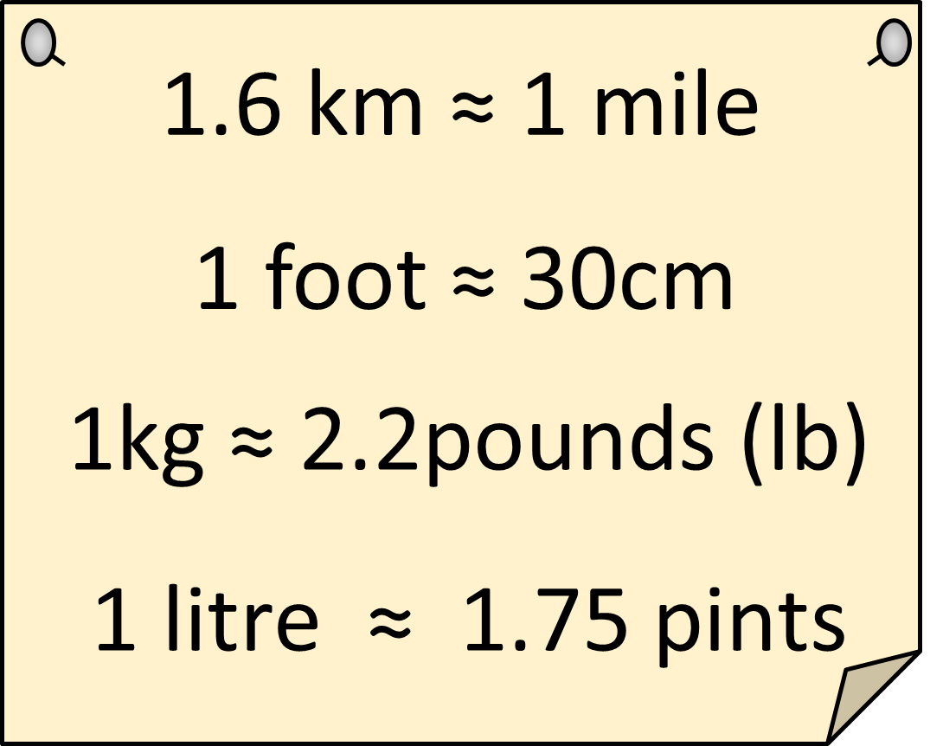
1kg =
2.2
pounds
3.5kg =
7.7
pounds

Slide 14
1.6km =
1
miles
1 km =
0.625
miles

